Slide 1


curriculum committee Annual Certification Training
Fall 2018 - Part One
CCCCIO
California Community Colleges Chief Instructional Officers
Based on the work of:
Jackie Escajeda, Dean of Intersegmental Programs and Credit Curriculum
Virginia Guleff, Vice President of Instruction, Butte College
Craig Rutan, Secretary, Academic Senate for California Community Colleges
Notes:
Craig

Slide 2

Purpose of Annual Training?
CCC!
To demonstrate that ECC warrants
the expanded authority from the
Chancellor’s Office related to
the curriculum approval process.
Notes:
Craig

Slide 3
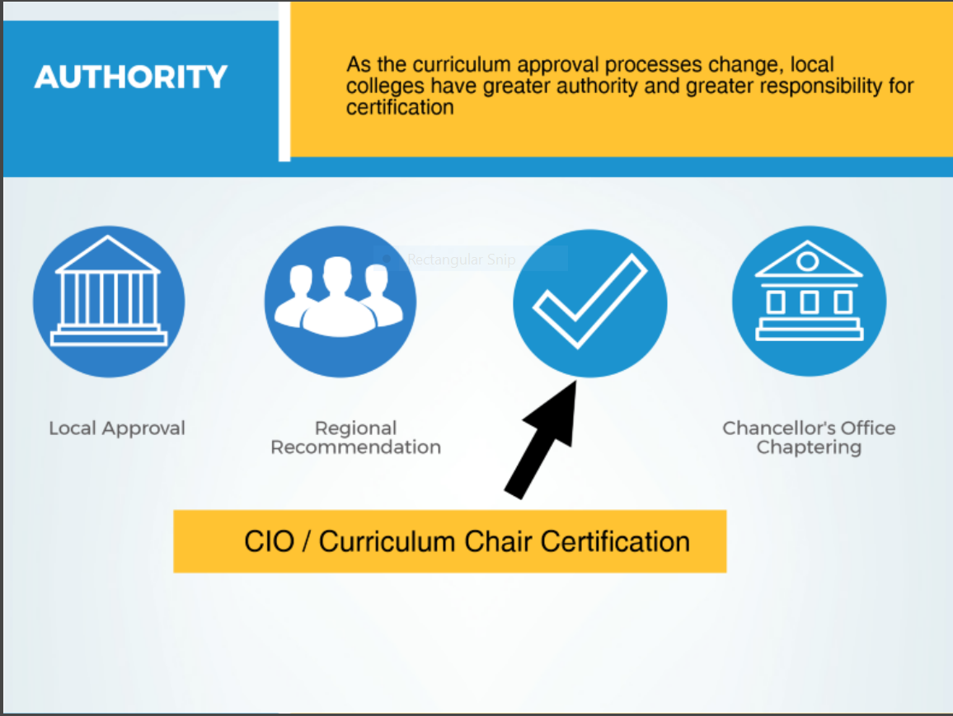
Senate President/Curriculum Chair/CEO/CIO Certification
Notes:
Virginia

Slide 4

Requirements of Certification
Colleges are certifying that all approved curriculum will align with all requirements outlines in Education Code, Title 5, and the 6th edition of the Program and Course Approval Handbook (On the CCC website.)
College must have a board policy related to the credit hour. Policy must be submitted to the CO with the certification memo.
College must have a cooperative work
experience plan that has been approved by
the local governing board (plan does not
need to be submitted to the CO).
ED CODE
Notes:
Virginia

Slide 5

2nd Curriculum Certification
Fall 2017
The memo required the signature of
  College President (CEO)
  Chief Instructional Officer (CIO)
  Academic Senate President
  Curriculum Chair
Submitting the form entitled the college automated approval (chaptering) of credit courses, excluding cooperative work experience.
Notes:
Virginia

Slide 6

3rd Curriculum Certification
Memo will be distributed in Fall 2018 and will be due to the Chancellor’s Office by October 16, 2018
Memo will require the same signatures as in 2017
Submitting the memo entitles the college to automated approval of:
  All credit courses (including cooperative work experience)
  Modifications to all existing credit programs except for ADTs
    Note that changing program goal will require a new program submission
  New local credit degrees and certificates (not ADTs or CTE)
Notes:
Virginia

Slide 7

Periodic Review by
Chancellor’s Office
Colleges will have their curriculum reviewed at least once every three years (maybe as frequently as once a year).
Colleges found to have curriculum that does not meet all requirements will be contacted by the CO.
Colleges may be “encouraged” to have an assistance visit by representatives from the CO, CIOs, and ASCCC
Colleges that refuse to follow the requirements for automated approval will have the approval disabled and all curriculum will need to be reviewed and approved by the Chancellor’s Office
Notes:
Jackie

Slide 8

Types of Courses and Programs
Refer to Four Types of Credit Courses and Noncredit Courses Handout.
Credit | Noncredit
Credit Courses | Noncredit Courses
Program-applicable Degree-applicable Non degree-applicable Stand Alone | Noncredit: no credit awarded to students for courses in 10 categories must be approved by CO and receives apportionment
Credit Programs | Noncredit Programs
Associate Degrees (AA, AS) Associate Degrees for Transfer (AA-T, AS-T) Certificates of Achievement Locally Approved Certificates | Certificate of Completion (CDCP) Certificate of Competency (CDCP) Adult High School Diploma Noncredit Apprenticeship Program Locally Approved Certificates (not CO approved)
Notes:
Craig

Slide 9

Requirements for Credit Courses
How does ECC Measure Up?
Course Number and Title Discipline Assignment(s) Catalog Description Prerequisites, Corequisites, Advisories Units Total Contact Hours Total Number of Hours in Each Instructional Category Outside of Class Hours Course Content Objectives/Outcomes | Instructional Methods Grading criteria (letter grade, P/NP) Methods of Assessment Reading, Writing, and Outside of Class Assignments Repeatability Options Open Entry/Open Exit Justification of Need CCCCO Data Elements (e.g. TOP and SAM Codes, CB codes)
Notes:
Craig

Slide 10

Possible Items for COR
Item | Why you might want it
Student Learning Outcomes | ACCJC Standard II.A.3
Required and Recommended Textbooks | Aids in C-ID and 4-yr articulation; helps new instructors
Transfer/GE Information/C-ID | It can be helpful to have this info on the COR
Supplemental Instruction | Could SI be part of your course?
Distance Education | Include modalities (e.g. online, hybrid) and possibly DE Addendum
Enrollment limits | Instructional quality, external accreditation requirements
Notes:
Craig

Slide 11

Requirements Associate Degrees
Minimum of 60 units
At least 18 units in a major or area of emphasis
Can use local GE pattern
Chancellor’s Office Approval if goal is CTE
Local Approval if it is a local degree
All revisions to degrees are locally approved
Notes:
Jackie

Slide 12

Associate Degrees for Transfer (ADTs)
Minimum of 60 units; no more than 60 units may be required
At least 18 units in a major
General education limited to a CSU Breadth or IGETC pattern
New and modified ADT’s require Chancellor’s Office approval
12
Notes:
Jackie

Slide 13
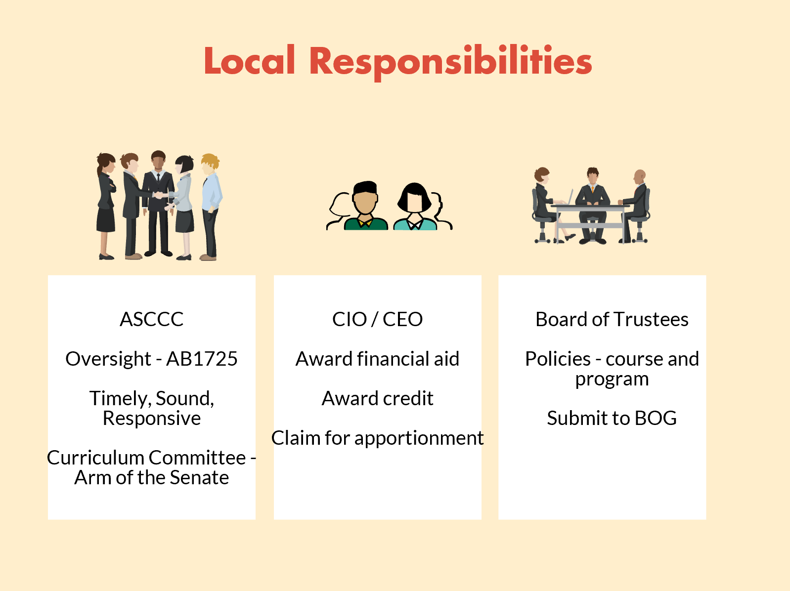
Notes:
Virginia

Slide 14



CCC Training Part Two:
OER, Credit Hour, Cooperative Work Experience, & Certificates
October 9, 2018
Notes:
Craig

Slide 15
Online Educational Resources (OER) and the Course Outline of Record
Notes:
Craig

Slide 16
Open Educational Resources (OER) Textbooks
Source: Nancy Purcille, Articulation Analyst University of California Office of the President (UCOP)
Even if OER textbooks are being used, there should be a representative sample for faculty to choose from. If faculty wish to use OER then those options may be listed as well.
For CSU and UC, it’s fine to use assembled materials or Open Educational Resources, as long as they’re stable and publicly available as published textbooks and not a list of links.
All CSU and UC campus departments consider the content of textbooks when reviewing articulation proposals from the CCCs. The use of online texts is reviewed by campuses on a case-by-case basis for articulation with CCCs.
There are multiple CCC courses that use online texts that are approved for CSU- and UC-transferability, and for articulation with CSU and UC campuses.
Some CSU and UC campus departments use online texts themselves.

Slide 17
Credit Hour Calculation
Notes:
Craig

Slide 18

Revisions to title 5 §55002.5
Removed reference to lecture and lab, replaced with “total student work” and “outside-of-class hours.” We still uses lecture/lab in our course outlines.
Inserted reference to regulations for cooperative work experience.
Inserted reference to federal regulations for clock hour programs.
Replaced prior language on incremental awards that required half-unit increments and permitted smaller increments. Permissive rather than prescriptive.
Inserted new requirement for local policy specifying local standards in compliance with this section and federal regulations.

Slide 19
Principles Behind the Revisions
Relying on careful development and consistent application of local policy
Tie state regulations to new federal requirements.
Update language and standards for consistency with federal regulations.
Bring CCC in line with other systems of higher education
Specific guidance on the application of these regulations is included in the 6th edition of the PCAH.

Slide 20
New: Local Governing Board Policy
Now REQUIRED to have this policy by new title 5 regulations - §55002.5(f)
Must be submitted with the Annual Course and Approval Certification form.
District policy shall specify:
  the credit hour calculation method for all academic activities (lecture, activity, lab, clinical, discussion, studio, work experience, etc.)
  expected ratios of in-class to outside-of class hours for each type of academic activity
  standards for incremental award of credit
  standard term length (number used to determine divisor in calculation)
  calculation methods for short term and extended term courses
  provisions for monitoring compliance with state and federal regulations related to credit hour calculations
Local policy is an academic and professional matter and
falls under the 10+1 process.
Notes:
Craig

Slide 21
Essential Terminology
Total Contact Hours
Sum of all contact hours for the course in all calculations categories. These are the hours the student is under the direct supervision of an instructor and are used to determine FTES and apportionment.
Outside-of-class Hours
Hours students are expected to engage in course work outside of the classroom.
Hours of Total Student Work
Term used in the revised regulations to describe the sum of contact hours and outside-of-class (homework) hours.
Hours-per-unit Divisor
Total student learning hours (contact + outside) for which the college awards one unit of credit. ECC uses 54 which is the standard.

Slide 22
Outside-of-Class Hours
Hours students are expected to engage in course work outside of the classroom.
New regulations require these hours to be included on the COR (title 5 §55002(a)(2)(B) and (b)(2)(B)) (ECC already includes this information.)
As a matter of standard practice, lecture and related course formats typically assume two hours of student work outside of class for every hour in-class.
All other academic work, including laboratory, activity, studio, clinical, practica, TBA, etc. must provide an equivalent total number of student learning hours as required for lecture, with the ratio of in-class to outside-of-class work prorated appropriately for the academic activity.

Slide 23
Standards for Credit Hour
California Code of Regulations, title 5 §55002.5(a)
“(a) One credit hour of community college work (one unit of credit) shall require a minimum of 48 semester hours of total student work or 33 quarter hours of total student work which may include inside and/or outside-of-class hours.”
* El Camino requires 54 semester hours.

Slide 24
Sample Credit Hour Calculation
To Calculate Units :
*54 is used for this example based on the recommendation from the Chancellor’s Office that local districts use an 18 week semester as the basis for calculating hour to unit ratios on Course Outlines of Record. Likewise, . .
Notes:
Craig

Slide 25
Refer to Credit Hour Handout

Slide 26
Cooperative Work Experience
Notes:
Craig

Slide 27
Cooperative Work Experience
On-the-job Learning Experiences
APPROVED PLAN REQUIRED - § 55250
REQUIREMENTS OF THE PLAN - § 55251
WORK EXPERIENCE CREDIT - § 55265.5
Supports the streamlining of curriculum by transferring authority from the Chancellor’s Office to local districts to approve CWE plans and courses.
Allow colleges to incremental units.
Notes:
Jackie

Slide 28
CWE - REQUIREMENTS OF THE PLAN - § 55250
Any program of Cooperative Work Experience Education conducted by the governing board of a community college district pursuant to this article and claimed for apportionment pursuant to sections 58051 and 58009.5 shall conform to a plan adopted by the district.
The plan adopted by the district shall set forth a systematic design of Cooperative Work Experience Education whereby students, while enrolled in college, will gain realistic learning experiences through work.
This plan shall be submitted to and approved by the Chancellor local governing board.
Notes:
Jackie

Slide 29
CWE - § 55251. REQUIREMENTS OF THE PLAN
(a) The district plan shall contain the following provisions:
(1) A statement that the district has officially adopted the plan, subject to approval by the State Chancellor local governing board.
(2) A specific description of the respective responsibilities of college, student, employer, and other cooperating agencies in the operation of the program.
(3) A specific description for each type of Cooperative Work Experience Education program.
(4) A description of how the district will:
(A) Provide guidance services for students during enrollment in Cooperative Work Experience Education.
(B) Assign a sufficient number of qualified, academic personnel as stipulated in the district plan to direct the program and to assure district services required in section 55255.
(C) Assure that students' on-the-job learning experiences are documented with written measurable learning objectives.
(D) With the assistance of employers, evaluate students’ on-the-job learning experiences.
(E) Describe basis for awarding grade and credit.
(F) Provide adequate clerical and instructional services.
(b) Prior to implementation, any changes or revisions to the district plan shall be submitted for approval to the Chancellor local governing board.
Notes:
Jackie

Slide 30
CWE - § 55256.5.
Work Experience Credit
(a) One student contact hour is counted for each unit of work experience credit in which a student is enrolled during any census period. In no case shall duplicate student contact hours be counted for any classroom instruction and Cooperative Work Experience Education. The maximum contact hours counted for a student shall not exceed the maximum number of Cooperative Work Experience Education units for which the student may be granted credit as described in section 55253.
(b) The learning experience and the identified on-the-job learning objectives shall be sufficient to support the units to be awarded.
(c) The following formula will be used to determine the number of units to be awarded:
(1) Each 75 hours of paid work equals one semester credit.
(2) Each 60 hours of non-paid work equals one semester credit.
(3) Units may be awarded in 0.5 unit increments.
Notes:
Jackie

Slide 31
Certificate changes
Notes:
All

Slide 32
Certificates of Achievement
16 or more related units must be Chancellor’s Office approved, noted on transcript
8–15.5 units may be Chancellor’s Office approved, but it is not required (although it is recommended)
All new certificates with a goal of Transfer or CTE must be approved by the Chancellor’s Office. All revisions and new certificates with a goal of Local are locally approved.
*Certificates noted on students’ transcript must be approved by the Chancellor’s Office.
32
Notes:
Jackie

Slide 33
Approval Changes
 | Submitted to the LAOCRC | Approved by Chancellor’s Office | Locally Approved Only (Chaptered) | Appears on Student’s Transcripts
CTE Certificates of Achievement | ✓ | ✓ |  | ✓
Non-CTE Certificates of Achievement |  |  | ✓ | ✓
Transfer Certificates |  | ✓ |  | ✓
Certificates of Accomplishment |  |  | ✓
New/Revisions to Non-CTE Degrees |  |  | ✓ | ✓

Slide 34
Units | Type of Certificate
3 -7 | Accomplishment
8 | Accomplishment or Achievement
9 | Accomplishment or Achievement
10 | Accomplishment or Achievement
11 | Accomplishment or Achievement
12 | Accomplishment or Achievement
13 | Accomplishment or Achievement
14 | Accomplishment or Achievement
15.5 | Accomplishment or Achievement
16+ | Achievement
Purpose of a Certificate of Accomplishment
1. Stackable certificates that lead to a certificate of achievement and/or degree
2. Low unit certificates that lead to employment
3. Do not garner as many “points” for the new funding formula.
4. Do not appear on students’ transcripts.

Slide 35
Final Thoughts FROM THE Chancellor’s office
Notes:
All

Slide 36
Things to Keep in Mind
Colleges must submit all courses to the Chancellor’s Office using the Chancellor’s Office Curriculum Inventory (COCI)
Colleges are still required to have a course control number before they can offer a course.
The Chancellor’s Office is still reviewing and approving all noncredit, new and revised ADTs, and new CTE programs.
The Chancellor's Office will conduct periodic reviews on all the courses that are receiving automated approvals.
Notes:
Virginia

Slide 37
Periodic Review by
Chancellor’s Office
Colleges will have their curriculum reviewed at least once every three years (and could be as frequently as once a year).
Colleges that have been found to have curriculum that does not meet all requirements will be contacted by the CO.
Colleges may be encouraged to have an assistance visit by representatives from the CO, CIOs, and ASCCC
Colleges that refuse to follow the requirements for automated approval will have the approval disabled and all curriculum will need to be reviewed and approved by the Chancellor’s Office
Notes:
Jackie

Slide 38
Thank you.
Notes:
All

