Slide 1
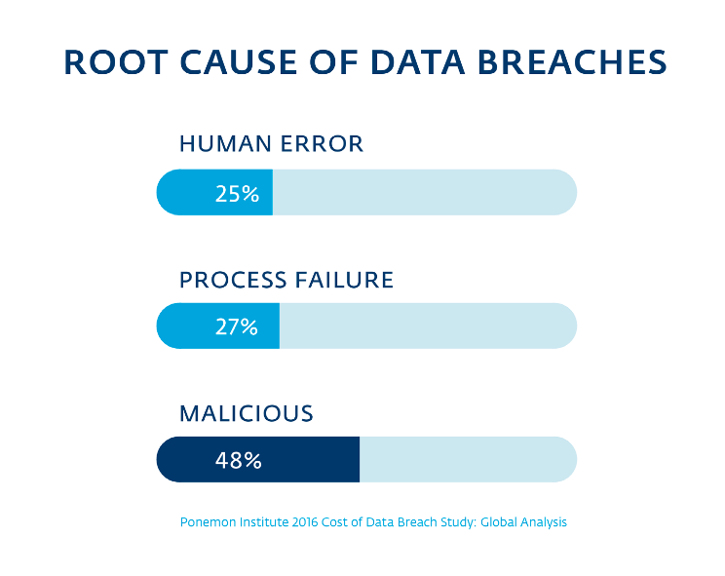
3 Causes of Data Breaches in Education
Notes:
*The per capita cost of a data breach in education is the second highest of all industries!

Slide 2
Human Error Defined
Leaving a computer unlocked & unattended
Writing passwords on sticky notes
Sharing passwords
Lost or stolen portable devices
Laptop, iPad, iPhone, iWatch
Carelessly discarding sensitive information
Not shredding documents containing PII
Makes you vulnerable to dumpster diving
Notes:
*73% of devices that were lost or stolen were in the owner’s work area or car.

Slide 3
Process Failure Defined
Failing to keep patches up-to-date
Failing to keep virus definitions up-to-date
Not properly implementing security products
Insufficient account security policies
No password expiration dates
Not enforcing principal of least privilege
Not having a layered security approach
Need perimeter, network, end-point, & data security solutions working together

Slide 4
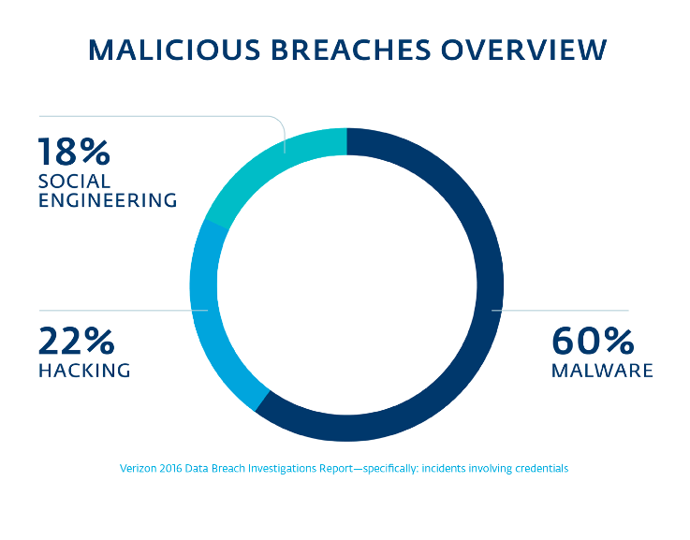
Notes:
*Although “hacking” gets the majority of attention in the news headlines, it is actually a very small slice of the malicious breaches pie.

Slide 5
Malicious Breaches Defined
Malware (60%)
Viruses (Trojans, Worms)
Ransomware variants (i.e. locky)
Spam emails w/ link to attached payload
Hacking attempts (22%)
From guessing/stealing weak or default passwords
Social Engineering (18%)
Phishing emails
Phone phreaking
F2F spoofing or sleight of hand

Slide 6
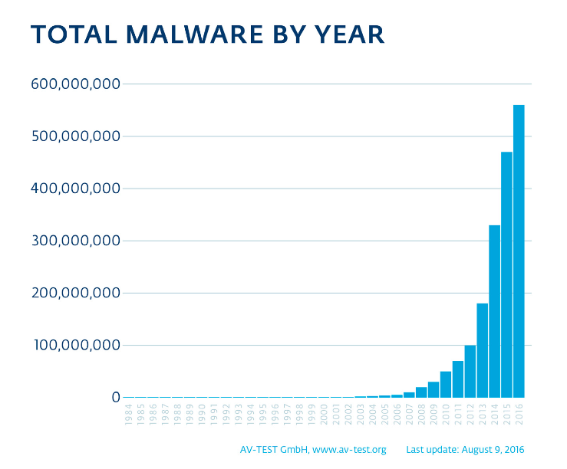
Notes:
*The number of malware strains typically doubles every 12-16 months!
*The independent test facility AV-Test sees around 390,000 new malicious items per day!
*Malware is no longer just a Windows problem – it is also targeting Mac & Linux systems.
*Malware that targets Mac & Linux systems has a very high penetration & infection rate since these systems are less likely than Windows systems to be using AV software.
*Malware is a serious concern to educational institutions since they see an unusually high average rate of 2,332 malware events per week! This could be due to the typical budget constraints that schools face or because of students “surfing the net” instead of doing homework.

Slide 7

So What Can We Do???

Slide 8
Can U Say Layered Security?!?!
Perimeter security
Firewall & VPN (close to EOL – need upgrades)
Network security
Switches (in process of replacing EOL switches)
IDS/IPS system (Forcepoint in procurement now)
Email security
Barracuda Spam Firewall (not keeping up – need replacement)

Slide 9
Can U Say Layered Security?!?!
End-point security
FDE & Lo Jack on laptops (investigating options)
NextGen desktop protection (investigating options)
Data security
Employ DLP technology (will have capability with Forcepoint)
Re-examine privileged accounts & enforce concept of least-privilege
User awareness training
Anti-phishing & spam training
Should use professional training software with user progress tracking capabilities (investigating options)
Notes:
*Some other strategies may include:
- Employing PCI-DSS and ISO27001 data security frameworks
- Implementing an SIEM system & performing vulnerability scans of network/systems

Slide 10
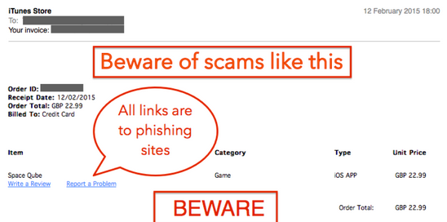
Top Holiday Phishing Scams
Fake Purchase Invoices
Notes:
*Clicking on receipt links in emails can install malware or take you to a phishing landing page!

Slide 11
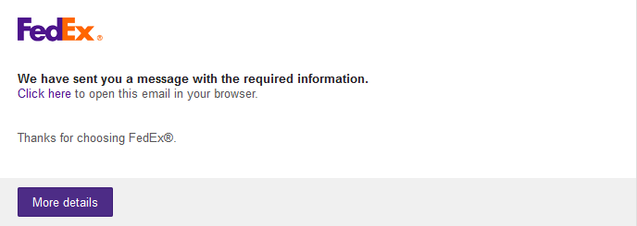
Top Holiday Phishing Scams
Shipping Status Malware Messages

Slide 12

Top Holiday Phishing Scams
Email Deal Advertisements
Notes:
*Not all email flyers and sales are going to be legit
*The most obvious fakes are from sites/stores that you’ve never done business with before
*Even recognizable name-brand stores that you have done business with before can have their email flyers spoofed by hackers

Slide 13
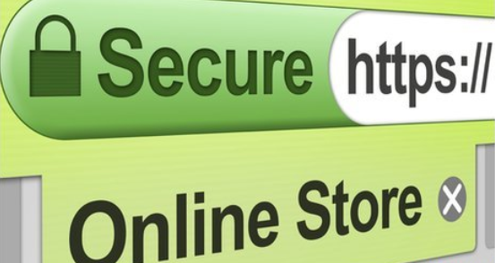
Top Holiday Phishing Scams
Inspect Links & URL’s More Closely!
Notes:
*It’s easy to let your guard down during the frantic holiday shopping season
*Hover over links in URL’s & emails to see where the address is REALLY going to
*If you are going to shop online, make sure the https “lock” icon is displayed in the URL bar before typing in your credit card info.
*Also look at frequent misspelling of words in emails – an easy way to spot fake content

Slide 14
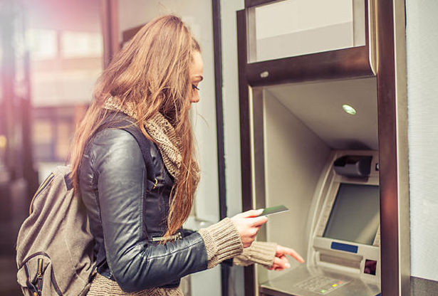
Top Holiday Phishing Scams
Keep A Close Eye On Your Accounts!
Notes:
*The holiday shopping season is the time of year when it is easiest for hackers & thieves to pilfer your checking, savings, and credit card accounts
*Login at least weekly to all your online-accessible accounts & setup temporary alarms for purchases & balance limits
*Try NOT to use Debit/Credit cards that are linked to your savings or checking accounts for shopping – use a credit card instead

Slide 15
Some Other Safeguards
Don’t use public computers or WiFi for online shopping
Don’t respond to popup ads
Don’t save your credit card info online
Use complex/long account passwords
Don’t walk around the mall with Bluetooth turned on & use an RFID wallet to protect your credit cards
Notes:
*No public computer or WiFi can be trusted. It may seem trendy & chic to shop online in Starbucks, but you are playing fast & loose with your personal & credit info!
*Popup ads are often laced with malware and the site owner may have no idea that visitors are even seeing these ads
*Yes – it’s a hassle to not store frequently used credit card info online, but it’s also one of the riskiest things you can do
*Ever heard of blue-jacking? That’s when someone is snarfing your phone data from another Bluetooth-enabled device

