Slide 1
At the end of every year, El Camino College reviews the progress on its Strategic Plan by looking at its institutional goals, aligned with the Chancellor’s Office Vision for Success.
To show the progress on our goals, we use leading and lagging indicators. This video focuses on the leading indicators, which provide information about the students’ progress.

Slide 2
Hello, we are El Camino College students and wanted to share with you some information about the College. This data helps us learn if we are making progress in our educational journey here at El Camino.

Slide 3
Did Students Who Enrolled in Fall
Come Back in Spring?
In 2020-21,70% of all ECC Fall students came back and enrolled in Spring.
Compared to the previous year, 1% more of our students persisted from Fall to Spring. The College nearly reached its 2020-21 goal of 71%.
2020-2021 Data
CCC Student Success Metrics

Slide 4
Let us check the groups of students who are disproportionally impacted when we look at persistence to stay in the College from Fall to Spring.

Slide 5
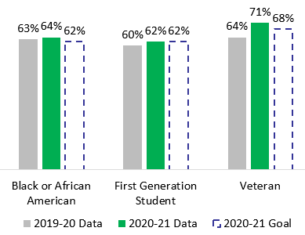
Did Students Who Enrolled in Fall
Come Back In Spring?
In the case of Black/African American and Veteran students, they surpassed the 2020-21 goals set by the college.
First Generation students reached the 2020-21 institutional goal.
2020-2021 Data
CCC Student Success Metrics

Slide 6
Did Students Who Enrolled in Fall
Come Back In Spring?
Compared to 2019-20, 1% more of LGBTQ+ students persisted from Fall to Spring.
The College continues working to reach the 2020-21 goal for these students.
LGBTQ+
2020-2021 Data
CCC Student Success Metrics

Slide 7
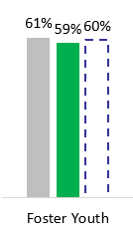
Did Students Who Enrolled in Fall
Come Back in Spring?
In 2020-21, 59% of Foster Youth students who enrolled in Fall came back and enrolled in Spring.
The College nearly reached its 2020-21 goal of 60% for these students.
2020-2021 Data
CCC Student Success Metrics

Slide 8
The College is also concerned with the number of units that we take each year. The ideal is to take annually enough courses so that we can graduate in two years.

Slide 9
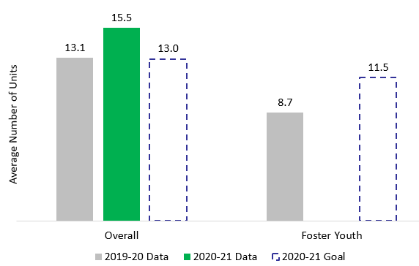
In Average, How Many Degree Applicable Units Did Students Earn During Their First Year?
In 2020-21, overall students at El Camino earned 2.4 more units than the previous year, surpassing the goal for 2020-21.
2020-21 Foster Youth student count less than 10
2020-2021 Data
ECC Colleague

Slide 10
Our College also examines if we are completing transfer-level English and Math courses during our first year. Doing good in these courses is closely associated to being successful in College over a longer term.

Slide 11
What Percentage of Students Completed Transfer-Level Math and English During Their First Year?
In 2020-21, 16% of all students at ECC completed transfer-level math and English courses during their first year, the same as the previous year.
The College surpassed its 2020-21 goal of 13%.
2020-2021 Data
CCC Student Success Metrics

Slide 12
Let us see how the groups of students who experience disproportional impact do in completing transfer-level math and English during their first year at El Camino.

Slide 13
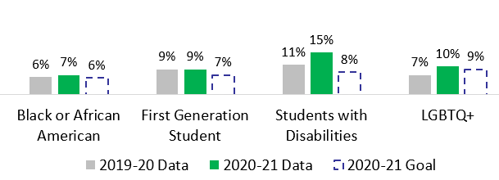
What Percentage of Students Completed Transfer-Level Math and English During Their First Year?
In 2020-21, Black/African American students, first generation students, students with disabilities, and LGBTQ+ students surpassed 2020-21 goals in completing transfer-level math and English courses during their first year.
2020-2021 Data
CCC Student Success Metrics

Slide 14
What Percentage of Students Completed Transfer-Level Math and English during Their First Year?
In 2020-21, Hispanic students who completed transfer-level math and English courses during their first year decreased compared to 2019-20. However, the College reached the 2020-21 goal for these students.
2020-2021 Data
CCC Student Success Metrics

Slide 15
El Camino also checks if we complete 30 units or more during our college first year.
Similar to completing transfer-level English and Math courses during the first year, completing 30 or more units in year one predicts success in College over a longer term.

Slide 16
What Percentage of Students Completed 30 Units or More during Their First Year?
As in 2019-20, in 2020-21, 6% of all students at El Camino completed 30 units or more during their first year.
The College almost reached its 2020-21 goal of 7%.
2020-2021 Data
CCC Student Success Metrics

Slide 17
Black and African American students, first generation students, and students with disabilities experience a disproportional impact in completing 30 units or more compared to all other students at the College. Let us check some more details about them.

Slide 18
What Percentage of Students Completed 30 Units or More during Their First Year?
In 2020-21, the percentage of Black/African American and first generation students completing 30 units or more during their first year was the same as in 2019-20.
The College continues working to reach its 2020-21 goal of 5% for these two groups of students.
Students with disabilities did reach the 5% goal for 2020-21.
2020-2021 Data
CCC Student Success Metrics

Slide 19
Another indicator our College monitors is what percentage of students withdraw from their courses during the academic year. Working on reducing withdrawal will help us complete the coursework we enroll in.

Slide 20
What Percentage of Students Withdrew from One or More Courses during the Academic Year?
In 2020-21, 40% of all students at El Camino withdrew from one or more courses during the academic year.
The 2020-21 goal was reducing student withdrawal to 37%. The College continues working to reach this goal.
2020-2021 Data
ECC Colleague

Slide 21
There are multiple groups of students who experience disproportional impact when talking about withdrawing from their courses during the academic year. Let us take a closer look at these students.

Slide 22
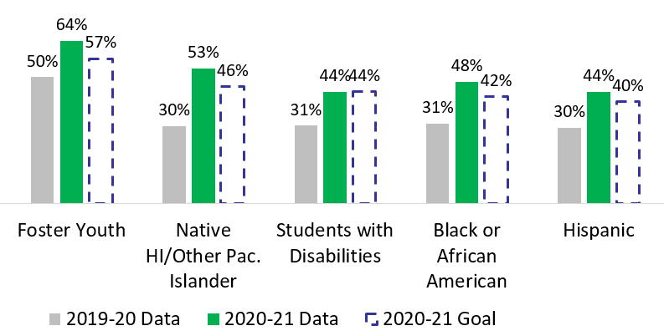
What Percentage of Students Withdrew from One or More Courses during the Academic Year?
Except for students with disabilities, the withdrawal percentage for all other groups in the chart increased in 2020-21 compared to 2019-20.
The institution continues working to reduce withdrawal and reach its 2020-21 goals.
2020-2021 Data
ECC Colleague

Slide 23
The last leading indicator that our College monitors is the percent of students who successfully complete Career Education courses that teach employable skills.
If students succeed in these courses, it means that we’ll be well prepared for the job market.

Slide 24
What Percentage of Students Successfully Completed Career Education Courses that Teach Employable Skills?
In 2020-21, 77% of all students that attempted a career education course successfully completed that course. This means 1% less than the previous year.
The College continues working to reach its 2020-21 goal of 80%.
2020-2021 Data
ECC Colleague

Slide 25
Five groups of students experience disproportional impact when it comes to successfully completing Career Education courses. Do you want to see how they did last year?

Slide 26
What Percentage of Students Successfully Completed Career Education Courses that Teach Employable Skills?
In 2020-21, the percentage of Native Hawaiian/Pacific Islander students and students with disabilities successfully completing Career Education courses increased, compared to 2019-20.
El Camino almost reached its 2020-21 goal of 78% for students with disabilities. ECC continues working to reach the 2020-21 goal of 77% for Native Hawaiian/Pacific Islander students.
2020-2021 Data
ECC Colleague

Slide 27
What Percentage of Students Successfully Completed Career Education Courses that Teach Employable Skills?
In 2020-21, the percentage of foster youth and Black/African American students successfully completing Career Education courses decreased compared to 2019-20.
El Camino continues working to reach its 2020-21 goals for these two groups of students.
2020-2021 Data
ECC Colleague

Slide 28
What Percentage of Students Successfully Completed Career Education Courses that Teach Employable Skills?
The percent of American Indian/Alaska Native students completing career education courses in 2020-21 was the same compared to 2019-20. El Camino surpassed its 2020-21 goal of 66% for these students.
2020-2021 Data
CCC Student Success Metrics

Slide 29
Let Us Summarize 2020-21 Leading Indicators…
“There needs to be more work-at-your-own-pace class structures, similar to how a continuation high school program tends to work. Some of us can excel but not at the hurried pace of many classes. Plus, add to that the distance-learning requirement because of COVID, it gets far more complicated.”
Source: 2021 Student Campus Climate Survey
Students Persisted from Fall to Spring
All students
LGBTQ+
Working towards Reaching Goals
Black/African American
First Generation
Veteran
Goal Surpassed

Slide 30
Let Us Summarize 2020-21 Leading Indicators…
“ElCo encourages me to finish what my goal was. They have counselors in many areas to guide me. Also if a problem arises that I need more help in, ElCo is ready to help me make my life better so I can finish school.”
Source: 2021 Student Campus Climate Survey
Students Earned Average Number of Degree Applicable Units during First Year
All students
Goal Surpassed
Foster Youth
2020-21 counts less than 10
N/A

Slide 31
Let Us Summarize 2020-21 Leading Indicators…
“Tutoring Center helped so much when I was taking math classes.”
“The tutors are so helpful (English 1A tutors).“
Source: 2021 Student Campus Climate Survey
Students Completed Transfer-Level Math and English during First Year
All students
Black/African American
First Generation
Students with Disabilities
LGBTQ+
Goal Surpassed
Hispanic
Goal Met

Slide 32
Let Us Summarize 2020-21 Leading Indicators…
“Help the professors that do not know how to teach classes online. To make it easier for the student to navigate their lectures, notes, and their syllabus. (…) I had to drop a class because a teach(er) was so unorganized.”
Source: 2021 Student Campus Climate Survey
Students Withdrew from One or More Courses during Academic Year
All students
Foster Youth
Native HI/Pac. Islander
Black/African American
Hispanic
Working towards Reaching Goals
Students with Disabilities
Goal Met

Slide 33
Let Us Summarize 2020-21 Leading Indicators…
“(There is a need to) hold more career fairs, networking opportunities, and assist students with finding jobs and internships.”
Source: 2021 Student Campus Climate Survey
Students Successfully Completed Career Education Courses that Teach Employable Skills
All students
Native HI/Pac. Islander
Students with Disabilities
Foster Youth
Black/African American
Working towards Reaching Goals
Amer. Indian/Alaska Nat.
Goal Surpassed

Slide 34
On behalf of our fellow students, we want to thank all the ECC community. The positive results we saw in this video are consequence of the good work you are doing!!
It would be great if you consider this data in your annual plans for 2023-2024. Last year the College built a dashboard with this information. There, you can dig deeper into the different groups of students and the multiple programs and divisions we have here at ECC.
Data is one tool that provides insight into students’ behavior and informs the strategies you use to help us excel at El Camino.

Slide 35
THANK YOU!
For more information, go to
El Camino College Institutional Goals

