Slide 1
FY2022-23 Annual Planning Nuventive Improve Training
January 14, 2022

Slide 2
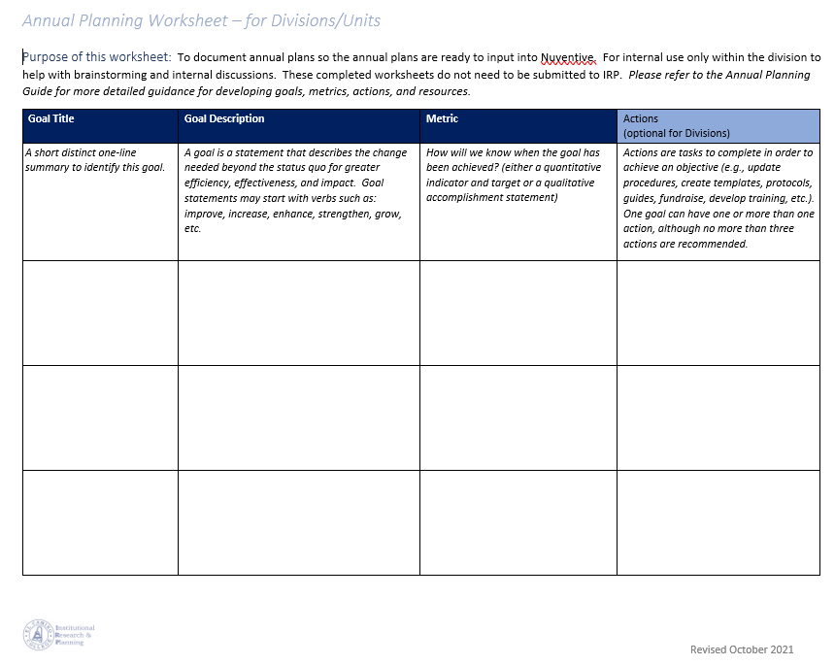
Purpose of this meeting
To provide an overview of how to navigate the Nuventive Annual Planning module and copy annual plans from the Word Annual Planning worksheet into Nuventive.
Notes:
To provide an overview of the Annual Planning module within the new Nuventive, including how to navigate and input annual plans from the Word worksheet into Nuventive.

Slide 3
Timeline and Process to Date
Annual Planning worksheet (MS Word)
New Nuventive annual planning forms
Divisions/Units begin developing annual plans
Divisions/Units enter annual plans in Nuventive
Nov
2021
January 28, 2022
Offices/ Programs begin developing annual plans
Offices/ Programs enter annual plans in Nuventive
Feb
2022
April 15, 2022

Slide 4
Nuventive Access & Log-in

Slide 5
Logging in with URL
https://solutions.nuventive.com/

Slide 6
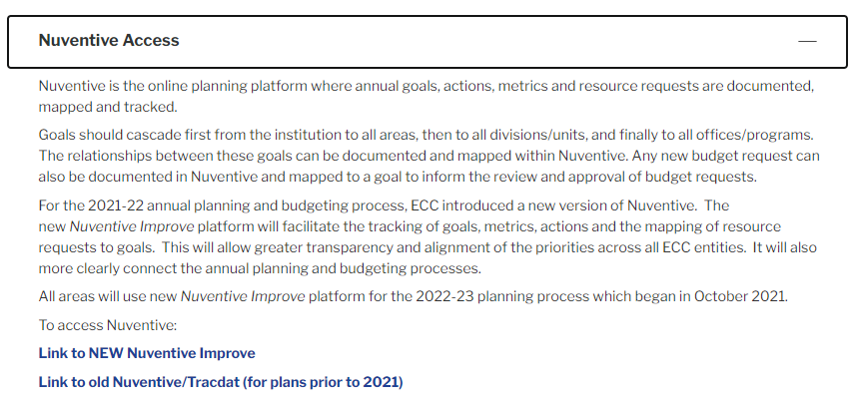
Logging in through IRP website
The log-in link can also be found in the IRP website . Click on the Nuventive button below for quick access to the New Nuventive Improve link.

Slide 7
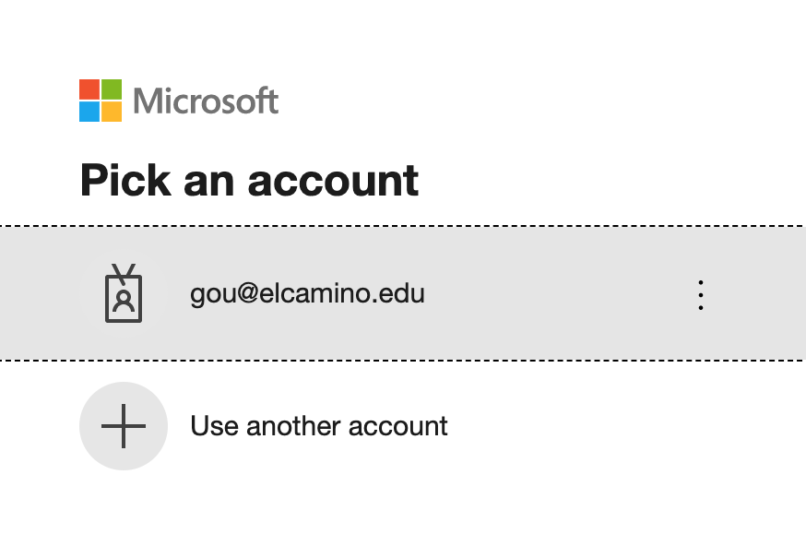
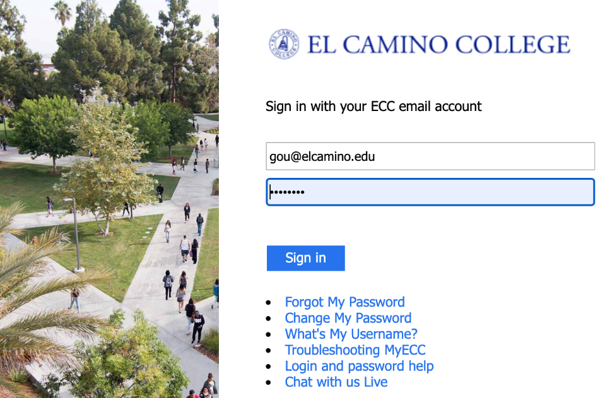
Logging in

Slide 8
Select Your Office Name
Select your division or program/office name by either typing in the name or by clicking the dropdown arrow to view the list.

Slide 9
Nuventive Menu
Click on the hamburger to get to the Home screen and then click on Planning of Annual Goals to start entering your goal(s).

Slide 10
Entering Goals

Slide 11
Entering Goals
Click to add a goal.

Slide 12
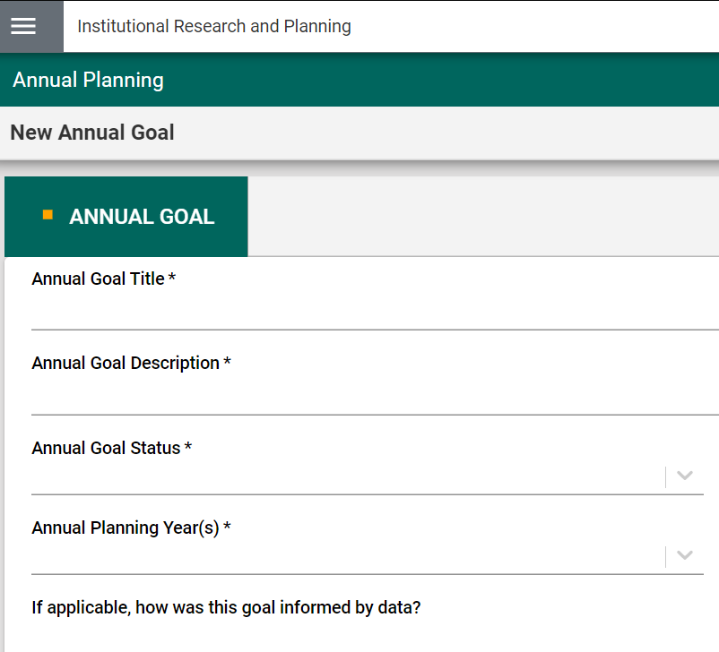
Entering Goals
* Indicates a required field

Slide 13
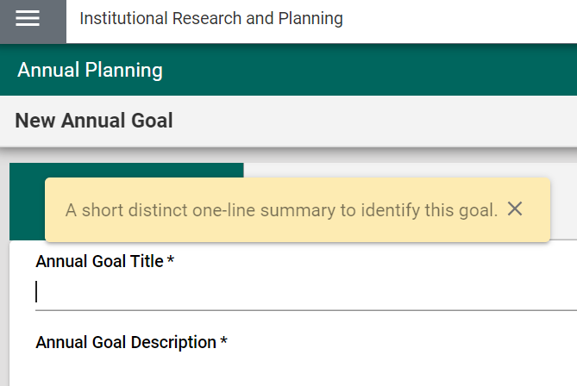
Entering Goals
A description will appear the first time you click in the field.
Click “x” to close the description box. To access the description again, click on the .

Slide 14
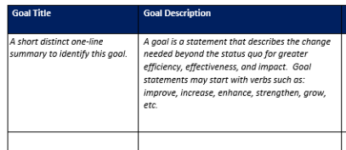
Entering Goals
Annual Plan – Word worksheet
When entering a new goal, select ACTIVE as the “Annual Goal Status”.
Annual Planning Year = 2022-23
Optional for divisions: Helps provide context to the goal.
Notes:
Annual goal status – the other categories can apply throughout the year (as goals are completed or abandoned because they are no longer relevant).

Slide 15
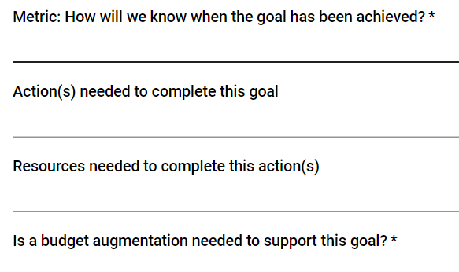
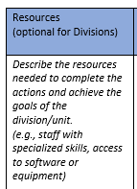
Entering Goals
Annual Plan – Word worksheet
Yes or No
Enter funding request in separate form.

Slide 16
Reviewing Goals
As goals are entered:
One “card” per goal
Filters used to view goal cards and hide old cards.
Notes:
Annual goal status – the other categories can apply throughout the year (as goals are completed or abandoned because they are no longer relevant).

Slide 17
Adding & Attaching Documents (Document Repository)

Slide 18
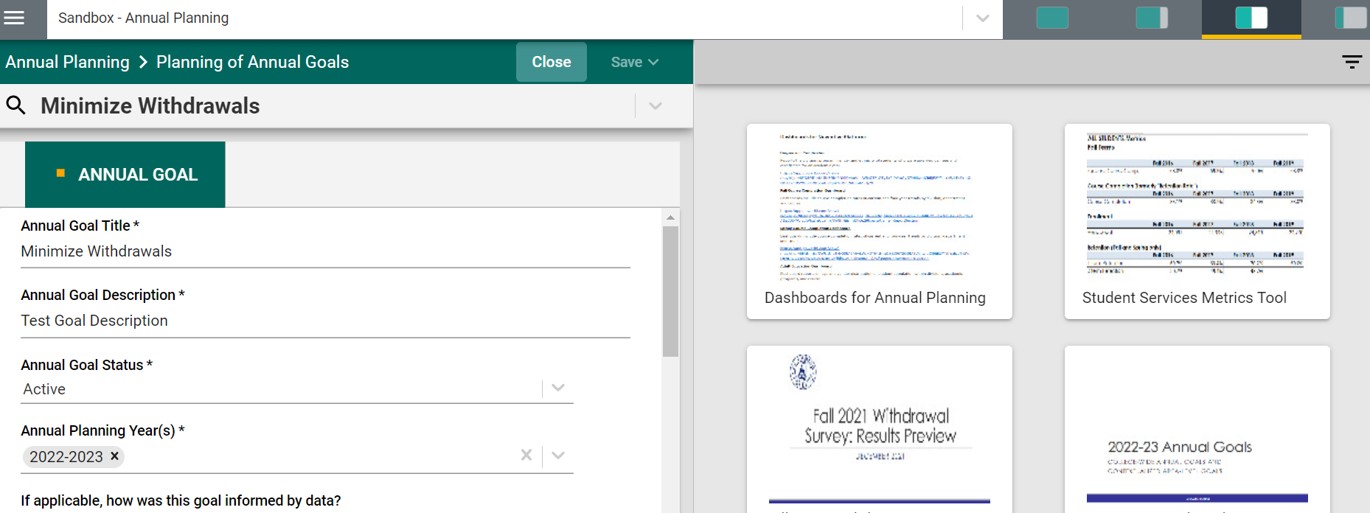
Data and Documents on the Side Bar
Some data/documents are available on the side bar for you to use to support your annual planning goals. Click on viewing options to enlarge data/documents on the right side bar.

Slide 19
Data and Document
Download or print documents by clicking on the appropriate icons.

Slide 20
Document Repository
Access the Document Repository by clicking on the hamburger. All the documents you upload/add are stored in the Document Repository.

Slide 21
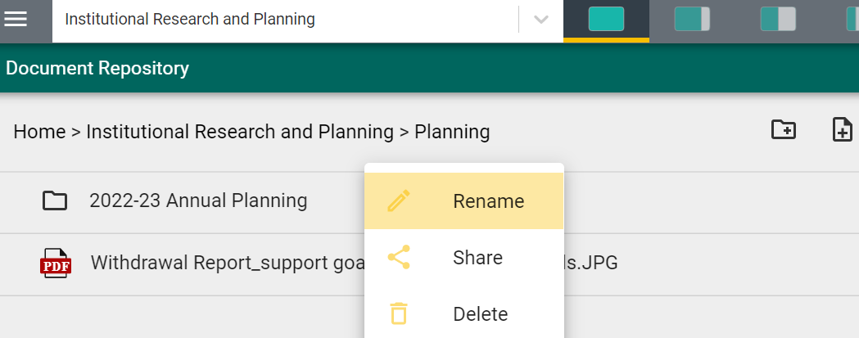
Document Repository: Creating Folders
As there is no drag and drop feature here, we highly recommend to create folders before adding in documents so you can add files to relevant folders before you attach the documents to the Planning of Annual Goals page(s)/card(s). Folders can be renamed, shared, and deleted.

Slide 22
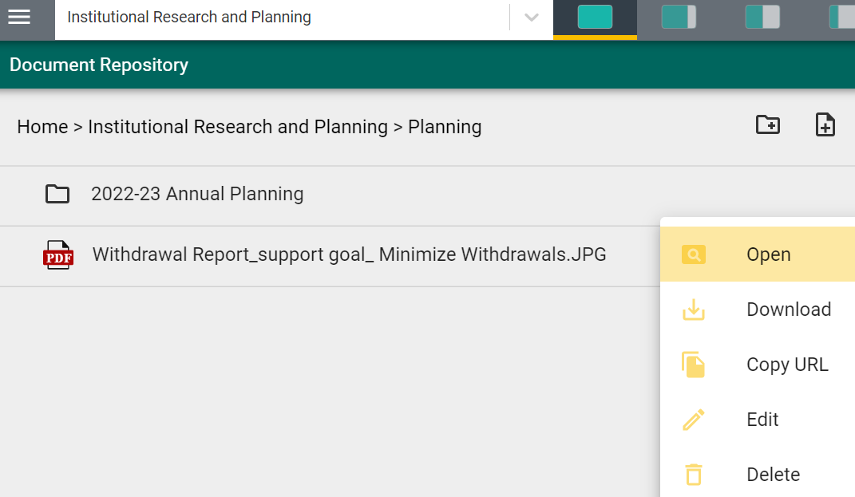
Document Repository: Adding Documents
Select the folder you would like add the document, then click to add.

Slide 23
Document Repository: Adding Documents
Complete the information in this pop-up window. Add a document by choosing files from you computer or by inserting the Url. Click Save when done.

Slide 24
Document Repository: Adding Documents
Click on the three dots to the right of a document to see a list of features.

Slide 25
Adding Documents in Planning of Annual Goals
Click on to attach a document.

Slide 26
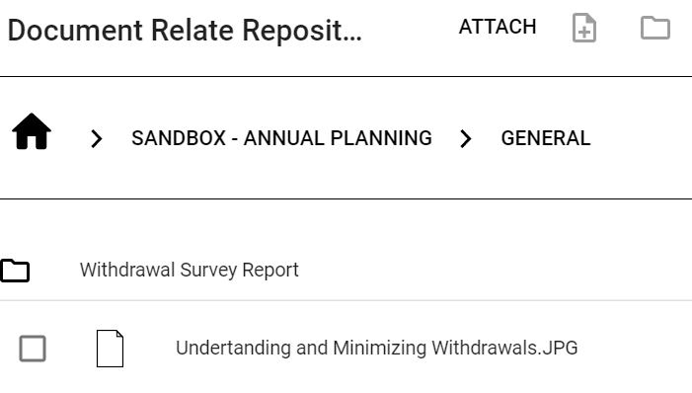
Adding Documents in Planning of Annual Goals
Add document
Create a folder
The documents will show here after they’ve been added.

Slide 27
Attaching Documents in Planning of Annual Goals
After the document has been added, select the document by clicking on it (when selected, the document appears yellow with a check mark) and then click “ATTACH”.

Slide 28
Attaching Documents in Planning of Annual Goals
The document that has been attached will appear in this section of the Planning of Annual Goals page.
To delete an attached document, click on the X.

Slide 29
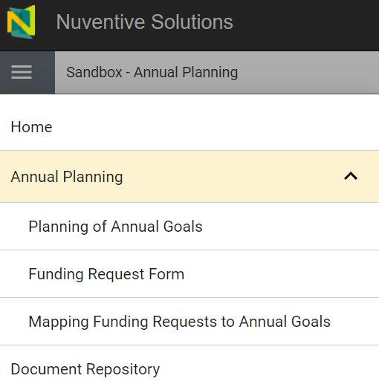
Budget Augmentation
If you select “yes” to this question, you will need to complete a Funding Request form.
Be sure to save Planning of Annual Goals page first before you access the Funding Request Form.

Slide 30
Saving Your Annual Plan

Slide 31
Saving Goals
The Save function only works when all required fields (indicated with *) have been completed. So be sure to complete all your fields, especially the required ones before saving.

Slide 32
Saving Goals

Slide 33
Funding Request Form

Slide 34
Do you need to complete a Funding Request Form?
You will only need to complete a Funding Request form if you select “yes” to the budget augmentation question in the Planning of Annual Goals.

Slide 35
Funding Request Form
A title for this funding request. Shortened description to help in the review of this request for approval.
Note: If a request requires more than one funding category (e.g., software and staff to implement the new software), please complete one form for each funding category.

Slide 36
Funding Request Form
A request for one-time funding supports an initiative that has a beginning and an end.
Applicable for Programs only. For divisions, select N/A – Program Review not required.
Notes:
• A request for ongoing funding is an increase to the annual operating budget.
• An initiative may also have an initial cost for implementation with ongoing maintenance costs, which may be a different amount. Specify the amount for annual ongoing maintenance under “Rationale for funding request”.

Slide 37
Funding Request Form
To Access Funding Request Form, click on the hamburger and select Funding Request Form.

Slide 38
Funding Request Form
* Indicates a required field. Be sure to complete the form and save your work.

Slide 39
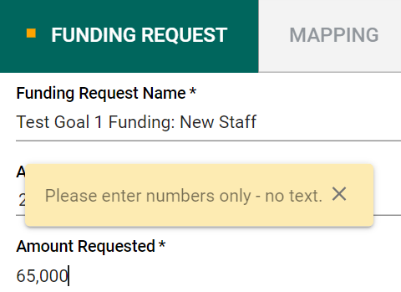
Funding Request Form: Amount Requested
Note to enter numbers only for the Amount Requested.

Slide 40
Funding Request Form
Complete the funding request form. Keep the “For Manager Use Only” blank.

Slide 41
Reviewing Funding Requests
As funding requests are entered:
One “card” per funding request
Filters used to view funding request cards and hide old cards.
Notes:
Annual goal status – the other categories can apply throughout the year (as goals are completed or abandoned because they are no longer relevant).

Slide 42
Mapping

Slide 43
Mapping
Click on Mapping to link each Funding Request to a goal.

Slide 44
Mapping Funding Request to Goal
Click on the “L” button to link the funding request to the goal(s) that apply. A button highlighted in Yellow indicates the funding request is linked to the goal on the left.
Do Not Use

Slide 45
Mapping Funding Request to Goal
The Word worksheet should help with mapping funding request to an annual goal.
Funding Request
Goal

Slide 46
Next Steps
By January 28th, enter divisional-level annual plans in Nuventive.
Division / Unit-level Annual Planning
Before February 25th, Deans/Managers meet with Office/Program Annual Planners to kick-off Office/Program-level annual planning.
By March 25th, Office/Programs complete Word worksheet with annual plans
By April 1st, Nuventive training with Office/Program Annual Planners
By April 15th, Office/Programs enter annual plans in Nuventive.
Office / Program-level Annual Planning

Slide 47
Contact for Support
Contact for questions related to Nuventive access & support: Diora Hong (dhong@elcamino.edu)
Contact for questions related to annual planning process: Grace Ou (gou@elcamino.edu)

Slide 48
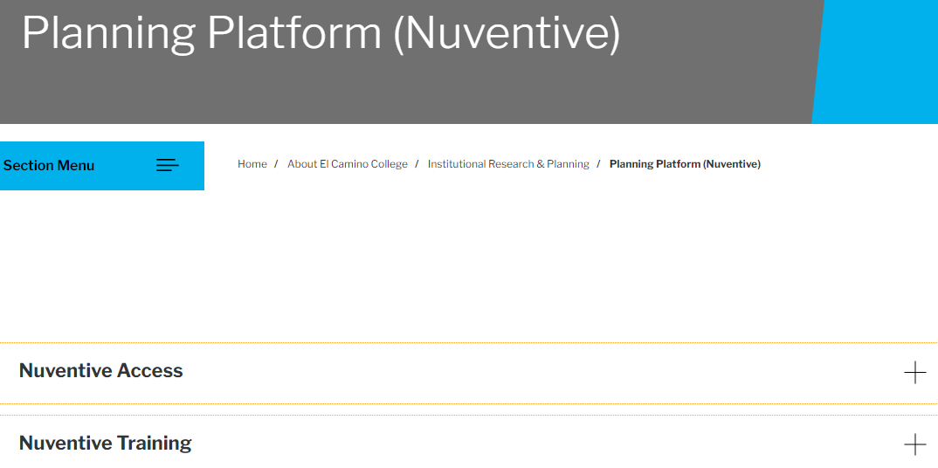
Nuventive Resources on IRP Website
Nuventive log-in link can be found in Nuventive Access
Today’s PowerPoint presentation can be found in Nuventive Training

Slide 49
Thank You
Questions?

