Slide 1
Administrative Program Review Training
institutional research & planning

Slide 2
Program Review Participants and Timeline

Slide 3
Participants – Group B
Area Program Reviewers Reports to | Office Conducting Program Review | Manager Conducting Program Review
President's Office | Institutional Research and Planning | Viviana Unda
Vice Presidency of Administrative Services | Fiscal Services | Jeff Hinshaw
 | Information Technology Services | Loic Audusseau
Vice Presidency of Human Resources | Title IX, Diversity and Inclusion | Jaynie Ishikawa

Slide 4
Timeline Program Reviewers
Task | Deadline
Group B participates in IRP Office training to kick-off program review process (template walk through) | Nov 2021
Group B develops program review based on template provided in training | Nov 2021 - Jan 2022
Program reviewers input program review information in Nuventive. | February 2022
Program reviewers incorporate feedback from committee | April 2022

Slide 5
Timeline Review Committee, Deans/VPs
Role Performing Task | Task | Deadline
Program Review Committee | Committee members meet and provide feedback on program reviews | March 2022
 | Committee Feedback Form completed in Nuventive | Late March/Early April 2022
 | Final Review Program Review Committee Chair | May 2022
VP/Dean | Read and Sign-Off Program Review Reports | May & June 2022
Institutional Research and Planning | Post program review reports on website | End of June 2022

Slide 6
Program Review Purpose and Cycle

Slide 7
Purpose of Program Review
Evaluate the progress towards achieving existing goals and outcomes of an office.
Involves looking forward to plan for the next four years, setting up new/adjusted goals and outcomes, guided by the aforementioned evaluation.
Each office has an opportunity to:
1) Critically evaluate the accomplishments and services offered during the last three years.
2) Plan and recommend necessary changes in order to ensure that goals and outcomes for the next four years are met.

Slide 8
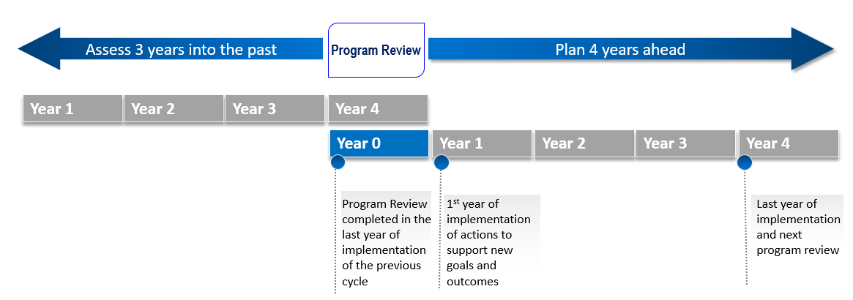
Program Review Cycle

Slide 9
Program Review Template

Slide 10
Set 4-Year Goals
Long-range, broad statements that express desired results. Reflect the key role and responsibilities of the office and help setting its direction.
One way of writing goals is to think about broad sentences starting with a verb that depicts areas that the office will work on in the next 4-years.
Guiding question: Given the unique role and responsibilities of the office, how would it better serve key constituents in the next four years?
Example of a goal from IRP: “Champion the re-engineering of the annual planning process.”

Slide 11
Set 4-Year Outcomes
Related to the distinct role of the office at ECC and to the key services it provides to the institution.
Express what stakeholders (students, faculty, staff, and possibly external stakeholders) served by the office will experience, receive, or understand if the goals of the office are met.
Guiding question: Given the unique role and responsibilities of the office, what will its stakeholders experience, receive, or understand in the next four years, if the goals of the office are met?
Example of an administrative outcome from IRP: “Managers who participate in the annual planning training will feel adequately prepared and confident to lead the annual planning process within their offices.”

Slide 12
Establish 4-Year Actions
Tasks to complete in order to progress towards a goal/outcome and/or to achieve a goal/outcome (e.g., update procedures, develop training, refurbish technology, etc.).
Guiding question: Given the goals and outcomes set for the office, what actions need to be completed by the office during the next four years to achieve/see progress on these goals and outcomes?
Examples of Actions from IRP: : “Provide annual training to managers participating in the annual planning process.”

Slide 13
Envision Resources
Assets relative to facilities, technology, staffing needed to achieve goals and outcomes (e.g. personnel hire, software/hardware, instructional equipment, non-instructional equipment, furniture, facilities).
Evaluate the need of resources for the office in order to ensure goals and outcomes are realized in the next four years.

Slide 14
Resources for Next 4-Years
Guiding Questions: Given the goals, outcomes, and actions established for the next four years: | Facilities | Technology/Software | Staffing
What resources does the office currently have?
What resources does the office need to better support the goals and outcomes? |  | Example from IRP: “Additional online team collaboration tools to coordinate and facilitate the training” | Example from IRP: “Hiring an additional staff member to coordinate and facilitate the training, and to develop training materials”

Slide 15
Performance Indicators/Accomplishments
Measures used to track progress of goals and outcomes of an office.
Outcomes of an office are tracked through the level of satisfaction, knowledge or awareness of its stakeholders.
While performance indicators are usually quantitative, some goals/outcomes may be linked to the successful completion of a project (e.g. the development of a document, the installation of a software, etc.). In these cases, the performance indicator is not quantitative, but an accomplishment (more qualitative).
Guiding question: Given the goals and outcomes set for the office, what measures or accomplishments will be used during the next four years to track progress of goals and outcomes?

Slide 16
Performance Indicators/Accomplishments
Example of a performance indicator from IRP: “Percentage of managers who participated in the annual planning training who are comfortable articulating clear goals for their offices.”
Example of an accomplishment from IRP: “Development of materials and templates for the annual planning training.”

Slide 17
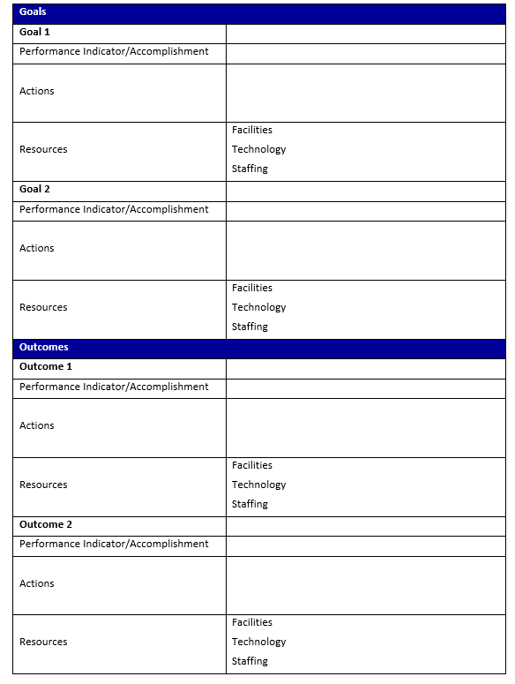
Program Review Worksheet
It is recommended to use cluster thinking when developing goals and outcomes.
For example, one goal for the Institutional Research Planning Office is to “champion the re-engineering of the annual planning process.”
Once the goal has been developed, think:
What indicator or accomplishment will help measure the progress of the goal?
What actions does the office need to perform to make progress towards the goal?
What current or additional resources will the office use or need to perform actions and make progress towards the goal?
This same path can be used to think about office outcomes.
It is important to know that actions and resources could serve to support progress in multiple goals and/or outcomes. This is why cluster thinking is important so that program reviewers always think about the relationships between all planning elements.

Slide 18
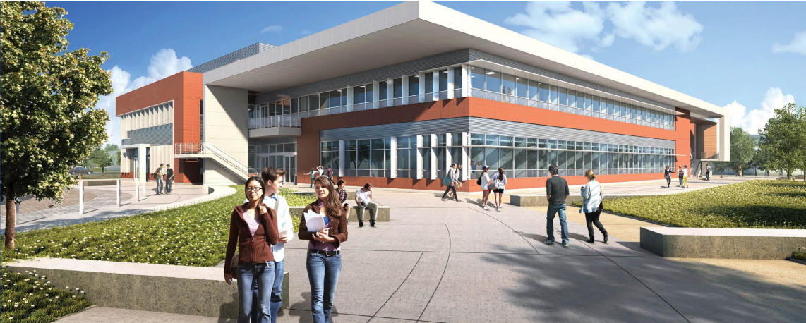
Thank You
Questions?

