Slide 1
Administrative Program Review Workshop
institutional research & planning

Slide 2
Agenda
Introduction
Setting 4 Year Goals (20 minutes)
Setting 4 Year Outcomes (20 minutes)
Establishing 4 Year Actions (20 minutes)
Envisioning Resources (20 minutes)
Questions (10 minutes)

Slide 3
Introduction
Why do we do Program Review?
Assessment & planning ahead
Compliance (ACCJC accreditation)
What is the structure ECC uses for Program Review in the administrative areas of the College (President’s Office, HR, and Administrative Services)?
Process takes Spring and Summer 2024
4-year cycle
Program reviewer develops report
Program Review Committee* provides feedback to report
Program reviewer incorporates feedback to report
Manager of program reviewer approves report
Program Review Committee Chair uploads program review report to the APR webpage
*Committee members work on the three administrative areas of the College

Slide 4
What Goals Do You Envision for the Office You Lead?
Goals in Program Review
Long-range, broad statements that express desired results related to key role and responsibilities of the office.
Help setting direction of the Office.
Example: IRP Goal
Contribute to the development of a campus-wide culture that uses integrated planning processes
Example: IRP Goal
Support a culture of data-informed decisions that are student-centered
Questions to help you develop goals
How do you envision your office contributing to the institutional mission in the next four years?
In what ways do you plan to increase your office’s efficiency and effectiveness to better support the needs of the college’s stakeholders?
What would you like others to say about your office by the end of the next four years?
Near-Final ECC Mission
A sense of belonging drives El Camino College. We are equity-focused and serve our diverse communities through student-centered learning, career development, and lifelong enrichment.

Slide 5
Goals Counterexamples
Goal too broad
Improve office productivity
Difficult to define concrete actions
Difficult to measure progress effectively
Doesn't provide guidance on aspects of productivity that need improvement.
Goal too specific or too short-term
Obtain funding for a new research project on renewable energy technology
Securing funding for a particular topic may not align with the broader strategy of the office for the next four years.
Lacks flexibility to pivot to respond to evolving trends and priorities in the next four years.
Goal that looks more like an activity
Develop a policy and procedure manual
Focuses on the process of creating a manual rather than the intended purpose of having such a manual.
Does not convey the broader purpose that the manual intends to serve.
Goal that equals a budget request
Hire a program coordinator
Focuses on action of filling a position rather than the intended purpose of having a program coordinator in place.
Does not convey the broader purpose that the hiring of a program coordinator intends to serve.

Slide 6
Let’s develop goals for:
Grants Office
Small Business Development Center
Contract Education
Bookstore and Food Services

Slide 7
What Outcomes Do You Envision for the Office You Lead?
Outcomes in Program Review
Express what stakeholders (students, faculty, staff, and possibly external stakeholders) served by the office will experience, receive, or understand if the goals of the office are met.
Example: IRP Outcome
Stakeholders will engage in training to learn how to use strategy to make improvements and work collaboratively towards common goals
Example: IRP Outcome
Stakeholders will willingly engage in planning processes to assess and enhance services provided
Questions to help you develop outcomes
What will your stakeholders experience, receive or understand by the end of the next four years?
What key expectations and needs of your stakeholders will be satisfied/fulfilled as a consequence of your office’s work?

Slide 8
Outcomes Counterexamples
Outcome too vague
Decrease claims for the District
Although it suggests a reduction in claims, it doesn't clearly articulate the impact or benefits that stakeholders (students, faculty, staff, etc.) will experience as a result of this decrease in claims.
Outcome that does not clearly state the benefits stakeholders who get from interacting with your office
Website improvements tracked, improved and measured through reporting provided by third-party company
Does not specify what stakeholders (students, faculty, staff, etc.) will experience, receive, or understand if the website improvements are tracked, improved, and measured.
Outcome that looks more like a goal
Develop campus wide compliance practices related to risk management
Focuses on the action of developing compliance practices rather than the impact that stakeholders will experience from having these practices in place.

Slide 9
Let’s develop outcomes for:
Grants Office
Small Business Development Center
Contract Education
Bookstore and Food Services

Slide 10
What Actions Will You Need To Complete To Make Progress On Goals and/or Outcomes?
Actions in Program Review
Tasks to complete in order to make progress towards a goal/outcome and/or to achieve a goal/outcome (e.g., update procedures, develop training, refurbish technology, etc.).
Example: IRP Action
Offer year-round planning professional development opportunities.
Example: IRP Action
Support Student Services and Administrative Services in strengthening their program review processes.
Question to help you develop actions
In order to make progress towards goals and outcomes, what key tasks need to be completed during the next four years?

Slide 11
Actions Counterexamples
Actions are too specific or too short-term
Develop training manuals, tools and materials
Overlooks broader four-year goals/outcomes and may result in an unstructured approach to training and development.
It is not framed within the context of four-year goals/outcomes.
Actions do not align with goals and/or outcomes
Outcome: Decrease claims for the District
Actions needed to achieve outcome: Information related to the department will be disseminated to the campus
Action does not directly address the underlying factors contributing to claims being filed against the District.
Action of disseminating department information to the campus may not necessarily lead to a decrease in claims.
Section is left blank

Slide 12
Let’s develop actions for:
Grants Office
Small Business Development Center
Contract Education
Bookstore and Food Services

Slide 13
What Resources Will You Need to Achieve Goals and Outcomes?
Resources in Program Review
Assets relative to facilities, technology and staffing needs to achieve goals and outcomes in the next four years.
Example: IRP Resources
Increased Nuventive analytical capabilities (assessment, goal mapping, academic planning, institutional goals, other institutional plans, etc.)
Example: IRP Resource
The team has determined the need of administrative support so that analysts have more time to do analytic and strategic work.
Questions to help you determine resources you have and resources you need
What resources does your office currently have? Are there any existing resources within your office that can be repurposed to align with four-year goals and outcomes?
Based on the goals, outcomes and actions established, what resources will you need in the next 4 years? How will each identified resource directly contribute to the accomplishment of goals and outcomes?

Slide 14
Resources Counterexamples
The section is left blank.
The section does not mention current available resources.
The section does not cover resources needed in the next four years.

Slide 15
Let’s think about resources for:
Grants Office
Small Business Development Center
Contract Education
Bookstore and Food Services

Slide 16
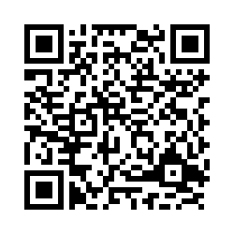
Next Steps
Complete updates to program review by Monday March 18th.
Please complete this short evaluation on workshop:
https://elcamino.co1.qualtrics.com/jfe/form/SV_9TrILHKz72ybZDE
Agree Nuventive training date for the week of March 4th

Slide 17
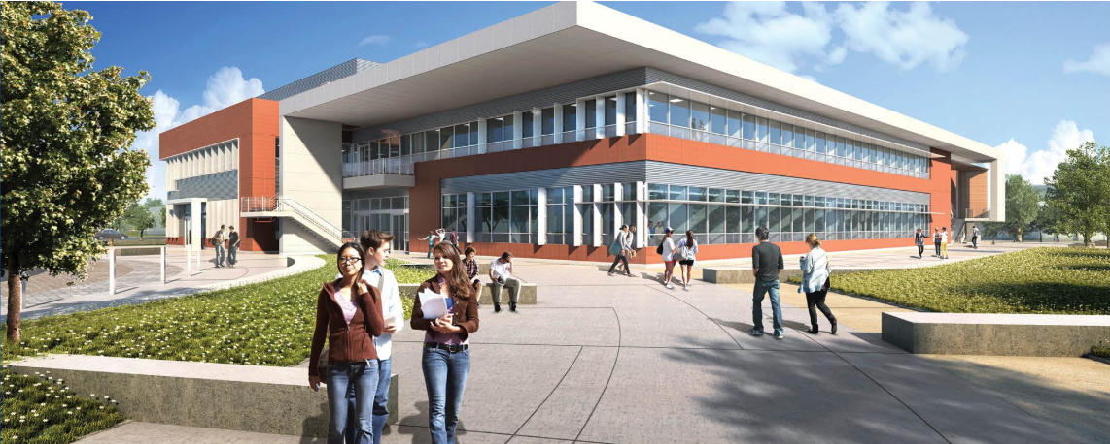
Thank You
Questions?

