Slide 1

Statewide RP Group College Attendance
Decisions Survey
February 2024

Slide 2
Statewide RP Group College Attendance Decisions Survey Summary
Why:
To understand factors influencing decisions of prospective and previously enrolled CC students to attend a California community college in Fall of 2023 and what they needed to attend college during this time.
When:
Administered in Fall 2023.
This is a follow-up to the 2022 administration of the College Attendance Survey
Response Rate:
Students | Contacted | Responded | Response Rate
Previously Enrolled | 21,777 | 286 | 1.3%
Prospective | 1,360 | 388 | 28.5%
Total | 23,137 | 674 | 2.9%

Slide 3
Characteristics of ECC Survey Respondents

Slide 4
What Was The Race/Ethnicity of ECC Respondents?

Slide 5
How Representative Were Survey Respondents Compared to Fall 2023 Student Race/Ethnicity Demographics?
Overrepresented
African/African American/Black
White
Slightly overrepresented
Native Hawaiian/Pacific Islander
American Indian
Underrepresented
Hispanic/Latinx
Slightly underrepresented
Middle Eastern/Arab/Arab American
Asian

Slide 6
What Was The Age Groups of ECC Respondents?

Slide 7
How Representative Were Survey Respondents Compared to Fall 2023 Student Age Groups Demographics?
Overrepresented
50 to 64
Slightly overrepresented
35 to 49
Underrepresented
18 to 24
25 to 34
Adequately represented
65+

Slide 8
Enrollment Plans
Fall 2023

Slide 9
OVERALL RESPONDENTS: Enrollment Plans
Enrollment plans of previously enrolled students improved compared to their enrollment last semester
Enrollment plans of prospective students show a preference for full-time enrollment
Previously enrolled students are considering other enrollment options besides ECC more than prospective students

Slide 10
BLACK/AFRICAN-AMERICAN RESPONDENTS: Enrollment Plans
Enrollment plans of Black/AA previously enrolled students improved compared to their enrollment last semester
Enrollment plans of Black/AA prospective students show a preference for full-time enrollment
Black/AA previously enrolled students are considering other CC besides ECC more than Black/AA prospective students
Black/AA prospective students are considering a 4-year institution more than Black/AA previously enrolled students

Slide 11
HISPANIC/LATINX RESPONDENTS:
Enrollment Plans
Enrollment plans of LatinX previously enrolled students improved compared to their enrollment last semester
Enrollment plans of LatinX prospective students show a preference for full-time enrollment
LatinX previously enrolled students are considering other enrollment options besides ECC more than LatinX prospective students

Slide 12
Reasons Not to Enroll
Fall 2023

Slide 13
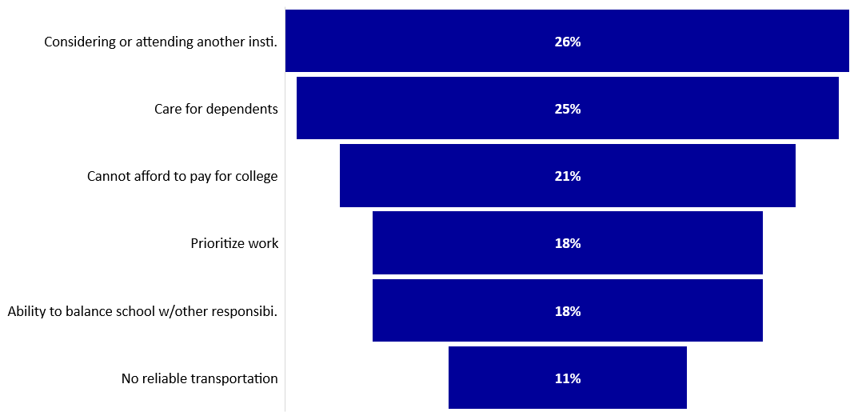
OVERALL RESPONDENTS: Top Reasons NOT to Enroll

Slide 14
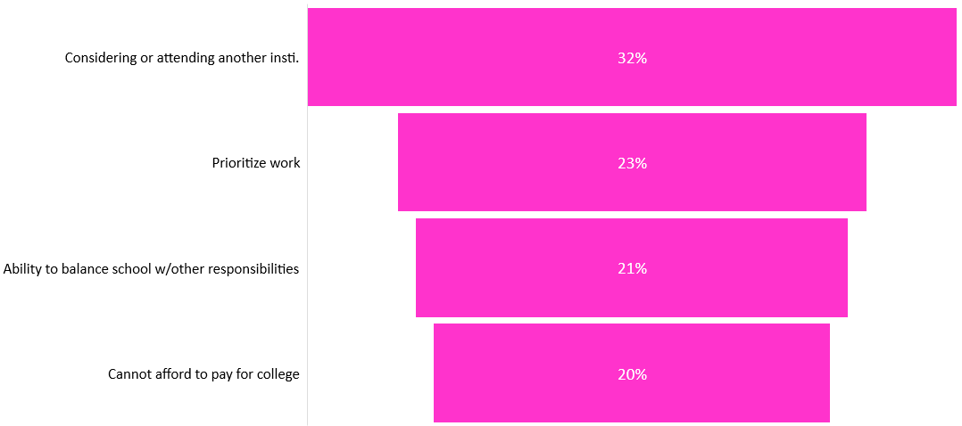
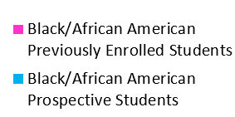
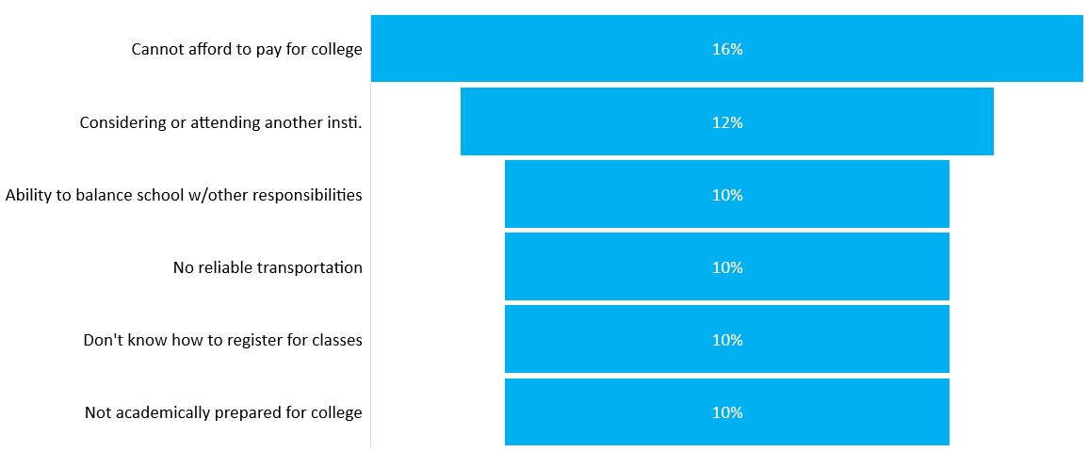
BLACK/AFRICAN-AMERICAN RESPONDENTS: Top Reasons NOT to Enroll

Slide 15
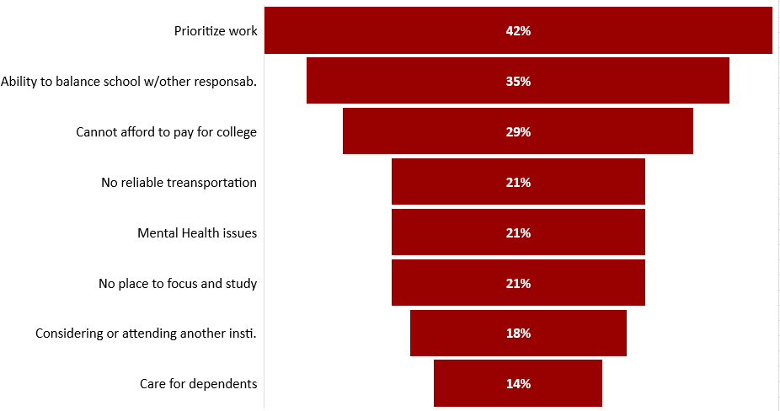
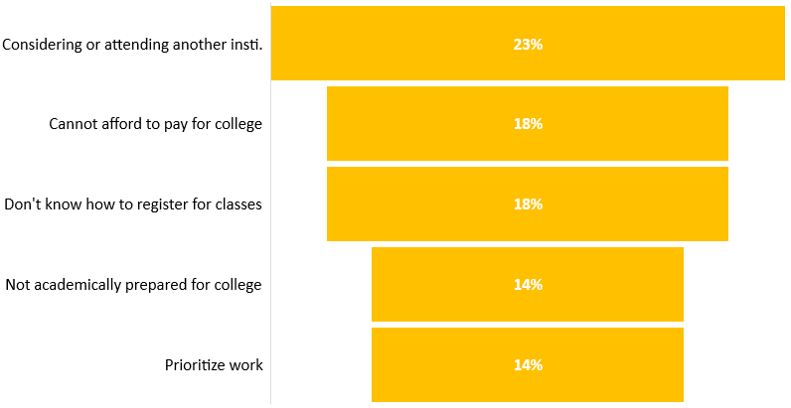
HISPANIC/LATINX RESPONDENTS: Top Reasons NOT to Enroll

Slide 16
Reasons to Withdraw
Fall 2023

Slide 17
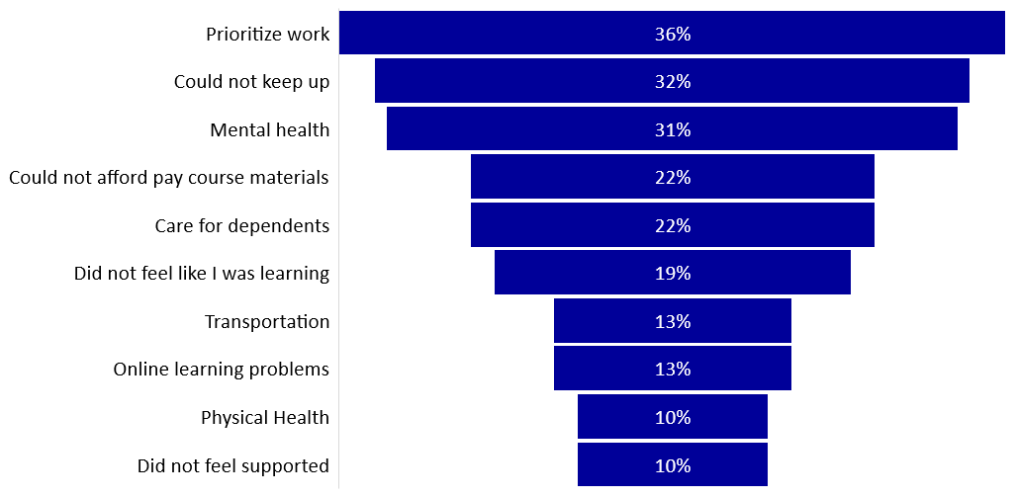
OVERALL RESPONDENTS: Reasons to Withdraw
Notes:
Top reasons to withdraw correspond to reasons a student might not enroll to begin with. 2023 N=78 students who withdrew.

Slide 18
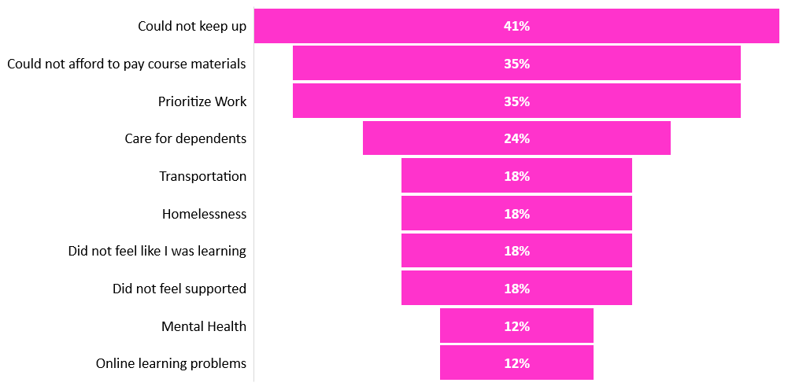
BLACK/AFRICAN-AMERICAN RESPONDENTS: Reasons to Withdraw
Notes:
Top reasons to withdraw correspond to reasons a student might not enroll to begin with. 2023 N=78 students who withdrew.

Slide 19
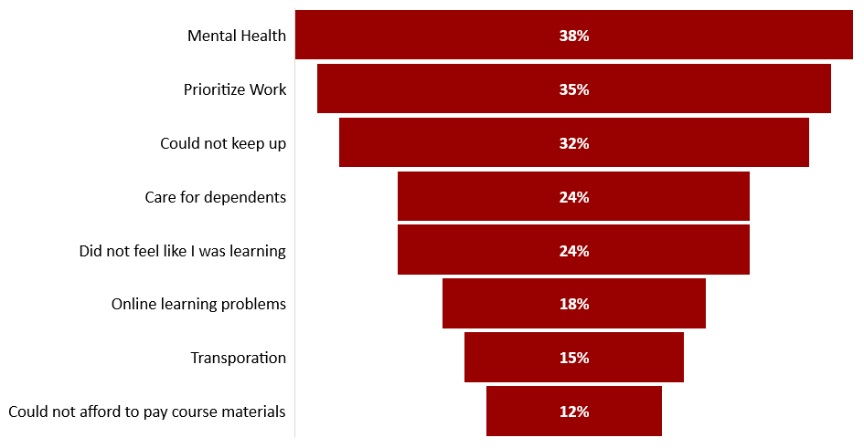
HISPANIC/LATINX RESPONDENTS: Reasons to Withdraw
Notes:
Top reasons to withdraw correspond to reasons a student might not enroll to begin with. 2023 N=78 students who withdrew.

Slide 20
QUESTIONS TO ADDRESS
Enrollment Plans & Full-Time Load Options
Have we examined why previously enrolled students overall and Hispanic/Latinx previously enrolled students are considering other enrollment options besides ECC?
As prospective students (overall, Black/African American and Hispanic/Latinx) show a preference for full-time enrollment, do we have program pathways options for students that can facilitate full-course loads?
Work & Financial Aid
As prioritizing work is a top reason not to enroll or to withdraw, are we working with local employers to help working students access job opportunities that are flexible and compatible with their academic schedules?
Considering the inability to afford paying for college is a top reason not to enroll for Black/African American and Hispanic/Latinx students, do we have an inventory of the types of financial aid students can apply for? Are we regularly disseminating this inventory through different communication means?
College Success
As the inability to balance school with other responsibilities is a top reason not to enroll for Black/African American, are we offering workshops that teach time-management and prioritization skills?
As the inability to keep up with college is a top reason to withdraw, have we examined how is the early alert system working?
When and where are academic support services being offered?
Can we engage challenged students to take a human development course (skills & knowledge needed to succeed in college)?
Mental Health
As mental health is a top reason to withdraw:
Do we have an inventory of the health and wellness services we offer?
Can we examine how we are disseminating the health and wellness services and with what frequency?
How are we building a culture of empathy, understanding, and support? How can we get to the students who do not feel a sense of belonging?

Slide 21

Thank You

