Slide 1

Academic Senate Meeting
2-21-2023

Slide 2
Quick Reminder
Comments/questions not directly related to current agenda item will not be acknowledged until public comment. Additionally, comments/questions on agenda items should contribute to the discussion in a meaningful way. Public comments will be limited to 1 three-minute comment per person per meeting.
The Academic Senate fully respects the time of all our senators and other meeting participants. With this in mind and because of the many items within senate purview that must be addressed each semester, we ask that discussions in senate meetings, even during the public comment period, be limited to topics within/related to the 10+1 purview of the Academic Senate. If your comment is completely unrelated to senate purview (i.e. topics such as salaries/wages, and benefits), you will be kindly asked to hold your comment and advised as to a more appropriate venue to have the conversation.

Slide 3

Approval of the Minutes from
(12-6-22)
Packet pages:6-12

Slide 4
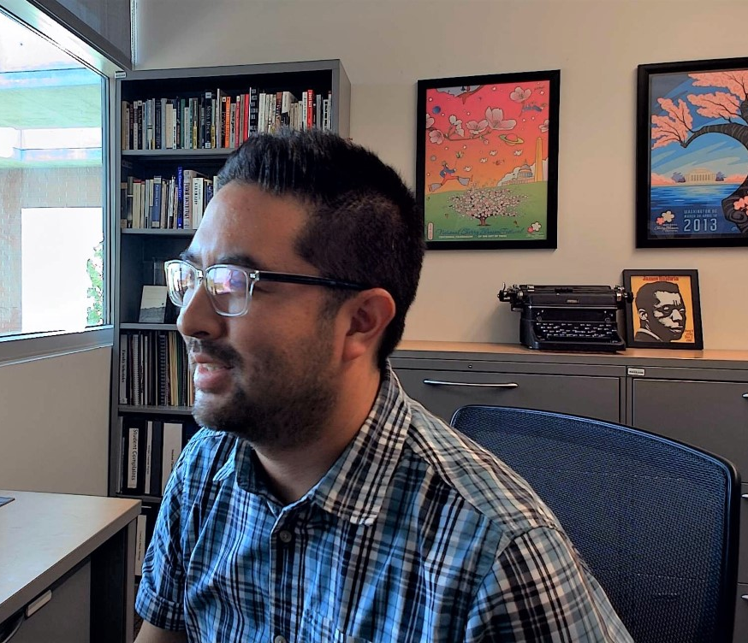
Welcome Dean's Representative!
Scott Kushigemachi (he/him/his)
Associate Dean
Humanities Division

Slide 5
Welcome
The Union
Representative!
Ethan Cohen | Managing, News & Photo Editor

Slide 6
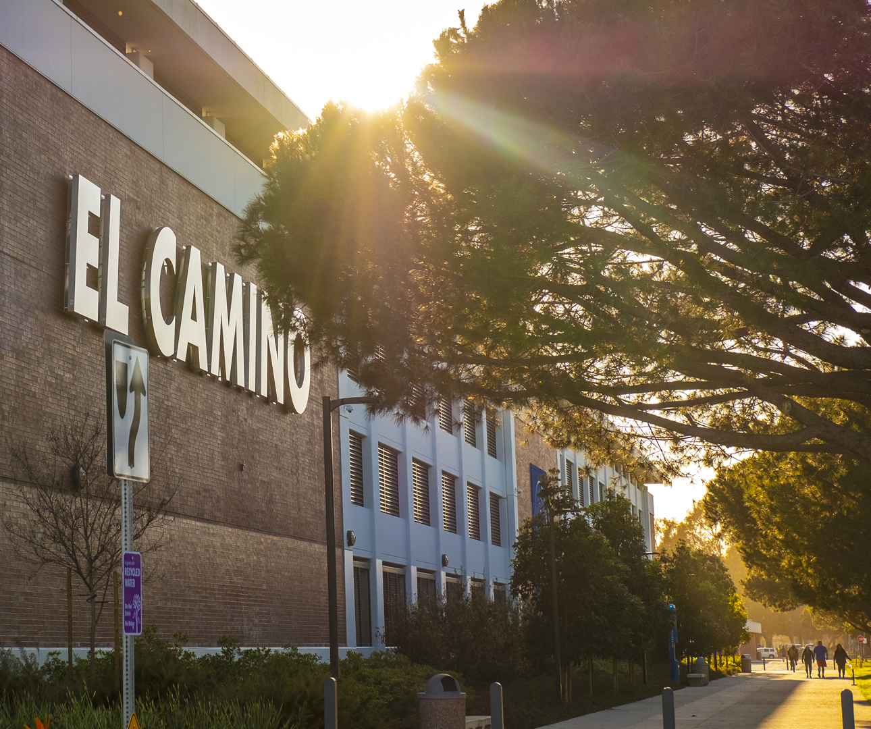
New Business

Slide 7
Proposed Changes to Distinguished Faculty Awards
Packet pages 13-19

Slide 8
Proposed ECC DEIA Statement
Packet page 20

Slide 9
BP/AP 4055/5140
Packet pages 21-27

Slide 10

Information Items

Slide 11
Academic Senate needs volunteers!
Student Success Committee
Campuswide Safety Committee
Faculty Hiring Committees
ODEC

Slide 12
Please welcome the newest member of the Senate Eboard

Slide 13
Introduction of new Guided Pathways Coordinators

Slide 14

New Academic Senate Logo

Slide 15

Educational
Technology Conference

Slide 16
Academic Integrity Committee Updates

Slide 17
Institutional Effectiveness
Announcements
SLO Results Analysis Reports from Fall 2022 are due to be entered in Nuventive by 3 March.
Changes to the Spring 2023 timeline for SLO and PLO assessment need to be submitted by Division Facilitators by 3 March.
PLO Results Analysis Reports from Fall 2022 are due to be entered in Nuventive by 17 March.
Canvas Outcomes Dashboards in Nuventive
SLO Data from Fall 2022 is available in Nuventive for participating gateway courses. It is disaggregated by race/ethnicity, age, gender, and units completed.
Access it at solutions.nuventive.com in the Course SLOs area in the Course Level Results area in split screen as you enter results or the Canvas Outcomes Dashboard tab.
FLEX-eligible trainings on 22 Feb, 1 & 8 March at 1:30pm. Sign up on Cornerstone
Please see the packet for the full report.

Slide 18
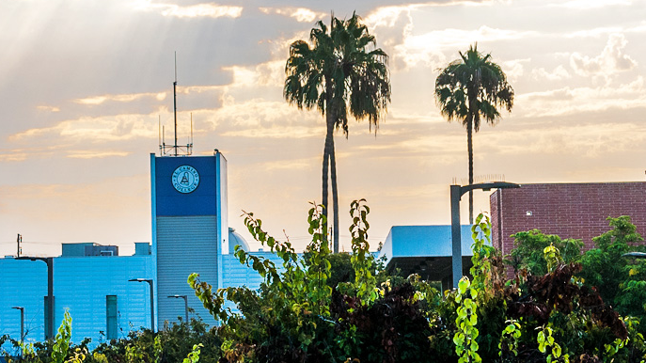
Officer Announcements

Slide 19
Faculty
Development
Please complete Spring PD day survey by 2/24/23
Spring PD materials can be found on PD website
Please see the packet for the full report. ​

Slide 20
Academic
Technology
Announcements
Please see the packet for the proposed meeting agenda items for our first meeting of the semester 2/24 via Zoom.
We also have a seat open for a student representative to sit on our committee.

Slide 21
EDI Standing Committee
Announcements
See packet for the proposed agenda for our first meeting (2/22) of the semester via Zoom.
If you'd like to join us, please email EBrenes@elcamino.edu
Stay tuned for an informational survey.

Slide 22
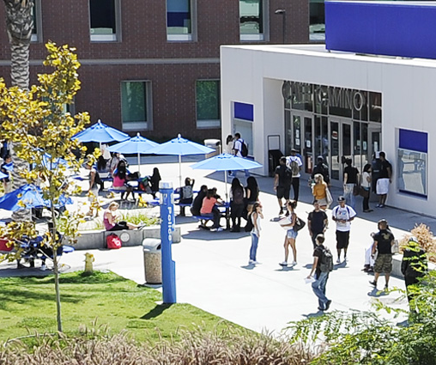
Special Committees

Slide 23
Academic Affairs

Slide 24
Student Services

Slide 25

Public Comments

