Slide 1


Academic Senate Meeting
4-18-2023

Slide 2

Approval of the Minutes from
(4-4-2023)
Packet pages: 6-11

Slide 3
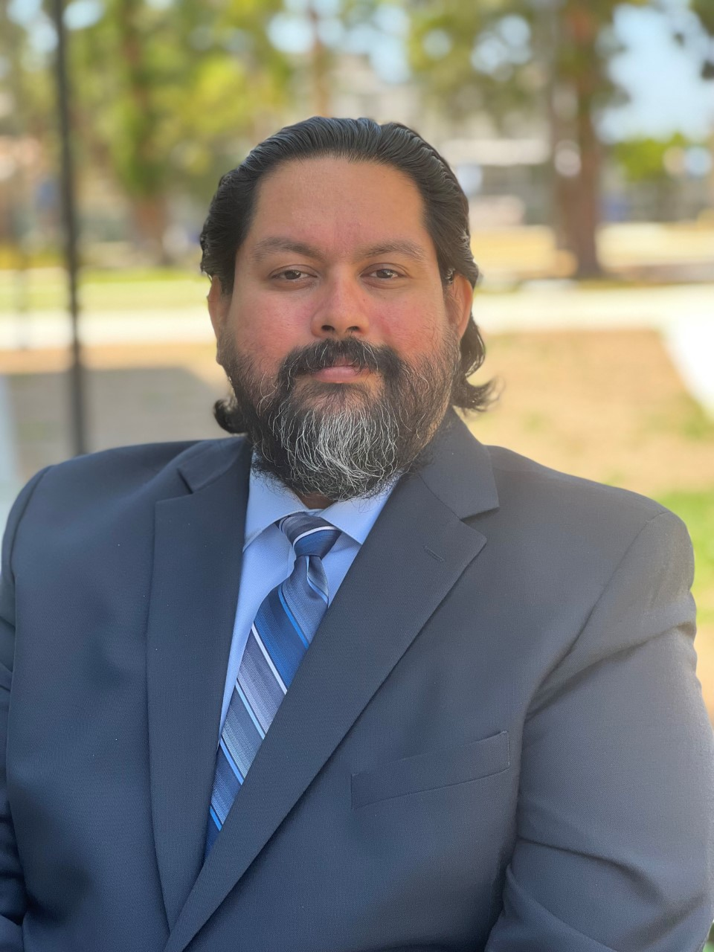
Welcome Dean's Representative!
Gerson Valle| He/Him/His
Associate Dean of Mathematical Sciences

Slide 4
Welcome
The Union
Reps
Samantha Quinonez| her/she
Major: Journalism

Slide 5
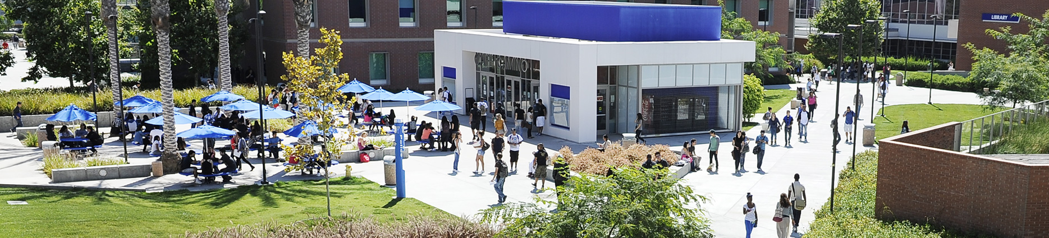
Unfinished Business

Slide 6
2022-2025 ECC Strategic Enrollment Management Plan
Packet pages 12-56

Slide 7
2022-2026 ECC Guided Pathways Workplan
Packet pages 57-82

Slide 8
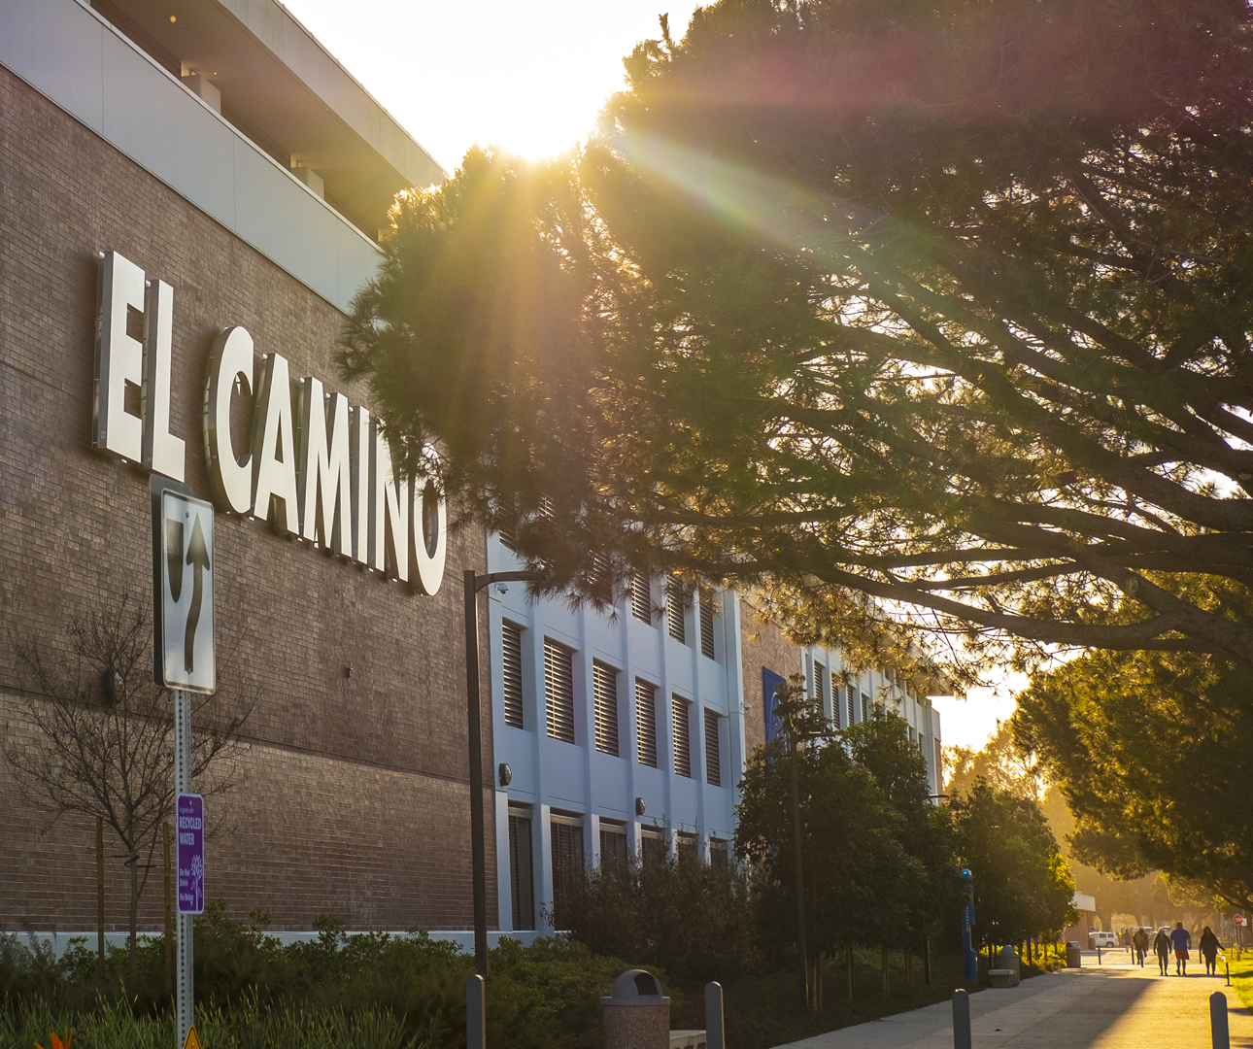
New Business

Slide 9
Call for Nominations, Academic Senate Executive Board
VP Academic Technology
  Stephanie Burnham
VP Educational Policies
  Darcie McClelland
VP Equity, Diversity, and Inclusion
  Erica Brenes
VP Faculty Development
  Anna Brochet
VP Finance and Special Projects
  Josh Troesh
VP Logistics and Communications
  Maria Garcia

Slide 10

Information Items

Slide 11
CIP Update
Packet pages 83-128

Slide 12


Faculty
Development
Announcements
Please complete Faculty Professional Development Needs Assessment by Friday, May 5th
Informed and Inspired, Classroom Climate Change: Leveling-up the Student Experience Post Pandemic
  Panel: Thursday, April 27, 1:15-2:15pm
  Discussion: Friday, April 28, 1:15-2:15pm
College Book Club, Fridays 11am-12pm:
    April 28
    May 19

Slide 13
ASCCC Resolutions
Please send feedback to Darcie (dmcclelland@elcamino.edu) by end of the day on Friday, April 21. Voting will take place on Saturday, April 22.

Slide 14
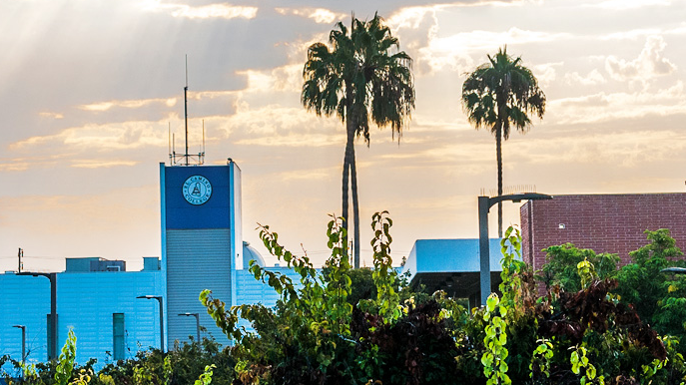
Officer Announcements

Slide 15
Curriculum
Announcements
Please see the packet for the full report.

Slide 16
Educational Policies
Announcements
Please see the packet for the full report.

Slide 17
EDI
Announcements
Please see the packet for the full report.

Slide 18
Finance
Announcements
Please see the packet for the full report.

Slide 19
Academic
Technology
Announcements
Reminder: any feedback for the "Resolution for Faculty in high-tech fields involvement in technology selection" (see packet from 4/4) please email to sburnham@elcamino.edu by 4/20
Please see the packet for the full report.

Slide 20
Instructional Effectiveness
Announcements
Please see the packet for the full report.

Slide 21
Special Committees

Slide 22
Academic Affairs

Slide 23
Student Services

Slide 24

Public Comments

