Slide 1


Academic Senate Meeting
5-16-23

Slide 2
Quick Reminder
Comments/questions not directly related to current agenda item will not be acknowledged until public comment. Additionally, comments/questions on agenda items should contribute to the discussion in a meaningful way. Public comments will be limited to 1 three-minute comment per person per meeting.
The Academic Senate fully respects the time of all our senators and other meeting participants. With this in mind and because of the many items within senate purview that must be addressed each semester, we ask that discussions in senate meetings, even during the public comment period, be limited to topics within/related to the 10+1 purview of the Academic Senate. If your comment is completely unrelated to senate purview (i.e. topics such as salaries/wages, and benefits), you will be kindly asked to hold your comment and advised as to a more appropriate venue to have the conversation.
If you type something in the chat that you would like read aloud, please begin the comment with ***. If your comment does not begin with ***, we will assume it's just for others to read silently and will not acknowledge it publicly.

Slide 3

Approval of the Minutes from
(5-2-23)
Packet pages:

Slide 4
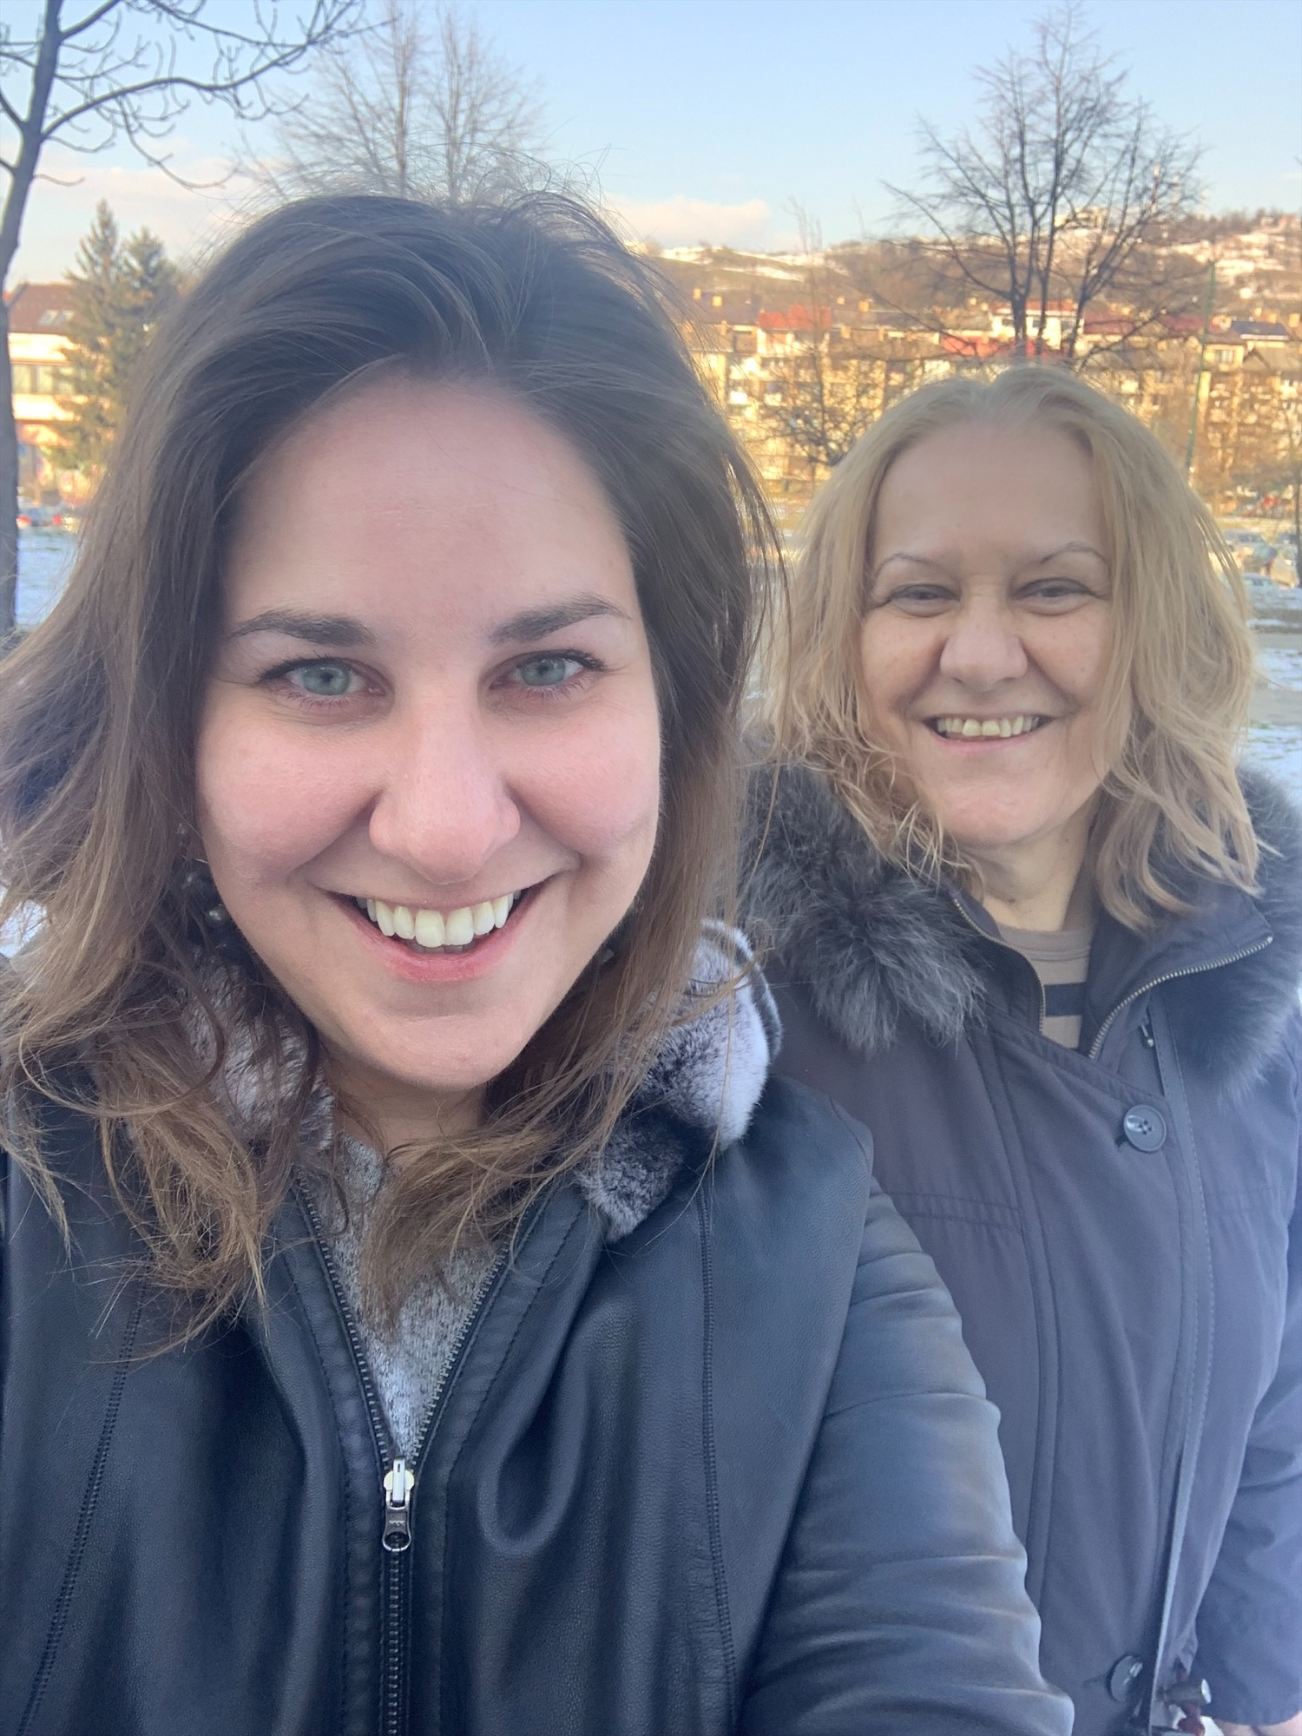
Welcome Dean's Representative!
Irena Zugic | she, her, hers
Associate Dean
Behavioral & Social Sciences

Slide 5
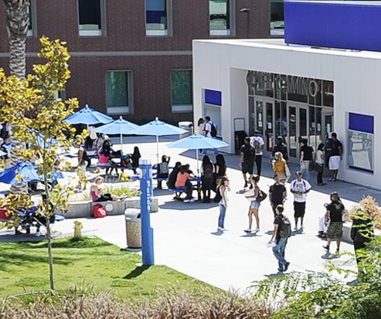
Unfinished Business

Slide 6
Counseling Faculty Evaluation Forms
Packet pages 13-22

Slide 7
BP/AP 4045, Instructional Materials
Packet pages 23-26

Slide 8
Letter to CIP re: Childcare
Packet page 27

Slide 9
Academic Senate Constitution Changes
Packet pages 28-42

Slide 10

Information Items

Slide 11
Student Health Services Update
Packet pages 43-68

Slide 12


Faculty
Development
Announcements
Save the Date for Fall PD Day!: Thursday Aug 24, 2023
  Call out for PD Power up Month Virtual Sessions (8/7-8/23) and Conversations with Colleagues Table Topics (DEADLINE EXTENDED!) due Monday, May 22th
College Book Club, Fridays 11am-12pm:
    May 19

Slide 13
EDI Announcements

Slide 14
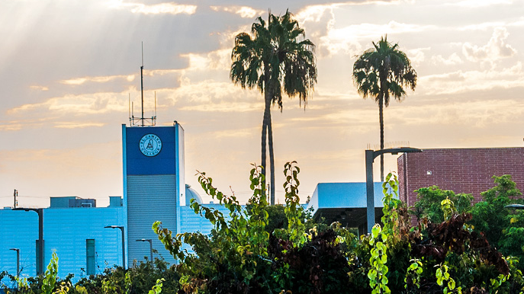
Officer Announcements

Slide 15
Curriculum
Announcements
Please see the packet for the full report.

Slide 16
Educational Policies
Announcements
Please see the packet for the full report.

Slide 17
Finance
Announcements
Please see the packet for the full report.

Slide 18
Academic
Technology
Announcements
Please see the packet for the full report.

Slide 19
Institutional Effectiveness
Announcements
LIVE workshop on Canvas Outcomes TOMORROW!
Come to Humanities 209 at 1:15pm to learn about Canvas Outcomes.
Workshop will be a live, working workshop – bring your laptop! Set up Canvas Outcomes in your Canvas shell to be able to collect SLO data that can be disaggregated.
Earn 1 hour of FLEX credit that counts for equity and DE hours. Register in Cornerstone!
Canvas Outcomes are currently available for all high impact courses that are assessing at least one SLO this semester. In the future, they will be available for all courses.
Please see the packet for the full report.

Slide 20

Public Comments

