Slide 1
Important note:
This file contains the presentation used at the Senate meeting. The president’s informal notes have been added in red.
These notes have not been reviewed nor have they been approved by the Academic Senate; they were created to provide a prompt (but informal) report about the meeting.
For a comprehensive, official accounting of Senate meetings, please refer to Senate meeting minutes: http://www.elcamino.edu/academics/academicsenate/.
Thank you!

Slide 2
ECC Academic Senate October 4th 2016
Please sign in & pick up name card.

Slide 3
Agenda
Call to Order
Approval of Minutes: Minutes were approved. It was suggested that more detail be provided for discussion items.
Officer Reports
Special Committee Reports
Unfinished Business
New Business
Information Items – Discussion
Future Agenda Items
Public Comment
Adjourn

Slide 4
G. Information Items – Discussion:
Many thanks to Greg Toya for agreeing on short notice to present to the Senate on the new Incident Report & Referral Form. He provided an overview of Student Development Office functions and a walk-through of the new online form. The goal of the presentation was to offer a brief overview. More in-depth training and discussion of student conduct will be forthcoming (e.g., in a breakout session at Professional Development Day).
Dr. Gregory J. Toya,
Director, Student Development
Student Conduct Officer
ASO, ICC, Commencement, ASB, Photo ID
Maxient: (The system used to manage the new reporting form.)
New Incident Report and Referral Form:
https://cm.maxient.com/reportingform.php?ElCaminoCollege&layout_id=5

Slide 5
Incident Report & Referral Form A link to the IRRF can be found in the following locations on the ECC website:
Under “I” (Incident Reporting and Referral Form) in the A-Z search http://www.elcamino.edu/siteindex/index.asp#I
Assessment, Intervention and Management for Safety Team (AIMS) http://www.elcamino.edu/administration/vpas/aims/
Faculty and Staff Quick Links page: http://www.elcamino.edu/administration/facstaff/facstaff.asp
SDO
http://www.elcamino.edu/studentservices/activities/sdo.asp

Slide 6
Incident Report & Referral Form A link to the IRRF can be found in the following locations on the Compton Center website:
El Camino College Compton Center
Student Life
Student Services
El Camino College and El Camino College Compton Center Title IX
Office of Staff and Student Diversity
Notice of Non-Discrimination
Sexual and Gender-Based Misconduct
Unlawful Discrimination
How to Report or Make a Complaint of Unlawful Discrimination

Slide 7
Description of Incident Greg provided guidance for documenting the details of an incident.
Document the person’s behavior and actions
Be specific
Include Quotes
Detailed behavior and action
Example:
“Student was disruptive.”
“Student fell asleep in class and started snoring loud enough to make it difficult for other students to hear the class content.”

Slide 8
Case Flow
Faculty action: Faculty have a number of options when submitting an IRRF, which are outlined on the IRRF:
Warning
1-2 day suspension
Campus Police
Submit IRRF and Copy Division Office
Division Office action – Faculty can copy their division on the report.
As appropriate, information will be referred to SDO, AIMS, Title IX, Campus Police, etc.
College sanctions
Legal ramifications

Slide 9
Future and Q and A
Faculty Notification of case status/result
Further training on IRRF
Q and A
Senators were directed to the President’s Report (pgs 12-13 in Senate packet) for a brief introduction of the Incident Report and Referral Form. Many thanks to Renee Galbavy for providing the information.
If faculty don’t have a name or ID# for a student they can provide a description or indicate “unknown” in those areas.
Greg suggested working with the division office to ensure a consistent approach to actions such as removing a student from class. He added that areas like the library and Writing Center may also suspend students from using their services for 1-2 days.

Slide 10
Future and Q and A
Q & A, continued…
In public spaces, such as the library, staff can take photos to include in a report. It’s not clear whether classrooms are public spaces.
If reporting academic integrity violations, it’s useful to attach copies of students’ work.
There will be more clarification forthcoming on how to manage privacy issues when submitting a report.
The Forms A, B, & C were replaced with an online form in recent years. The new IRRF now replaces that form.
Accident reports are distinct from the IRRF.
Sexual assault incidents would be reported to Jaynie Ishikawa.

Slide 11
C. Officer Reports: President Kristie Daniel-DiGregorio
Pages 12-13 in Senate packet.
Please remember to sign in.
Introductions:
Linda Ternes, Associate Dean, Mathematics
Associate Dean Ternes noted that she has been at ECC since 2016, that she previously taught and worked with C-ID (Course Identification System), and that she enjoys working with the faculty in her division.
Charlene Brewer-Smith, Industry & Technology Alternate.
Professor Brewer-Smith will be serving as an alternate for Professor Gebert on the Senate. She is teaching full-time on an interim basis and reported on the strong student outcomes – graduation and licensing rates – for the Cosmetology department.

Slide 12
C. Officer Reports: President Kristie Daniel-DiGregorio
Academic Senate President’s Report. The Academic Senate has a seat at the table for many forums and groups on campus. The President’s Report, in the Senate packet, offers updates and information about what’s happening on campus. She will offer some highlights from the report at the Senate meetings.
Campus-wide Safety Drills:
Earthquake Drill: 10.20.16 @ 10:20 a.m.
New this semester: Emergency Preparedness Drill: 11.9.16 @ 10 a.m. & 7 p.m.
Many faculty and staff have been advocating for an emergency drill to help prepare for an event such as an active shooter. Chief Trevis has worked tirelessly to implement the drill and senators were encouraged to offer their support by helping get the word out.
Like the earthquake drill, the emergency preparedness drill will include Shelter-in-place
But it will differ from the earthquake drill in the following ways:
Lockdown: lock doors from inside; otherwise create obstacles to block intruder’s path into classroom/office.
NO evacuation
Chief Trevis will present @ 11.1.16 Senate meeting.
Senators requested that the date for all drills be advertised before the start of the semester so faculty can schedule classes, assignments and exams accordingly.

Slide 13
C. Officer Reports: President Kristie Daniel-DiGregorio See below for next steps in the review and consultation process for the CMP, which includes the EMP (Educational Master Plan).
Comprehensive Master Plan (CMP) 2017-2020 Timeline for Consultation:
Coming Soon:
President’s Newsletter announcement
Direct email to all employees
Second forum. Faculty are encouraged to attend the second forum (stay tuned for details) – there will be food!
Academic Senate Consultation:
Many thanks to the team that worked diligently over the summer on the Educational Master Plan: Anna Brochet, Claudia Striepe, Josh Troesh, Irene Graff
Review Educational Master Plan at meetings on 10.18.16 & 11.1.16

Slide 14
Legislative Updates The Senate brainstorm activity suggested including discussion of legislative issues. See below for excellent resources. Chris Halligan (Compton) is active in FACC and may be invited to share at a future Senate meeting.
ASCCC: Academic Senate for California Community Colleges - Information on ASCCC positions.
http://www.asccc.org/legislative-updates
FACCC: Faculty Association of California Community Colleges – Follows current legislation, tool for contacting legislators.
http://www.faccc.org/advocacy/
CCLC: Community College League of California: monthly newsletter, legislative tracking, Budget & Policy Center, legislature directory.
http://www.ccleague.org/i4a/pages/index.cfm?pageid=3284

Slide 15
C. Officer Reports: President Kristie Daniel-DiGregorio
Watch the faculty listserv for information about nominating your program for recognition by the ASCCC.
The EXEMPLARY PROGRAM Award: Contextualized teaching and learning
Sponsors: Academic Senate for California Community Colleges (ASCCC) & Foundation for California Community Colleges
ECC Deadline: November 1st, 2016 emailed to kdaniel@elcamino.edu.
Past recipients:
Early Childhood-Math Learning Community
General Bio Hybrid Course
Accelerated Math and English Pathways
Mechanized Agriculture Program

Slide 16
C. Officer Reports: VP Compton Center, Paul Flor
The special trustee has recommended that the Compton Center revert back to local control. It is hoped that the interim chancellor will make a decision by the end of the year or in January.
The Center applied to the IEPI (Institutional Effectiveness Partnership Initiative) for $50K in funding to establish a Leadership Academy.
The Center is completing the second reading of three board policies related to curriculum.

Slide 17
C. Officer Reports: Chair, Curriculum: Allison Carr
College Curriculum Meeting 9.27.16
Full Course Review Approvals
BUS 11
ENGL 78
Allison Carr was unable to attend due to illness. The results of the 9.27 CCC are noted here. To support sustainability efforts, senators will be directed to the CCC minutes online in lieu of including them in the packet.
Consent Agenda Approvals
ATEC 11
CHEM 20
CIS 29
CSCI 30
CTEC 172
EDEV 29
ENGL 98
FTEC 2, 9
MATH 33, 43
PE 220, 257, 290
POLI 1
SUPV 27
More information, including College Curriculum Committee minutes, can be found on the ECC website:
http://www.elcamino.edu/academics/ccc/.

Slide 18
C. Officer Reports: VP Ed Policies, Chris Gold.
Pages 14-15 in Senate packet.
The pace for Ed Policies has been different this year. Rather than several smaller policies, the committee has been focused on a few large policies and procedures. Expect to see policies/procedures related to attendance, copyright (which was discussed in the spring), and intellectual property at future meetings.

Slide 19
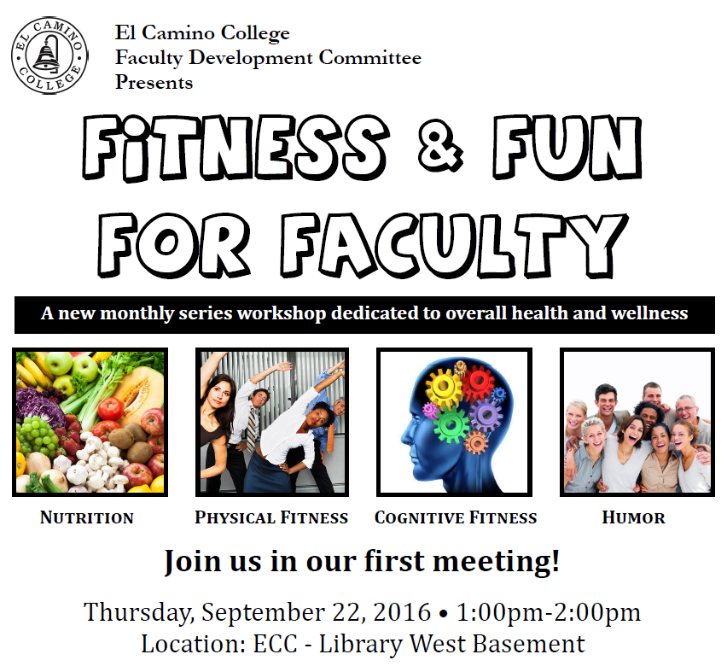
C. Officer Reports: VP Faculty Development, Stacey Allen
Pages 16-19 in Senate packet. Attendance was strong at Fitness and Fun for Faculty. The next event is 10/20 with each workshop focused on physical activity, cognitive fitness, nutrition and humor.
Only 10 days left to nominate faculty for the Outstanding Adjunct Faculty Award. Please consider nominating a colleague! All it takes is a letter of nomination!

Slide 20
C. Officer Reports: VP Faculty Development, Stacey Allen
There were a number of topic ideas that emerged from the Senate brainstorm last meeting. These will be discussed by the Faculty Development Committee (FDC) for future Professional Development Day events.
Pages 16-19 in Senate packet.
Academic Rank: Congratulations to all faculty who achieved new rank in Fall 2016!
The academic rank system appears in the catalog. Faculty who achieved a new rank are included in the packet on pages 19 & 20.

Slide 21
C. Officer Reports: VP, Finance Lance Widman
Professor Widman and Professor Josh Troesh represent the Senate at the PBC (Planning and Budgeting Committee). After 45 years in the classroom and nearly 30 on PBC, Professor Widman is retiring. So, the Senate will need a new rep to serve with Josh. The PBC is an important committee and makes decisions that affect all of us. Senators are encouraged to consider serving. See Lance for more information.

Slide 22
C. Officer Reports:
VP, Academic Technology, Pete Marcoux
Pages 20-24 in Senate packet.
It’s been estimated that WiFi will be installed by the start of the spring semester. The Academic Technology Committee will meet on 10/11. Topics will include the Technology Educational Plan and the Technology Conference in spring semester.
VP, Instructional Effectiveness/ALC & SLOs Update Russell Serr

Slide 23
D. Special Committee Reports
ECC VP of Student & Community Advancement – Jeanie Nishime
Dr. Shankweiler is on an accreditation visit, her first. Dr. Nishime will be on a visit next week – to City College of San Francisco. The visit will determine whether the college is able to retain their accreditation. Dr. Nishime noted that the intent of accreditation is to improve colleges.
The ECC college-wide accreditation committee will soon begin working toward the mid-term report, due next fall. Colleges are required to address outcomes data, including first-time, full-time students’ ability to complete within 150% of the time (e.g., three years for an associates degree). If these rates fall below 15%, there’s cause for concern. ECC rates are approximately 26%; Compton Center is at approximately 13%.

Slide 24
E. Unfinished Business: Senate Meetings & Topics: Brainstorm Results
Senators were thanked for their energy, insights and contributions to the brainstorming session last meeting. The brainstorming summary is in the Senate packet pages 25 & 26. Some proposed next steps were incorporated into the current meeting – more to follow. Suggested next steps include:
Meetings:
Shift agenda – business before VP reports.
Offer more opportunities to interact.
Provide more tutorials, explain terms, limit use of acronyms
Put reports in context of “big picture”
When possible, seek input before representing Senate at meetings.
Legislative updates.
Have deans introduce themselves briefly.

Slide 25
E. Unfinished Business: Senate Meetings & Topics: Brainstorm Results
Topics/Guest Speakers @ Senate:
International Students
Captioning
Program discontinuance.
Dual enrollment.
Enrollment management, including process improvement
Online resources: hybrid classes, Canvas, WiFi
Student Success Initiatives: SSSP, SEP, BSI, MMA/Common Assessment, Financial Aid
Topics for Future Workshops: Some topics require more time than can be allotted in a Senate meeting. Thus, the Faculty Development Committee will discuss incorporating them into future PD Day programs.
Cultural sensitivity training.
Budget: Presentation/workshop on where money goes
Grants
Resources/training on developing certificates and degrees

Slide 26
E. Unfinished Business: Senate Meetings & Topics: Brainstorm Results
A theme in the brainstorming was to disseminate information from the Senate – events, issues, etc.
Strategies for Getting the Word Out:
Exec: There are a number of ways the executive board works toward this goal, including:
Maintain Academic Senate website (Thank you Traci Granger!)
Distribute packets, minutes, PowerPoints to campus
Senators: As representatives of academic divisions, senators are relied upon to share information from the meetings. Some suggestions:
Seek input and report at department & division meetings
Post packet hard copies in mailroom
Forward relevant information to colleagues – individually, through department/division-wide email.

Slide 27
F. New Business: Faculty Handbook, Chris Gold
The faculty handbook was most recently updated in 1987. It should be updated within 6 months of the approval of a contract so we are a little behind schedule (understatement). Much of what is in the handbook has not changed. A notable exception: service awards for men were pewter tankards, pewter bud vases for women. Also, there was a faculty center – an idea that is often mentioned by faculty – where faculty could gather informally.
Chris is forming a steering committee – she will provide much of the legwork but needs the advice of experienced and new faculty. Several examples were displayed (see next slide) and senators were invited to give feedback.
Format:
Online
Hardcopy with links
Hybrid
Questions to consider:
Which format would be most useful?
Most used by faculty?
Most up-to-date?
Most labor intensive to keep up-to-date?

Slide 28
F. New Business: Faculty Handbook, Chris Gold
Traditional hardcopy handbook – Pasadena City College: http://pasadena.edu/faculty-and-staff/docs/faculty-handbook.pdf
Traditional hardcopy handbook – Saddleback: https://www.saddleback.edu/uploads/asenate/documents/FacultyHandbook1213updated.pdf
Online handbook – University of Mary Washington: http://publications.umw.edu/facultyhandbook/
Hybrid (pdf document with the narrative of traditional hardcopy handbook but it opens online with easy to use links) – Los Angeles Valley College: http://www.lavc.edu/facultyhandbook/Faculty-handbook-2014.pdf
Hybrid – Austin Community College: https://drive.google.com/file/d/0B-EwSafm0XzVVjdFOE9lRC0xd1U/view

Slide 29
F. New Business: Faculty Handbook, Chris Gold
Comments included:
Preference for PDF documents. Faculty don’t need another book in their offices.
An icon on the laptop desktop would be especially convenient.
Part-time instructors don’t have laptops, so they would need to access the handbook online.
An online handbook would allow us to track searches to make it easier to know what information was accessed most frequently.
In the Ed Policies committee, counselors felt that it would be useful to have hard copies – they use many print-based resources already.
A PDF can be both printed and online. But an online PDF doesn’t allow us to capture search data.
The FDC suggested that it would be useful to provide limited copies of the handbook in the division offices.

Slide 31
From supporting documents used in the 2012 SBCC discussion of whether or not to switch to plus/minus grading. SBCC now uses plus/minus grading.
For more information visit:
https://drive.google.com/file/d/0B7e8tjX6R0foQURlU01vMWJaSGc/view

Slide 32
G. Information Items – Discussion:
Chris Jeffries, President & Chief Negotiator, El Camino College Federation of Teachers (ECCFT)
Former president, Academic Senate 2014-2016
A number of articles have been sunshined to discuss during negotiations, including Articles 3, 6, 8, 10, 11, 20, & 25. Legislation providing seniority for part-time faculty was recently passed so will need to be negotiated. For salaries, the Federation is looking at comparables for area schools. Negotiations begin 10.14.16 and need to be concluded by December. The Proof newsletter was emailed; hard copies will be delivered soon. To prevent a flood of email traffic on the listserv, the Federation will use a forum like Facebook to keep in touch with faculty. There will be a general meeting in a few weeks. The executive board includes Susanna Prieto, Kyle Strohmaier, Gene Armao, Evelyn Uyemura, and Kelsey Iino. There is still a need to fill some division rep positions. Chris noted that the negotiating team is able to share information about topics being discussed in the negotiations.

Slide 33
Agenda
H. Future Agenda Items
Ed Policies: AP 5070, BP/AP 5010, AP 5011 Admissions and Concurrent Enrollment
Online Educational Resources
Educational Master Plan (10/18 – 1st reading, 11/1 – 2nd reading).
Campus-Wide Emergency Response Drill: Chief Michael Trevis (11/1)
I. Public Comment
L. Widman encouraged faculty to attend a panel from the League of Women Voters organized by the Political Science department for 10.25.16. The League provides non-partisan information about the issues.
D. Berney suggested that a task force be established to consider department chairs.
J. Adjourn

Slide 34
ECC Academic Senate 2016-2017 Thank you for your service!
BSS
Stacey Allen
Kristie Daniel-DiGregorio
Chris Gold
Lance Widman
Michael Wynne
Business
Kurt Hull
Philip Lau
Nic McGrue
Josh Troesh
Compton Ed. Center
Paul Flor
Chris Halligan
Counseling
Anna Brochet
Yamonte Cooper
Rene Lozano
Industry & Technology
Charlene Brewer-Smith (alt)
Ross Durand
Mark Fields
Patty Gebert
Lee MacPherson
Jack Selph
Library Learning Resources
Mary McMillan
Noreth Men
Claudia Striepe
Mathematical Sciences
Megan Granich
Matthew Mata
Jasmine Ng
Benjamin Mitchell
Catherine Schult-Roman
Natural Sciences
Mohamad Abbani
Sara Di Fiori
Troy Moore
Ryan Turner
Anne Valle
Fine Arts
Ali Ahmadpour
Daniel Berney
Diana Crossman
Russell McMillin
Chris Wells
Health Sciences & Athletics/
Nursing
Andy Alvillar
Traci Granger
Yuko Kawasaki
Colleen McFaul
Russell Serr
Humanities
Rose Ann Cerofeci
Ashley Gallagher
Pete Marcoux
Christina Nagao
Adrienne Sharp

