Slide 1
Important note:
This file contains the presentation used at the Senate meeting. The president’s informal notes have been added in red.
These notes have not been reviewed nor have they been approved by the Academic Senate; they were created to provide a prompt (but informal) report about the meeting.
For a comprehensive, official accounting of Senate meetings, please refer to Senate meeting minutes: http://www.elcamino.edu/academics/academicsenate/.
Thank you!

Slide 2


ECC
Academic Senate February 21, 2017
Please sign in & pick up name card.
Happy 70th Birthday ECC: 1947-2017

Slide 3
Agenda
Call to Order
Approval of Minutes: Minutes were approved, with no corrections/revisions.
Officer Reports
Special Committee Reports
Unfinished Business
New Business
Information Items – Discussion
Future Agenda Items
Public Comment
Adjourn

Slide 4
C. Officer Reports: President
Kristie Daniel-DiGregorio
Welcome & Introductions:
New Senators:
  Dr. Renee Galbavy, Psychology (BSS): Dr. Galbavy will be filling Lance Widman’s large shoes as senator from BSS. One of her first steps as senator has been to volunteer for the Distance Education Advisory Committee.
  Charlene Brewer-Smith, Cosmetology (I&T): Professor Brewer-Smith served as an alternate last semester but with Patty Gebert’s retirement in the fall, the I&T faculty support her move to senator.

Slide 5
C. Officer Reports: President
Kristie Daniel-DiGregorio
Welcome & Introductions, continued…
At the senate’s fall brainstorming session, senators requested more opportunities to interact with their fellow senators. So, senators were invited to participate in a “Think-Square-Share” activity which gave them a chance to meet and exchange ideas with other senators. Ideas were gathered with the goal of finding useful ways to continue the exchange of ideas, possibly with a campus-wide newsletter.
Think-Square-Share
1. THINK: 1-2 sentences (see handout). Senators were asked to share “a strategy or approach you use with students to support their success and retention.”
2. SQUARE: Form groups of 4 and share ideas. Choose ONE to share with Senate.
3. SHARE: Introduce ONE idea from group. Want more information later? See/email author.

Slide 6
C. Officer Reports: President
Kristie Daniel-DiGregorio
Reminder: Next Senate Meeting is THURSDAY 3.9.17
KDD noted that the next senate meeting has been moved to Thursday so our Compton colleagues could schedule their Faculty Council meeting during the senate’s typical time slot on Tuesdays. This is to coincide with the accreditation team visit.
Pages 14-17 in Senate Packet
Collegial Consultation at ECC
Minutes from two of the college’s collegial consultation committees were included in the packet: College Council & PBC. For all official meeting agendas and minutes visit:
http://www.elcamino.edu/administration/campus-committees/college-council/index.asp
http://www.elcamino.edu/administration/president/pbc/.
Review “Making Decisions at El Camino College” to learn more about how campus decisions are made, included in Senate Handbook and available at:
https://www.elcamino.edu/administration/ir/docs/planning/MakingDecisionsElCaminoCollege2015.pdf

Slide 7
C. Officer Reports: President
Kristie Daniel-DiGregorio
In an effort to support the senate’s Goal #2 (Strengthen faculty involvement in the activities of the Academic Senate), deans and directors have agreed to include the Academic Senate as a standing agenda item at division and department meetings. Senators were asked to support these efforts by providing updates on senate business and activities and by inviting faculty input and involvement. Senators were reminded that each senator represents 12 FT faculty and that senators are asked to:
Before meetings: Review packet, consult with constituents.
During meetings: Offer comments, input and feedback.
After meetings: Share information and consult with constituents (e.g., share at division/dept meetings, post meeting packet in mailroom).
Institutional Effectiveness Outcomes: Certificates
There has been a recent drop in the number of students earning certificates. Please encourage students to consider certificates. They should see their counselor to make an informed choice and prevent any issues with financial aid.
THANK YOU: Faculty Search Committee Representatives
John Baranski (Library), Sue Dowden (HDEV), Renee Galbavy (History), Janet Young (Poli Sci)
There will be a number of faculty searches this semester and all require senate representation, so please consider serving.

Slide 8

C. Officer Reports: President
Kristie Daniel-DiGregorio
ASCCC Events: Exec Committee meeting was hosted by ECC on February 2nd
Thank you’s:
Dr. Shankweiler for sponsoring lunch & attending.
Chris Gold for helping welcome the team.
Donna Baldwin (Library), Sal Valencia (Media Services), Mimi (Catering), Araceli Palacio Broadhead (VPAA), Sheryl Kimball (ITS), Maria Cortez (BSS), Debbie Turano & Robert Brobst (Facilities).

Slide 9
C. Officer Reports: President
Kristie Daniel-DiGregorio
ASCCC Events: Upcoming
Minimum Qualifications Workshop South, March 10.
Spring Plenary: April 20-22. (Please see Kristie if you are interested in attending the Spring Plenary.)
Instructional Design and Innovation, March 17-18.
CTE Leadership Institute, May 5-6.
Legislative Advocacy Day, May 9.
Faculty Leadership Institute, June 15-17.
Curriculum Institute, July 12-15.
More info: www.asccc.org.
Apply through your division office for funding through the District-Wide Conference Committee.

Slide 10
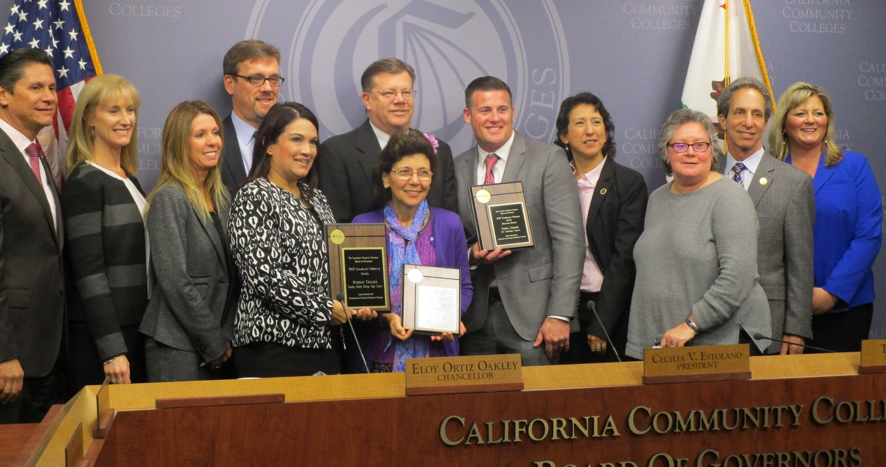
Congrats ECC Educational Development Department!
Honorable Mention, Exemplary Program Award from the CCC Board of Governors.
Professor Land will present @ Instructional Design & Innovation Institute offered by the ASCCC, March 17 & 18 in San Jose.
Professor J. Land, EDEV

Slide 11
C. Officer Reports:
VP Compton Ctr., Paul Flor
Vice President Flor was engaged in activities at the Compton Center so was unable to provide a report.

Slide 12
C. Officer Reports:
Chair, Curriculum: Allison Carr
Professor Carr noted that CCC meetings are open to all and are held the 2nd and 4th Tuesday each month, 2:30-4:30 in Admin 131.
College Curriculum Meeting 2.14.17
Consent Agenda Approvals
AJ 100 Intro to Administration of Justice
AJ 103 Concepts of Criminal Law I
NURS 48 Dosage Calculations
NURS 118 Respite Care for Children and Adolescents
More information, including College Curriculum Committee minutes, can be found on the ECC website:
http://www.elcamino.edu/academics/ccc/.

Slide 13
C. Officer Reports:
VP, Ed. Policies, Chris Gold
3710 BP/AP Securing of Copyright and Intellectual Property (new)
4020 BP/AP Program, Curriculum & Course Development
4022 AP Course Approval (new)
4102 AP Career and Technical Training (new)
4103 AP Work Experience (new)
4115 BP Limitation of Remedial Coursework
4222 AP Remedial Coursework (new)
4226 BP Multiple and Overlapping Enrollment (new)
4227 BP Repeatable Courses (new)
4230 BP/AP Grading and Academic Record Symbols (AP new)
4236 BP/AP Credit by Exam (AP new)
4250 BP/AP Probation Dismissal and Readmission
4300 BP/AP Field Trips and Excursion
5010 BP/AP Admissions
5011 AP Concurrent Enrollment
5031 AP Instructional Materials Fees (new)

Slide 14
C. Officer Reports:
VP, Ed. Policies, Chris Gold
Additional EPC Goals for Spring Semester:
Expand membership
Advanced Placement Tests and Units
Minimum Qualifications
Ed Policies Committee meets
2nd and 4th Tuesday – SOCS 123
1-1:50 pm
The Ed Policies Committee will be busy this semester, supporting the college’s efforts to update existing policies/procedures and develop new ones that are legally required. Like CCC, EPC meetings are also open to all and the committee needs additional representatives. Contact Chris Gold if you are interested.
The committee may also consider inserting policies related to recording classroom activities, given the recent concerns that have emerged in local colleges. It was noted that Ed Code prohibits recording without instructor permission and suggested that faculty consider including a statement on their syllabi.

Slide 15
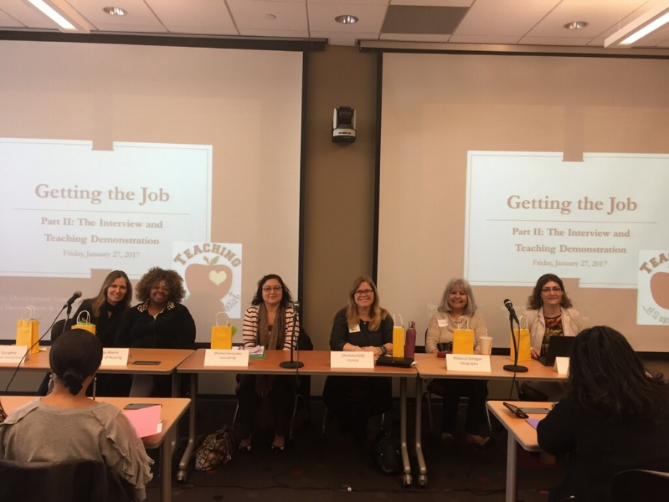
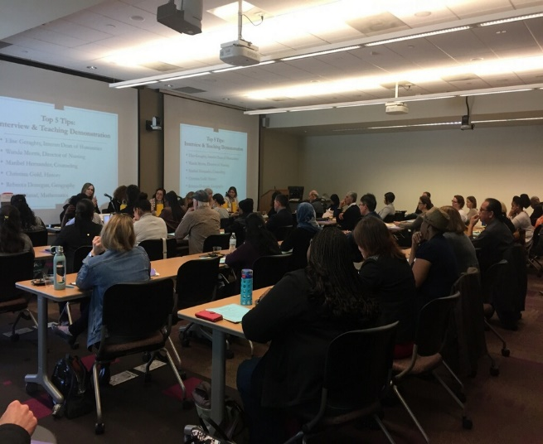
C. Officer Reports:
VP Faculty Development,
Stacey Allen
Getting the Job, Part II: The Faculty Interview, January 27th 2017
Not to be outdone by the other VPs, VP Allen noted that FDC meetings are also open to all and held 2nd & 4th Tuesdays, 1-2 in the library basement. She thanked Dr. Shankweiler and Dr. Maloney for their support of the first, annual tenure reception. New this semester is a workshop series, “Informed and Inspired” the 1st and 3rd Thursday 1-2 in the library basement. The first topic will be “RISE and Shine” focused on the RISE Center. The Getting the Job workshop (pictured here) was a success – thanks to all who participated!

Slide 16
C. Officer Reports:
VP, Finance & Special Projects, Josh Troesh
  Pages 18-23 in Senate packet.
Professor Troesh has agreed to step into Lance Widman’s large shoes and is our newest VP. Prop 98 is being reduced which means a potential loss of $750 million for ECC. The CMP was discussed at PBC and emphasizes a future vision with practical steps for achieving that vision. The Foundation is in need of readers for scholarships. KDD noted that, at Pete Marcoux’s request, the Foundation will provide writers feedback on the outcomes of their students’ applications.
The senate needs an alternate for the PBC – please see Josh if you are interested. This is an important role, supporting our collegial consultation process and providing faculty representation.
VP, Academic Technology, Pete Marcoux
The wifi installation has begun. The Academic Technology Committee is scheduled for March 31st and interest surveys were sent to all faculty. VP Marcoux’s eyes sparkled (and it’s suspected that his heart rate increased, though this was not confirmed) as he reported on a google conference he attended over winter. He was able to test drive new gadgets and gizmos, including Sonic, 72” touch-screen tabletops. He has invited some of the vendors to attend the Technology Conference. (Come to the conference and you, too, can experience sparkly eyes and an increased heartrate.)
VP, Instructional Effectiveness/ALC & SLOs Update Russell Serr
  Pages 24-28 in Senate packet.
The Program Review committee is seeking two new members. This is an excellent way to learn about programs on campus. The slides that follow provide updates on the many activities related to assessment and planning.

Slide 17
Assessment of Learning Committee
2016 – Critical thinking ILO completed 1,422 students from 41 sections participated in the assessment, disaggregated data analysis found weakness in analyzing and drawing conclusions. Evidence of gap for African-American students and students with indicated disability. Gaps for African-American students is being addressed by many of the student Equity initiatives currently in process.
2017 – Community and Personal development

Slide 18
Academic Senate SLO Symposium
Over 100 attendees
  Uses for TracDat – Student Equity Proposals
  Hot topic = Disaggregating SLO/PLO/ILO data
    ECC and others have done with ILO assessments
    ECC pilot with English in 2017
    Overload for IR, more to come

Slide 19

SLO/PLO assessments
Fall 2016 Assessments- Due: March 3
  Workshops March 1 & 2

Slide 20
Program Review
2017 Orientation – March 16 1:00-2:00, TLC area in library basement
2017 – Created a new Program review electronic template to help with organization and formatting.

Slide 21
D. Special Committee Reports
ECC VP of Academic Affairs – Dr. Jean Shankweiler.
As noted in Dr. Shankweiler’s letter to all faculty before the start of the semester, a number of efforts are underway to support enrollment management. Dr. Shankweiler made a presentation at the 2.21.17 Board of Trustees meeting. The goal for winter was 200 sections – 224 were offered. The goal was 800 FTES – a total of 827 FTES enrolled. Despite this progress, the college is very likely to go into stabilization at the end of this year to allow us to reset since we can no longer borrow from summer enrollments to make our cap. As noted by VP Gold, we have a number of policies and procedures we’re working on. Dr. Shankweiler commended the faculty and the Program Review Committee for the improved quality of recent reviews. Please consider serving on the Enrollment Management Committee, which currently has only two faculty representatives. Contact Dr. Shankweiler to express your interest.
ECC VP of Student & Community Advancement – Dr. Jeanie Nishime
The Accreditation Mid-Term Report went to the Board of Trustees 2.21.17 for information. An electronic copy was provided to all senators and the senate (represented by your humble servant KDD) has provided input. This report focuses on the 11 recommendations from the accreditation team as well as the goals identified by the college. Please provide any feedback to Dr. Nishime by March 10th – the report is due March 15th.
Unfortunately, the college was not successful in it’s application for a CA Promise Grant for $750K. However the college still plans to expand the program from 60 students currently to 500 in fall 2018. Each student would be in a learning community cohort. The Foundation will lead the fundraising efforts (so if Andrea Sala asks you for money, please say yes). For more information about the ECC program: http://www.elcamino.edu/studentservices/fye/South%20Bay%20Promise%20Page.asp

Slide 22
E. Unfinished Business: None

Slide 23
F. New Business: Review Senate Goals for 2016-2017
Pages 29-30 in Senate packet.
Members of the executive board provided an overview of progress toward the senate’s goals for the year, which are summarized in the following slides and appear in the senate packet. Thank you to all who have participated, contributed and led these efforts!
Theme: “Effective and Engaged Senate”; goals reflect commitment to ECC’s Strategic Initiative C: Collaboration.
1. Ensure full faculty involvement in decision-making related to academic and professional matters (BP 2510)
Progress:
  Representation: Hiring, collegial consultation, and campus committees. Alternate for PBC needed for spring 2017.
  Planning: Senate consulted on ECC EMP, CMP, TMP and Compton Center Self-Study and CMP.
  Officers: New Secretary, VP Faculty Development, VP Finance & Special Projects, election of Curriculum Chair. Additional elections upcoming in spring 2017.
  Senators: Census indicated need for +1 LLR senator, -1 BUS senator. Nine new senators in fall, 2 in spring.

Slide 24
F. New Business: Review Senate Goals for 2016-2017
…continued
1. Ensure full faculty involvement in decision-making related to academic and professional matters (BP 2510)
Faculty Handbook: Models reviewed and input sought from Ed Policies Committee, Faculty Development, Academic Senate, Council of Deans, new faculty, and administrative assistants. C. Gold liaising with relevant offices; anticipated completion F17.
Collaboration with AFT: presentation at 10.4.16 meeting, C. Gold and Ed Policies updating Appendix G, presidents collaborate.

Slide 25
F. New Business: Review Senate Goals for 2016-2017
2. Strengthen faculty involvement in the activities of the Academic Senate
Progress
  Orientation: Senate Handbook updated, orientation @ 1st meeting, “ECC Acronyms” included in packets.
  Communication with all faculty: Packet front matter streamlined, packets and meeting notes distributed to all faculty and posted on Senate website.
  ECC faculty encouraged to participate in statewide awards and events (e.g., Exemplary Program and Hayward Awards, ASCCC institutes).
  Expanded faculty learning opportunities offered through new initiatives (e.g., “Fitness & Fun” workshop series, “Dreamers 101” forum).
  Faculty reps recruited for new campus initiatives (e.g., Process Improvement, Dreamers Task Force).
  Initiatives underway to involve faculty earlier in process of developing ed policies (e.g., establishing dean/faculty working teams).
  ADDED: Senate meetings posted to ECC calendar.

Slide 26
F. New Business: Review Senate Goals for 2016-2017
…continued
2. Strengthen faculty involvement in the activities of the Academic Senate
Participation of senators:
brainstorming session implemented & input incorporated into packet (e.g., “ECC Acronyms”), meetings (e.g., dean introductions, campus safety, Canvas), workshops (e.g., new “Informed & Inspired” workshop series), and campus-wide events (e.g., Spring PD Day).
Senators provided leadership for EMP, OEI, FACCC, and regional meetings of ASCCC.
Senators provided leadership for “Dreamers” event & visit by ASCCC executive board.
ECC deans to include Academic Senate on agenda for all division-wide, dept meetings; senators asked to convey updates.

Slide 27
F. New Business: Review Senate Goals for 2016-2017
…continued
2. Strengthen faculty involvement in the activities of the Academic Senate
Senate Office relocation: Completed and communicated. In progress: signage and reminders to campus. .
Tenure recognition: With ECC President and VPAA, Senate initiated annual tenure reception at 2017 Spring PD Day. 14 honorees received a gift, provided by Academic Senate and VPAA.

Slide 28
F. New Business: Review Senate Goals for 2016-2017
3. Support the college’s institutional effectiveness goal that more students from our diverse communities will attain educational success and achieve their academic goals.
Progress
Enrollment management: FDC collaborating with VPAA on interventions to support success and retention, ECC VPs providing ongoing updates on EMP efforts, additional presentations scheduled for spring semester.
Support Compton Center’s accreditation: Senate reviewed self-study and CMP & endorsed unanimously. March Senate meeting rescheduled, Senate president to attend Faculty Council, Faculty Council president on ECC eboard, handbook shared as model.

Slide 29
F. New Business: Review Senate Goals for 2016-2017
…continued
3. Support the college’s institutional effectiveness goal that more students from our diverse communities will attain educational success and achieve their academic goals.
Awareness and involvement in initiatives related to student success, equity, enrollment, retention and completion:
Statewide initiatives incorporated into new Informed & Inspired workshop series (e.g., The RISE Center).
Regular updates from Student Success Advisory Committee.
Collaboration with Dreamers Task Force is ongoing.
Spring 2017 meetings: Discussion of statewide initiatives and their implementation (Multiple Measures Assessment Program, Strong Workforce Project, etc.)

Slide 30
F. New Business: ECC Comprehensive Master Plan
Pages 31-41 in Senate packet.
Irene Graff, Institutional Research & Planning

Slide 31
Comprehensive Master Plan 2017
Irene Graff noted that the CMP is composed of four detailed plans, all of which have been through the consultation process. The Staffing Plan was finalized in December, which didn’t allow sufficient time to consult during the fall. That’s why the plan is coming to the senate now. The staffing plan was based on a consultants’ report, a link to which is provided in the senate packet. The college Planning Summit will be April 21st – the senate’s engraved invitation is in the mail.
Educational Master Plan
Facilities Plan
Staffing Plan
Technology Plan

Slide 32
Staffing Plan
Review of staffing levels by employment category
  Past, Present, Future
Staffing considerations
  Aging workforce
  Employee turnover & retention
Professional development
Recommended planning agendas

Slide 33
Next Steps
Proceed to Phase II – integrated planning to the “program” level across the College
Development of the Implementation Plan, including integration into the annual planning and resource allocation process
Finalize an annual evaluation process for marking progress and ensuring a “living” plan that can change to respond to emerging needs

Slide 34

G. Information Items -- Discussion: Dreamers Task Force Update
Pages 42-43 in Senate packet.
Senate Efforts:
Resolution of Support for All Students
Dreamers 101 workshop (12.1.16): +44 faculty/staff
Post-Election Task Force: Faculty reps include Rene Lozano, Cynthia Cervantes (CDEV), Kristie Daniel-DiGregorio

Slide 35
G. Information Items -- Discussion: Dreamers Task Force Update
Pages 42-43 in Senate packet, Board of Governor’s Resolution
All CCCs “open, safe and welcoming to all students who meet minimum requirements…regardless of immigration status…financial aid remains available to certain undocumented students.”
Administration urged to continue DACA in which students brought to the US by parents have “reprieve from deportation.”
CCCO will release no student info related to immigration status without warrant, subpoena, court order or student permission.
CCCO will not cooperate with efforts to create registry based on characteristics such as religion, national origin, race, or sexual orientation;
Encourage districts to ensure students can receive education regardless of immigration status.
Encourage districts to consider CCC values when from government agencies request assistance enforcing immigration law or student information,
Vigorously advocate at every level of government to protect our students and our system’s values.

Slide 36
G. Information Items -- Discussion: Dreamers Task Force Update
Rene Lozano (Counseling)
Senator Rene Lozano, who is providing leadership for efforts to support undocumented students, gave an update on progress by the Dreamers Task Force (chaired by Dean Dipte Patel). He noted that, currently, 66% as many students have applied for Dream Act funding compared to last year. (See http://www.latimes.com/local/education/la-me-dream-act-applications-trump-20170222-story.html for more information.)
AB540 Task force was created by President Maloney to streamline all programs and services that can better serve our undocumented population. We met at the end of Fall 2016 semester.
The AB540 webpage was added to the main ECC page to increase visibility to all new and continuing students (originally housed on the FYE webpage.) Additionally, other programs have added links to this page as well such as EOPS, financial aid, transfer center, etc.
Financial Aid has increased the number Dream Act application workshops offered to students and flyers were distributed at flex but more information is available online at the financial aid webpage and ECC campus calendar of events.
FYE and Transfer Center faculty and staff hosted a Saturday Dream Act application on Saturday, January 28th.

Slide 37
G. Information Items -- Discussion: Dreamers Task Force Update
Rene Lozano (Counseling)
The “FAQ” pdf was approved a couple of weeks ago and is now available for download for our undocumented student population online at the ECC AB540 page.
Our next “student event” is happening next Tuesday, Feb 28th from 5-7pm in the Alondra Room
Three grad interns from USC, LMU, and CSUDH have begun working on the undocumented resource handbook for ECC students. There are many resource handbooks out there but we want something that is more local to our neighborhood as well as national resources.

Slide 38

Professor Rachel Williams (Humanities) &
Chris Dela Cruz (Student Development)

Slide 39
Professor Rachel Williams (Humanities) &
Chris Dela Cruz (Student Development)
Professor Williams and Mr. Dela Cruz asked faculty to let students know about their efforts to create safe spaces for students to talk about and discuss their experiences. A workshop series begins this Thursday, February 23rd, 5:30-7 pm in the Alondra Room (see previous slide for details). Student are anxious to share and find a sense of community with fellow students on campus. This gives students resources for civic engagement, mental health and more. Students are welcome to come join conversations on topics regarding but not limited to race, ethnicity, gender, sexuality, religion, etc. Panelists will include Dr. Barbara Jaffe and Dr. Jan Schaeffer. Facilitators are needed – please email rawilliams@elcamino.edu if you are willing to serve.
If you are reading this, send an email to kdaniel@elcamino.edu to receive a gift card for a coffee break. The first to respond will be our winner! It pays to stay informed!

Slide 40
Agenda
H. Future Agenda Items
Ed Policies: BP/AP 4230 Grading and Academic Symbols
Student Success Initiatives (SSSP, SEP, BSI, BSSOT, MMA, etc.)
Enrollment Management Plan, including Dual Enrollment Initiatives
Strong Workforce Program
I. Public Comment
J. Adjourn

