Slide 1
Important note:
This file contains the presentation used at the Senate meeting. The president’s informal notes have been added in red.
These notes have not been reviewed nor have they been approved by the Academic Senate; they were created to provide a prompt (but informal) report about the meeting.
For a comprehensive, official accounting of Senate meetings, please refer to Senate meeting minutes: http://www.elcamino.edu/academics/academicsenate/.
Thank you!

Slide 2

ECC Academic Senate
September 6th 2016
Please sign in & pick up your name card.

Slide 3
A. Call to Order
Introductions:
Name
Department
Number of years of service to the Senate.
Our longest serving senator is Lance Widman with 30 years of tenure. Many thanks to Lance for his long service!

Slide 4
A. Call to Order
Welcome New Senators!
Anna Brochet (Counseling)
Mary McMillan & Noreth Men (Library Learning Resources)
Diana Crossman (Fine Arts)
Yuko Kawasaki (Health Sciences & Athletics/Nursing)
Adrienne Sharp (Humanities)
Jack Selph (Industry & Technology)
Catherine Schult-Roman (Mathematics)
Troy Moore (Natural Sciences)
Thanks to all who helped recruit: P. Marcoux, R. Serr, C. Striepe, S. Di Fiori.

Slide 5
A. Call to Order
Handouts:
Academic Senate Handbook (& Post-its to mark pages)
ASCCC Membership Card
Party favor: Human Development Pencil
You may need to share:
  Meeting Packet
  Clicker

Slide 6
Agenda Order of business was changed to discuss Senate Orientation.
A. Call to Order
B. Approval of Minutes
C. Officer Reports
D. Special Committee Reports
E. Unfinished Business
F. New Business
G. Information Items – Discussion
  Collegial Consultation Committee Orientation: Academic Senate
H. Future Agenda Items
I. Public Comment
J. Adjourn

Slide 7
ECC Academic Senate Handbook (table of contents, second pg.)
SENATE ORGANIZATION
ECC Senate Constitution & By-laws
Compton Center By-laws
Curriculum Committee By-laws
SENATE SUBCOMMITTEES, FEDERATION, AND PROCESSES
Subcommittees: Educational Policies, Program Review, Curriculum, Faculty Development
COLLEGIAL CONSULTATION
Making Decisions at El Camino College 2015-2020

Slide 8
Academic Senate Orientation
Clicker Orientation
Clickers are already ON.
Only press NUMBER of your answer – do not press MENU or ENTER or any other buttons.
Answer will appear on screen then disappear.
Check mark indicates your answer was recorded – it does NOT mean you were correct.
Change answers as many times as you’d like until polling closes.
Got a strange message on your screen? Press MENU until you see “Channel 41.” Let screen clear and enter your answer.
Please return your clicker to the case before leaving.

Slide 9
Academic Senate Orientation
Senate Orientation follows (through slide #22).

Slide 10
Why does ECC have an academic senate? In other words, which of the following organizations empowers the ECC academic senate?
ECC Board of Trustees
The state Chancellor’s Office
The state government
Correct answer: C.

Slide 11
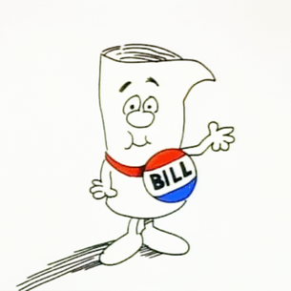
Academic Senate Authority
Handbook, pgs 1-3.
State Law:
(AB 1725, 1988) Community College Reform Act.
Education Code:
Title 3 Postsecondary Education
Title 5:
Rules to implement Ed Code by Board of Governors
The Academic Senate is “an organization whose primary function is to make recommendations with respect to academic and professional matters.” 53200 Title 5

Slide 12
Academic & Professional Matters
Curriculum, including establishing prerequisites.
Degree and certificate requirements.
Grading policies.
Educational program development.
Standards or policies regarding student preparation and success.
College governance structures, as related to faculty roles.
Faculty roles and involvement in accreditation processes.
Policies for faculty professional development activities.
Processes for program review.
Processes for institutional planning and budget development.
Other academic and professional matters as mutually agreed upon.
= 10 + 1 Purview of the Academic Senate

Slide 13
Senate Leadership and Committees Handbook, pg. 4 & pages 33-49
Senate
President
Curriculum Chair
Curriculum Committee Chair
VP of Technology
VP Finance & Special Projects
VP Faculty Dev’t
VP of Educational Policies
VP of Compton Educational Center
Educational Policies Committee Chair
Senate Secretary
Sits on campus-wide Planning & Budgeting Committee
Faculty Dev’t Committee Chair
Compton Faculty Council Chair
Academic Technology Committee
VP of Instructional Effectiveness
Co-Chairs the Academic Program Review Committee and sits on the Assessment of Learning Committee
Traci
Granger
Allison Carr
Pete Marcoux
Stacey Allen
Paul Flor
Chris Gold
Lance
Widman
Russell Serr

Slide 14
When the ECC senate votes on a policy that falls within its 10+1 purview, its word is the final word.
True
False

Slide 15
Collegial Consultation
Handbook, pages 1-3
False.
Governing boards must consult collegially with the Academic Senate on academic and professional matters through a process of “rely primarily” or “mutual agreement” with the Academic Senate. (Title 5)
“The Board will normally accept the recommendation of the Academic Senate on academic and professional matters… If the district Governing Board of Trustees disagrees with the recommendation of the Academic Senate, representatives of the two bodies shall have the obligation to meet and reach mutual agreement…” (ECC Board Policy 2510).

Slide 16
The senate and the union purviews are entirely separate and the two organizations must not intermingle.
True
False

Slide 17
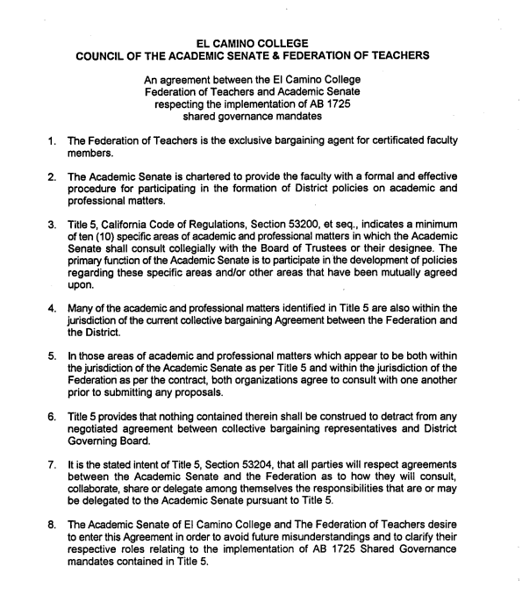
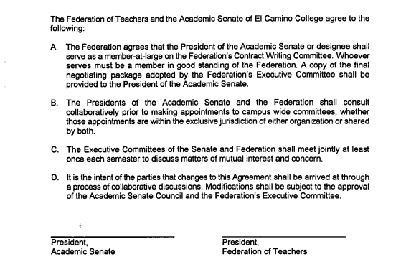
False. Separate and Overlapping Purviews of Academic Senate & Federation
Academic
Senate
10+1 Academic
and professional
areas
Federation
Workload
Working hours
Salary
Benefits
Sabbaticals,
Flex
Obligations,
Faculty
Evaluation,
SLOs,
Tenure
Review…..
Agreement between Academic Senate & Federation, Handbook, pgs. 3, 50-51.

Slide 18
The ECC Academic Senate is composed of senators, the exec board, and our administrative collaborators (aka ex officio members such as VPAA, VPSCA)
True
False

Slide 19
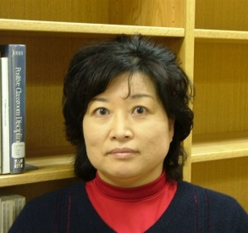
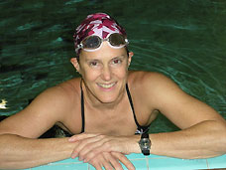
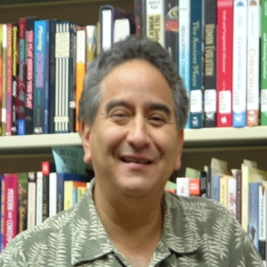

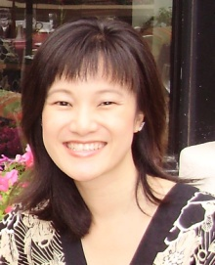
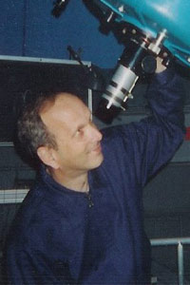
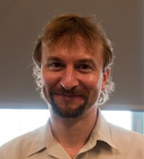
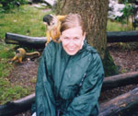
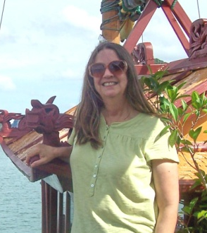
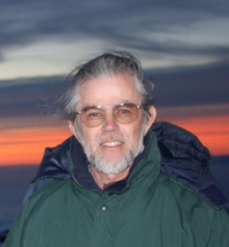
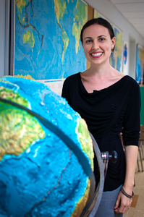
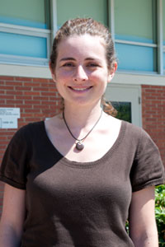
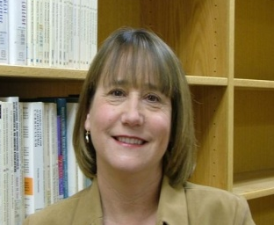
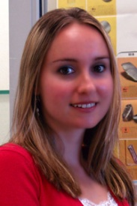
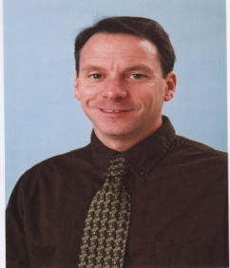
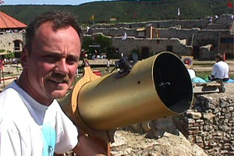
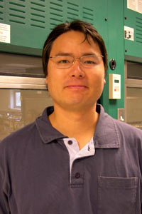
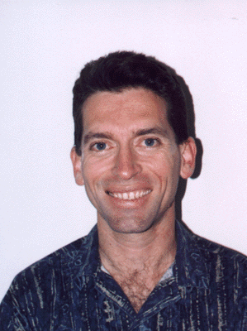
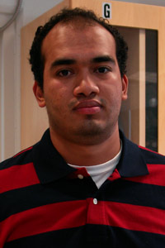
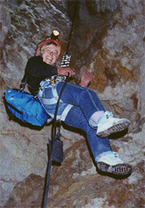
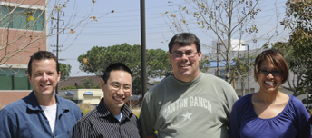
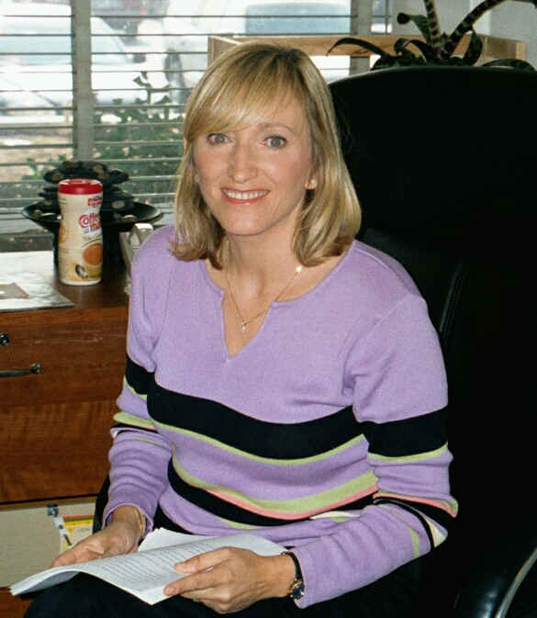
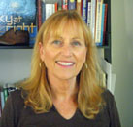
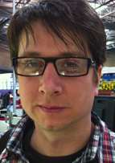
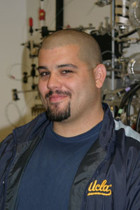
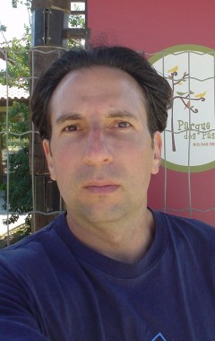
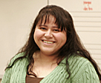
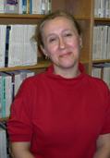
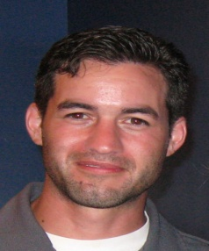
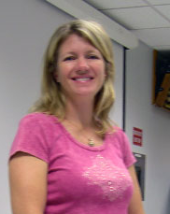
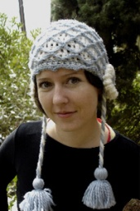
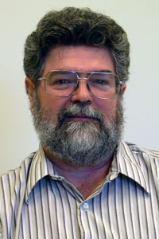
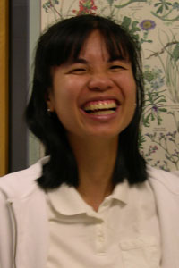
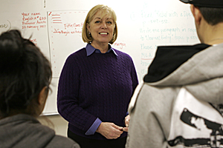
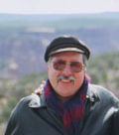
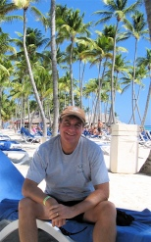
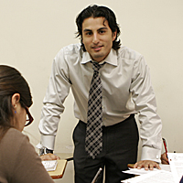
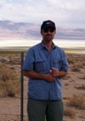
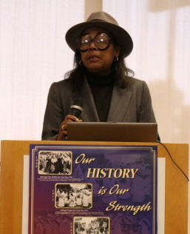
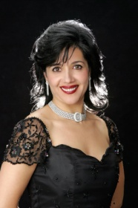

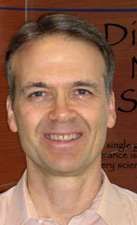
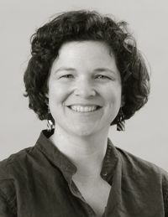

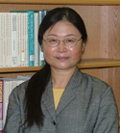
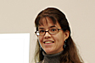
False. All ECC Faculty are Members of the ECC Academic Senate. (Senators are the only voting members.)

Slide 20
How long is the term for a senator on the ECC Academic Senate?
Three years
Four years
Lifetime

Slide 21
Senators
Constitution, Article III, Section I.
(Handbook, pgs 7-9)
Three-years.
Full-Time Faculty:
  One senator for every 12 Full-Time Equivalent Faculty (FTEF) -- minimum of two per division.
  47 FT senators represent approximately 575 FT faculty.
Adjunct Faculty:
  2 adjunct senators represent 335 PT faculty.

Slide 22
Senators
Constitution, Article III, Section I.
(Handbook, pgs 7-9)
Attendance: Senators are expected to attend all regularly scheduled senate meetings. A senator may be removed for excessive absences. Article III, Section 1.10.
Participation in Meetings:
Before meetings: Review packet, consult with constituents.
During meetings: Welcome comments, input and feedback. Roberts Rules of Order (handbook, pg.52-54). Thank you for minimizing distractions!
After meetings: Share information and consult with constituents (e.g., share at division/dept meetings, post meeting packet in mailroom).
Consider joining a Senate committee.

Slide 23
The Packet
Page 1:
Senators & terms, executive board. Any corrections? Senior senators for Math? Natural Sciences?
Page 2:
Purpose, 10 + 1.
Senate & Campus Committee meetings and representatives. Meetings are open – confirm details with chair.
Page 3:
Agenda & Table of Contents
Minutes - information, context for decision-making.
Action items – please review before meeting.
Note: Only “no’s” and abstentions are recorded.

Slide 24
Agenda Order of business was resumed with approval of minutes. Minutes were approved as amended.
A. Call to Order
B. Approval of Minutes
C. Officer Reports
D. Special Committee Reports
E. Unfinished Business
F. New Business
G. Information Items – Discussion
H. Future Agenda Items
I. Public Comment
J. Adjourn

Slide 25
C. Officer Reports
a. President (pgs. 13-21)
New Meeting Location for 2016-2017: DE 166.
  More central, smaller, further from construction.
Will experiment with room set-ups and invite your feedback.
OK to bring your lunch.
Please help us keep our food privileges by being neat.

Slide 26
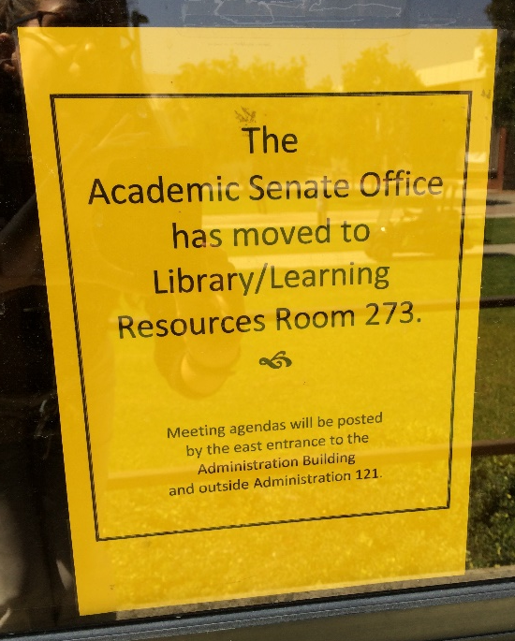
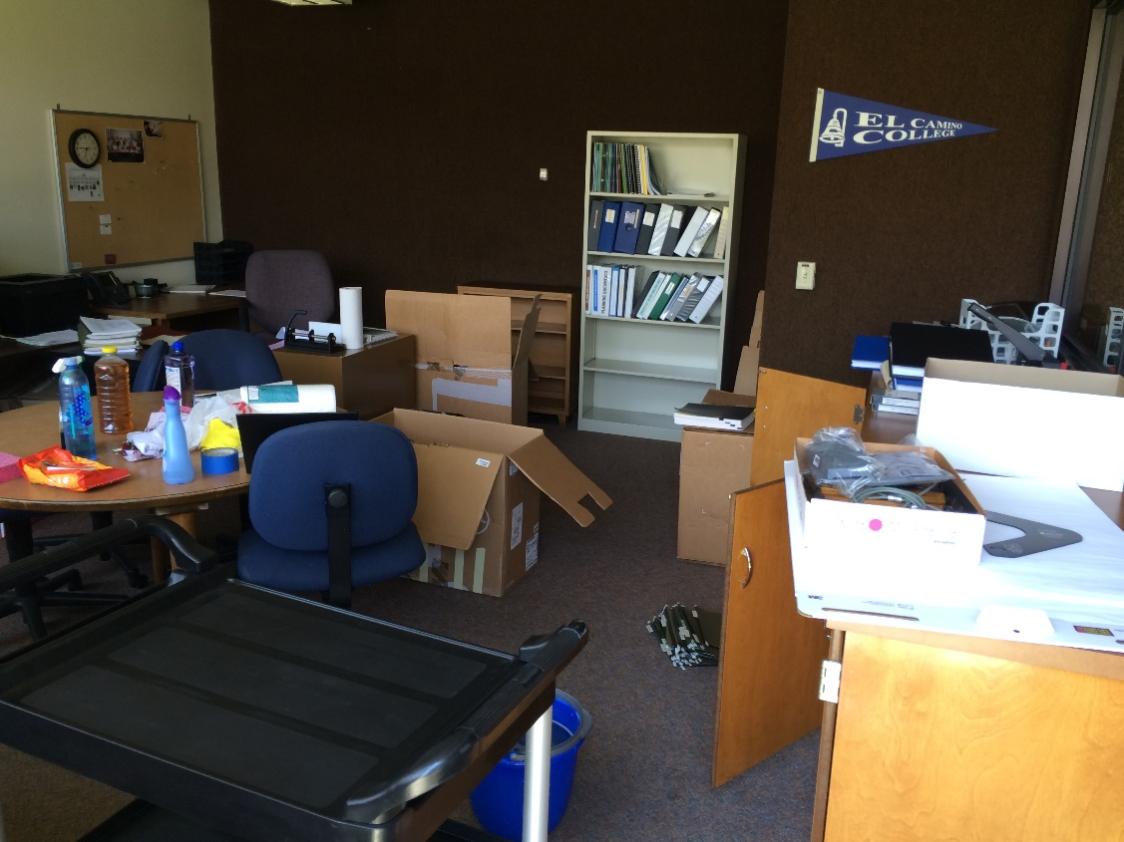
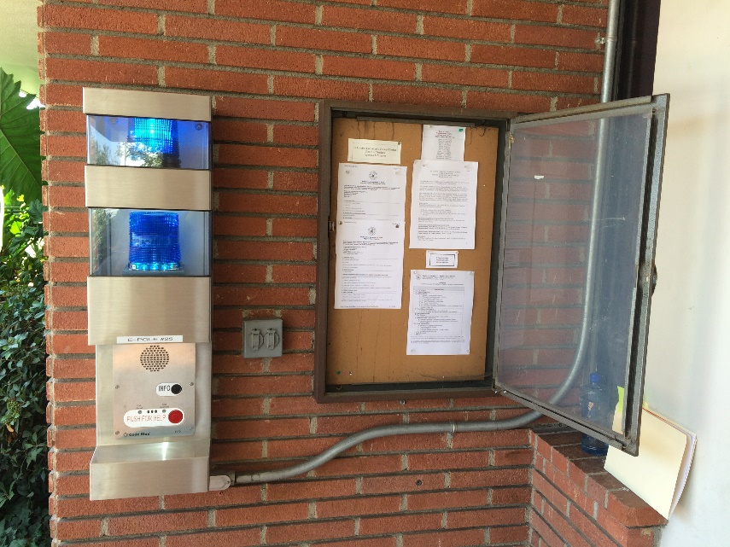
New Office Location: Library 273
Agendas: Outside Admin Bldg,
by Admin 121 & on ECC website.
“Bikram Packing”
– Mid-80s & no A/C on campus!

Slide 27
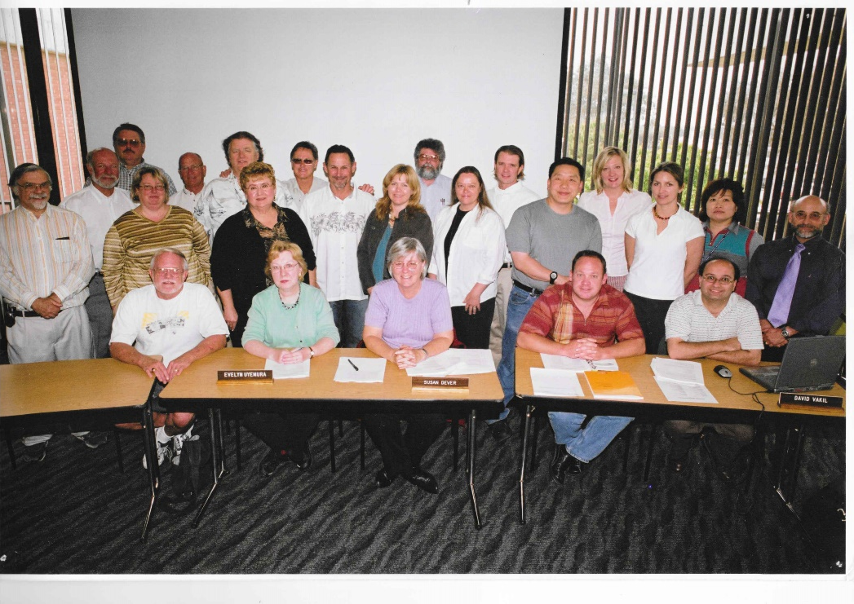
How many people in this photo
continue to serve on the Senate?
Pete Marcoux had the right answer…

Slide 28
Six: Chris Wells, Lance Widman, Daniel Berney, Chris Gold, Claudia Striepe, Pete Marcoux.

Slide 29
C. Officer Reports
a. President:
Office & Meeting moves: Thanks to Library (R. Russell, S. Kunisaki, D. Baldwin, H. Story) and Facilities (D. Turano, R. Richardson, K. Pipkins, J. Macareno, R. Dietz) for help moving three decades of archives!
Online Educational Resources (OER) Grant for Online Textbooks: Senator M. Fields & Grants Office supporting ~18 sections (4 faculty) to adopt online textbooks by SP18. Mark selected to serve on the statewide Academic Senate Online Ed Committee.

Slide 30

C. Officer Reports
a. President:
Financial Aid: Starting F16 2.0 GPA required to keep Board of Governor’s Fee Waiver.
Freeze date implementation -- financial aid based on units at census.
Enrollment: College will continue to seek ideas and opportunities to build enrollment.
Dual Enrollment: Number of contracts approved at August BOT. MOUs emphasize maintaining academic standards. Steering committee to be formed.
Process Improvement: Steering Committee considers how current processes may hinder student enrollment (data analysis, spoofing student experience, reviewing communications). “Every interaction counts.”

Slide 31
C. Officer Reports
b. VP Compton Center: Paul Flor
Compton has completed the first draft of the self-evaluation and working on the second wave of edits. The accreditation visit is scheduled for March. The first March meeting of the ECC Academic Senate will be on a Thursday so the accreditation team can observe the Compton Faculty Council in action. January will be the 90th anniversary for the Center. The Faculty Council is planning a year-long campaign so visitors to the college see that the college has a long history. The Compton Faculty Council meets 1st and 3rd Thursdays of the month. They are currently shadowing the ECC curriculum process so there will be a process in place once the Center becomes accredited.

Slide 32
C. Officer Reports
c. Chair, Curriculum: Allison Carr (pgs. 22-61). The CCC is fully staffed with representatives to the CCC. The Chair met with all division deans over the summer. If there are questions or if faculty need assistance they are encouraged to reach out to their division rep or to Allison.
d. VP Educational Policies: Chris Gold Chris explained that policies are “big picture” broad statements of what the college will do. Procedures explain how we will implement the policies. The committee will be working with the VPs to develop their “to do” lists and to prioritize policies and procedures to review this year. Refer to the following four slides for an orientation to the work of the Educational Policies Committee.

Slide 33
Educational Policies Committee
Second and fourth Tuesday of the month in SOCS 123
Members
Mark Fields, Administration of Justice, Industry and Technology
Vanessa Haynes, Counseling, Compton Center
Chris Jeffries, Counseling, Student Services
Lori Suekawa, Articulation Officer, Student Services
Karl Striepe, Political Science, Social Sciences

Slide 34
Policies and Procedures
Board policies are usually broad statements of how a college and district is organized and functions.
Administrative procedures are longer statements that explain how Board policies are implemented. Often, they explain the process to complete the work described in the Board policy.
BPs and APs are divided into seven series that are numbered in the thousands:
1000s The District
2000s Board of Trustees
3000s General Institution
4000s Academic Affairs
5000s Student Services
6000s Business and Fiscal
7000s Human Resources

Slide 35
Considerations in Revising and Creating BPs/APs
Revised or New AP/BP
Federal Law
(Dept. of Ed.)
State Law
(Ed Code & Title 5)
CCLC Template
Accredtn Require. (ACCJC)
Negotiabl Items
(ECCFT Contract)
Local Processes,
Practice,
Culture
Student Success

Slide 36
10+1 Policies and Procedures – Typical Consultation
Ed
Policies Comm.
Deans Council and College Council
Academic Senate
1st & 2nd reading and a vote
ECC Board of Trustees
1st & 2nd reading and a vote

Slide 37
C. Officer Reports
e. VP Faculty Development: Stacey Allen. The first meeting of the FDC will be next Tuesday, September 13th. The Faculty Book Club was recently approved for funding from the Student Equity Program for both books and refreshments – stay tuned for details. Please take a few minutes to complete the Fall Professional Development Day evaluation which was sent through email by the Professional Development Department. Watch for information about the Outstanding Adjunct Faculty Award.

Slide 38
C. Officer Reports
f. VP Finance: Lance Widman (pgs. 62-66).
Planning and Budgeting Committee is year-round committee. Sometimes meetings occur every week in August in anticipation of the approval of the budget. The most important meeting of the year is the August meeting in which the president provides an overview of the budget. Lance was unable to attend but understood there was a lot of interaction and discussion.

Slide 39
C. Officer Reports
Josh Troesh, the Senate alternate to the PBC, provided the following highlights from the meeting:
No COLA from the state
Enrollment will result in stabilization
Growth funds will not be available to El Camino
$14 million reserve for increasing pension obligation
Some of the reserve could be used for one-time investments into enrollment growth.
Lance noted that this Wednesday (9/7) the Board of Trustees is sponsoring a Budget Workshop, 3-4 in the Board Room. He has many years’ experience on the Senate and has never been aware of a Budget Workshop being offered. He feels this is a serious move in the right direction.

Slide 40
C. Officer Reports
g. VP Academic Technology: Pete Marcoux
The College Technology Committee meets the 4th Tuesday of the month. Academic Technology Committee meets as needed. Canvas should be ready to be utilized in Winter Session. It’s anticipated that the Board of Trustees will approve a contract to install wifi on campus. It’s anticipated that the project will be completed in 6 months.

Slide 41
C. Officer Reports
h. VP Instructional Effectiveness/Assessment of Learning Committee & SLOs: Russell Serr (pgs. 67-68). The Program Review Committee meets every week in the fall semester. The quality of the SLOs is getting better – it seems that faculty are getting the hang of it. (See following three slides for a comprehensive overview of the ALC, Assessments and Program Review.

Slide 42
ALC
Fall 2016
Communication ILO 2014 – Writing Across Curriculum - pilots and planning in progress
Critical Thinking ILO 2015 – Included:
  37 Faculty
  59 Sections
  1,424 Students
Community and Personal Development ILO 2016

Slide 43
SLO/PLO Assessments
Fall 2016 SLO Assessments, 761 Scheduled, 205 Completed, 27%
Fall 2016 PLO Assessments. 25 Scheduled, 9 Completed, 36%
Fall 2016 assessments are due Sept. 16
Spring 201 617 SLO Assessments Scheduled
Spring 2016 44 PLO Assessments Scheduled
Entering Workshops Flyer attached

Slide 44
Program Review
13 Full Program Reviews
7 CTE Review
Schedule Attached
Future workshops (October-November) to enter PRs into TracDat, immediately followed by workshops for Program Planning

Slide 45
Agenda
D. Special Committee Reports
  a. ECC VP of Academic Affairs: Dr. Jean Shankweiler
  Dr. Shankweiler reiterated the information about the Budget Workshop being offered by the Board of Trustees. This week’s BOT will be the first to use Board Docs. The Canvas Institutional Participation Agreement is making its way through the process. The Canvas implementation is progressing according to the timeline recommended by the Canvas task force. Enrollment is even with last fall – Jean had hoped we would be higher but this reverses the trend of declines for the last two years. The goal is to see improvements in the spring semester from recent enrollment management initiatives. No Show reports are due Friday, 9/9. The Faculty ID process has started. Deans may request assistance from faculty as they develop proposals. Irene has been working hard on the master plans – kudos to her and her team as this is a significant undertaking. There will be an open forum on 9/29 – stay tuned for details. Pete Marcoux suggested that it may help keep enrollment on the front burner to revive the practice of sending enrollment updates to the faculty listserv. There have been some technical challenges but Jean will investigate. (And will remind everyone that it was Pete’s suggestion!)
  Chris Wells asked how many FT hires are anticipated: at least 15. Last year, fall and spring, 26 faculty were hired.

Slide 46
Agenda
D. Special Committee Reports
  a. ECC VP of Academic Affairs: Dr. Jean Shankweiler
  Dr. Shankweiler reiterated the information about the Budget Workshop being offered by the Board of Trustees. This week’s BOT will be the first to use Board Docs. The Canvas Institutional Participation Agreement is making its way through the process. The Canvas implementation is progressing according to the timeline recommended by the Canvas task force. Enrollment is even with last fall – Jean had hoped we would be higher but this reverses the trend of declines for the last two years. The goal is to see improvements in the spring semester from recent enrollment management initiatives. No Show reports are due Friday, 9/9. The Faculty ID process has started. Deans may request assistance from facut
  b. ECC VP of Student & Community Advancement: Dr. Jeanie Nishime On Vacation.
E. Unfinished Business: None at this time.
F. New Business:
  a. Senate Goals 2016-2017 – first reading. Packet pages 4 & 5. Second reading and vote will take place at our next meeting.

Slide 47

Agenda
G. Information Items – Discussion
  b. Associated Student Organization: Patrick McDermott, Director, Academic Affairs.
  Mr. McDermott is a second year student majoring in Accounting. This is his second year attending Senate meetings. Approximately 40-50 students participate in ASO. The three big goals for the year include:
  1. Hydration stations. Five stations should be arriving soon.
  2. Addressing the overcrowding of students in the hallways of the Admin Building by providing charging stations in the Student Activities Building.
  3. Transcript notations for students in ASO.
  Mr. McDermott is the messenger between the ASO and the Senate.
  Chris Gold indicated that upcoming educational policies may need student feedback. She will connect with Mr. McDermott.

Slide 48
Agenda
H. Future Agenda Items: These include a visit from President Maloney at our next meeting, Federation and ASO Updates, Faculty handbook which was last updated in 1987, educational policies related to attendance and dual enrollment and the OER program.
I. Public Comment: Chris Wells noted the a number of pieces of legislation were in consideration, including considering seniority for part-time faculty.
J. Adjourn: Meeting was adjourned at 1:56 p.m.

Slide 49
ECC Academic Senate 2016-2017
Thank you for your service!
BSS
Stacey Allen
Kristie Daniel-DiGregorio
Chris Gold
Lance Widman
Michael Wynne
Business
Kurt Hull
Philip Lau
Nic McGrue
Josh Troesh
Compton Ed. Center
Paul Flor
Chris Halligan
Counseling
Anna Brochet
Yamonte Cooper
Rene Lozano
Industry & Technology
Ross Durand
Mark Fields
Patty Gebert
Lee MacPherson
Jack Selph
Library Learning Resources
Mary McMillan
Noreth Men
Claudia Striepe
Mathematical Sciences
Megan Granich
Matthew Mata
Jasmine Ng
Benjamin Mitchell
Catherine Schult-Roman
Natural Sciences
Mohamad Abbani
Sara Di Fiori
Troy Moore
Ryan Turner
Anne Valle
Fine Arts
Ali Ahmadpour
Daniel Berney
Diana Crossman
Russell McMillin
Chris Wells
Health Sciences & Athletics/
Nursing
Andy Alvillar
Traci Granger
Yuko Kawasaki
Colleen McFaul
Russell Serr
Humanities
Rose Ann Cerofeci
Ashley Gallagher
Pete Marcoux
Christina Nagao
Adrienne Sharp

