Slide 1
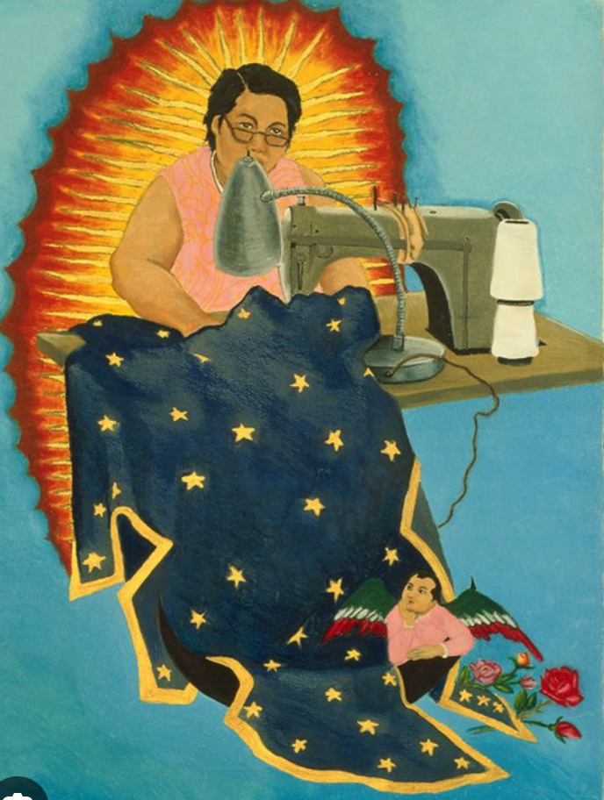
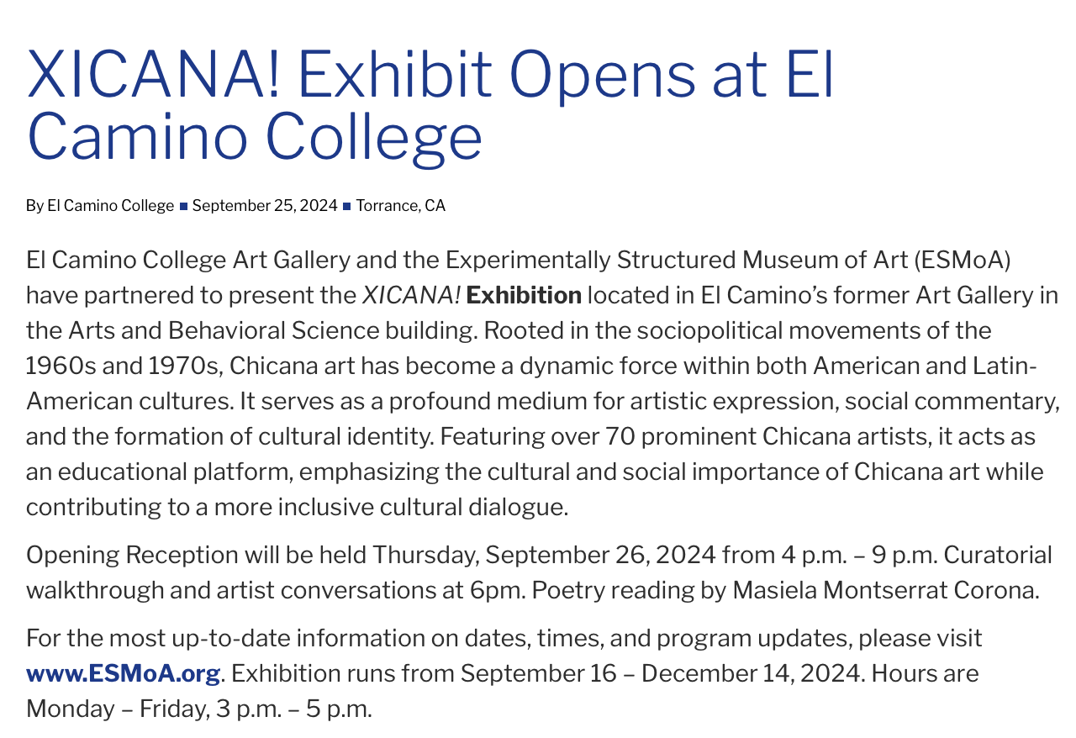
Art History Department Meeting
Tuesday, October 22, 2024

Slide 2
Art History Dept - Agenda
Minutes are embedded in the PowerPoint in red boxes.
In attendance: Chris Gold, Al Ahmadpour, Lucy Alamillo, Karen Beckstead, Mina Majstorovich, Elizabeth Russel
Fall Enrollment and Scheduling
Committee Membership
Curriculum and Courses
SLO Updates
Evaluations
Updating Pathways

Slide 3
Fall Enrollment and Spring Scheduling
Year | # of Sections | Seats Filled | Fill Rate
Fall 2024 | 26 | 1,254 | 91%
Fall 2023 | 25 | 961 | 88%
Fall 2022 | 22 | 811 | 85%
Fall 2021 | 20 | 722 | 93%
Enrollment, fill rates and the number of sections are up.
The department approved offered two less 101s and one more 102C and 207.

Slide 4
Committee Membership
Division Council – Ali Ahmadpour
Load Committee – Ali Ahmadpour
BSS Division Curriculum Committee – Karen Beckstead
BSS SLO Committee – Karen Beckstead
Annual Plan – Karen Beckstead

Slide 5
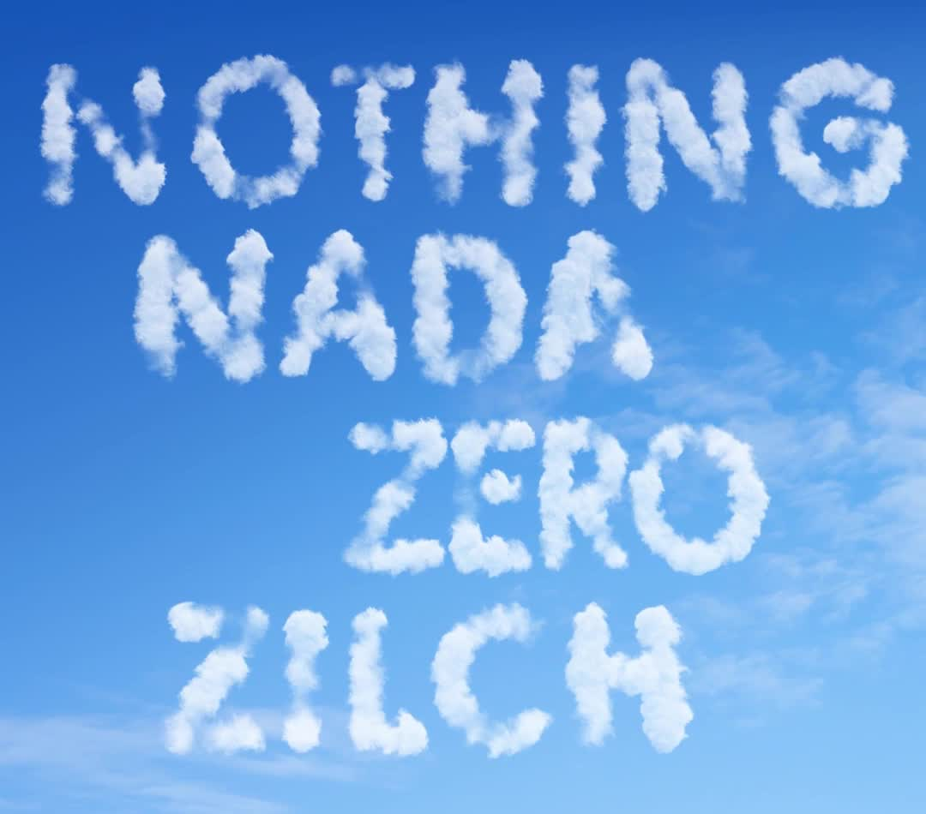
Curriculum Review
No curriculum is due this Fall 2024.
Islamic Art needs to be UC transferable before it can be offered – this will possibly be in Fall 2024. Someone will need to be hired to teach the course.
In the future, the Art History of Mexico, Central & South America will be divided into two parts.

Slide 6
SLO Assessment
Spring 2024 Assessments
All completed and entered. Thank you!
Fall 2024 Assessments
AHIS 101 SLO 1
AHIS 102A SLO 1
AHIS 102B SLO 1
AHIS 102C SLO 1
AHIS 205B SLO 1
AHIS 207 SLO 1
AHIS 208 SLO 1
AHIS 209 SLO 1
Karen reported that SLO assessment will use Canvas outcomes moving forward so the results can be disaggregated. They will need a common rubric for each assessment so the data can be combined.
Other Topics:
Program Review – the computer site says the program review will be in Spring 2026.
Wifi – the wifi in the classrooms needs to be improved. It is slow when used by multi devices.

Slide 7
Faculty Evaluations
Online Observations – 16 week classes – closed Oct. 19 (let Chris know if you need an extension).
On-Campus Observations – last day November 8
Self-Evaluation – 16 week classes – Due Nov. 27
Evaluation Conference – by November 27 (except 2nd 8 week sections by Dec. 6)

Slide 8
Updating the Art History Pathway
Due Date: End of Semester
Please:
Review your degree and see if any changes are needed.
Review the order of courses and indicate any changes (please keep transfer-level Math and English in the first year).
Narrow down the choices for all the green and yellow boxes to 3-4 choices.
Review the course information provided by the Dean to inform your decisions.

Slide 9
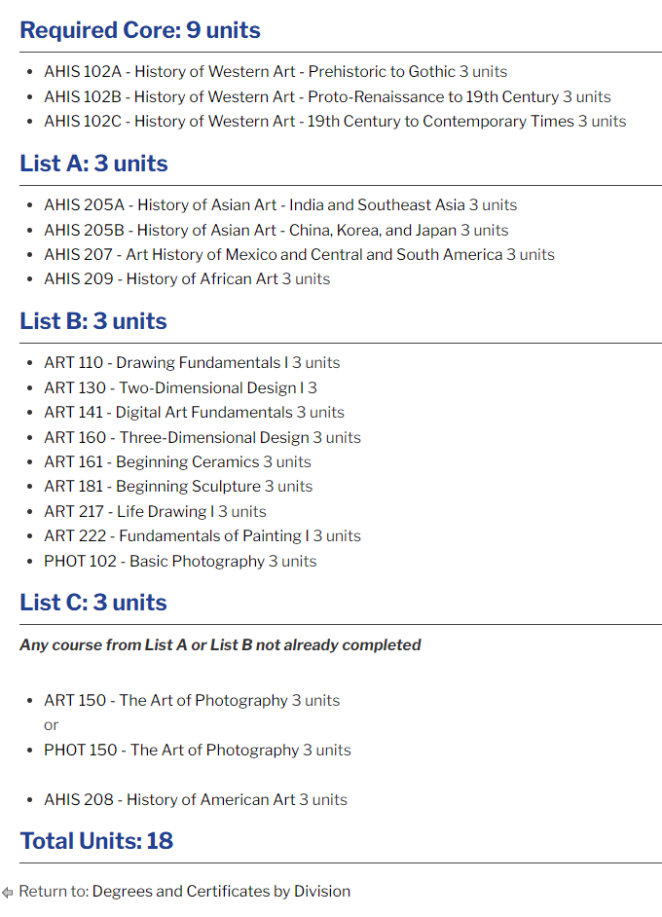
Updating the Art History AAT

Slide 10
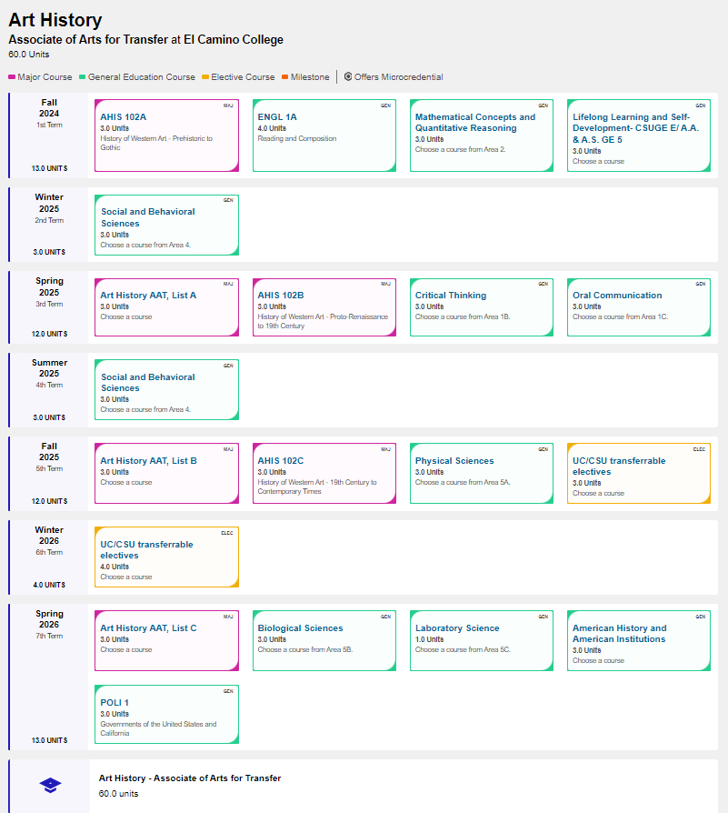
Updating the Art History AAT
Due Date: End of Semester
Please:
Review your degree and see if any changes are needed.
Review the order of courses and indicate any changes (please keep transfer-level Math and English in the first year).
Narrow down the choices for all the green and yellow boxes to 3-4 choices.
Review the course information provided by the Dean to inform your decisions.

