Slide 1
Communication Studies
Tuesday, September 19, 2023

Slide 2
Communication Studies Department Meeting Attendance
Meeting Notes are found in red text embedded in the PowerPoint.
Lizette Alonso
Julia Anderson
Francesca Bishop
Trisha Brodak-Silva
Diana Crossman
Mark Crossman
Jason Davidson
Joseph Evans
Wesley Hernandez
Brittany Hubble
Kelly Janke
Lilly Johnson
Casey Jones
Charmaine Kaimikaua-Green
Larry Leach
Rodolfo Lopez
Julie Matos
Julia Matthews
Daryle Nagano
Valerie Ortega
Elyse Peterson
Fariba Sadeghi-Tabrizi
Chantel Solomon
Warren (DeRod) Taylor
Chizoba Udeorji
Helene Wagner
Chris Wells
Dean: Christina Gold
Assoc. Dean: Irena Zugic
Admin Clerk: Cecelia Mataalii
Division Counselor: Cheryl Kroll

Slide 3
Communication Studies Department Meeting Agenda
Reports
Cheryl Kroll, Counseling
AI and Fraudulent Students
II) Scheduling, Enrollment, Success and
Gap Data
III) Department Business
a) Committee Assignments
b) Curriculum and SLOs
c) SOCS Building

Slide 4
Counseling Updates for Department Meetings: Fall 2023
Transfer Center Events:
https://www.elcamino.edu/academics/transfer-center/events-and-workshops/index.aspx.
September is TAG month. We offer the following TAG workshops: IN PERSON @ the Transfer Center LAB (SSB 200) 9/20 from 1-4 pm and 9/28 from 12-3 pm. Virtual via Zoom: 9/26 from 2-5 pm and 9/29 from 11am-1pm
University Fair: Our University Fall 2023 fair will be on Thursday, September 21st from 11am-2pm. With the fencing gone, we are bringing it back to the center of campus on the Library Lawn.
CSU/UC Application workshops began on October 1st. Both in person and virtual options will be available through the end of November. Students will sign up on the Transfer Center website.
Career Center Events:
https://www.elcamino.edu/support/careers/index.aspx
More meta major resources have been added to this website and students can now access job opportunities here as well.
Scheduling Counseling Appointments:
All general counselors were on Express/Drop in for the first two weeks of the term. Regular appointments resume on the week of September 11th. Students are able to book appointments via this link: https://www.elcamino.edu/support/counseling/appointments.aspx.
Note: My office has moved to BSSB 120.
Meta Major Outreach
Planned events include contacting BSS majors with 40+ units to inform them of our Transfer Center events and to connect them to the Transfer Center; hosting a career panel with various BSS meta major professionals so students can learn more about careers in our majors; and creating a BSS social media page to give students a central place to access information regarding upcoming events, resources, etc. Per the flyer inserted into your mailboxes, we will also continue to host Chat With a Counselor events as well as meta major drop in events and appreciate you sharing these events with your students.
Any questions?

Slide 5
AI and Fraudulent Students
Meeting Notes: The department discussed the rising rates of fraud and related use of artificial intelligence this Summer and Fall.
Create an assignment that can’t be answered by AI or a BOT that is required to stay enrolled and helps weed out fraudulent students. The Distance Education Office recommends requiring a student to post a short introductory video or audio post or using an interaction on Pronto.
Drop students as No Shows who do not complete the assignment, or do not complete it in the required format.
You can always reinstate a student who is mistakenly dropped.
Send a list of the fraudulent students you dropped with their name, email and student id, to the financial aid office (eccfaid@elcamino.edu).
After No Shows, require a student suspected of fraud to meet with you on Zoom to stay enrolled. Drop them if they don’t respond or show to the meeting.
If you find a fraudulent student after No Shows have been filed, submit a Maxient form and select “suspected fraud” as the reason for the report. It will go to Student Development, Financial Aid and Admissions & Records. You can submit multiple students on one Maxient report. This will trigger the student discipline process which can lead to the withdrawal of the student(s) from your course.

Slide 6
Summer Section Count
Meeting Notes: COMS Summer enrollment is robust and likely to grow with new CalGETC requirements.
Course | Summer 2018 (20 sections) | Summer 2019 (17 sections) | Summer 2020 (24 sections) | Summer 2021 (24 sections) | Summer 2022 (25 sections) | Summer 2023 (21 sections)
100 | 14 | 11 | 19 | 16 | 15 | 15
120 | 2 | 2 | 2 | 3 | 3 | 1
130 | 1 | 1 | 2 | 3 | 5 | 4
140 | 2 | 2 | 0 | 1 | 1 | 0
265 | 1 | 1 | 1 | 1 | 1 | 1

Slide 7
Class | Fall 2020 (82 sections) | Fall 2021 (73 sections) | Fall 2022 (71 sections) | Fall 2023 (75 sections)
100 | 44 | 30 | 35 | 40
120 | 5 | 5 | 5 | 4
130 | 14 | 17 | 12 | 11
140 | 6 | 7 | 7 | 7
180 | 2 | 2 | 2 | 2
250 | 2 | 2 | 1 | 1
260 | 2 | 2 | 2 | 2
265 | 3 | 3 | 2 | 4
270 | 0 | 1 | 1 | 1
275 | 1 | 1 | 1 | 0
292/3/4 | 1/1/1 | 1/1/1 | 1/1/1 | 1/1/1
Fall Section Count
2020-22
Meeting Notes: The number of Fall sections increased this semester as enrollment is recovering. The department would like to build enrollment in COMS 130 (Interpersonal Communication) – it fulfills the same requirement as 100.

Slide 8
Fall Schedule and Enrollment Snapshot – week two
Meeting Notes: Fill rates are strong at 87.5%. On-campus fill rates are especially strong (95%). The Dean is struggling to staff on campus sections for Spring. PT faculty are declining on-campus offers.
Total Sections – 75
Seats Filled – 2,006
Overall Fill Rate – 87.5% fill rate
Online – 37 sections, 85% fill rate
On Campus – 32 sections, 95% fill rate
Hybrid – 1 sections, 111% fill rate
Dual Enrollment – 4 sections, 41% fill rate

Slide 9
Fall 2022-23 Schedule & Enrollment (Snapshot in week two)
Meeting Notes: In the week 2 snapshot of enrollment, seats filled in Fall 2023 COMS classes increased 11% from Fall 2022.
Fall 2022
Total Sections – 66
Seats Filled – 1,805
Overall Fill Rate – 87% fill rate
Online – 34 sections, 92% fill rate
On Campus – 31 sections, 82% fill rate
Hybrid – 1 sections, 97% fill rate
Fall 2023
Total Sections – 75
Seats Filled – 2,006
Overall Fill Rate – 87.5% fill rate
Online – 37 sections, 85% fill rate
On Campus – 32 sections, 95% fill rate
Hybrid – 1 sections, 111% fill rate
Dual Enrollment – 4 sections, 41% fill

Slide 10
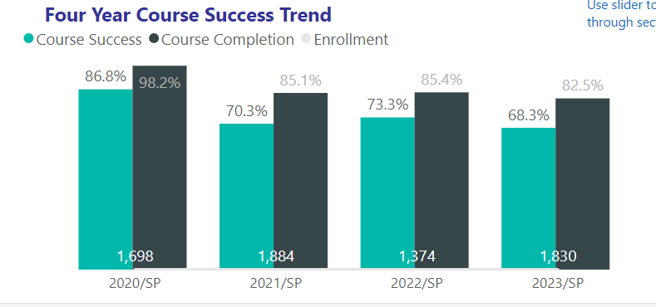
Communication Studies Success Rates
Ethnic Studies Success Rates
Meeting Notes: Resembling BSS patterns, COMS success rates were high during the outbreak of the pandemic in Spring 2020. Breaking away from BSS patterns, success rates in Sp2023 declined significantly from Sp2022.

Slide 11
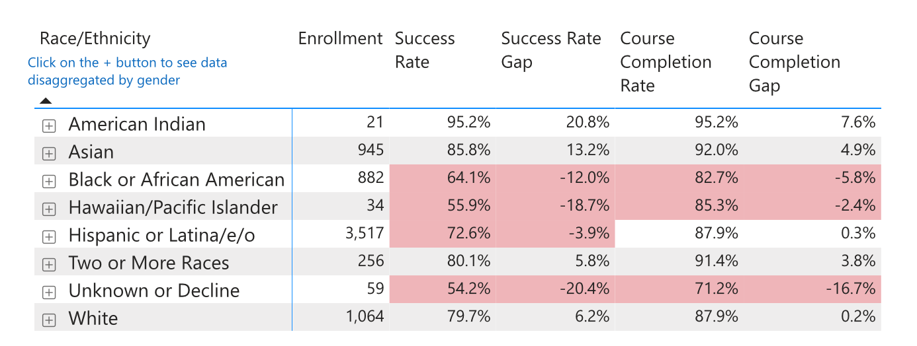
Communication Studies Equity Gaps Last four Spring terms

Slide 12
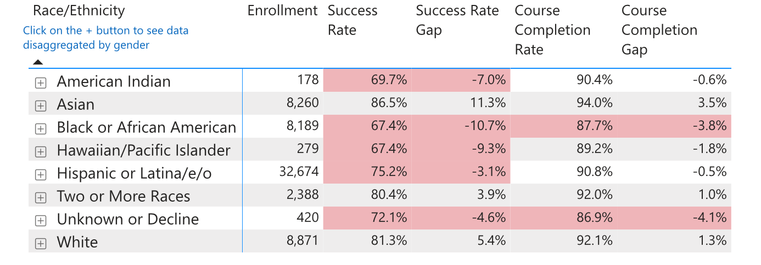
BSS and COMS Equity Gaps (last 4 Spring terms)
Meeting Notes: The equity gap for Black COMS students is 12%, which is higher than the division gap of 10.7%. The equity gap for Latina/o COMS students roughly the same as the division gap.
COMS
BSS

Slide 13
SLOs, Curriculum and Committee Assignments
Meeting Notes: The department discussed SLOs and curriculum revisions and reviewed committee assignments. The department asserts that 10th grade students do not have the maturity and academic skill set to be successful in dual enrollment courses. Faculty who have taught COMS courses to high school students report they need to simplify the content in order to provide sufficient instruction. They would like to remove 130 from the list of courses available to 10th grade students.
Spring 2022 – SLOs and PLOs
All done.
Fall 2022
Brittany is on it!
Curriculum
The department is reviewing and revising its courses to fit into new CalGETC categories.(i.e 100, 120, 130, 260, 265, 275). Those courses will need to be offered in Fall 2025 and must align with CID.
Committee Assignments
Division Council – Mark Crossman
BSS Curriculum Committee - Davidson
BSS Assessment Committee – Brittany Hubble
BSS Load Committee – Diana Crossman

Slide 14
Social Sciences Building
Meeting Notes: The other BSS faculty have moved out of the SOCS building and the offices are ready for occupation by COMS faculty. Several COMS faculty would like to move into the offices this Fall and begin teaching in the building. Francesca and Brittany are working on creating the new squad room in SOCS 117. Furniture is being moved in.

