Slide 1
BSS Division Council
Thursday, October 17, 2024

Slide 2
BSS Division Council
Minutes are embedded in the PowerPoint in red boxes.
Reports
Business and Reminders
Counselor’s Report
Associated Students’ Organization
Federation
Evaluations
Introductions
Full-time Faculty Position Requests
Annualized Scheduling
Announcements
BSSB Student Mural
Membership
Anthropology – Angela Mannen
Art History – Ali Ahmadpour
Child Dev’t – Michelle Moen
Comms Studies – Mark Crossman
Econ – Tanja Carter
Ethnic Studies – Xocoyotzin Herrera
History – Sandra Uribe
Philosophy – Felipe Leon
Political Science – David Reed
Psychology/Human Dev’t – Renee Galbavy
Sociology – Stacey Allen
Staff – Beverly Knapp
Chair/Dean – Chris Gold
ASO – Julissa Celis
BSS Metamajor Counselor – Dora Miranda
BSS Metamajor Counselor – Angela Hagan
Federation – John Baranski

Slide 3
Counselor’s, ASO and Federation Report
Dora and Angie are Co-BSS Counselor Leads.
This semester, the focus is on the Communication Studies. Next semester, they will focus on Child Development. There will be a Communication Studies employment networking fair on Oct. 23 from 1-2 in DE 166. It will include an employers panel, which organizations such as the City of Torrance, So Bay Lakers, La Cultura radio, etc. On Oct. 29 from 12-2, there will be a mini transfer fair.
On Nov. 14, and Dec. 12 there will be Chat with a Counselor from 9-11:30am. They will also host a mini-Reg Prep hat will promote registration. The first 30 students will get a BSS shirt.
ASO Report – Homecoming is next week with a variety of events.
Federation Report – There is a new sick leave formula and faculty should check their hours. They are negotiating compensation and health care with the help of a state mediator.

Slide 4
Minutes
Evaluations – student evaluations for 16 week classes will be conducted October 7-19. Observations must be completed by Nov. 8.
The Full-Time faculty position requests were prioritized by Division Council in this order: Psychology, Anthropology, Human Development, History, Ethnic Studies, Psychology #2, Human Development #2.
Annualized Scheduling – Schedule requests for the full year are due on Dec. 10. Next summer, students will see Fall and Spring schedule. In the future, they will be able to register for Fall and hold seats for Spring. There is a lot of work on the back end in Colleague to make this work.
Art Gallery – Student Mural - the Art Gallery will be collecting student designs for a mural in the building. There will be a contest. BSS Division Council will pick the mural.

Slide 5
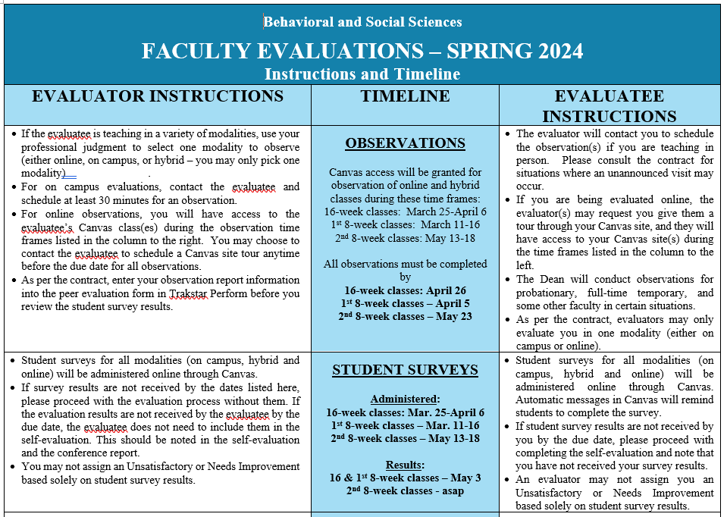

Slide 6
