Slide 1
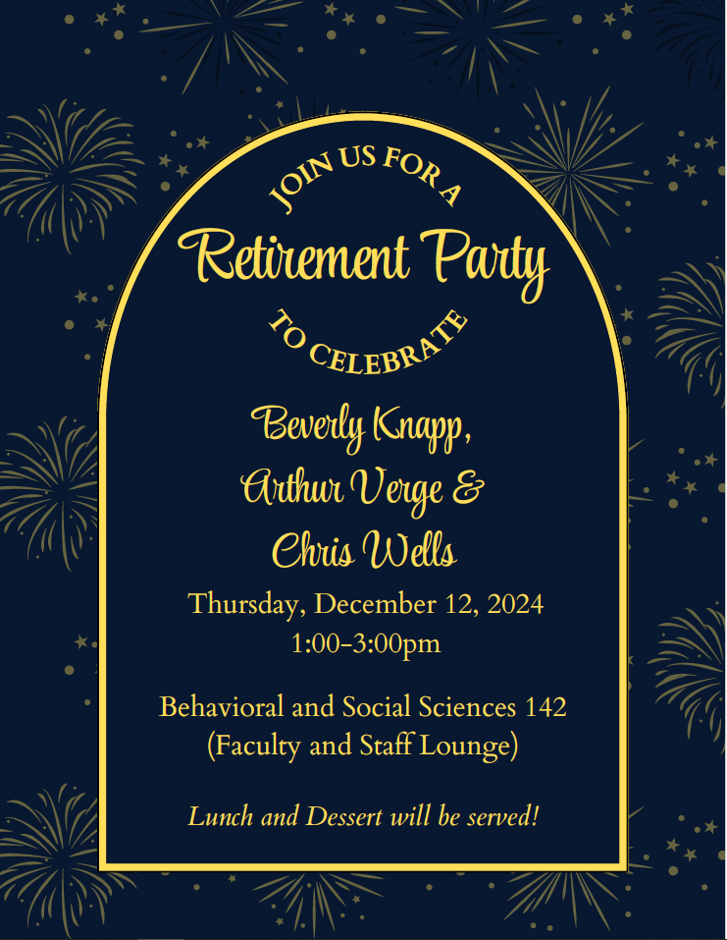
BSS Division Council
Thursday, December 5, 2024

Slide 2
BSS Division Council
Minutes are embedded in the PowerPoint in red boxes.
In attendance: Chris Gold, Dora Miranda, Tanja Carter, Mark Crossman, Xocoyotzin Herrera, Julissa Celis, David Ree, Michelle Moen, Ana Celis, Craig Sauer, Angela Mannen.
Reports
Business and Reminders
Associated Students’ Organization
Federation
Faculty Evaluations
Counselor’s Report
Annualized Scheduling
Announcements
Student Academic Dishonesty
Remind Students to Register for Spring Classes
SRP – Retirement Incentive
Division Reorganization
Membership
Anthropology – Angela Mannen
Art History – Ali Ahmadpour
Child Dev’t – Michelle Moen
Comms Studies – Mark Crossman
Economics – Tanja Carter
Ethnic Studies – Xocoyotzin Herrera
History – Sandra Uribe
Philosophy – Felipe Leon
Political Science – David Reed
Psychology/Human Dev’t – Renee Galbavy
Sociology – Stacey Allen
Staff – Anna Celis
Chair/Dean – Chris Gold
ASO – Julissa Celis
BSS Metamajor Counselor – Dora Miranda
BSS Metamajor Counselor – Angela Hagan
Guests

Slide 3
Counselor, Federation and ASO Reports
Counselor’s Report
Dora Miranda is the new BSS lead. BSS counselors are piloting a rep prep in December. Goal is to create mini-ed plans for about 45 students for Winter and Spring. In Spring they are focusing event on Childhood Education.
Federation Report (emailed by John_
2024-2025 Reopener Bargaining (PT health care and 2024-2025 compensation): We completed a PT health care MOU that is better than what we had and certainly better than what the district offered 5 years ago. 2024-2025 compensation still going, we are waiting for the state mediator to schedule the next meeting. 2024-2025 state funded COLA is 1.07%.
2025 Full Contract Negotiations: Will likely start in January/February 2025.
General membership meeting on Monday, Dec. 9, at 5pm. All members welcome.
If anyone has questions, let them know they can always reach out to me.
Thanks,
John
III) ASO Report
ASO held a Harvest Festival. They helped with Senator Bradford’s turkey give-away. They will be holding Finals Madness.

Slide 4
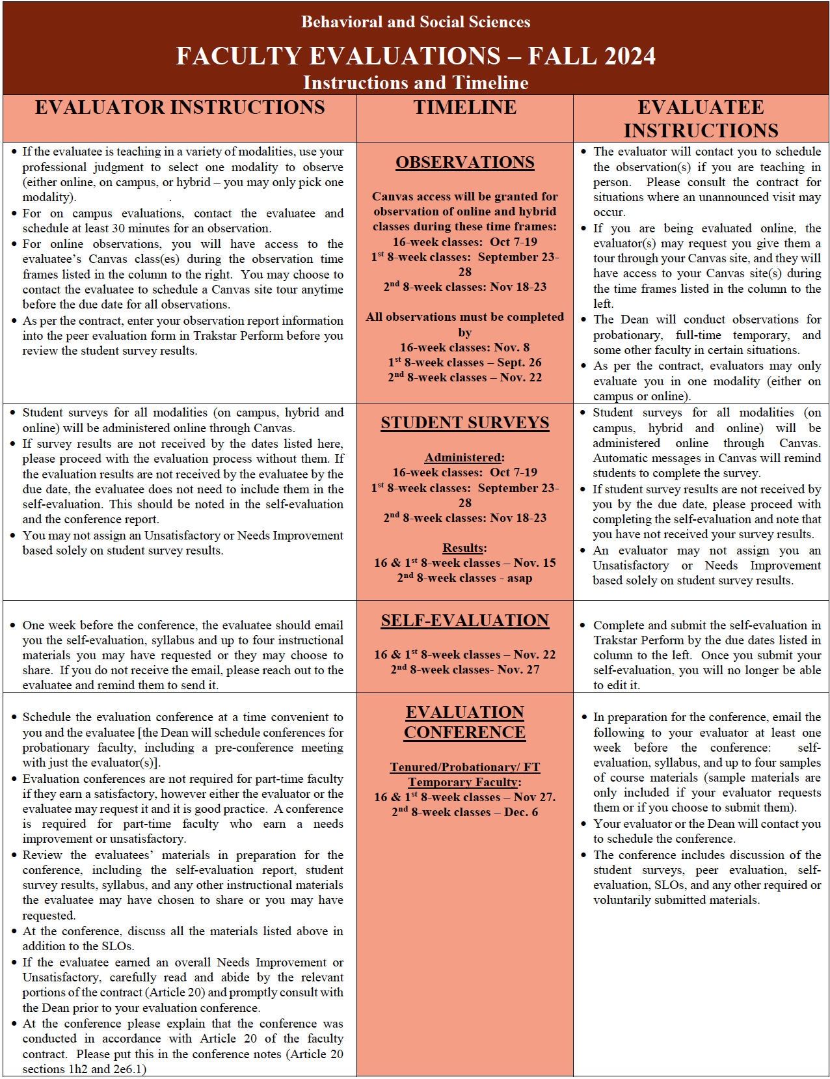
Self-Evaluations – Past Due. All should
have been submitted to evaluators.
Evaluation Conference – Past Due. All
conferences should have been
completed.

Slide 5
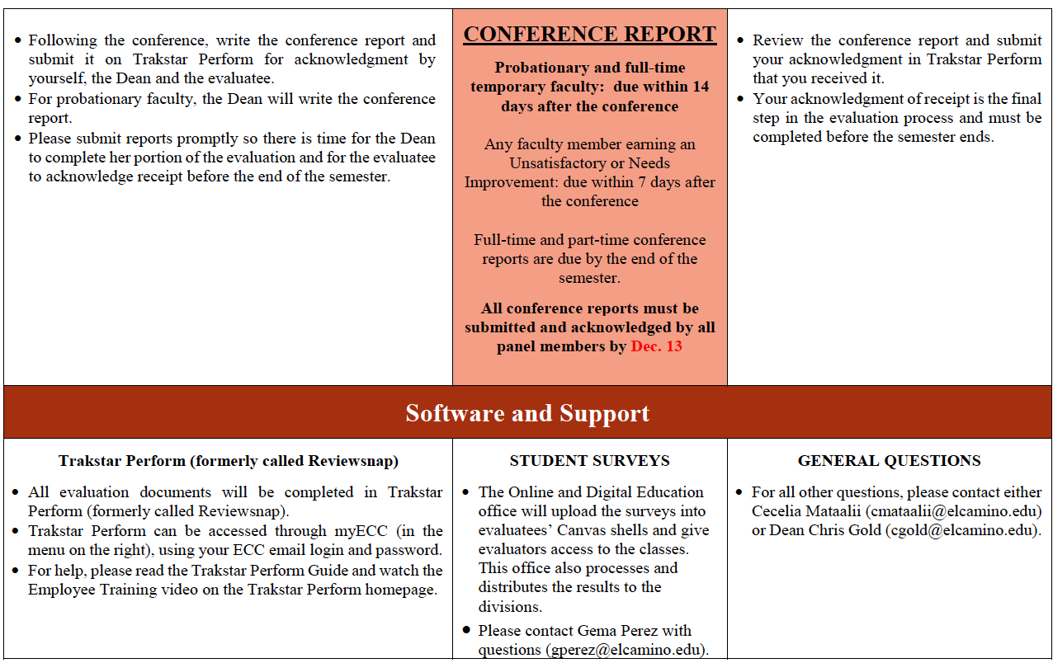
Conference Reports– Need to be completed
and acknowledged by all panel members
in Trakstar by December 13.

Slide 6
Annualized Scheduling
What is it?
Why are we doing it?
To support student progress towards degrees and certificates by allowing students to plan out their full academic year schedule.
Building Summer 2025, Fall 2025, Winter 2026 and Spring 2026 this Spring.
What you need to do.
End of Spring 2025 – Students will be able to see the full 2025-26 academic year schedule.
End of Spring 2026 – Students will be able to register and/or hold spots in the full 2026-27 academic year schedule (if all the technology pieces fall into place).
Only 62.5% of first year students enrolled in Fall classes will return to take classes in Spring (59.8% for BSS).
Email your full academic year schedule request to Ana Celis if you haven't already.
Chris will start developing the 2025-26 academic year schedule over Winter break/session.

Slide 7
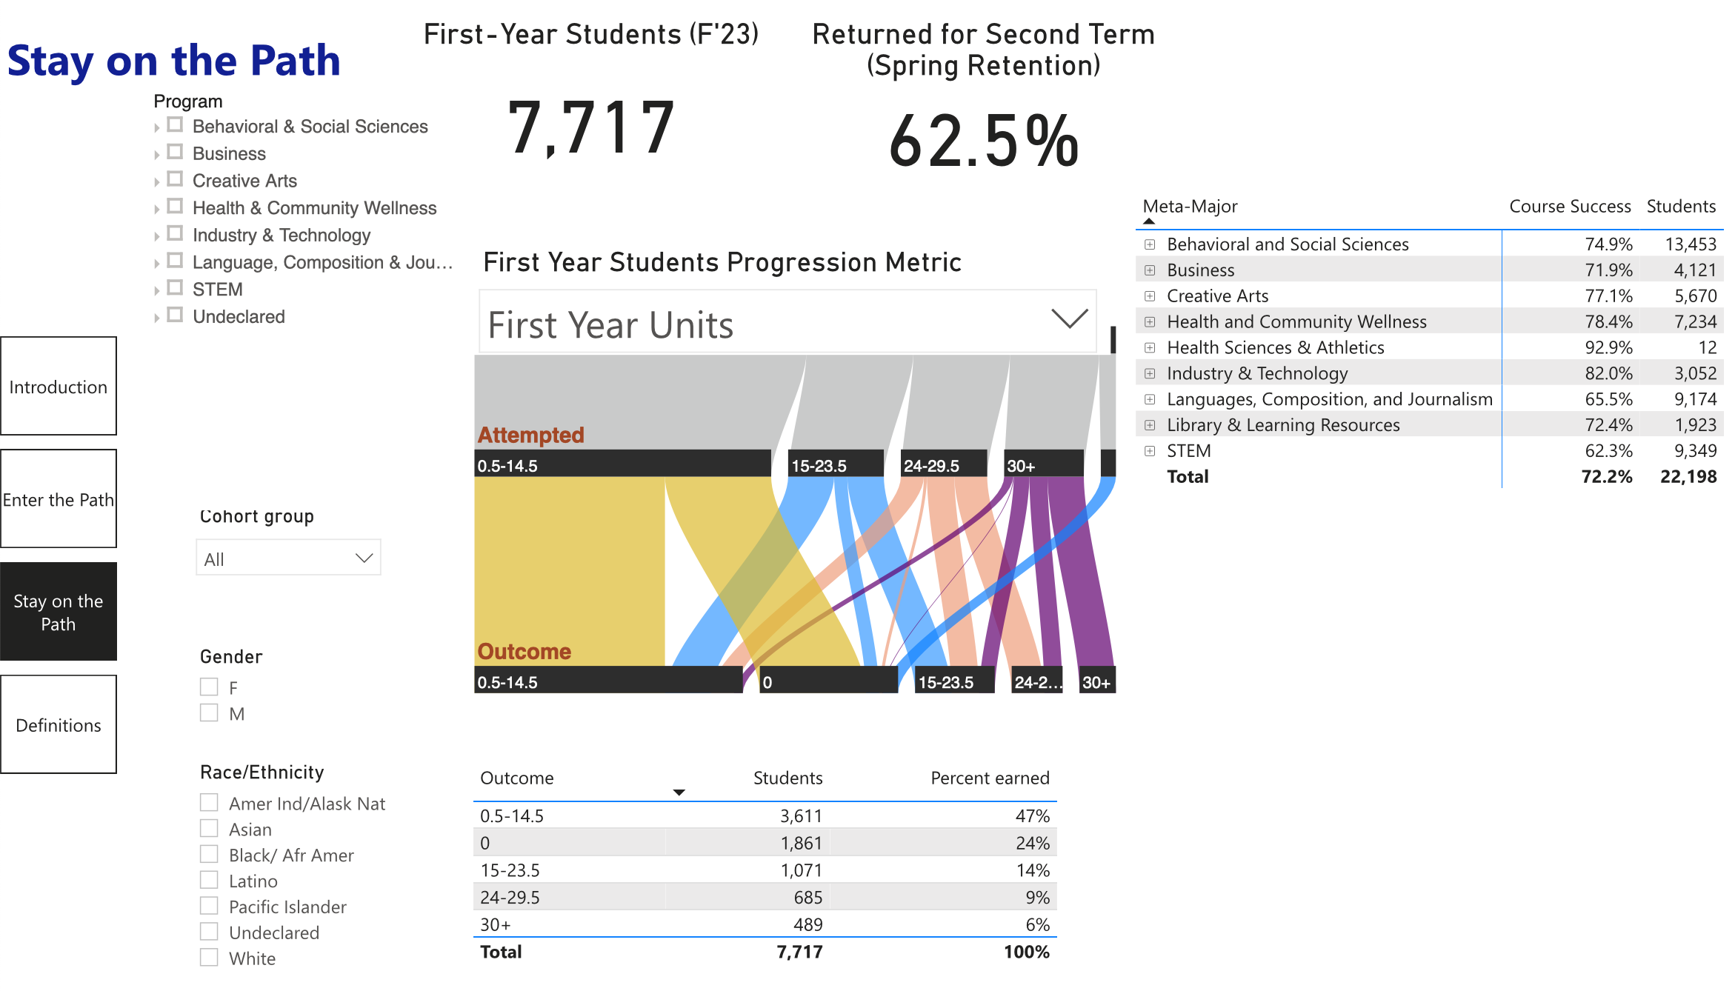

Slide 9
Remind Students to Register for Spring Classes!
Student Academic Dishonesty
Education Code 76224(a) - Faculty determine the grades in their courses except under rare instances of mistake, bad faith, fraud or incompetency.
Let's get the BSS rate of return up to the College average!
Academic Dishonesty – report using an Incident Report and Referral form (aka Maxient) and it will be addressed from a disciplinary stand-point by the Student Development Office.
Grade Change Petition – if a student believes they did not cheat and there was mistake, bad faith, fraud or incompetency, they may file a grade change petition and pursue that process.

Slide 10
SRP - Retirement Incentive
College Reorganization
The College has not fully recovered from the pandemic enrollment losses, yet we have more employees than we did before the pandemic.
SRP deadline extended to Nov. 22. Only four people additionally decided to take the SRP, which was below the threshold to raise from 75% to 85%.
Announcements
Retirement/Holiday party - lunch provided! – December 12, 1-3pm – BSSB Faculty Lounge.
Please give food and gift donations to Cecelia.
At its Nov. meeting, the Board approved the SRP for 84 employees. Solid number, but more would be better.
Next Board meeting: Dec. 18th. The list of people retiring will be in the agenda. The Board will consider whether to approve the additional four applicants. Also on the agenda is delaying the 2% salary increase for unrepresented employees (includes managers and confidential employees).
As a result of the SRP, Academic Affairs. Student Services, and Administrative Services are considering ways to reorganize their areas. Current estimate is 20-25% of the positions will be replaced.

Slide 11
