Slide 1

BSS Division Council
Thursday, April 24, 2025

Slide 2
BSS Division Council
Reports
Business and Reminders
Federation – John Baranski
Evaluations
Associated Students’ Organization
Prioritization of Annual Plan Requests
Annualized Scheduling Progress
Announcements
Study Abroad Cancelation
Academic Awards
Puzzle Donations
Part-time Faculty Division Council Member(s)? Selection?
SLOs - on behalf of Eduardo Munoz
Membership
Anthropology – Angela Mannen
Art History – Ali Ahmadpour
Child Dev’t – Michelle Moen
Comms Studies – Mark Crossman
Econ – Tanja Carter
Ethnic Studies – Xocoyotzin Herrera
History – Sandra Uribe
Philosophy – Felipe Leon
Political Science – David Reed
Psychology/Human Dev’t – Renee Galbavy
Sociology – Stacey Allen
Staff – Cecelia Mataalii
Chair/Dean – Chris Gold
Guests
ASO – Nicolas Tomsio
BSS Metamajor Counselor
Federation – John Baranski
BSS Associate Dean – Irena Zugic
Notes:
Yeah, it’s always good just to nag them on SLOs 😊 Just mention to them that hopefully things are going smoothly for faculty in their departments scheduled to assess this semester, and if they have any issues to contact me.

Slide 3
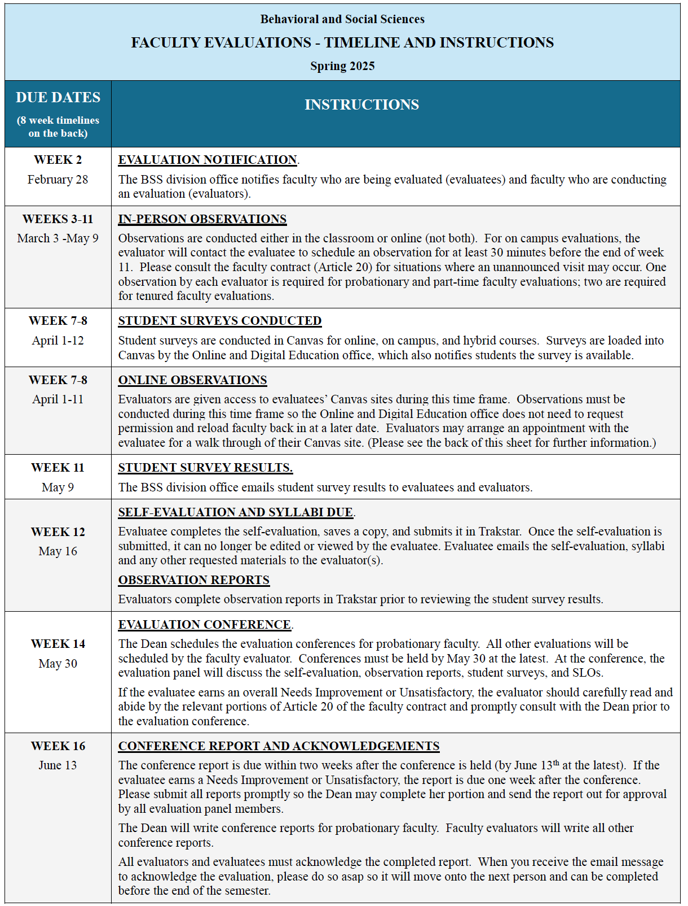
In-Person Observations – these are on-going right now. Please
schedule a time with evaluatees for an observation, or reach out
to your evaluator to check in about a time.
Online Observations – the window has closed. Please contact Gema Perez if you need to be placed back into a class.
Student Survey Results – have been distributed for 16 week and 1st 8 week classes. 2nd 8 week surveys will be conducted May 19-25 and will be distributed by Ana as soon as she receives them.
Self-Evaluations – not due until May 16.

Slide 4
Prioritization of Annual Plan Funding Requests
Anthropology Museum Special Assignment
Forensics Travel Budget Restoration
Childhood Education (CDEV) Teacher Stipends
CDEV – Student Live Scans
CDEV – Permit Specialist
CDEV – 40% Reassign
CDEV – Child Development Center

Slide 5
BSS Division Council
Business and Reminders
Annualized Scheduling Progress
Academic Awards
Puzzle Donations
Study Abroad Cancelation

Slide 6
Part-time Faculty – Division Council Member? Selection?
Should we add a part-time faculty member to our Division Council membership?
If so, how will they be selected? Appointment? Nomination and voting by BSS part-time faculty?

Slide 7

Announcements

