Slide 1

BSS Division Council Minutes
Thursday, November 16, 2023
Meeting minutes are embedded in the PowerPoint in boxes with red text.

Slide 2
BSS Division Council Attendance
Meeting minutes are embedded in the PowerPoint in boxes with red text.
Members:
☑ Dean: Christina Gold
☑ Philosophy: Felipe Leon
☑ Anthropology: Angela Mannen
☑ Art History: Ali Ahmadpour
☑ Political Science: David Reed
☑ Psychology: Renee Galbavy
☑ Childhood Educ: Michelle Moen
☑ Communication Studies – Mark Crossman
☑ Sociology: Stacey Allen
☑ Economics: Tanja Carter
☑ Ethnic Studies: Xocoyotzin Herrera
☑ History: Jamahl Melton
☑ Human Dev’t: Juli Soden
☑ ASO: Tala Ashkar
☑ ASO: Jake Smith
☑ ASO: Linus Yeh
☑ Staff: Beverly Knapp
Guests: ☑ Associate Dean: Irena Zugic
☑ Counselor: Cheryl Kroll
☑ Staff: Cecelia Mataalii

Slide 3
BSS Division Council Agenda
Business, Announcements, and Reminders
Evaluations – Self-Evaluation and Student Survey Results
Program Annual Planning (2024-25)
Fall Scheduling and On Campus Classes
Retro Checks – pick up in the division office.
Sabbaticals
Load Banking
Christmas Party
Reports
Counselling – Cheryl Kroll
ASO – Tala Ashkar and Jake Smith
Program Reports – Anthropology, Art History, Childhood Education, Communication Studies, Economics, Ethnic Studies, History, Human Development, Philosophy, Political Science, Psychology, Sociology, Women’s Studies.

Slide 4
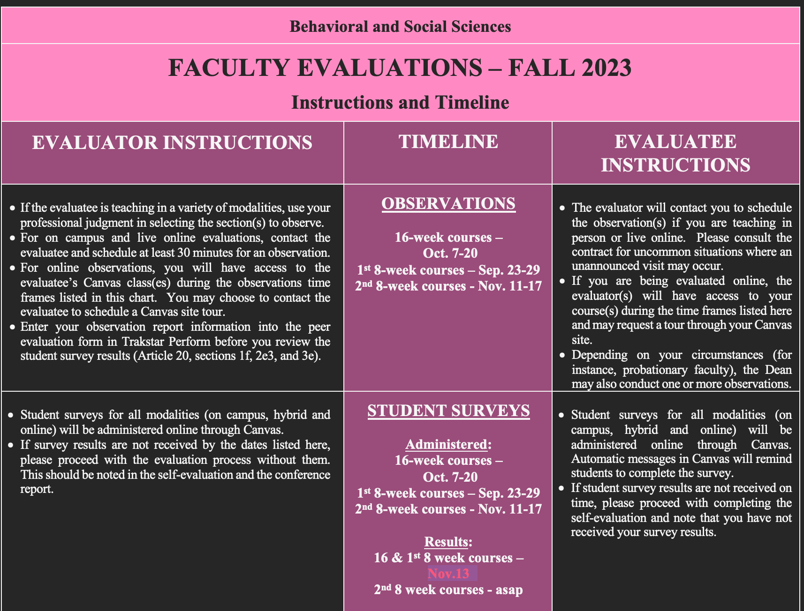

Slide 5
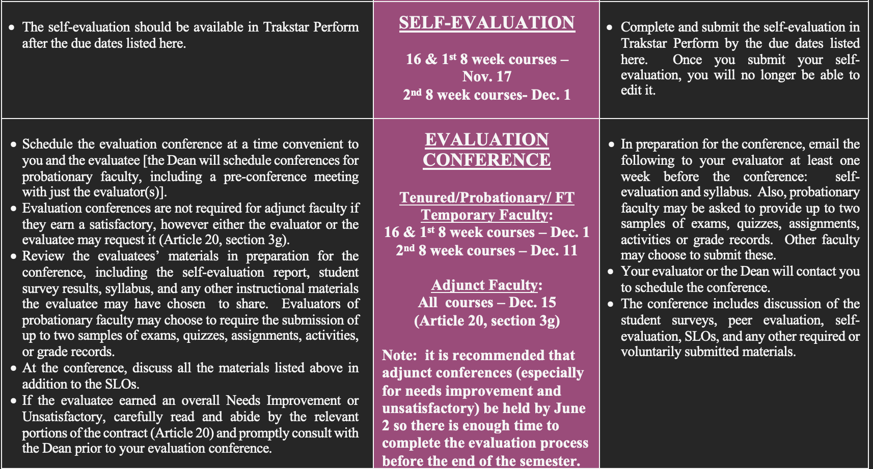
The student survey results were not distributed to evaluatees until the beginning to week 12. According to the contract, the self-evaluation then is not required to analyze the results. The survey results can be discussed in the conference though. The data requires a surprising amount of fussing to produce the instructor and division averages.

Slide 6
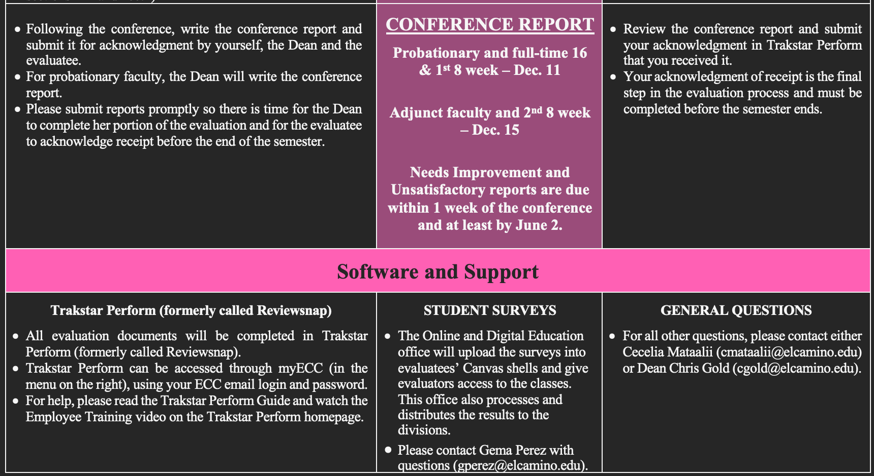
Conference reports with part-time faculty are not required, but they are good practice and they give part-time faculty an opportunity to get to know someone in the department. This is especially important as we head out of COVID.

Slide 7
Program Annual Planning (2023-24 and 2024-25) – holding pattern
We are still in a holding patterns as adjustments are made to the College budget in light of the newly negotiated salaries. Decisions are yet to be made re: 2023-24 budget requests and annual plans from the programs will likely need to wait to be submitted until faculty are back for the Spring semester. In the meantime, please be thinking about your program planning items ahead of time.
Funding requests for 2023-24 academic year have not been decided yet (waiting for contract negotiation to complete).
Annual Planning process for 2024-25 has not yet been announced, but please start thinking about your program plan and budget requests.

Slide 8

Fall Scheduling and On Campus Classes
On-campus enrollment is up but Chris is having a lot of difficulty staffing on-campus classes. Many part-time faculty are refusing on campus classes. Full-time faculty, please consider requesting more on-campus sections. If you are teaching a TTh on campus section in Spring perhaps you could teach 2 back-to-back on campus TTh sections in Fall.
Contract requires faculty to be on campus three days a week.
Dean is having LOTS of difficulty with staffing on campus sections.
Many PT faculty are only accepting online classes.
We don’t need more people, we need the people we have to teach on campus.
Fall Schedule requests being distributed soon – please be mindful of this problem and request more on campus classes.

Slide 9
Retro Checks, Sabbaticals and Load Banking
Faculty will receive an email when it is time to pick up their retro check or have it mailed. Cecelia is collecting information for those who would like to have it mailed. Only 4 sabbaticals are being awarded this Spring. This is especially disappointing to faculty who have applied repeatedly and not yet received sabbatical. One faculty member is skeptical about the accuracy of budget estimates. The committee discussed load banking and how it could be used to take off a full semester or teach a lighter load one semester. See the details below.
Retro Checks
Pick up in the division office. Ready before the holiday.
Sabbaticals
Only four in 2024-25.
Contract language says “up to 12.”
Cost saving measure to reduce $23m deficit from all our raises and in preparation for the end of hold harmless.
Load Banking
Teach overload/winter/summer without pay.
“Bank” the load.
Teach a semester with a lighter load or don’t teach a full semester (depending on how much you’ve banked).
Must use your bank with 3-4 years or it will be paid to you automatically.

Slide 10
BSS Division Council Agenda
Faculty like the idea of bringing in food for the Christmas party and combining it with a potluck component for generous faculty who enjoy cooking and so we can all enjoy Luukia’s macaroni and cheese! Week 16 is best because faculty are much less busy than in week 15.
Business, Announcements, and Reminders
Evaluations – Self-Evaluation and Student Survey Results
Program Annual Planning (2024-25)
Fall Scheduling and On Campus Classes
Retro Checks – pick up in the division office.
Sabbaticals
Load Banking
Christmas Party
Reports
Counselling – Cheryl Kroll
ASO – Tala Ashkar and Jake Smith
Program Reports – Anthropology, Art History, Childhood Education, Communication Studies, Economics, Ethnic Studies, History, Human Development, Philosophy, Political Science, Psychology, Sociology, Women’s Studies.

Slide 11
Counseling Updates for Department Meetings: Fall 2023
Transfer Center Events:
https://www.elcamino.edu/academics/transfer-center/events-and-workshops/index.aspx.
November 30th is the deadline to complete CSU and UC applications for Fall 2024. Please encourage students to attend one of our application workshops and to apply if they have not already done so. Both in person and virtual workshop options will be available through the end of November. Students will sign up on the Transfer Center website.
Career Center Events:
https://www.elcamino.edu/support/careers/index.aspx
More meta major resources have been added to this website and students can now access job opportunities here as well.
Scheduling Counseling Appointments:
Please encourage students to begin their winter/spring planning now. Students are able to book appointments via this link: https://www.elcamino.edu/support/counseling/appointments.aspx.
Meta Major Outreach for Spring 2024
Planned events include Chat With a Counselor on March 12, April 23rd and May 7th from 9:30-11 am; a social work panel on 3/12 or 3/26 from 12:30 -2; a transfer university panel for BSS majors (date TBD); the creation of a BSS meta major newsletter for BSS students; and continued work on our developing social media page that will also include links to our division clubs. Outreach will also continue to our African American students who need an education plan and are not in a cohort.
Any questions?
The Division thanked Cheryl for providing helpful updates and for doing such a great job with our students. Please follow the new BSS Instagram account at BehavioralSS_ECC and give it lots of likes! In Spring, BSS club information and other events can be posted there.

Slide 12
BSS Division Council Agenda
The ASO participated in a Basic Needs Harvest Festival in which they collected donations for the pantry and encouraged students to volunteer. They had a table at College night and held open forums for students.
Business, Announcements, and Reminders
Evaluations – Self-Evaluation and Student Survey Results
Program Annual Planning (2024-25)
Fall Scheduling and On Campus Classes
Retro Checks – pick up in the division office.
Sabbaticals
Load Banking
Christmas Party
Reports
Counselling – Cheryl Kroll
ASO – Tala Ashkar and Jake Smith
Program Reports – Anthropology, Art History, Childhood Education, Communication Studies, Economics, Ethnic Studies, History, Human Development, Philosophy, Political Science, Psychology, Sociology, Women’s Studies.

Slide 13
Department Reports
Anthropology – Anthro faculty are excited to get back to planning events like they had prepandemic. Lawrence Ramirez delivered a presentation on haunted houses and has an upcoming presentation planned on “Yuletide, Christmas and Identity.” Fourteen Anthro students have begun working to revive the club in Spring. They are meeting again on Nov. 28th.
Childhood Education – The Child Development Club meets every week and are having presentations by professionals working in the discipline.
Communication Studies – Forensics held a successful on campus tournament. One highlight – the Crossman’s daughter brought her Forensics students from another College to participate. A few hundred students attended the speaker’s forum event.
Ethnic Studies – The ESTU department has received Chancellor’s Office funding to help implement Area F and to fund activities promoting equity. They are in the planning stages of how to spend the money. They are particularly interested in taking students to conferences and on trips. Additionally, they are planning an Ethnic Studies Conference on campus with speakers on May 14-15. Xocoyotzin will be organizing Chicano heritage events in late April and early May. He will be leading another study abroad trip to Madrid in Summer 2024. It is possible that remaining money from the Chancellor’s Office could be used to fund scholarships to students to participate in Study Abroad.
History – History fill rates have been rising and are up to 83.5%. History 110 will be assessed in Spring. In their SLO assessments, History faculty are especially interested in assessing student use of primary and secondary sources in their assignments.
Human Development – HDEV has had a busy semester. They are revising HDEV 110 and 110H to meet Area D. The are also developing a for-credit service-learning class and 7 non-credit courses. They have a class in an LGBTQ+ link and have designed SOCS 203 as a welcoming space for the students for this link and future linked courses. In Spring, the LGBTQ+ link will include History 101 and Psychology 119.

Slide 14
Department Reports
Philosophy – The Philosophy Club meets every Thursday and there are about 20 students participating. The Medical Ethics course that is offered to the Respiratory Care BS students went very well. The students wrote especially strong papers. An Inductive Logic class is currently being developed. A Feminist Philosophy class is on the horizon. Felipe will be teaching Political Philosophy this semester (a special thanks to David Reed for “sharing” this class which has traditionally only been taught by the Political Science department.
Political Science – The Political Science Club is not active this semester because the President didn’t get the paperwork in on time. They will be back in Spring. All four POLI faculty members attended College Night and enjoyed dinner together. They are assessing POLI 1.
Psychology – The LGBTQ+ learning community is great! They are hoping to restart the Psychology Club.
Sociology and Women’s Studies – They are excited about a future Feminist Philosophy class that would be a nice fit for the Women, Gender and Sexuality Studies AA. The Sociology Club is on hiatus, but they are hoping to bring it back soon. Martin Leyva joined the faculty this Fall and has been very involved on campus. He and Stacey hosted a FIRST event for formerly incarcerated students that was very successful. A panel of students shared their experiences. They have been successfully using Microsoft Teams for SLO collaboration. It’s a great tool for record keeping and document sharing.

