Slide 1

Economics Department Meeting
Wednesday, October 9, 2024

Slide 2
Economics Department - Agenda
SLOs – Spring and Fall 2024
Fall Enrollment and Scheduling
Committee Membership
Curriculum Review
Evaluations
Updating Pathways

Slide 3
SLO Assessment
Spring 2024
None because of Program Review.
Fall 2024
  None (assessment resumes in Spring 2025)
  Canvas outcomes will be used.

Slide 4
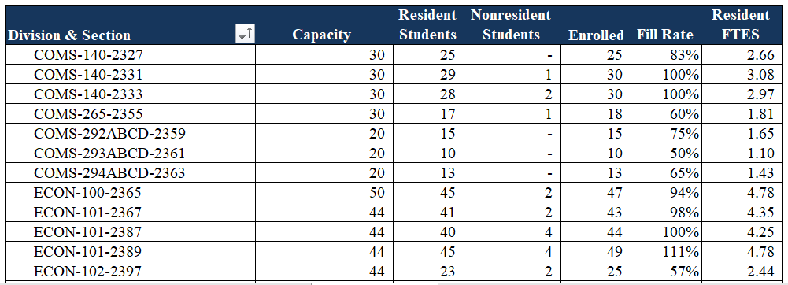
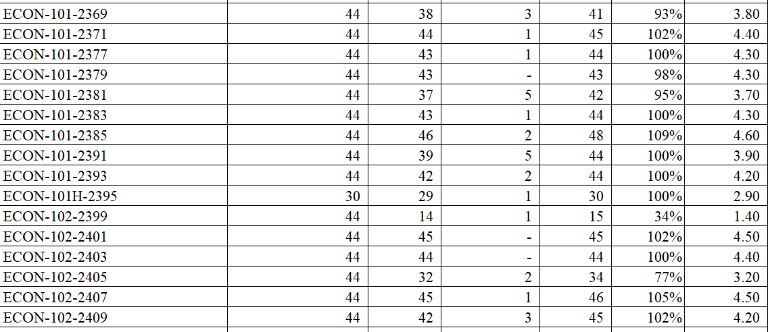
Fall Enrollment - Online possible fraud

Slide 5
Fall Enrollment and Spring Scheduling – On Campus and Hybrid possible fraud
On Campus
Hybrid

Slide 6
Committee Membership
Division Council – Tanja Carter
BSS Division Curriculum Committee – Tanja Carter
BSS SLO Committee – Mine Inouye
Annual Plan – Tanja Carter

Slide 7

Curriculum Review – Fall 2024

Slide 8
Faculty Evaluations
Everyone who is being evaluated or is evaluating should have received and email from Cecelia. Let Cecelia and I know if you get an email from Trakstar that is incorrect.

Slide 9
Updating the Economics AA and AAT Pathways
Due Date: End of the Semester
Please:
Review your degree and see if any changes are needed.
Review the order of courses and indicate any changes (please keep transfer-level Math and English in the first year).
Narrow down the choices for all the green and yellow boxes to 3-4 choices.
Review the course information provided by the Dean to inform your decisions.

Slide 10
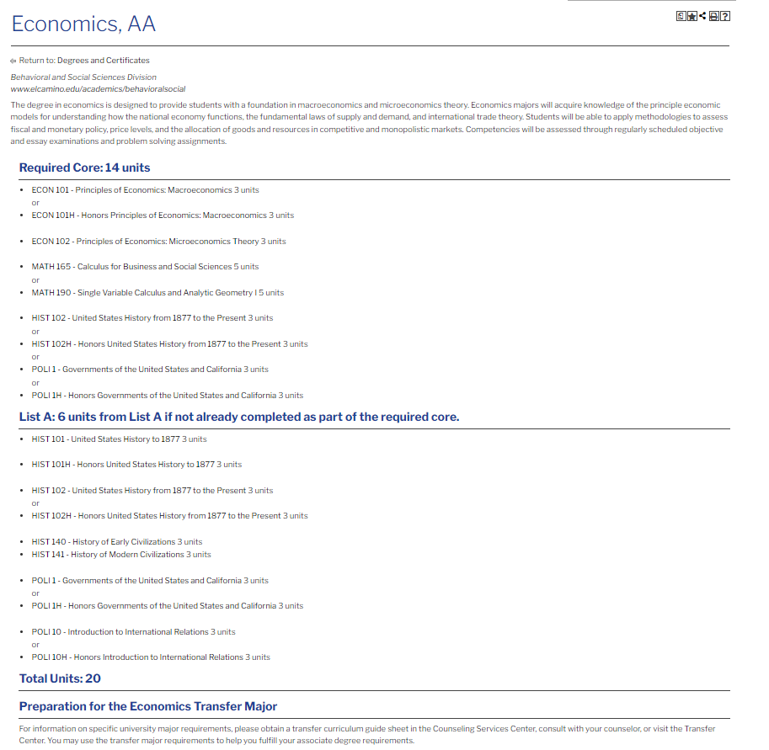
Updating the AA Degree
Due Date: End of the Semester
Please:
Review your degree and see if any changes are needed.
Review the order of courses and indicate any changes (please keep transfer-level Math and English in the first year).
Narrow down the choices for all the green and yellow boxes to 3-4 choices.
Review the course information provided by the Dean to inform your decisions.

Slide 11
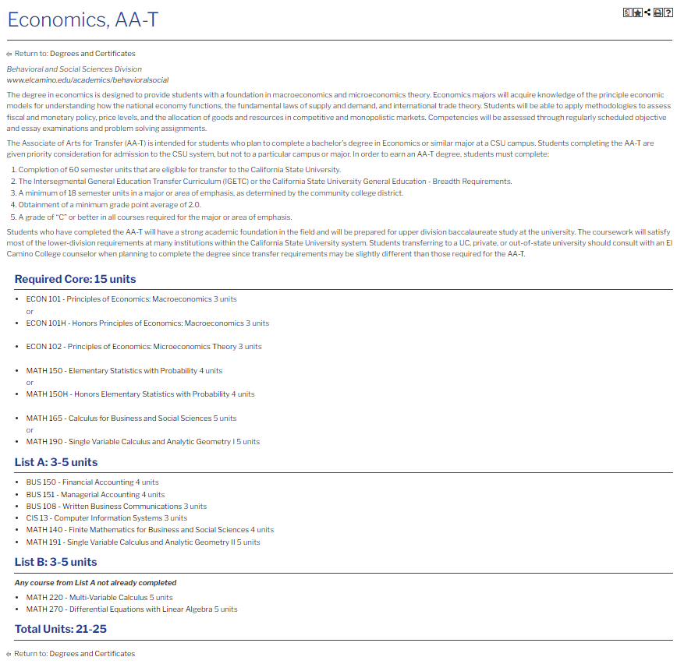
Updating the AAT Degree
Due Date: End of the Semester
Please:
Review your degree and see if any changes are needed.
Review the order of courses and indicate any changes (please keep transfer-level Math and English in the first year).
Narrow down the choices for all the green and yellow boxes to 3-4 choices.
Review the course information provided by the Dean to inform your decisions.

Slide 12
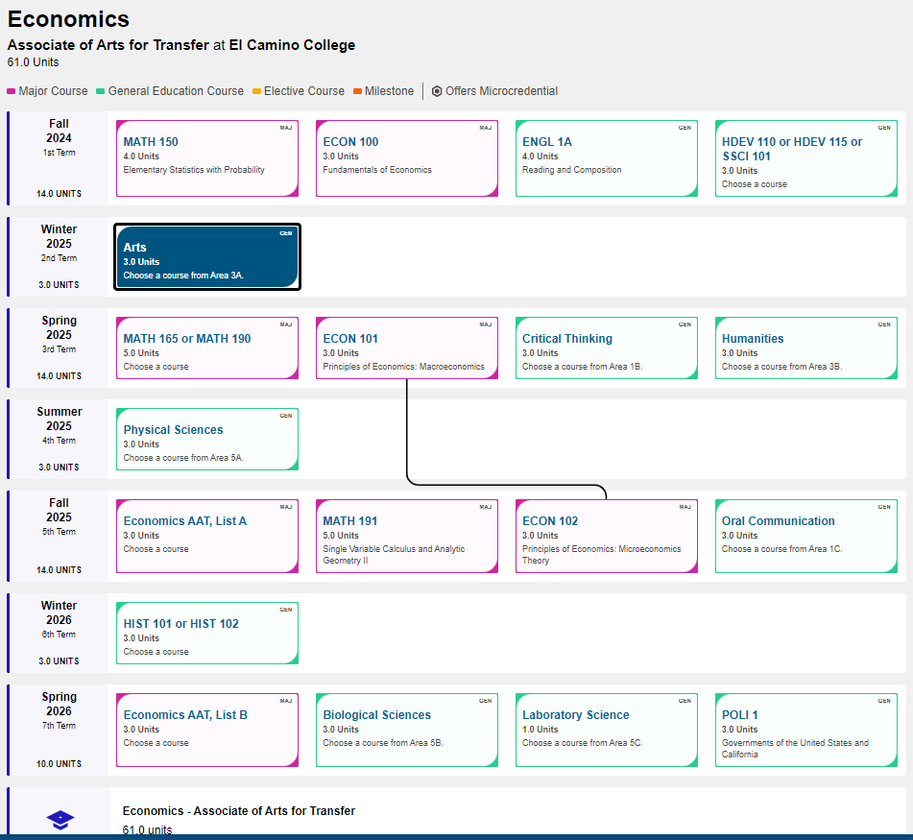
Updating the Economics AA and AAT Pathways
Due Date: End of the Semester
Please:
Review your degree and see if any changes are needed.
Review the order of courses and indicate any changes (please keep transfer-level Math and English in the first year).
Narrow down the choices for all the green and yellow boxes to 3-4 choices.
Review the course information provided by the Dean to inform your decisions.

Slide 13
