Slide 1
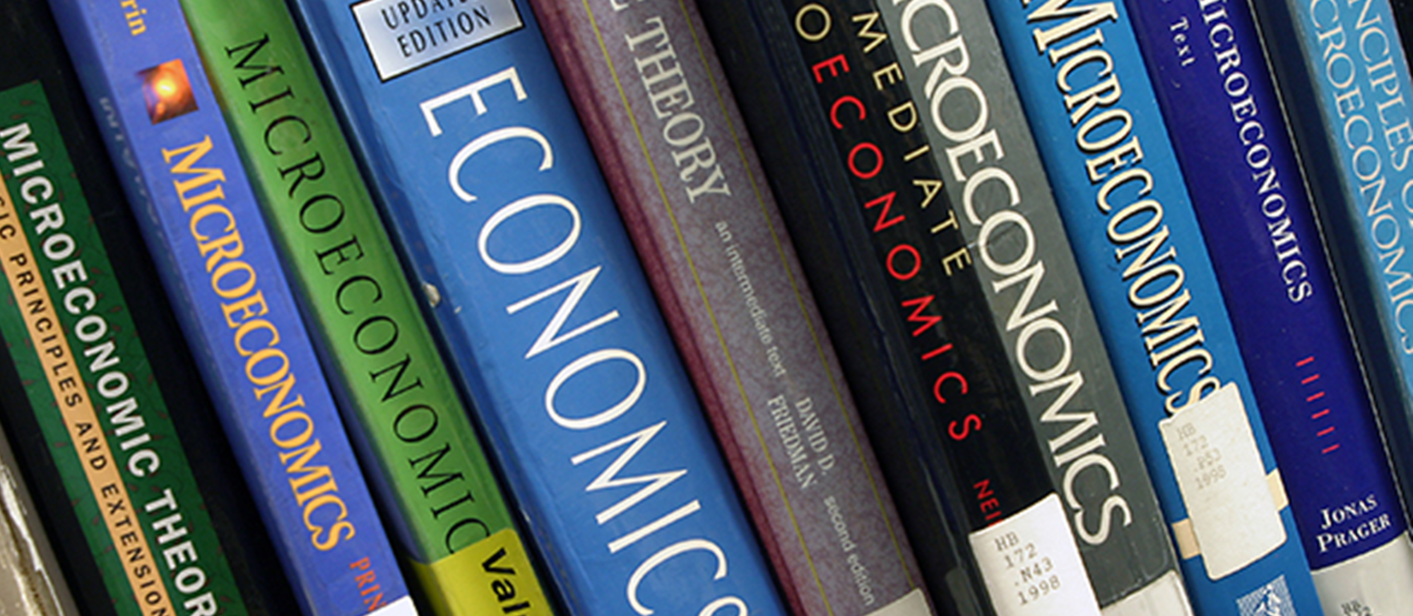
Economics Department Meeting
Wednesday, September 24, 2025

Slide 2
Economics Department - Agenda
MINUTES: In red text in boxes within the PowerPoint.
Attendance: Tanja Carter, Michael Fradkin, Brett Marschall
Christina Gold.
SLOs – Spring and Fall 2025
PT Faculty Search
Fall Enrollment
Curriculum Review

Slide 3
SLO Assessment
Tanja will finish SLOs for 101 but Mine needs to do 102 since
she doesn’t teach it. Gerardo may be able to still do ECON
100.
Spring 2025
ECON 100, SLO 1
ECON 101, SLO 1
ECON 102, SLO 1
PLO 1
Fall 2025
None! Zip! Nada!

Slide 4
Economics Enrollment – Fall 2022-25
Fill rates are excellent, and Counselors have been asking for more sections of ECON.
23 sections
89% Fill Rate
24 sections
99% Fill Rate
24 sections
94% Fill Rate
Another section of
ECON 101 was added
today.

Slide 5
Economics Department - Agenda
We may need to hire one more part-time faculty member to add more sections to meet student demand.
Counselor’s Report
SLOs – Spring and Fall 2025
Fall Enrollment
PT Faculty Search
Curriculum Review

Slide 6
Curriculum Review – Fall 2025
ECON C2001 and C2002 are in the curriculum review process. There are comments in Curriculog. Tanja will review the comments and make the updates.
ECON C2001 Principles of Microeconomics
ECON C2002 Principles of Macroeconomics

