Slide 1

Ethnic Studies Department Meeting
Tuesday October 15, 2024

Slide 2
Agenda
Fall Enrollment and Scheduling
Committee Membership
Curriculum and Courses
SLO Updates
Faculty Search - Part-Time
Full-Time Faculty Position Request
Evaluations
Updating Pathways
Study Abroad

Slide 3
Fall Enrollment and Spring Scheduling
Year | # of Sections | Seats Filled | Fill Rate
Fall 2024 | 30 | 1,294 | 105%
Fall 2023 | 25 | 1,014 | 95%
Fall 2022 | 15 | 542 | 86%
Fall 2021 | 9 | 234 | 65%

Slide 4
Committee Membership
Division Council – Xocoyotzin Herrera
Load Committee – Taka Tanaka
BSS Division Curriculum Committee – Amina Humphrey
BSS SLO Committee – Xocoyotzin Herrera
Annual Plan – Xocoyotzin Herrera
Conference Committee – Taka Tanaka

Slide 5
Curriculum - Amina
  Review
    Ethnic Studies 1 - Taka
  New Courses
    Ethnic Studies 9 – Intro to Asian Pacific Islander DESI American Studies
      Waiting on CSU and IGETC approval
    Ethnic Studies 1H - Taka
    Intro to African American Studies - Amina
  c) Degrees – ADTs? Chicano Studies ADT requires Chicana/Latina in Contemporary Society Course

Slide 6
SLO Assessment
Spring 2024 Assessments
All completed and entered. Thank you!
Fall 2024 Assessments
ESTU 1 SLO 2 Xocoyotzin
ESTU 3 SLO 2 Xocoyotzin
ESTU 5 SLO 2 Xocoyotzni
SSCI 101 SLO 2 Felipe Leon and Sandra Uribe
SSCI 103 SLO 2 Amina

Slide 7
Part-time and Full-time Faculty Searches
Full-Time Faculty Position Request
  Ranked 5th by Division Council (Psyc, Anthro, HDEV, Hist, Ethnic Studies)
  Amy Himsel – BSS Faculty Rep
  College committee submitted rankings last week
  Results in next week or two
  President will decide before Thanksgiving
Part-Time Faculty Search – 3 new part-time colleagues teaching 6 sections.

Slide 8
Faculty Evaluations
Everyone who is being evaluated or is evaluating should have received and email from Cecelia. Let Cecelia and I know if you get an email from Trakstar that is incorrect.

Slide 9
Updating the Ethnic Studies Pathways
Due Date: End of Semester
Please:
Review your degree and see if any changes are needed.
Review the order of courses and indicate any changes (please keep transfer-level Math and English in the first year).
Narrow down the choices for all the green and yellow boxes to 3-4 choices.
Review the course information provided by the Dean to inform your decisions.

Slide 10
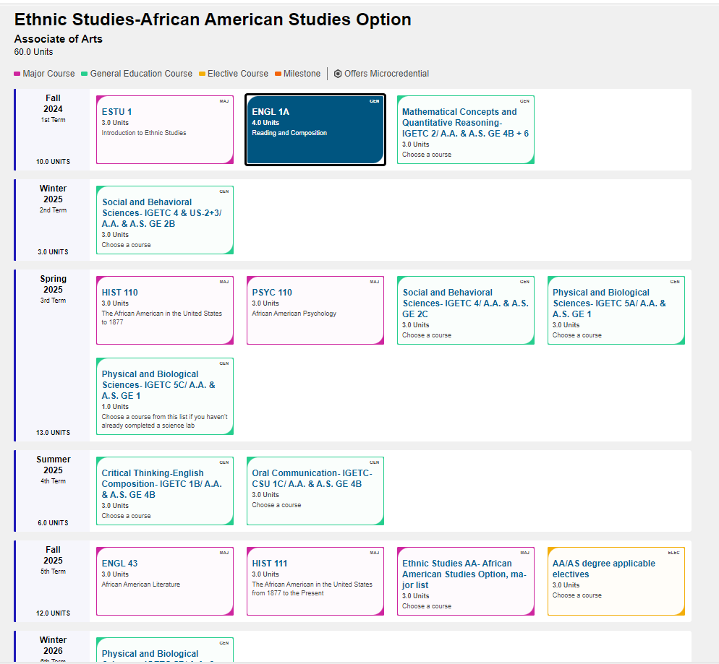
Updating the Pathways

Slide 11
Study Abroad

