Slide 1
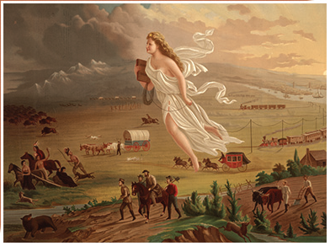
History Department Meeting
Thursday October 10, 2024

Slide 2
History Department - Agenda
Minutes are embedded in the PowerPoint in red boxes.
In attendance: John Baranski, Chris Gold, Xocoyotzin Herrera, Hong Herrera Thomas, Saul Panski, Kirsten Resnick, Orion Teal, Sandra Uribe.
Fall Enrollment and Scheduling
Committee Membership
Curriculum and Courses
Review
Course Cap Application
AA/AS GE – Elimination of History and Political Science requirements
Non-GE Course Inactivation – American Studies 7
Program Review Update – John
SLO Updates
Faculty Searches – Full-Time and Part-Time
Evaluations
Updating Pathways

Slide 3
Fall Enrollment and Spring Scheduling
Enrollment and fill rates in history sections are rising.
Year | # of Sections | Seats Filled | Fill Rate
Fall 2024 | 63 | 2,381 | 93%
Fall 2023 | 59 | 2,206 | 87%
Fall 2024 | 61 | 2,196 | 85%

Slide 4
Committee Membership
Division Council – Sandra Uribe
Load Committee – Orion Teal (History); Hong Herrera Thomas (Federation)
BSS Division Curriculum Committee – John Baranski
BSS SLO Committee – Orion Teal
Annual Plan – John Baranski/Orion Teal

Slide 5
Curriculum - John
An application to lower the course caps for History 101/102 has been submitted. The request is to reduce the cap from 45 to 40.
Common Course numbering for History 101 and 102 is coming up.
Discussion of the elimination of the History & Poli requirements by CSUs is ongoing.
Would like to schedule Asian American History each semester if enrollment warrants it.
Review
History 101 & 101H
History 102 & 102H
History 152 (Latin America Through Independence)
Course Cap Application
AA/AS GE – Elimination of History and Political Science requirements
Non-GE Course Inactivation – American Studies 7

Slide 6
Program Review and SLO Assessment
Orion reported that all assessments will be conducted through Canvas outcomes. The google doc doesn’t make sense anymore given the new process. Orion will help faculty with assessment. He will sent out instructions and videos to help. The timeline for assessment will change, and assessments will need to be completed during the semester in which they are assessing. Saul requested examples of assessment from FT faculty.
John will send out the program review for feedback.
Spring 2024 Assessments
All completed and entered. Thank you!
Fall 2024 Assessments
SLO #1 in HIST 101, 101H, 105, 108, 110, 112, 114, 129, 140, 154
Program Review Update - John

Slide 7
History Faculty Searches
Full-Time Faculty Position Request
Ranked 4th by Division Council (Psyc, Anthro, HDEV, Hist, Ethnic Studies)
Amy Himsel – BSS Faculty Rep
College committee submitted rankings yesterday
Results in next week or two
President will decide before Thanksgiving
Part-Time Faculty Search (John) – US and World

Slide 8
Faculty Evaluations
Everyone who is being evaluated or is evaluating should have received and email from Cecelia. Let Cecelia and I know if you get an email from Trakstar that is incorrect.

Slide 9
Updating the History Pathway
Due Date: End of Semester
Please:
Review your degree and see if any changes are needed.
Review the order of courses and indicate any changes (please keep transfer-level Math and English in the first year).
Narrow down the choices for all the green and yellow boxes to 3-4 choices.
Review the course information provided by the Dean to inform your decisions.

Slide 10
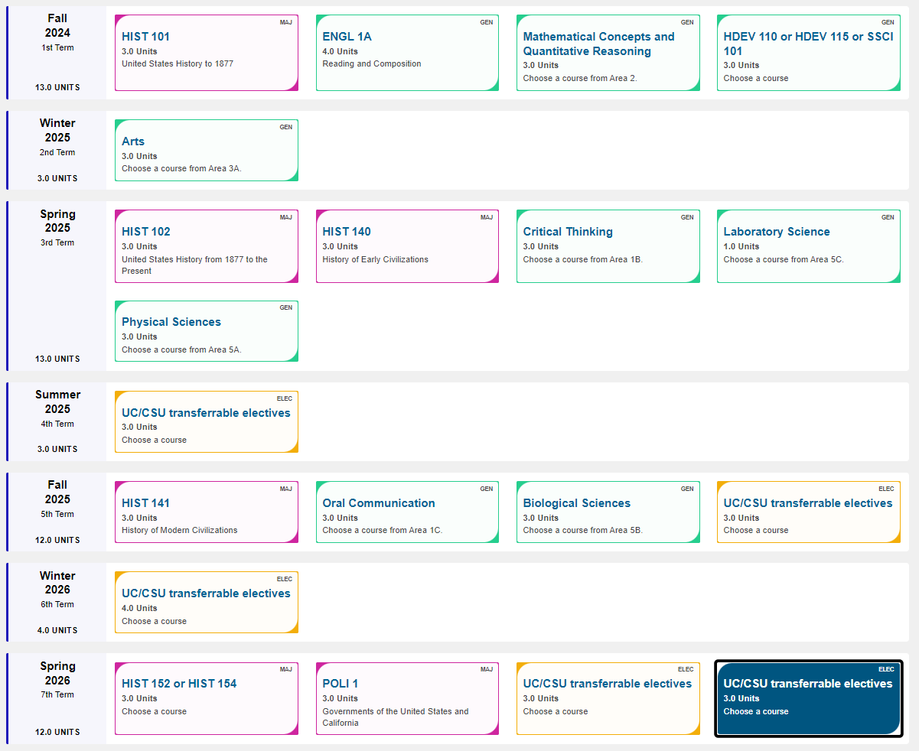
Updating the History AAT and Pathway

