Slide 1
Philosophy Dept. Meeting
Thursday, April 2, 2024

Slide 2
Philosophy Department
Meeting Notes are found in red text embedded in the PowerPoint.
Attendees: Larry Fike, Randy Firestone, Roberto Garcia, Chris Gold (Dean), Cheryl Kroll, Felipe Leon, Melissa Ramirez, Luca Struble, Irena Zugic (Assoc. Dean).
Reports and Announcements
Business
Counselor’s Report
Modality Balance
Fraudulent Students
SLOs and Curriculum
Annual Plan and Comprehensive Integrated Plan
Philosophy Club and Announcements
Enrollment and CalGETC

Slide 3
Counseling Updates for Department Meetings: Spring 2024
Transfer Center Events:
https://www.elcamino.edu/academics/transfer-center/events-and-workshops/index.aspx.
The Transfer Center is hosting a number of in person visits this semester, including CSULB on 4/4 from 11-1 and USC on Tuesdays from 1-3 until the end of April. These are held on the first floor of the Student Services Center. A full list of university visits can be found on the TC website, including those with virtual options.
For UCSB bound students, the Transfer Center is hosting a campus tour on Saturday, April 13th. Students sign up in the Transfer Center w/ a $5 refundable deposit.
For UCLA bound students, the Transfer Center is hosting its annual tour/STOMP Transfer Conference on Friday, April 19th. Students can sign up in the Transfer Center with a $5 refundable deposit.
Career Center Events
www.elcamino.edu/support/careers
Blueprint Job Fair for Youth and Young Adults – April 25th from 10-2 in the Student Services Plaza (but our students can come too!)
“What Can I Do With a Major in Psychology?” workshop on Tuesday, April 16th from 1:30-3 pm in SSB 200.
“Let’s Write Your Resume Workshop” on the following dates: 4/23; 4/24; 5/20 and 5/30 in Comms 207. Students sign up on the Career Center’s website.
“Undecided Majors Workshops” on the following dates: 4/4; 4/15; 4/18; 4/22; 5/6; and 5/9. Students sign up on the Career Center’s website.
Scheduling Counseling Appointments:
Please encourage students to book NOW for summer/fall planning. Students are able to book appointments via this link: https://www.elcamino.edu/support/counseling/appointments.aspx.
Meta Major Drop Ins (Counseling Division): Tuesdays from 12-1 for BSS, HCW, STEM, Creative Arts, and LCJ; Tuesdays from 1-2 for Business; Tuesdays from 2-3 for ITEC; and Wednesdays from 4-5 for HCW and STEM again.
Meta Major Outreach for Spring 2024
Our BSS meta major newsletter (please share with your students on Canvas)
Chat With a Counselor on April 23rd and May 7th (BSSB indoor Promenade)
A virtual social work program Transfer University Panel on 4/25
A BSS meta major transfer university panel in Fall 2024
Continued work on our social media pages and outreach to African American Students

Slide 4
Philosophy Department
Meeting Notes: We are seeing a decrease in fraudulent students. State is also using ID.Me when students enroll to prevent the issue. Multi-Factor Authentication (MFA) could be helping with this issue as well.
Reports and Announcements
Business
Counselor’s Report
Modality Balance
Annual Plan and Comprehensive Integrated Plan
Fraudulent Students
SLOs and Curriculum
Philosophy Club and Announcements
Enrollment and CalGETC

Slide 5
Modality in PHIL Classes (Spring Week Two)
Meeting Notes: Proportionately as many online sections as across the division. About 2/3 online and even more so in the 2nd 8 weeks.
10% Hybrid
9% Hybrid
25%
OC
26%
OC
64%
Online
65.5%
Online
PHIL
Spring 2024
Week Two
BSS
Spring 2024
Week Two

Slide 6
Annual Plan and Comprehensive Integrated Plan
Meeting Notes: Comprehensive Integrated Plan (CIP) - feedback is that we should focus on larger projects. Dean will send some suggestions. Annual Plan – Work with Library and Learning Resources (LLR) to ask for tutors. Consider myPATH program as well. Supplemental Instruction (SI) Coaches could be requested by sending an email to the Dean.
Comprehensive Integrated Plan
Add new courses and add course content to core classes that reflect ECC student backgrounds, including the development of Latin American, Race, and Feminist/Gender courses.
Promote Philosophy courses and the Philosophy major and encourage Philosophy students to declare their Philosophy major and earn the AAT before transferring.
Encourage equity training and the implementation of equitable instructional practices in order to raise success rates and diminish equity gaps. This includes a modification of class syllabi to foster a more welcoming, equitable approach.
Annual Planning Request from Last Year (for 2023-24)

Slide 7
Program Business
Meeting Notes: PHIL 114 has not been offered in a while – Department agreed to inactivate it. PHIL 116 new course – Roberto was told that it could be offered this Fall, but Associate Dean mentioned that he should double check that information since Lori, the Articulation Officer, needs to wait for UC/IGETC approvals, which usually takes additional year.
SLO Assessment
Fall 2023
All done, as usual.
Spring 2024
PHIL 101 SLO 2
PHIL 103 SLO 2
PHIL 105 SLO 2
PHIL 106 SLO 2
PHIL 114 SLOs 1,2,3 (class not being offered)
Committee Assignments - Spring
Division Council – Felipe
BSS Curriculum Committee – Roberto (DCC Chair!)
BSS SLO Assessment Committee – Randy
Annual Plan – Felipe
Curriculum
PHIL 105 & 105H Critical Thinking and Writing
PHIL 116 Inductive Logic and Probability Theory (Will check when it can first be offered.)
Inactivate PHIL 114
Program Review
Last completed: Spring 2019 - Randy
Next due: Spring 2025 - Roberto

Slide 8
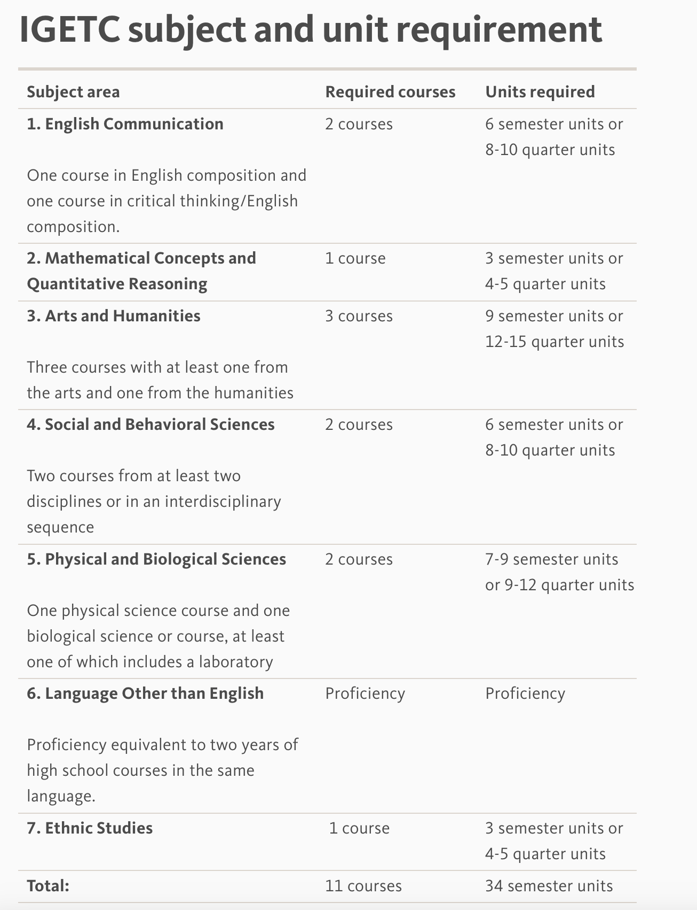
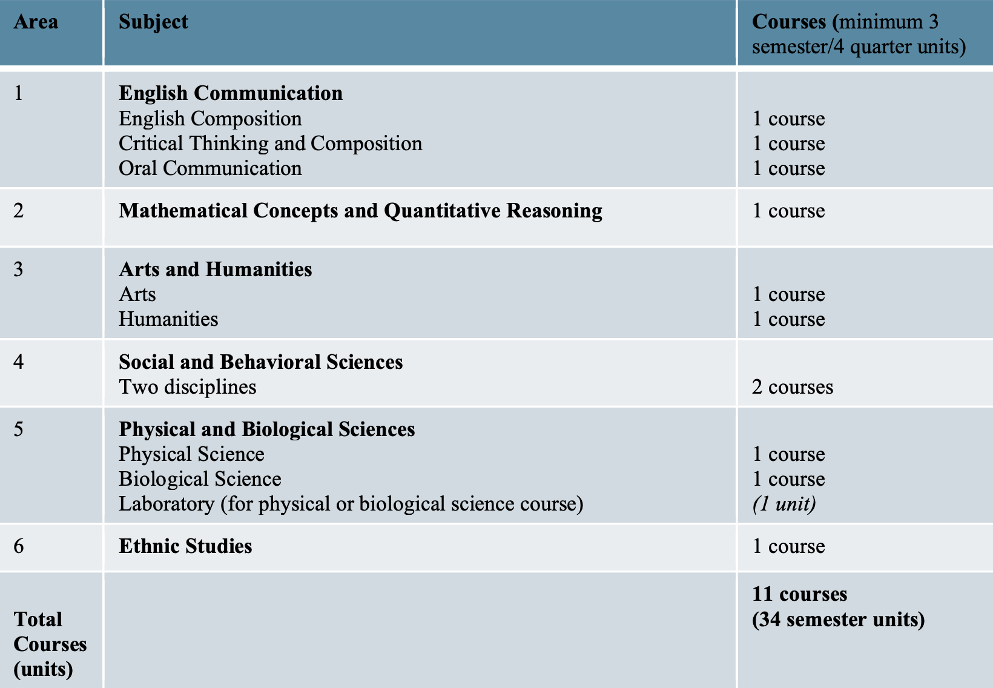
CalGETC – Fall 2025
PHIL 105
PHIL 105/105H
PHIL/POLI 117 3 or 4
PHIL/POLI 117 3 or 4
Meeting Notes: Effective Fall 2025, IGETC will become CalGETC. Department should check with Lori, the Articulation Officer, regarding PHIL 105/105H being grandfathered in or if it should be revised for the new CalGETC.

Slide 9
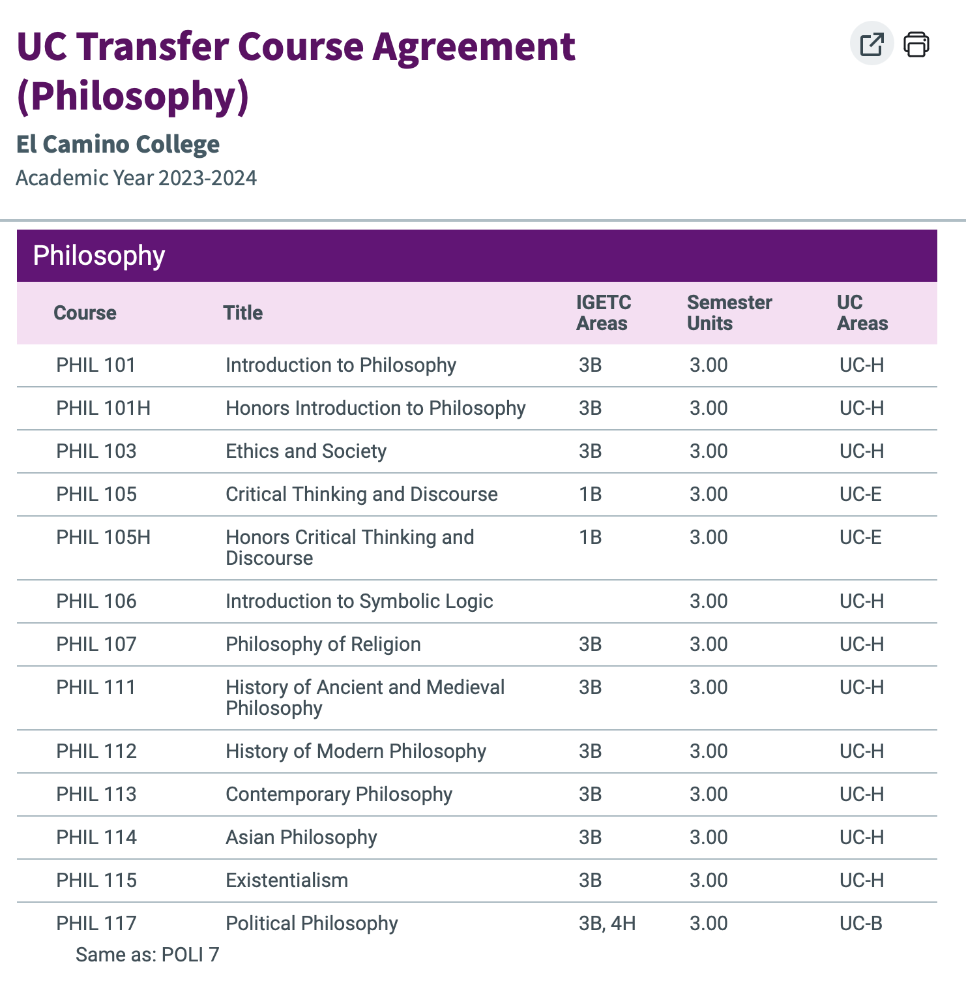
Philosophy 106 – Introduction to Symbolic Logic
PHIL 106 is not listed on Assist.org on the IGETC pattern. Listed as meeting CSU GE A3 Critical Thinking. This means it meet the CSU Critical Thinking GE, but not the UC Critical Thinking GE. Need to talk with Lori Suekawa re: finding a “Cal-GETC home” for this class. Find out if it needs revision this Spring for submission for consideration next Fall.
Meeting Notes: Concern re: PHIL 106 since it’s not listed in any IGETC area currently, which means it won’t have a CalGETC area. This course is required for the AA-T. Discussion ensued about it being revised to fit CalGETC. Either review it or inactivate it. 106 is required for majors. Also computer science majors are taking it. Roberto plans to work on updating the course in hopes that it can get accepted for math requirement.

Slide 10
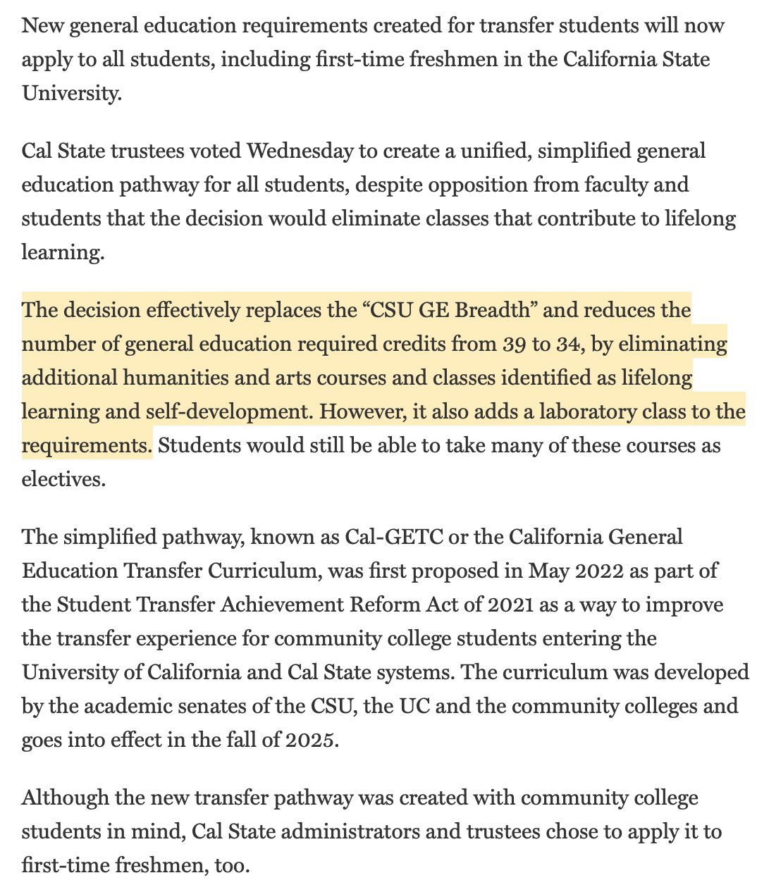
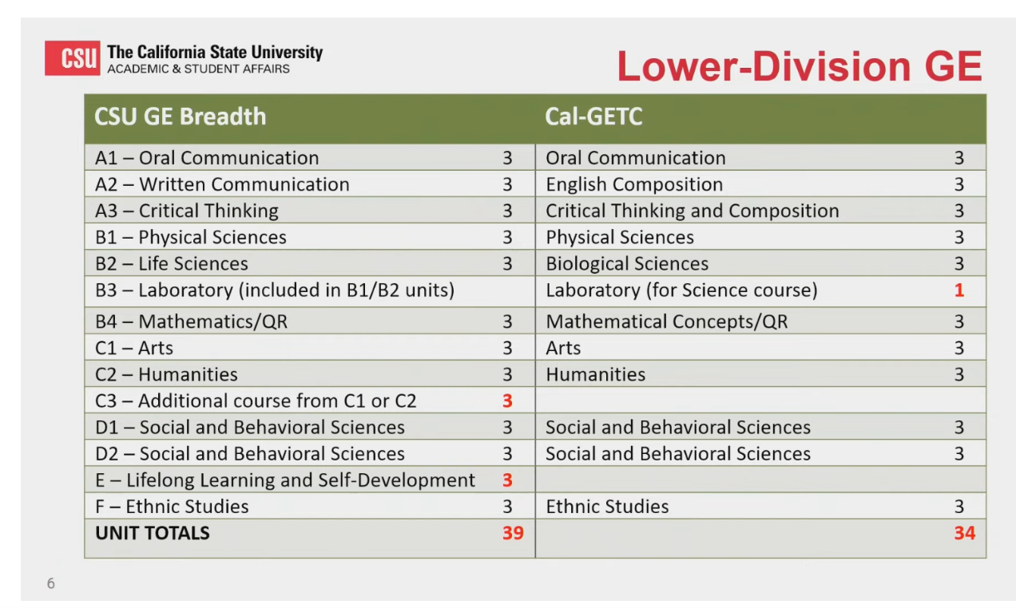
CSU GE (old) and Cal-GETC (new in Fall 2025
Old
New – Fall 2025
(incoming freshmen and transfers)
Ed Source, ”Cal State extends general education requirements for transfers to first-time freshmen:
Change reduces required courses in arts, humanities and self-development. March 27, 2024.

Slide 11
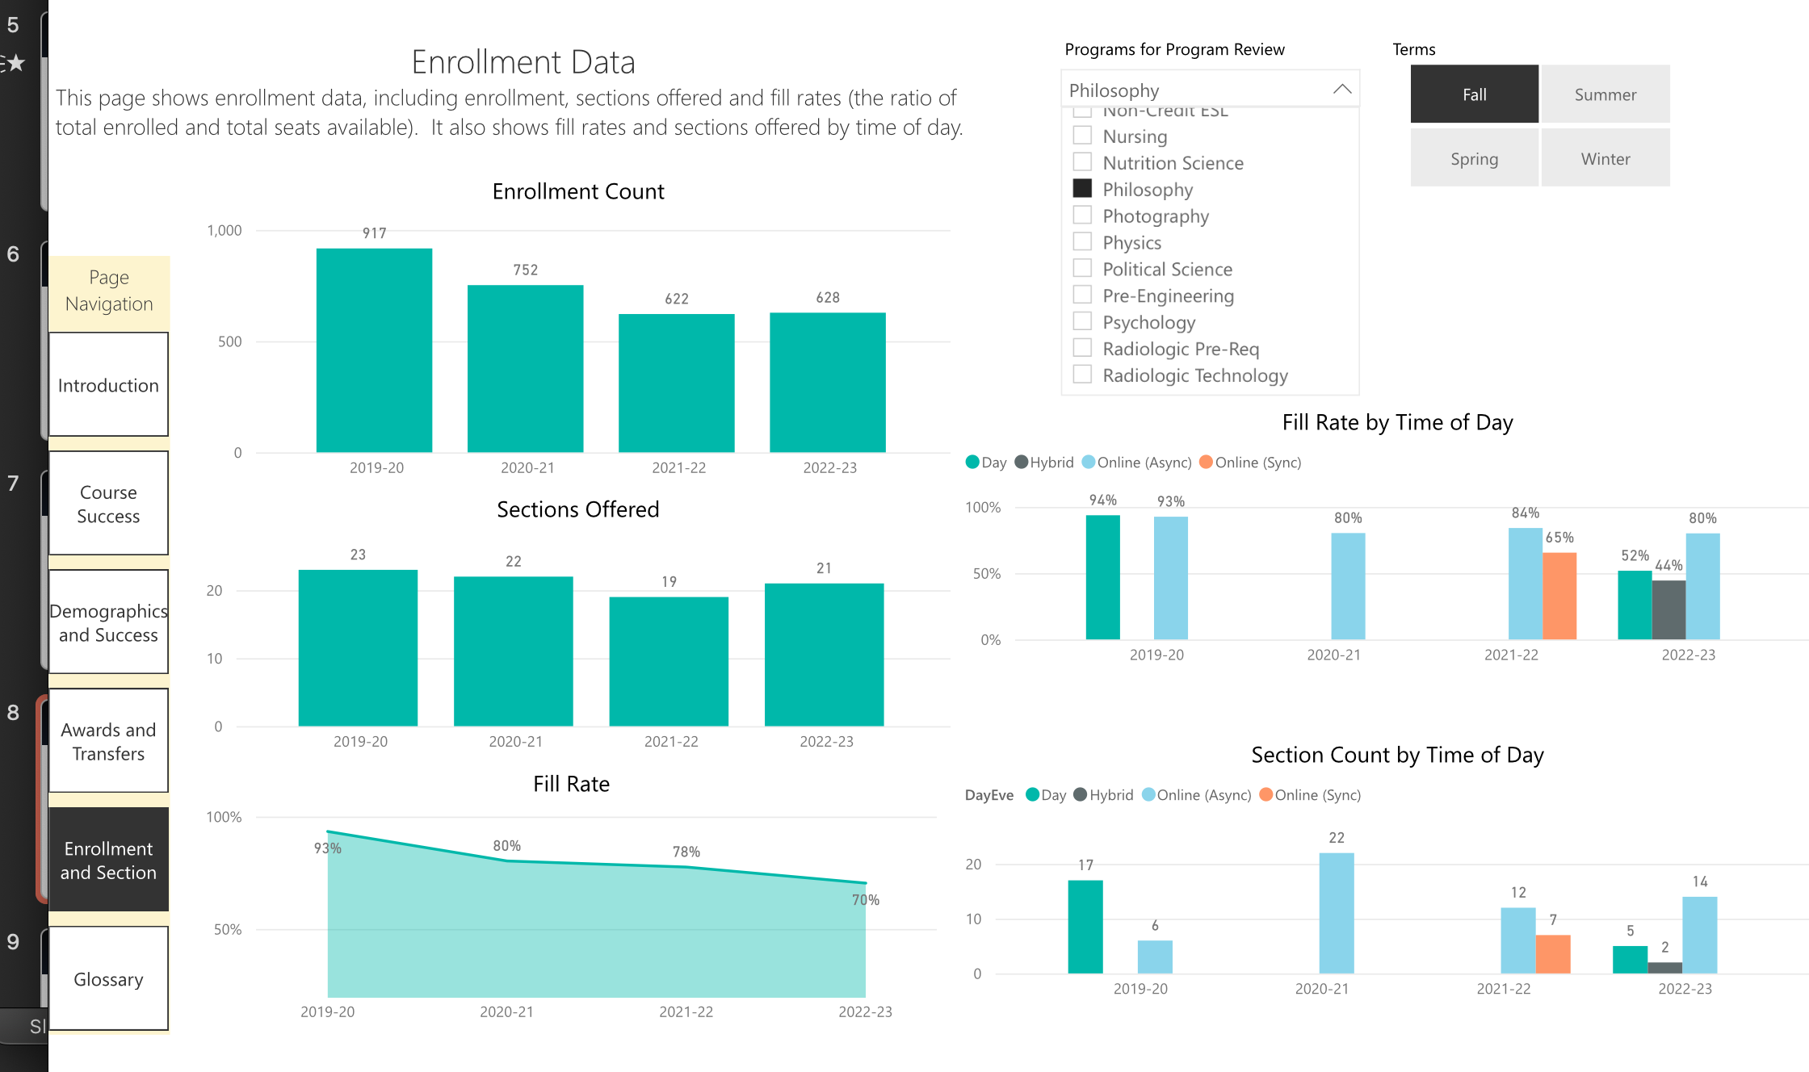
Meeting Notes: There is a decline in enrollment from Fall 2019 to Fall 2023 – Philosophy enrollment is declining faster than the rest of the college.

Slide 12
Philosophy Club and Announcements
Meeting Notes: Philosophy club is going better than usual and it has between 10 and 15 students.
Philosophy club raised some money in the past, but they are not sure where that money could be. Dean suggested that they contact the Student Development Office Director, Ricky Gonzalez, to find out if that money is in the Associated Student Organization (ASO) account.
Roberto has 2 publishers who are looking at his book manuscript. This will be the 1st out of 3 books he plans to publish.

