Slide 1
Philosophy Department Meeting
Thursday, September 26, 2024

Slide 2
Philosophy Department - Agenda
Minutes are embedded in the PowerPoint in red boxes.
In attendance: Chris Gold, Randy Firestone, Roberto Garcia, Felipe Leon, and Larry Fike.
SLOs – Spring and Fall 2024
Fall Enrollment and Scheduling
Committee Membership
Curriculum Review
Evaluations
Updating Pathways

Slide 3
SLO Assessment
Randy reviewed the SLOs to be evaluated in Fall 2024. The department needs to start collecting data from part-time faculty. They also need to use Canvas outcomes for assessment. They can create a multiple choice test. They will work together to create similar questions to be ready for next semester in the intro, ethics and religion courses.
Spring 2024
Completed!!!!!!
Fall 2024
PHIL 111 SLO 3 (Luca)
PHIL 112 SLO 2 (Felipe)
PLO 2 (Randy and Roberto)
New SLO Requirements - Randy

Slide 4
Fall Enrollment and Spring Scheduling – On Campus
Fraud was found throughout the BSS division in online and on-campus classes. Specific sections within specific programs were targeted. Philosophy faculty found fraud in an on-campus ethics class.
Number of
Enrolled
Students
Course Cap
Fill Rate

Slide 5
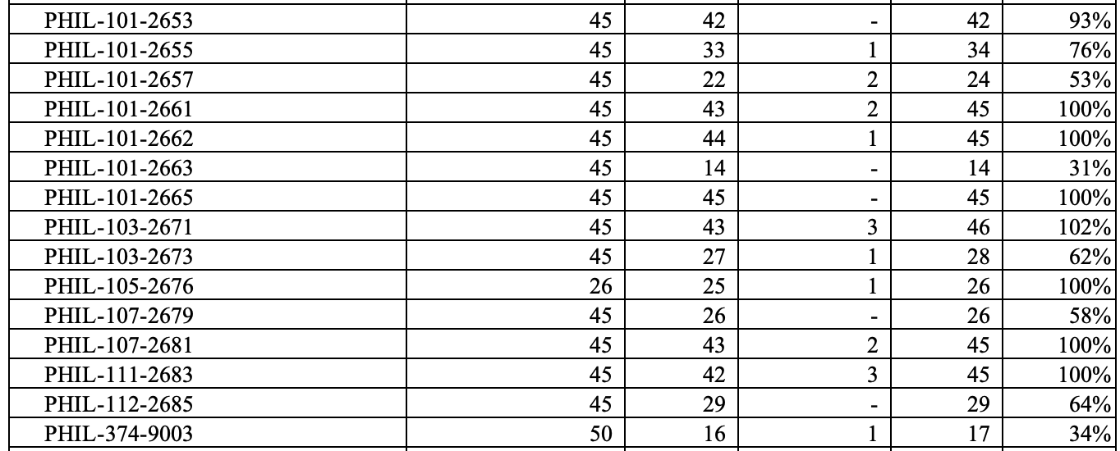
Fall Enrollment and Spring Scheduling – Online possible fraud
Five online Philosophy classes were likely targets of fraud.
Number of
Enrolled
Students
Course Cap
Fill Rate

Slide 6
Committee Membership
Division Council – Felipe Leon
Load Committee – None
BSS Division Curriculum Committee – Roberto Garcia (Chair)
SLOs Committee – Randy Firestone
Annual Plan – Felipe Leon
Program Review – Roberto Garcia (thank you!)

Slide 7
Curriculum
Fall Curriculum Review – none
New Philosophy Courses
Inductive Logic – likely can be offered in Spring 2026.
Future possible courses
Philosophy of the Mind (possibly meet biological sciences GE)
Philosophy of Aesthetics
Philosophy of Science (possibly meet physical science GE)
Rotations
The department discussed possible two-year rotations for new courses.

Slide 8
Faculty Evaluations
Keep an eye on your email and let Cecelia and I know if you get an email from Trakstar that is incorrect.

Slide 9
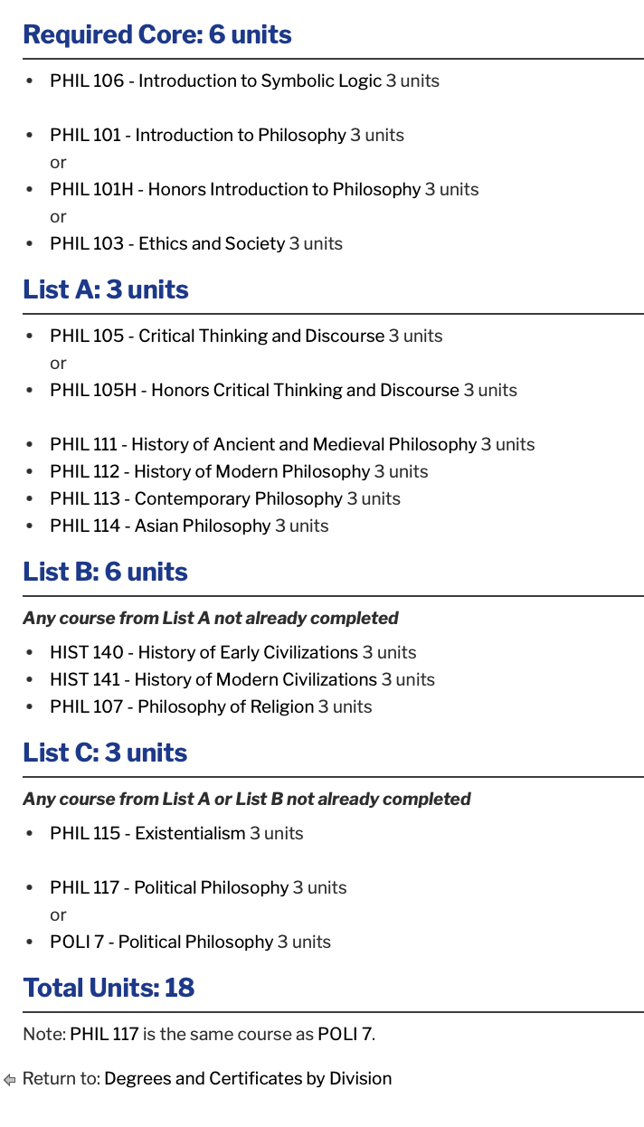
Review the Philosophy AAT
Due Date: October 18
Please:
Review your degree and see if any changes are needed.
Review the order of courses and indicate any changes (please keep transfer-level Math and English in the first year).
Narrow down the choices for all the green and yellow boxes to 3-4 choices.
Review the course information provided by the Dean to inform your decisions.
Add PHIL 116?

Slide 10
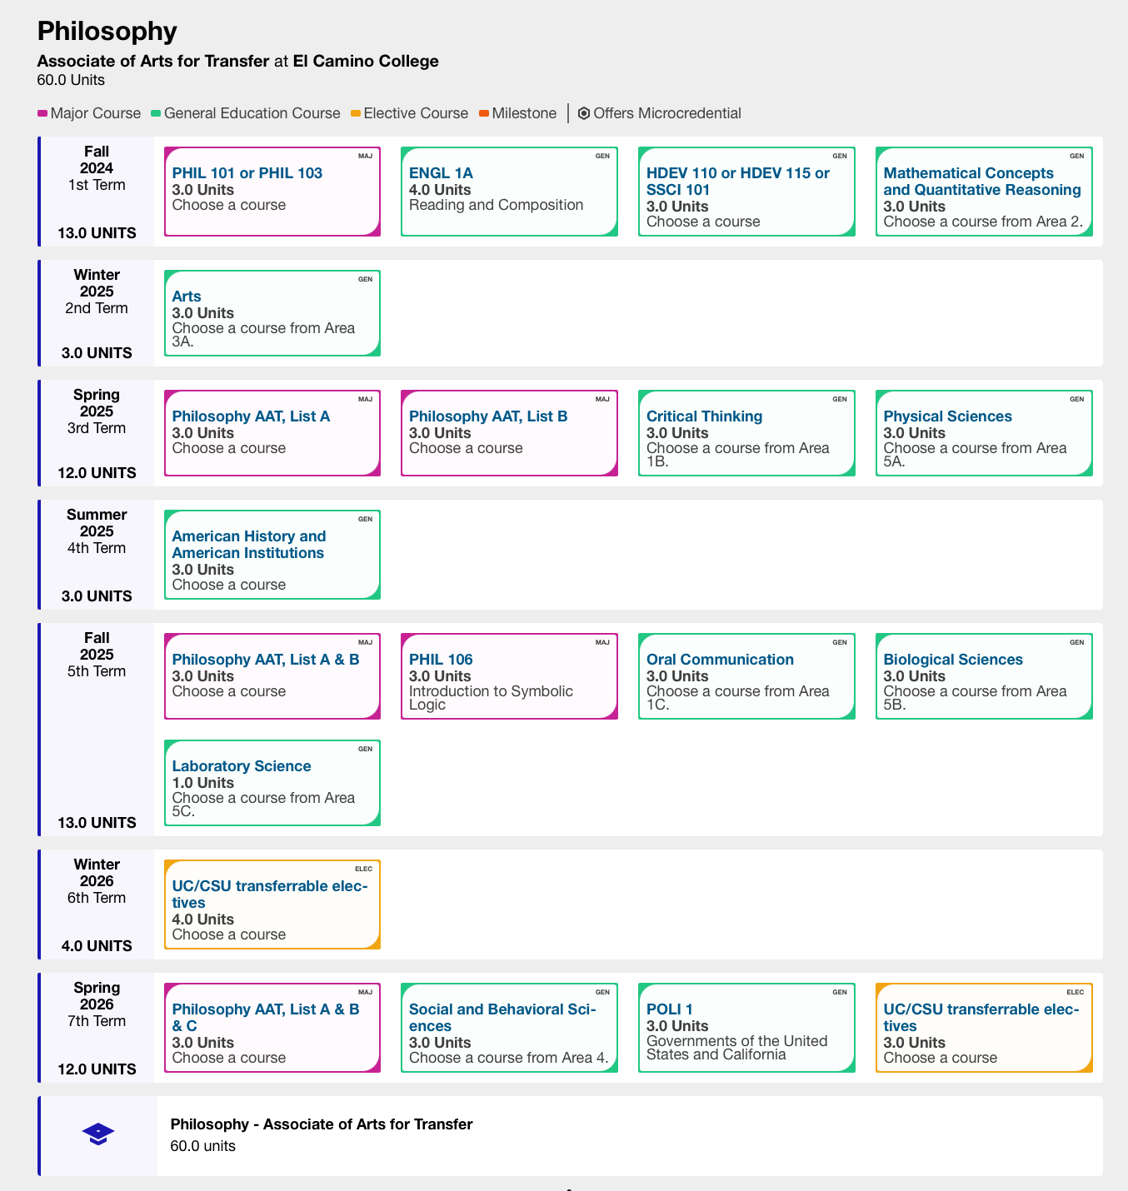
Updating the Philosophy AAT Pathway
Due Date: October 18
Please:
Review your degree and see if any changes are needed.
Review the order of courses and indicate any changes (please keep transfer-level Math and English in the first year).
Narrow down the choices for all the green and yellow boxes to 3-4 choices.
Review the course information provided by the Dean to inform your decisions.

Slide 11
