Slide 1

Political Science Department Meeting
Tuesday, October 8, 2024

Slide 2
Political Science Department - Agenda
SLOs – Spring and Fall 2024
Fall Enrollment and Scheduling
Committee Membership
Curriculum Review
Evaluations
Updating Pathways
AA/AS GEs

Slide 3
SLO Assessment
Spring 2024
All completed and entered. Thank you!
Fall 2024
  POLI 1 SLO 1 - Eduardo
  POLI 1H SLO 1 - Eduardo
  POLI 2 SLO 3 - Josh
  POLI 3 SLO 1 - Laurie
  POLI 7/PHIL 117 SLO 3 – David
  Part-time faculty will share data. Canvas outcomes will be be used.

Slide 4
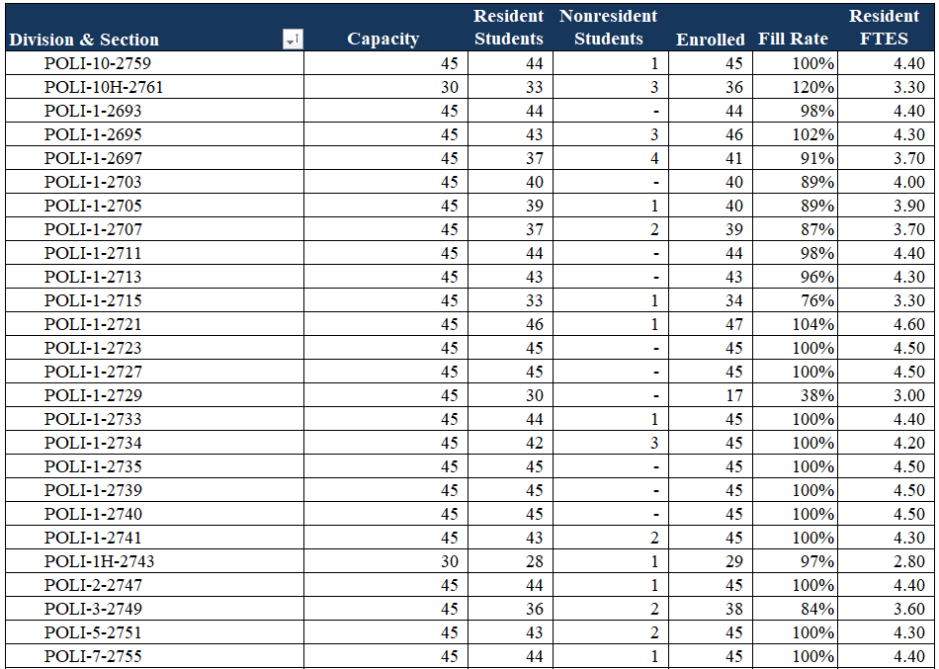
Fall Enrollment and Spring Scheduling – Online possible fraud

Slide 5
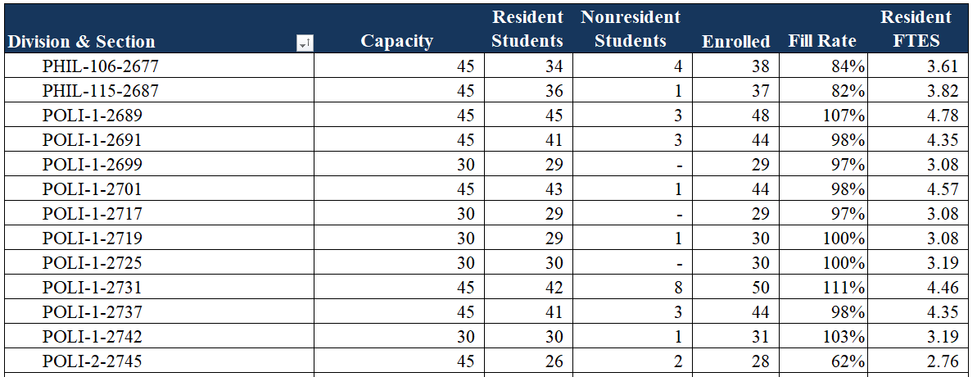
Fall Enrollment and Spring Scheduling – On Campus possible fraud
Only one hybrid section of POLI – no signs of fraud.

Slide 6
Committee Membership and Political Science Club
Division Council – David Reed
BSS Division Curriculum Committee – Laurie Houske
BSS SLO Committee – Eduardo Munoz (Chair)
Annual Plan – Laurie Houske
ODEAC – Laurie Houske
College Assessment Committee – Eduardo Munoz
Political Science Club – David Reed
BSS CCC Rep – Josh Casper

Slide 7
Curriculum Review – Fall 2024
Political Science 1 – Common Course Numbering POLSC1000

Slide 8
Faculty Evaluations
Everyone who is being evaluated or is evaluating should have received and email from Cecelia. Let Cecelia and I know if you get an email from Trakstar that is incorrect.

Slide 9
Updating the Political Science AAT Pathway
Due Date: End of the Semester
Please:
Review your degree and see if any changes are needed.
Review the order of courses and indicate any changes (please keep transfer-level Math and English in the first year).
Narrow down the choices for all the green and yellow boxes to 3-4 choices.
Review the course information provided by the Dean to inform your decisions.

Slide 10
Updating the Political Science AAT Pathway
Due Date: End of the Semester
Please:
Review your degree and see if any changes are needed.
Review the order of courses and indicate any changes (please keep transfer-level Math and English in the first year).
Narrow down the choices for all the green and yellow boxes to 3-4 choices.
Review the course information provided by the Dean to inform your decisions.

Slide 11
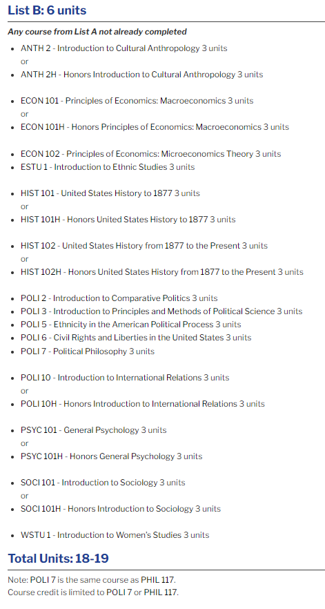
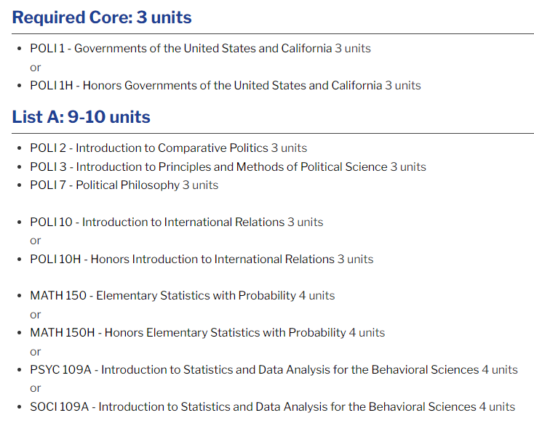
Review Political Science AAT
New courses that may fit: Intro to Social Justice Studies and
Intro to LGBTQ+ Studies.

Slide 12
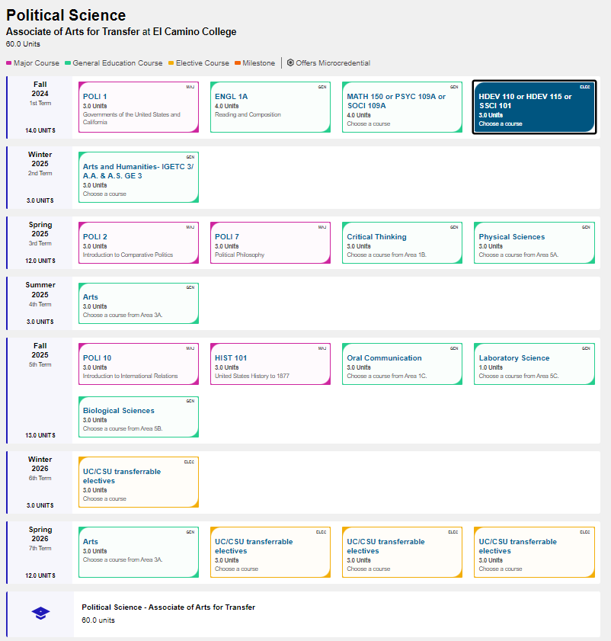
Updating the Political Science AAT Pathway
Due Date: End of the Semester
Please:
Review your degree and see if any changes are needed.
Review the order of courses and indicate any changes (please keep transfer-level Math and English in the first year).
Narrow down the choices for all the green and yellow boxes to 3-4 choices.
Review the course information provided by the Dean to inform your decisions.

Slide 13
