Slide 1
Guided Pathways, Meta-majors, and the Vision for El Camino College
Maria Garcia, Guided Pathways Coordinator
Janice Pon-Ishikawa, Guided Pathways Coordinator
Jenny Simon, Guided Pathways Coordinator
Notes:
As we just saw, the withdrawal survey offered some insight into why students drop and don’t succeed; Guided Pathways offers solutions for the obstacles students face to increase student success and equity. Here is El Camino’s Vision for Guided Pathways implementation.

Slide 2
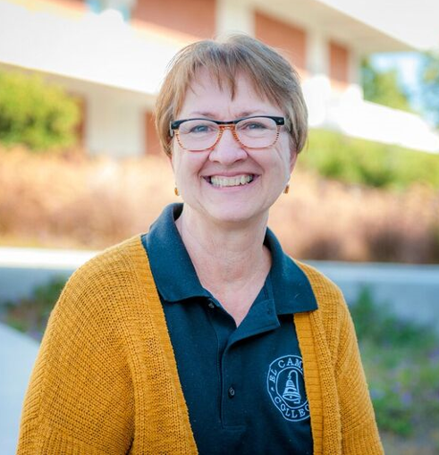
Dr. Jean Shankweiler
Vice President, Academic Affairs
“Imagine a community college where entering students choose among seven meta-majors rather than facing a list of over 200 degrees and certificates.”

Slide 3
Cheyenne Grimes Student Leadership Institute Alumna Major: Psychology
Transfer goals: UCLA, SDSU Graduates Spring 2020
“Imagine a community college where we students know exactly which professions are possible with each major, as well as how much we can expect to make.”

Slide 4
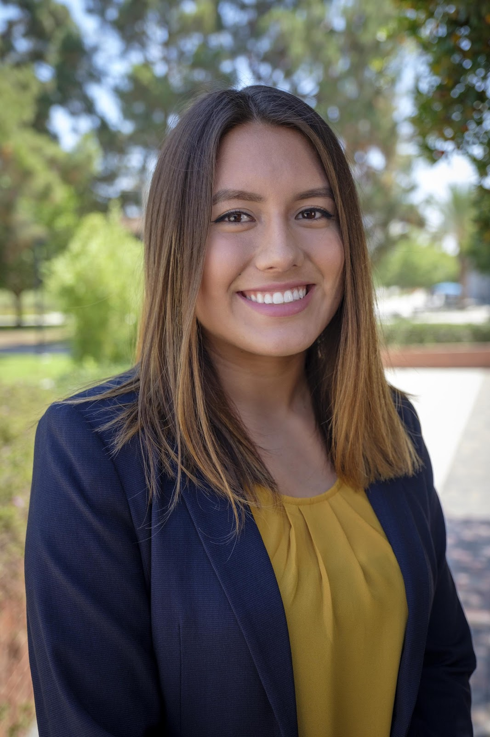
Frida Linero Student Leadership Institute Alumna Major: Business Administration
Transfer goals: LMU, USC, UCR Graduates Spring 2020
“Imagine a community college where we students know exactly which courses to take each semester to complete our educational goal.”

Slide 5
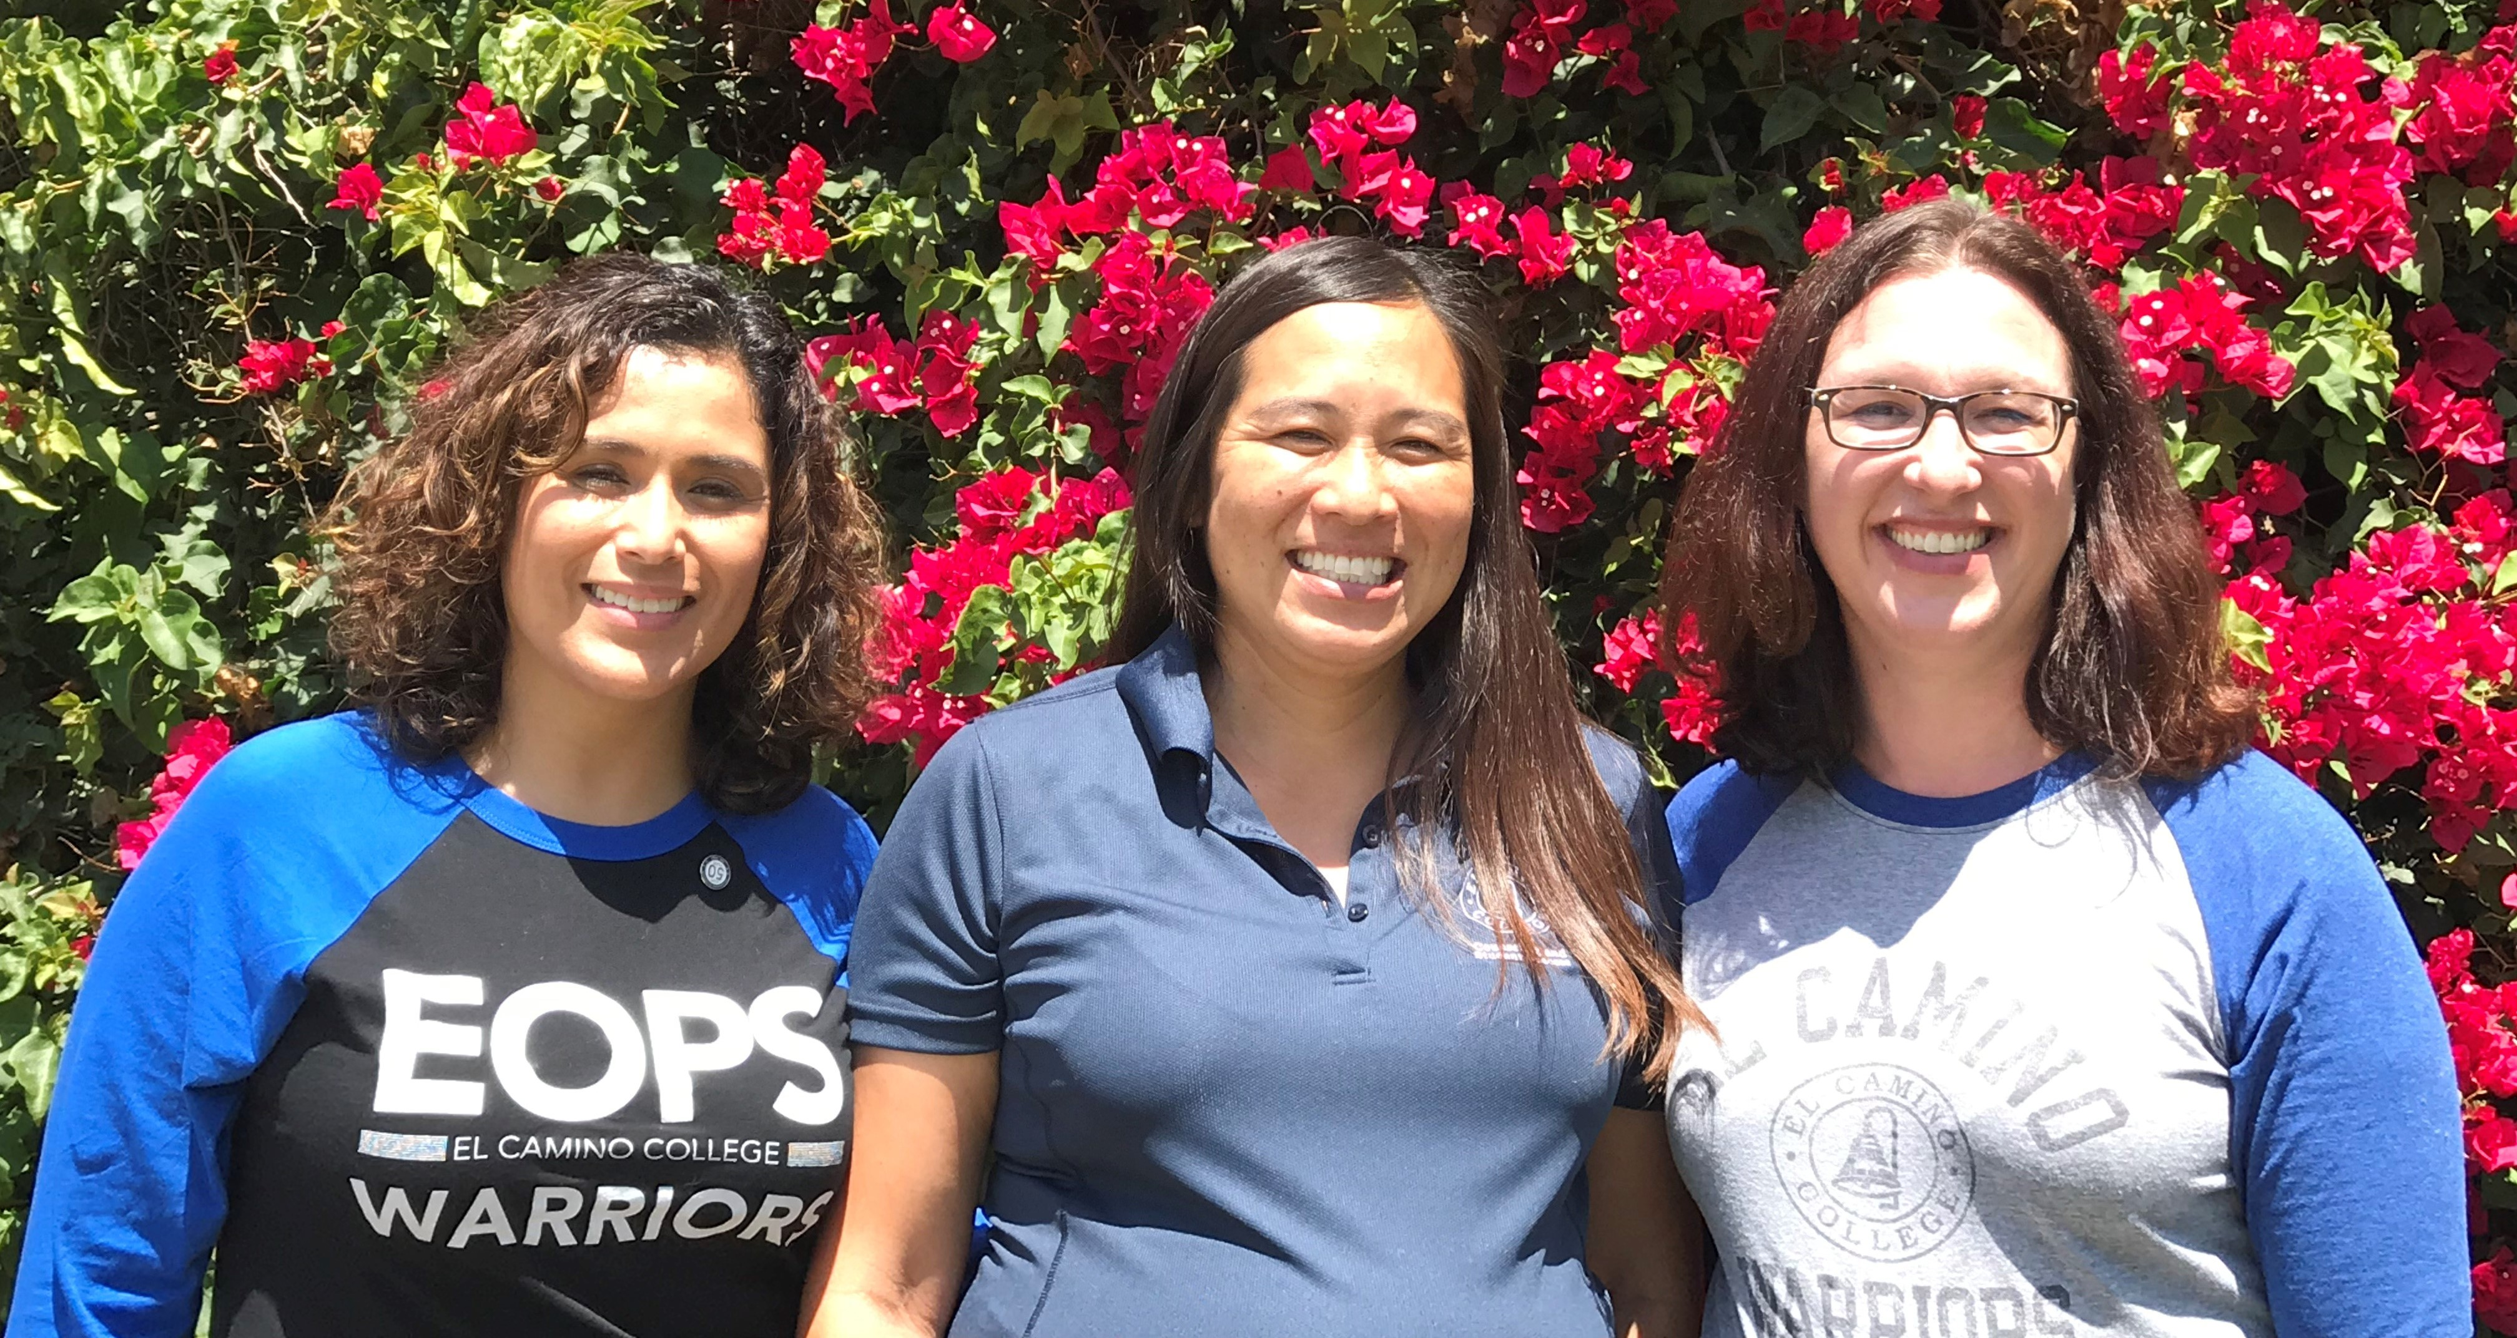
Maria Garcia
EOPS Counselor, Guided Pathways Coordinator
Janice Pon-Ishikawa,
Counselor, Guided Pathways Coordinator
Jenny Simon
ESL Faculty, Guided Pathways Coordinator
“Imagine a community college where instructional faculty, counseling faculty, staff and administrators work together to ensure student success.”

Slide 6
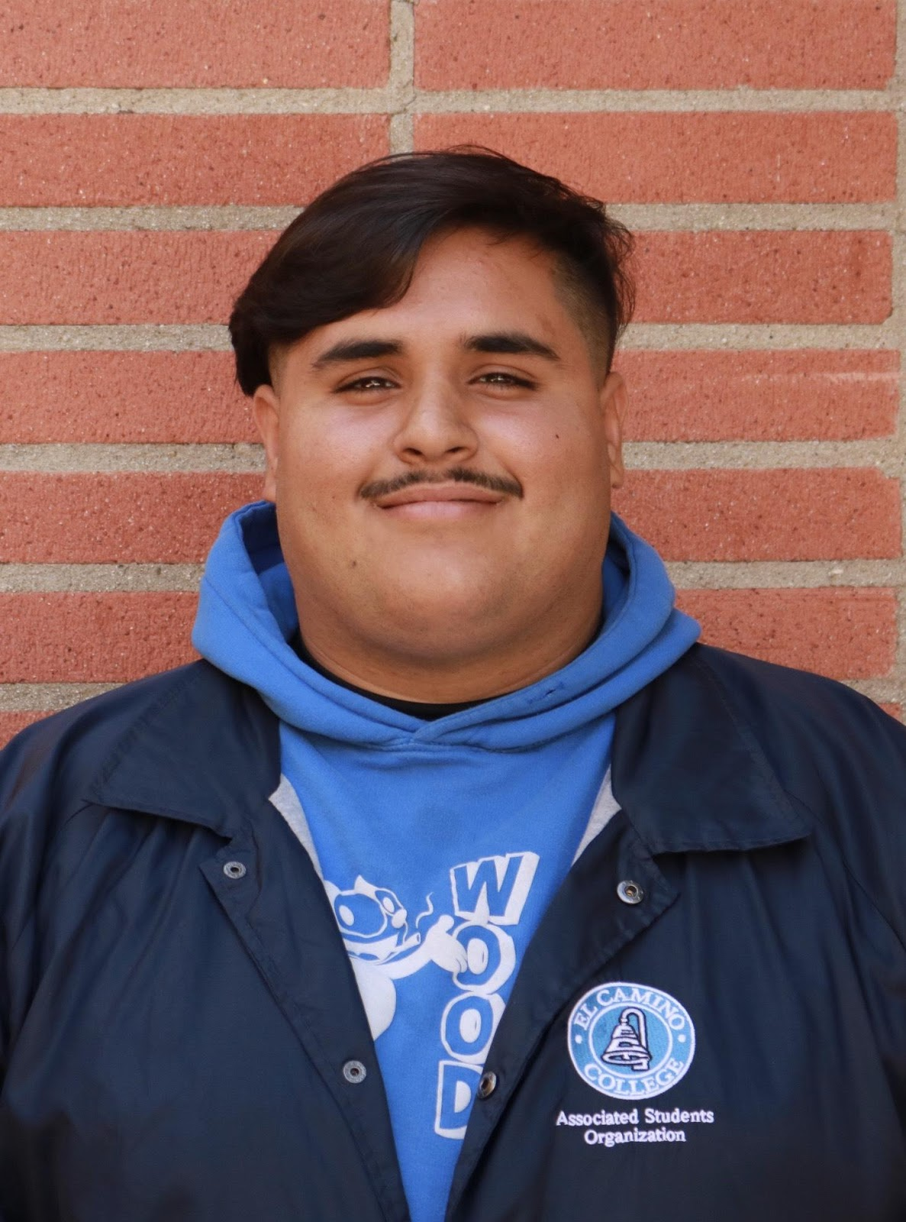
Mario Lopez Student Leadership Institute Alumnus Major: Admin of Justice & Sociology
Transfer goals: UCLA, SDSU Graduates Spring 2020
“Imagine a community college where we students accumulate fewer unnecessary units when completing degrees and certificates.”

Slide 7
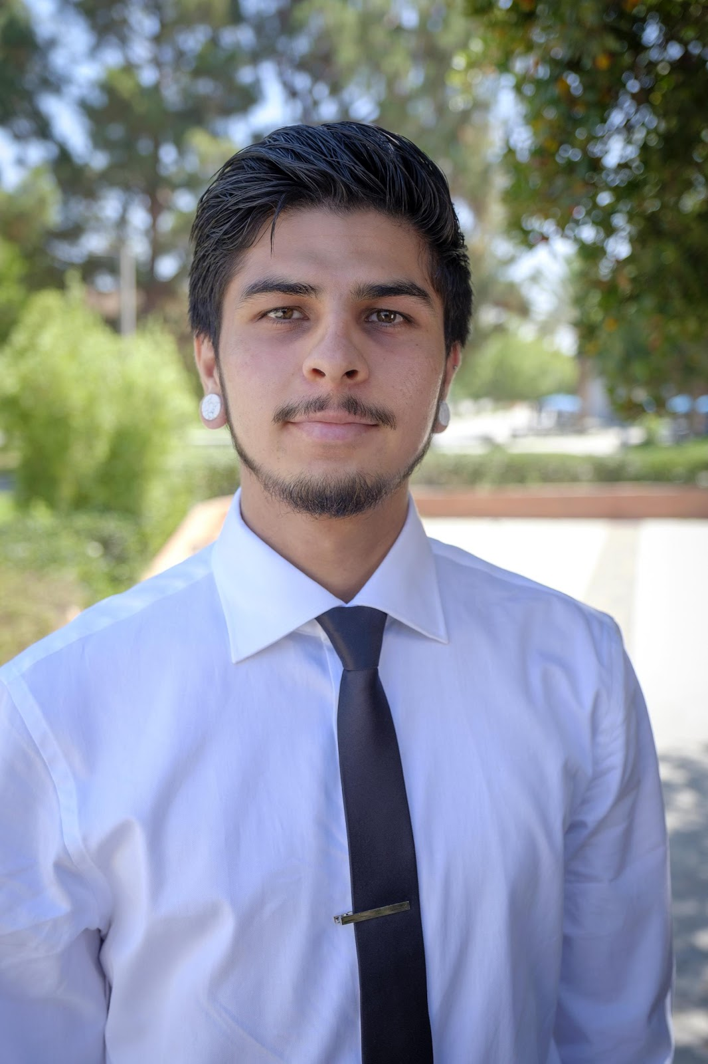
Jose Vazquez Student Leadership Institute Alumnus Major: Spanish
Transfer goals: UCSB Graduated Spring 2019
“Imagine a community college where more students complete degrees and certificates because of more proactive guidance and help when we need it most.”

Slide 8
Update on Guided Pathways at El Camino
Notes:
We have been working on Guided Pathways for the last two years. As a reminder, the Guided Pathways approach includes four pillars: clarify the path, enter the path, stay on the path, and ensure learning. This past year, you may have participated in a card-sorting activity to determine our meta-majors, or you may have worked on a program map for a degree or certificate in your program. Before we get to our update, we just wanted to go over a few more general things about Guided Pathways to refresh your memory.

Slide 9
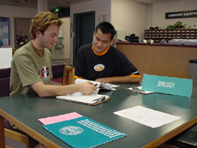
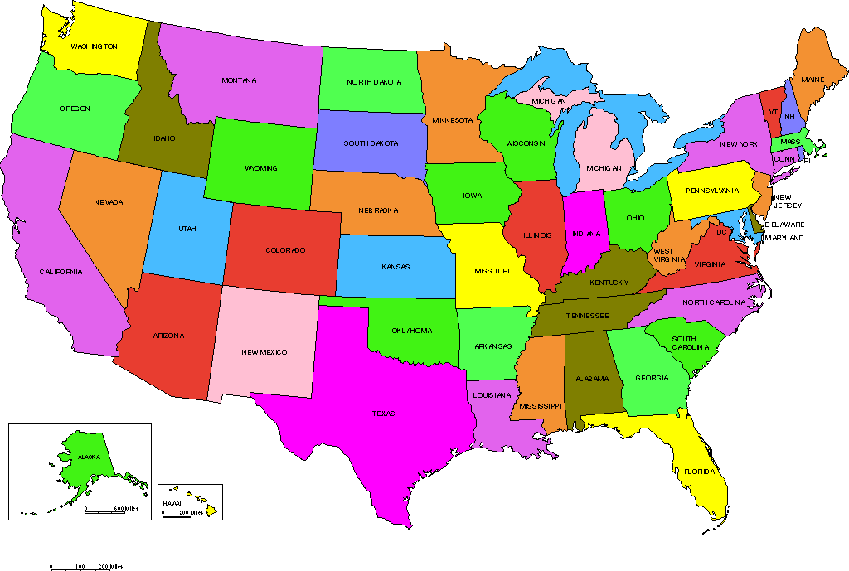
What Guided Pathways IS
Reduce confusion
Building learning
Guided exploration
Increase support
Nationwide
Notes:
Guided Pathways is a research-based approach to redesigning community colleges that:
--reduces confusion for students;
--and increases proactive support for students to complete their educational goals;
Using the ideas of guided pathways, we:
--design pathways that encourage guided exploration;
--design learning experiences in which students build on their knowledge from course to course;
Also remember that:
--Guided Pathways is a nationwide movement based on decades of research on community colleges.

Slide 10
What Guided Pathways is NOT…
NOT only local
Does NOT reduce programs
NOT the latest initiative
Notes:
Which leads to some things that Guided Pathways is not:
--NOT local only to California (it’s a nationwide effort);
--it is NOT a way to reduce programs;
--and it is NOT an initiative with a limited shelf-life

Slide 11
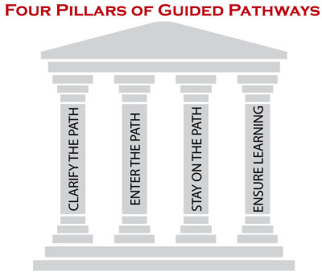
Meta-Majors
Meta-majors—clarifying the path for students
Definition: groups of related majors with similar requirements, outcomes, or methodologies
Data collected in Spring 2019
January 2019 summit
Card Sorting Events
Classrooms
Faculty meetings
130 groups; 75% of participants were students
Notes:
One big development that took place over this past year is the development of meta-majors. As a reminder, meta-majors are groups of related majors with similar requirements, outcomes, or methodologies. Meta-majors are a way to reduce confusion and “clarify the path” for students by placing majors into a small number of more general categories. We determined our meta-majors through card-sorting activities conducted last semester. We had a summit in January, card sorting events scheduled throughout the semester, and we also visited classrooms and faculty meetings. In all, 130 different groups consisting of a mixture of faculty, staff, administrators, and students participated; 75% of the participants were students.

Slide 12
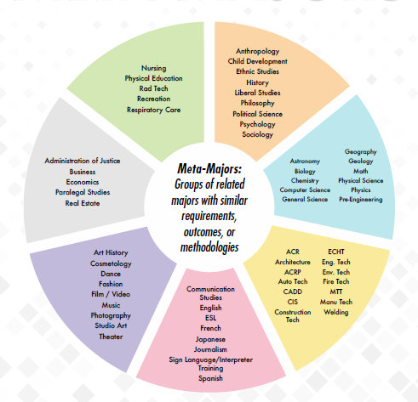
Notes:
You may have received a flyer in the mail a few weeks ago that looked like this. These are our meta-majors. You don’t have to try to read it on this screen—we will go through each one-by-one in a minute. The color associated with each one is only for today—one of the tasks of the meta-major breakout sessions in the afternoon is to come up with names for the meta-majors. So, don’t be too concerned about the color.

Slide 13
Clarifying the Path: “Program Pathways Mapper”
Provides template and infrastructure for publishing meta-majors and program maps online
Notes:
However, before going through our meta-majors, here are some ways that they will be used. One way that we will be applying meta-majors in the coming year is to publish them online for our students. They will be able to choose a meta-major, and then see all the majors associated with it, in addition to career information and program maps.

Slide 14
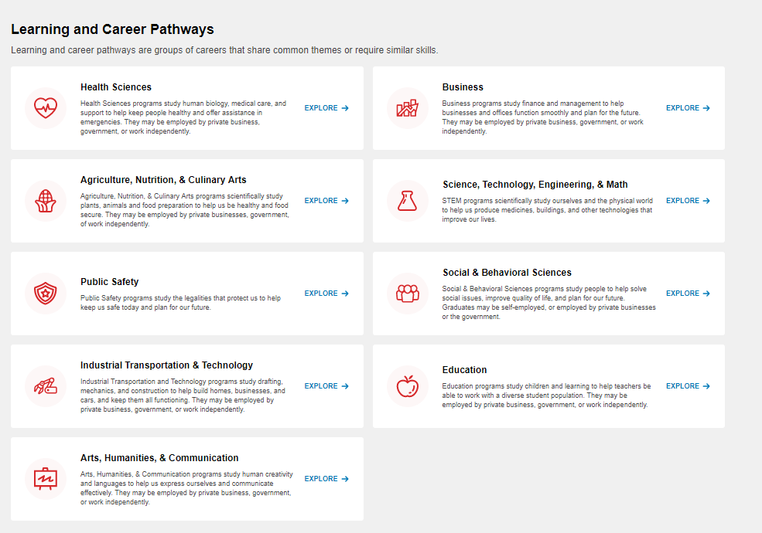
Meta-Majors
Notes:
When users enter program pathways mapper, they first see all the meta-majors that are available. This is an example from Bakersfield College. They can then click on a meta-major to see the degrees and certificates available—for example, “health sciences”.

Slide 15
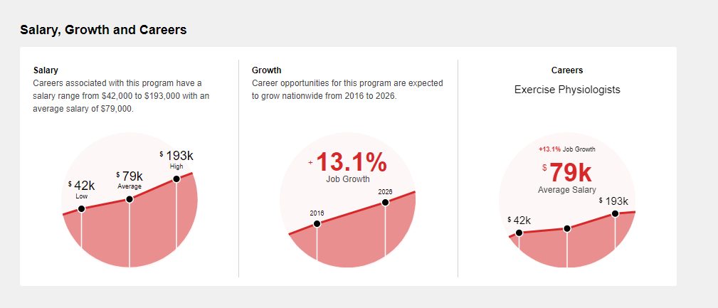
Career and Salary Information
Notes:
Once users choose a major, one of the first things they see is the career and salary information. This is for Kinesiology majors. They can see salary information, information about how the career is growing, and some possible careers.

Slide 16
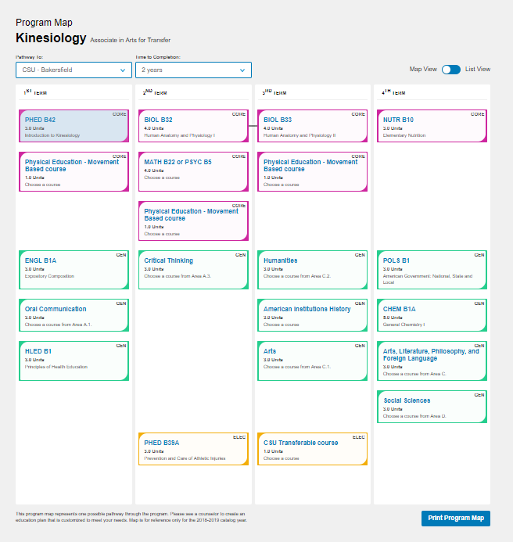
Program Map
Notes:
Here’s an example of a program map for a kinesiology transfer degree from Bakersfield College, where program pathways mapper was developed. Notice that students are able to choose how long they want to take to complete a degree, using a drop-down menu. This increases equity by showing students a path that reflects possible paths they might actually take. The program map gives them a semester-by-semester plan, and each course is color coded—purple for core courses, green for gen ed, and yellow for electives. We will be working on putting your program maps online—grouped by meta-major—during the fall semester, so keep those program maps coming!

Slide 17
Success Teams for Each Meta-Major: Proactive Support for Students
“Success Teams” for each meta-major
Counselors
Instructional faculty
Peer advisors
Data coach
Financial aid representative
Administrator
Activities:
Career events
Design learning experiences
Identify success barriers and plan interventions
Use ECC Connect to connect students, staff, instructional faculty and counselors
Notes:
Another way that we’re going to use meta-majors here at El Camino College is to form success teams for each meta-major in order to provide targeted, proactive support so that students are able to make the best decision about which path to enter as well as stay on the path. This strategy is also equity-minded by providing support for students wherever they’re at.
The success teams will consist of
--counselors who will be assigned to particular meta-majors;
--instructional faculty who will represent the majors within that meta-major;
--peer advisors who can really help inform the group about the student experience;
--a data coach, who will help identify data about where resources should be targeted as well as how best to help students;
--a financial aid representative;
--and an administrator
Some activities that these success teams will do are:
--plan career events;
--design learning experiences such as linked courses, or thematic courses for general ed requirements;
--identify success barriers and plan interventions to help students overcome these;
--and promote the use of ECC Connect to bring everyone together

Slide 18
Will things remain the same or different with meta-majors?
SAME
Faculty will still teach the same courses.
Students can still choose a specific major.
Student services will still provide support to students.
DIFFERENT
There will be more opportunities to collaborate.
All students will be associated with a meta-major.
The support provided will be more targeted, proactive, and data-driven with the “success teams.”
Academic divisions will co-exist with success teams.
Notes:
One of your big questions might be—how will Guided Pathways, and meta-majors in particular, change things here at El Camino College? Here are some answers:
--Some things that will remain the same are that faculty will still teach the same courses; students can still choose a specific major; student services programs will still exist to provide support to students. However, the differences are that:
--faculty will have more opportunities to collaborate in terms of linked courses, or themed courses for general ed.
--while students can still choose a specific major, they will all be associated with a meta-major;
--the support we provide to students in our meta-majors will be more targeted, proactive and data-driven because of the implementation of success teams;
--finally, academic divisions will co-exist with success teams; however, our academic division structure will be under review this year.

Slide 19
Timeline
Academic Year 2019-2020
Program Pathways Mapper implementation
Success Teams (including data coaches) piloted
“Student Engagement Toolbox” incentive program
Academic Year 2020-2021
Program Pathways Mapper fully implemented
Success Teams fully implemented
Student engagement tools used by all counseling faculty, instructional faculty and students
Beyond…
More degrees and certificates completed
Fewer unnecessary units accumulated
More integrated learning experiences
More proactive and targeted support
Notes:
Here is our timeline for implementation of Guided Pathways:
--this year, 2019-2020, we are going to bring “Program Pathways Mapper” online and pilot our success teams to see what strategies we can apply here at El Camino. We are going to dig in to the data, and flesh out the idea of using data coaches and how they can be used in these success teams. In addition, because ECC Connect and Canvas are so important in holding everything together, we have an incentive program this year to get more people to use these tools. There’s a flyer in your folder to find out how to participate!
Next academic year, you will see “Program Pathways Mapper” and “Success Teams” fully implemented. And you will all be using ECC Connect and Canvas to bring everyone together.
The impact of these changes will be more students completing degrees and certificates with fewer unnecessary units. The learning that students experience in courses will be more integrated, and the support they receive will be more proactive and specific to their needs.
Now, without further ado, we present our meta-majors!

Slide 20
Communication Studies
English
ESL
French
Japanese
Journalism
Sign Language/Interpreter Training
Spanish
1st Breakout
Notes:
This meta-major includes language and communication majors.

Slide 21
Astronomy
Biology
Chemistry
Computer Science
General Science
Geography
Geology
Math
Physical Science
Physics
Pre-Engineering
1st Breakout
Notes:
This meta-major includes many of the sciences and mathematics.

Slide 22
Nursing
Physical Education
Radiologic Technology
Recreation
Respiratory Care
1st Breakout
Notes:
This one contains the majors associated with health and wellness.

Slide 23
Administration of Justice
Business
Economics
Paralegal Studies
Real Estate
1st Breakout
Notes:
This meta-major includes the business and law-associated majors.
These first four meta-majors will meet in the first breakout session.

Slide 24
Anthropology
Child Development
Ethnic Studies
History
Liberal Studies
Philosophy
Political Science
Psychology
Sociology
2nd Breakout
Notes:
This meta-major includes most of the social and behavioral sciences.

Slide 25
ACR
Architecture
ACRP
Automotive Technology
CADD
CIS
Construction Technology
ECHT
Engineering Tech
Environmental Tech
Fire and Emergency Technology
MTT
Manufacturing Tech
Welding
2nd Breakout
Notes:
Here is the meta-major with the more applied technologies.

Slide 26
Art History
Cosmetology
Dance
Fashion
Film / Video
Music
Photography
Studio Art
Theater
2nd Breakout
Notes:
This meta-major includes the fine and applied arts.
These last three meta-majors will meet in the second breakout session.

Slide 27
Notes:
And there we have it—El Camino College’s meta-majors!

Slide 28
Join us in implementing Guided Pathways!
Come to today’s breakout sessions:
First session: “Pink,” “Blue,” “Green,” “Grey” meta-majors
Second Session: “Orange,” “Yellow,” “Purple” meta-majors
Consider joining a meta-major success team
Think about possible barriers to student success
Identify opportunities for linked courses / learning communities
Brainstorm ways to engage and help students
Notes:
Now for what YOU can do to help implement Guided Pathways on our campus:
First, you can come to today’s meta-majors breakout sessions. In the first session, we will have the “pink” (languages), “blue” (math and sciences), “green” (health sciences, physical education, and recreation), and “grey” (business and law-related majors). In our second session, we will have “orange” (social and behavioral sciences), “yellow” (the technology and industry-related majors), and “purple” (the fine and applied arts majors).
Next, please consider joining and meta-major success team! These will be piloted this year! The things you can do on a success team are think about possible barriers to student success, identify opportunities for linked courses or learning communities, and brainstorm ways to help and engage students.

Slide 29
Join us in implementing Guided Pathways!
Use your “Student Engagement Toolbox”: ECC Connect and Canvas
“Student Engagement Toolbox” Incentive program (see flyer)
Instructional: Take attendance and keep grades in Canvas; send progress reports in ECC Connect
Counseling: Create Ed Plans and respond to flags raised by instructors in ECC Connect
Earn $100 for fulfilling these requirements!
Attend “Student Engagement Toolbox” Incentive Program Info Session TODAY!
Notes:
Finally, please use your student engagement toolbox! These tools include ECC Connect and Canvas. As mentioned before, we have an incentive program this year to encourage use of these tools. THe requirements for instructional faculty are to use Canvas to take attendance and keep grades, and ECC Connect to send progress reports. For counseling faculty, the requirements are to create ed plans and respond to flags raised by instructors in ECC Connect. If you fulfill these requirements, you can earn $100 this semester—this is for anybody to take advantage of, even if you already use these tools! If you’re interested in finding out more about the incentive program, or need a little help getting started with Canvas or ECC Connect, please attend the “Student Engagement Toolbox” information session during today’s breakouts!

Slide 30
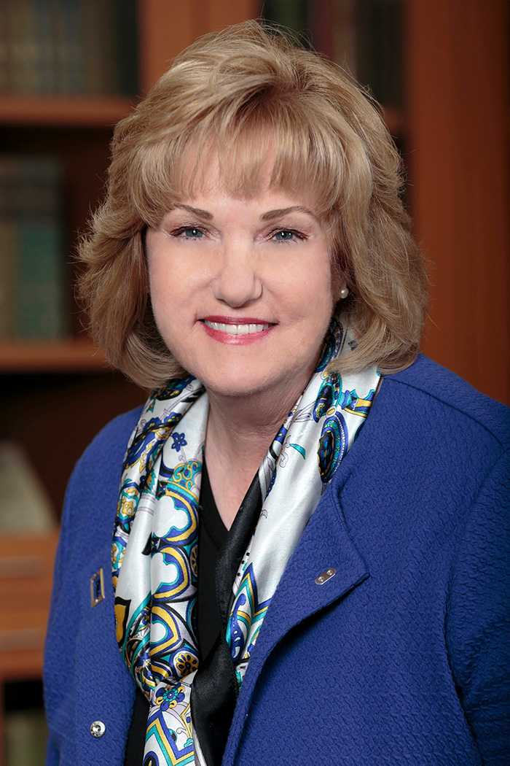
Dr. Dena Maloney
President, El Camino College
“Imagine El Camino College, which has
embraced the pillars of Guided Pathways to send
students on a clear path to success.”
Notes:
Finally, here’s President Maloney to conclude our presentation.

