Slide 1
Welcome to the Guided Pathways Winter Summit on Success Teams!
Agenda
9:30 - 10:00 AM Arrival & Welcome
10:00 - 10:30 AM Presentation: Business Success Team Pilot: Lessons Learned
10:30 - 11:15 AM Presentation: Integrated Student Supports: Success Teams
11:15 - 11:30 AM BREAK
11:30 - 12:15 PM Activity: Our Dream Success Team
12:15 - 12:45 PM LUNCH
12:45 - 1:30 PM Activities: Bright Spots & Areas of Improvement | Timeline
1:30 - 1:40 PM Presentation: “Student Engagement Toolbox” Incentive Program
1:40 - 2:10 PM Next Steps: Success Team Logistics
2:10 - 2:30 PM Wrap Up
Notes:
9:30 AM Jenny - Opening comments

Slide 2
Imagine a community college where
more students complete degrees and certificates because of more proactive guidance and help when they need it most.
Notes:
9:40 AM Jenny

Slide 3
Imagine a community college where
student success is always at the center of decision-making and the way we do business.
Notes:
9:42 AM Jenny

Slide 4
Imagine a community college ...
Notes:
9:44 AM Jenny

Slide 5
Winter Summit Outcomes
Participants will
Apply ideas about what they learned about success teams at other colleges to their work on developing success teams at ECC.
Explain to a colleague what a success team is and why success teams are important.
Work with the meta-major student data to get to know their students.
Work with their success team to start plan logistics and goals.
Notes:
9:46 AM Jenny

Slide 6
Imagine a community college where
all students choose a meta-major cohort, and get the same support from start to finish.
Notes:
9:50 AM Jenny

Slide 7
Fall 2019 Business Success Team Pilot
Lessons Learned
Notes:
10:00 AM- Maria

Slide 8
Business Pilot, Fall 2019
Business division was chosen because it was the first division in the entire College that completed all of its program maps.
Business division successfully mapped all 12 degree programs and all 16 certificate programs.
We engaged in inquiry around:
How to increase communication with the Business students
How to increase student retention in Business division
How to increase graduation rates of Business students
How to assist business students in graduating/transferring in a timely manner
How to increase the number of students of color in business division
Notes:
10:01 AM- Maria & Jay

Slide 9
Roles
Instructional faculty lead
Data coach
Counseling faculty
GP Coordinators
Librarian
Outreach
Dean
Career Pathways
Strong Workforce
Notes:
10:03 AM- Maria

Slide 10
Activities
Got to know the students in the meta-major (data)
Brainstormed about ways to help students
Initiated a survey to facilitate proactive counseling in a classroom setting
Shared ideas about additional needs in order to ensure success
Notes:
10:05 AM- Maria & Jay

Slide 11
Lessons Learned
Who our students were
Demographics, special programs, how many in meta major, etc.
How many had educational plans
How long it took students to complete a degree/transfer
Who to bring on board
Counselors, instructional faculty, administrators, professional staff, students, etc.
Partners: librarians, financial aid, admissions, etc.
Notes:
10:08 AM- Maria & Jay
Not all majors are correct!

Slide 12
Lessons Learned
More guidance and coordination are needed (higher level)
Purpose (Why)
Goal setting (What)
Objectives (How)
Needed clear structure
Members wanted more direction, defined goals and roles within success team
As a result, a team will be participating in the RP Group’s, Leading from the Middle, ‘Redesigning The Student Experience’ Academy to develop this further.
Need to develop the role of the data coach
A “dashboard” for use by data coaches is under development
As a result, another team will be participating in the RP Group’s, Leading from the Middle, ‘Data’ Academy to develop this further.
Notes:
10:10 AM- Maria

Slide 13
Goals for Spring 2020
Success Teams can help:
Develop a model for supporting students as a success team
Success Teams can get acquainted with the data in order to:
Get to know the students in your meta-major
Identify “Gateway Courses” in your meta-major
Identify ways to strengthen students’ general competencies such as reading, writing and quantitative reasoning skills across disciplines.
Inform the development of the data coach role and the dashboard
Notes:
10:13 AM- Maria

Slide 14
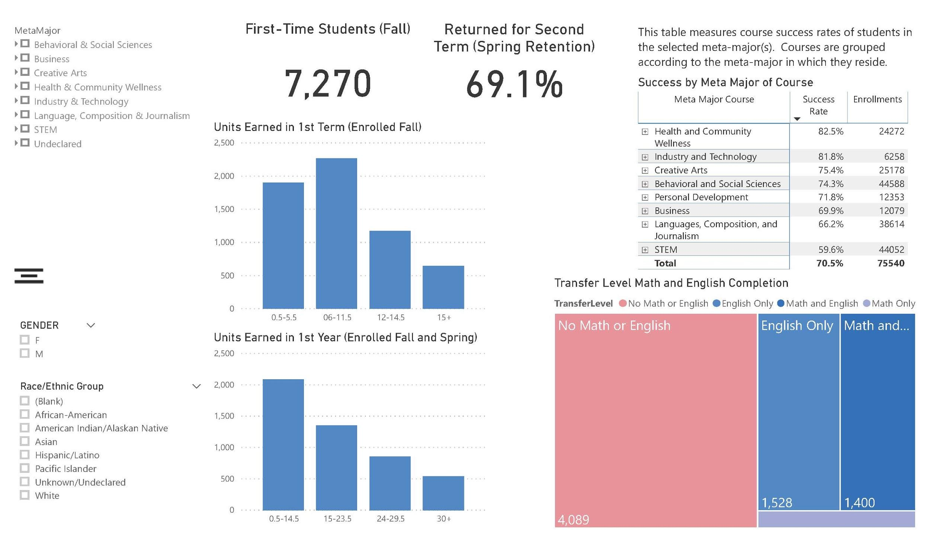
Success Teams Dashboard
Notes:
10:16 AM- Josh

Slide 15
Integrated Student Supports: Success Teams
Designing an El Camino Model
Notes:
10:30 AM - Libby

Slide 16
Integrated Student Supports via Success Teams
Outcomes
Define success teams
Review examples from other colleges
Design the first iteration of your success team model
Notes:
10:31 AM - Libby

Slide 17
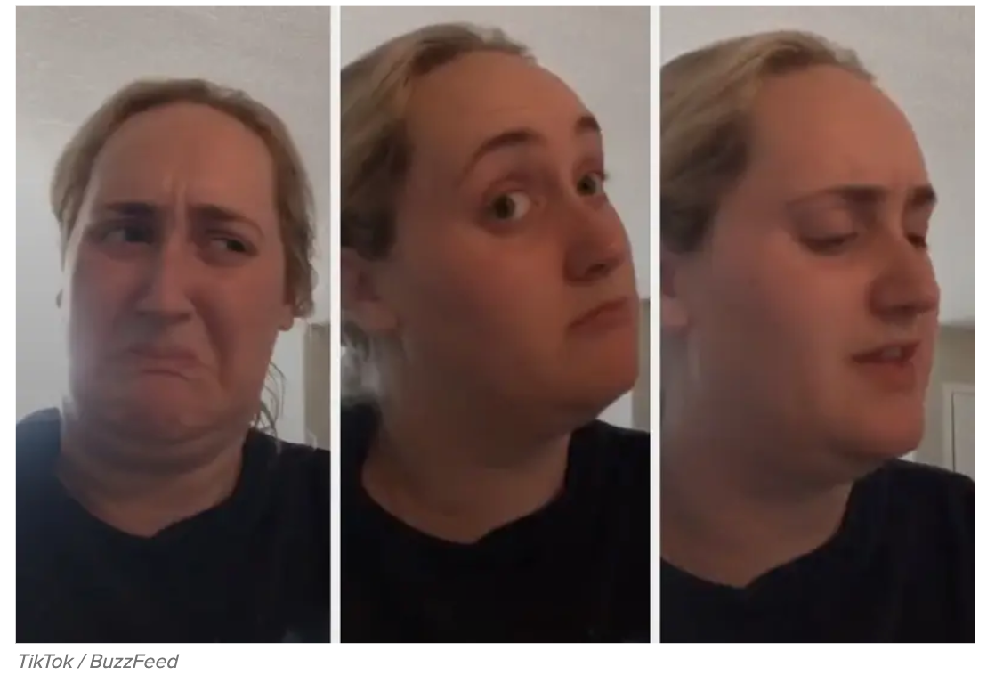
Hate?
Love?
Wait, what?
How do we do this?
Success Team Reactions . . .
Notes:
10:32 AM - Libby

Slide 18
How do we define success teams?
Students - A team of people, I know, who are supporting me throughout my college journey to achieve my goals and help me land my dream job so I can support myself and those I love!
Institutions - A team of individuals throughout the college who utilize a case management approach to provide just in time supports to ensure students enter and stay on the path to complete, and transfer successfully to the workforce, and or a university.
Success teams also go by other names i.e., Completion Team, Career Community, etc.
Notes:
10:33 AM - Libby

Slide 19
But what exactly is a success team?
It depends on the problem(s) you’re trying to solve:
Important questions to ask:
What institutional problems are we trying to solve?
What student needs must we better address?
What are our current practices? How should success teams supplement or help redefine them?
Notes:
10:35 AM - Libby
Top 3 institutional goals when we started guided pathways was: 1. Reduce time to completion of degrees, certificates, or educational goals, 2. increase 30 unit completion, 3. Reduce total number of units at time of degree.

Slide 20
Front End | Back End
What will be Student facing (Front End)?
What will be radically different for students because of success teams?
How will the student experience change?
What will be Institution facing (Back End)?
What policies, procedures, process will change and how?
How might roles shift to better meet student needs?
Notes:
10:39 AM - Libby

Slide 21
Essential Factors & Considerations
Equity is the of this work!
Scaling (program) vs. Designing at scale (entire pop)
Software, physical space needs/capacity
Institutional culture, governance structures, union contracts
Capacity for evaluation and continuous improvement
Sustainability, funding, resource allocation and connection with fund areas: SEA, GP, SWP, Promise, Title V, and other grants
Notes:
10:42 AM - Libby

Slide 22
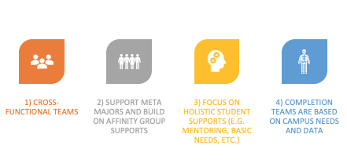
Design Principles
Notes:
10:45 AM - Libby
Provide just in time student supports and services to increase completion rates
Increase student sense of belonging
Provide tailored career exploration/preparation experiences
Break down silos to coordinate efficient shared processes/knowledge to meet student needs

Slide 23
Design Elements - The 5 C’s
Cohorting Identifying and grouping students by meta-major.
Case Management Providing differentiated timely services by designated professionals (students know their team and professionals know who their students are).
Collaboration Various professionals are working together from across the college to provide cohesive, targeted, just-in-time support to identified groups of students.
Communication Students are nudged along each step of their journey to address barriers (in and outside the classroom) in a cohesive and coordinated manner.
Connection Students feel connected, engaged and a sense of belonging because teams are collaborating to create a set of common experiences to build community.
Notes:
10:48 AM - Libby
Chat bot at GSU

Slide 24
Sierra College: Success Facilitator Teams
Went from “How can we help students be college ready?”
Which resulted in . . .
Inequitable Outcomes
Isolation & Disengagement
Confusion
Examples of Other Colleges
Notes:
10:50 AM - Libby
https://www.sierracollege.edu/student-services/support-programs/rise.php
Utilizing Starfish
Provides students timely feedback from their instructors or staff
Promote academic support service information to students through referrals
Updates students and their success network of instructors and staff in one central place

Slide 25
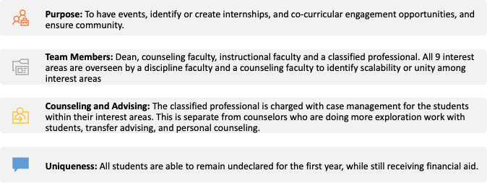
Sierra College: Success Facilitator Teams
Examples of Other Colleges
Notes:
10:52 AM - Libby

Slide 26
Sierra College: Success Facilitator Teams
To “Our college must be student ready”
Operationalized: Facilitator Teams
Intended Result:
More equitable outcomes
Counseling & Instructional Faculty
The 5 C’s
The Student
Classified Professional
Examples of Other Colleges
Notes:
10:55 AM - Libby
Cohorting, Case Management, Connection, Collaboration, Communication
https://www.sierracollege.edu/student-services/support-programs/rise.php
Using Starfish
Provides students timely feedback from their instructors or staff
Promote academic support service information to students through referrals
Updates students and their success network of instructors and staff in one central place
RISE SUCCESS TEAM BENEFITS
Personal and Academic Support
Success Coaching and Counseling
Field Trips, Events, Conferences, and Summer Jam
Workshops on Success and Skill-Building throughout the year
Visits to Four-Year Universities
Team-building, Leadership, and Networking Opportunities
Exclusive access to a RISE Center

Slide 27
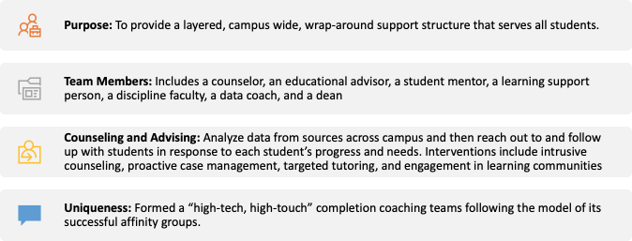
Bakersfield College: Completion Teams
Examples of Other Colleges
Notes:
10:57 AM - Libby
will have to determine what information you want/need to have and figure out how to leverage existing sources such as Colleague, Reporting Services, ECC Connect, etc, to get just in time data.
How they use data - Continuous improvement - Just in time support

Slide 28
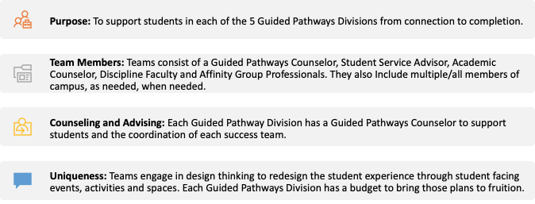
Compton College: Tarter Success Teams
Examples of Other Colleges
Notes:
10:59 AM - Libby
Highlight difference between GP C and traditional C

Slide 29
The Student Journey
Completion By Design
Notes:
11:00 AM - Libby

Slide 30
Where we lose students
Loss Points
Students do not complete a comprehensive ed plan - 49% without a comprehensive ed plan
Students do not explore career options - 64% did not meet with career counselor
Students are not informed of the benefit of attending full time vs. part time - 59% part time
Students do not pass college level Math and English (AB 705) - 81% first year students did not pass English and Math
Students do not persist past first semester or first year - 31% are not retained from Fall to Spring
Students never or rarely meet with a counselor - 35% did not discuss course of study
Students do not access available academic supports - 63% did not use academic supports
“At first I was clueless, I didn't know what I wanted to do . . .”
Notes:
11:03 AM - Libby & Josh
"Students feel disconnected from peers, faculty and institution" - 94% of the students do feel some early connection according to our most recent SENSE survey.
When they declare a major? Confirmation and level of accuracy
Who is in the cohort (affiliations: DSP, EOP, Puente, etc.)

Slide 31
Staying On Path
Momentum Strategies
Counseling support for all student + comprehensive ed plans
Showing students the college believes in them and cares about their success
Offering tailored interventions and supports (inside and outside of class) based on student needs, strengths and educational stage
Proactively reaching out to students who are struggling
Peer supports - facilitating opportunities for students to nurture other students
Creating a set of experiences to provide ongoing career exploration and preparation
Foster community
“Programs [like Puente] really help students succeed . . . [I have] friends who are . . . too shy . . . going to a counselor [they] don’t know.”
Notes:
11:06 AM - Libby

Slide 32
Momentum Points
Purpose first
Student makes informed decisions about their career and major early on.
Gateway Courses
Student is enrolled in transfer level Math and English their first year!
15 to Finish
Student attempts 15+ units by the end of their first semester.
Student completes 30+ units by the end of their first year.
9 Core
Student completes 9 core units in their program of study within the first year.
ccrc.tc.columbia.edu
Notes:
11:08 AM - Libby
https://ccrc.tc.columbia.edu/media/k2/attachments/early-momentum-metrics-college-improvement.pdf

Slide 33
3 Metrics We Want to Move The Needle On
Fall to Spring Retention
Purpose first
Know our students
Provide exploration opportunities to help students make an informed decision about their career and major early on
Confirm existing major declarations
Math & English Completion
Gateway Courses
Review our placement and advising strategies, messaging, supports, course offerings for transfer level Math and English
Provide academic and social support
Strengthen evaluation & review
3. Units Earned Per Year
15 To Finish
Encourage students to attempt 15+ units in their first semester as appropriate
Support students to complete 30+ units by the end of their first year
9 Core
Encourage students to take 9 units (approximately 3 courses) in their field of study within the first year.
What else should we consider?
Notes:
11:10 AM - Libby
Course Success = A,B,C or Pass (CO Definition) - Goal is to get student to finish more.
Success Rate Stretch Goal - 74% - 70.5%
Majority of students are part time.

Slide 34
Illustration Activity
Designing Our Dream Success Team
Use posters & markers provided to visualize a dream success team.
What do we want the new student experience to look like?
Who should be on a success team to make it happen?
How can success teams work together to improve these 3 metrics?
Increase Fall to Spring Retention
Increase Transfer Level Math & English Completion
Increase Units Earned Per Year
What should the teams do? When?
Notes:
11:20 AM - Libby - 10 min to discuss & illustrate, 30 to present (3 min each)
Depends on # Students - If lots, they will be in groups to discuss and design, while faculty, classified and administrative professionals will be placed in theirs to do the same.
Each team will share out designs with the large group.
Student go first or last?

Slide 35
LUNCH
We will resume at 12:45 PM
Notes:
12:15 PM - Libby

Slide 36
Bright Spots & Areas of Improvement
What supports do students mention are most helpful?
Are there some we can expand upon?
How might a success team support this work?
What barriers truncate student success in the classroom? Outside of the classroom?
How could a success team work together to address those barriers?
What policies and or practices might need to be revised?
Examine your data by meta major (Located on page 10 of your workbook)
What does this data communicate? Identify 3 things that stand out to you.
Use this data to inform how you think success teams should support students.
Notes:
12:45 PM - Libby They have 15 minutes

Slide 37
Creating A Timeline: Backwards Planning
What programming, policies, committees need to occur to meet our goal?
By Fall 2020,
Success Teams
will be ready for
implementation.
What actionable steps should success teams take in order to improve the 3 metrics? (Please also place your ideas on sticky notes)
What is realistic? (Blue Stickies)
What is aspirational? (Yellow Stickies)
Today - what needs to happen now
Notes:
1:00 PM - Libby
One big timeline all can contribute to. Have them place their ideas along the timeline for who should tackle the idea, when and how.

Slide 38
Creating A Timeline: Backwards Planning
What programming, policies, committees need to occur to meet our goal?
By Fall 2020,
Success Teams
will be ready for version 1.1 of
implementation.
Know Students
Learn Tools
By Week 3,
Campaign to confirm major (call & email)
By April 2020,
Create a plan to Cross train all staff on Program Mapper & ECC Connect
Today - what needs to happen now
Summer 2020
Place “sticky” notes along the timeline
Notes:
1:01 PM - Libby - 20 minutes
One big timeline all can contribute to

Slide 39
Support & Resources
Thank you!
Regional ListServ (Join by emailing me)
Regional Guided Pathways Community of Practice (Coming soon!)
Vision Resource Center (Also available via Cornerstone)
Libby Lee Curiel
LA/OC Guided Pathways Regional Coordinator
California Community College Chancellor’s Office
llcuriel@cccco.edu
(323) 369-1171
Notes:
1:28 PM - Libby

Slide 40
Imagine a community college where
instructional and counseling faculty, staff, administrators, and students work together to ensure students’ success.
Notes:
1:30 PM Jenny

Slide 41
“Student Engagement Toolbox”
Incentive Program Expansion
Notes:
1:30 PM Jenny

Slide 42
The Basics
The Basics
Instructional Faculty
Counseling Faculty
For one section:
Send one progress report with ECC Connect (two highly encouraged!)
Keep grades in Canvas
Keep attendance in Canvas
Complete post-survey
Use ECC Connect to create Educational Plans
Respond to 25 flags raised by Instructional faculty in ECC Connect
Complete post-survey
Notes:
1:31 PM Jenny

Slide 43
Former Participants
You may participate again for the same stipend!
&
Become an ambassador
Visit department meetings and demonstrate how to use ECC Connect with Canvas
Conduct brown bag trainings in your division
Receive an hourly stipend to conduct these trainings!
Notes:
1:32 PM Jenny

Slide 44
Feedback from Former Participants
“Students who received kudos were excited to come to class and tell me about how it motivated them. Students that were not attending class or had concerns woke up when they got the warning notification and helped to push them back onto course.” --ECC Instructor
“Some students seemed to become a bit more serious about getting their assignments done on time and others were more willing to engage in additional discussions about their progress.” --ECC Instructor
Notes:
1:33 PM Jenny
Is there any data on effectiveness? Was there an uptick in course success rates for instructors who used this? Was there an uptick in students seeking academic support or meeting with a counselor? Data that can speak to indications of effectiveness may be more persuasive.

Slide 45
Feedback from Former Participants
“I think that the ed planning part makes it easy to find the student's ed plan when they return or come after seeing another counselor. I like that I can put notes on the ed plan.” --ECC Counselor
“The tool makes a lot easier to develop a comprehensive educational plan. It help lessen time spend searching for classes to add to the plan and gave me the opportunity to spend more time with students. ” --ECC Counselor
Notes:
1:34 PM Jenny

Slide 46
Survey Data Highlights
96% of instructional faculty, and 100% of counseling faculty will continue using ECC Connect and Canvas
74% of instructional faculty and 80% of counseling faculty reported that these tools had a positive impact on students
The remainder reported a neither positive nor negative impact
No faculty member reported a negative impact on students
Notes:
1:35 PM Jenny

Slide 47
Why are success teams helping with the incentive program?
Use of ECC Connect and Canvas will support the work of the success teams
Break down silos between counselors and instructional faculty
Way to connect students to support
If used by everybody, students will get a consistent message
Ed plans created by counselors; progress reports, grades and attendance records from faculty are available to students and support personnel 24/7
Notes:
1:37 PM -

Slide 48
How are success teams helping with the incentive program?
Recruit former participants to help be ambassadors for the incentive program
Success team leads will receive a list of faculty from their meta-majors that participated last semester
Send follow-up emails to faculty in meta-major to remind them of deadlines
Faculty need to sign up for the incentive program by Friday, Feb. 28
Notes:
1:39 PM Jenny

Slide 49
Next Steps . . .
What must we do to move this forward?
Your Illustrations and feedback from today will be synthesized and shared campus-wide in the coming weeks to support implementation.
Please schedule your 1st success team meeting before you leave today.
Discuss how often you need to meet to help move the needle? What should be on your first meeting agenda? Who else needs to be invited?
All Success Team Counseling & Instructional Faculty Leads will meet
March 3rd, 1-2pm
Notes:
1:40 PM - Libby

Slide 50
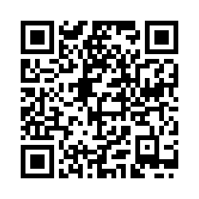
Thank you!
Please take a this short survey
bit.ly/GPSummit2020
Notes:
2:10 pm - Josh, Maria & Jenny

