Slide 1


Slide 2
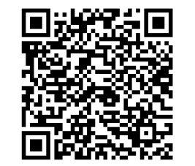
FORGOT TO CHECK-IN?
SCAN QR CODE to receive flex!

Slide 3
Active Shooter Safety
Chief Trevis, Chief of Police

Slide 4
Responding to an Active Shooter/Armed Intruder
El Camino College Police Department
Chief Michael Trevis
Spring Professional Development Day
February 9, 2023

Slide 5

Surviving an Active Shooter
The Ohio State University
Notes:
Link to video: https://www.youtube.com/watch?v=9Z9zkU--FLQ&feature=emb_logo

Slide 6
Run, Hide, Fight
Run if possible; get far and call 9-1-1
Hide if running is not a possibility. For example, running may not be possible if the alert has stated that the shooter is near your current location, or if you hear shots that seem to be close
Fight. Use any objects around you to do so. El Camino College is absolutely not advocating that you put yourself in harm’s way, but you might find yourself in a situation where defending yourself is your only choice

Slide 7
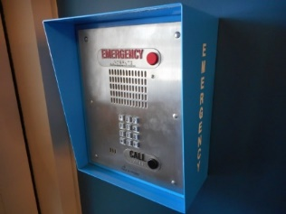
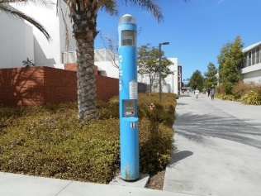
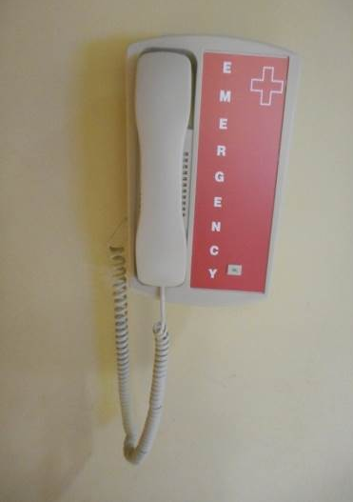
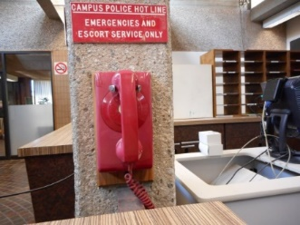
Emergency Communications
Sign up for NIXLE
  Text ECCPD to 888777
ECCPD Contact
  Open 24 hours, 365 days a year
  310-660-3100
  9-1-1
  Text to 911
  Emergency phone: blue poles, red phones, blue emergency call boxes, Cisco desk top phone.

Slide 8
End of Slides

Slide 9
Re-Centering Exercise
Anna Brochet and Maria Garcia

Slide 10


The last few years might have felt like:

Slide 11
Release the Pressure
Maria Garcia
Spring 2023 Professional Development Day

Slide 12
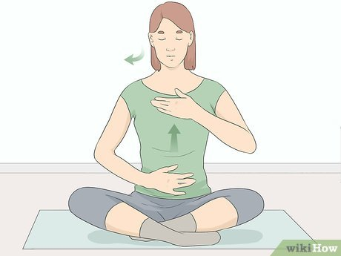
Long Slow Deep Breathing
  1. Sit in chair with legs uncrossed and hands relaxed at knees if possible
  2. Place one hand on your belly and one hand on your chest.
    -Accessible alternatives: place one hand on belly or visualize/focus your awareness on your chest and belly
  3. Close your eyes or simply look down and fix your gaze in one area
  4. Now just breathe in and out through your nose. NO MOUTH BREATHING. Focus your awareness on how your breath flows down as you breathe in and up as you breathe out.
      -If your mind wanders, gently bring it back and focus on your breath.
      -Is your breath flowing all the way down to your belly?
      -Do you feel your chest and belly rising as you breathe in?
      -It’s common for people just breathe into their chest.

Slide 13

3 Long Slow Deep Breaths
https://youtu.be/cjkFG6bHGNc
-Visualize your belly as a balloon. Each breath in blows up that balloon. You should feel your belly expand as you breathe in.
  -Hold your breath for 5 seconds if possible. If this causes any lightheadedness please do not hold breath in and simply breathe out .
  -Now exhale slowly all the way out. Visualize your belly deflating like a balloon.
  Do this 3 times as slow as possible.

Slide 14

Movement to Release Tension
We hold tension in our body/muscles and we may use movement as a way to help release tension/pressure
Tension can be from trauma, stress, lack of movement, etc. (think fight or flight response from the peripheral nervous system)
This could result in physical pain, lethargy, low energy, etc.
In yoga I learned to use movement (any kind!) to help release some of that pressure
(This is not to be taken as medical advice! ☺)
DANCE PARTY ANYONE???

Slide 15
Time to release that pressure!!!!

Slide 16

Vilma Fuentes and Isabel Gonzalez

Slide 18


Slide 19
President's Address
Dr. Brenda Thames
President/Superintendent

Slide 20
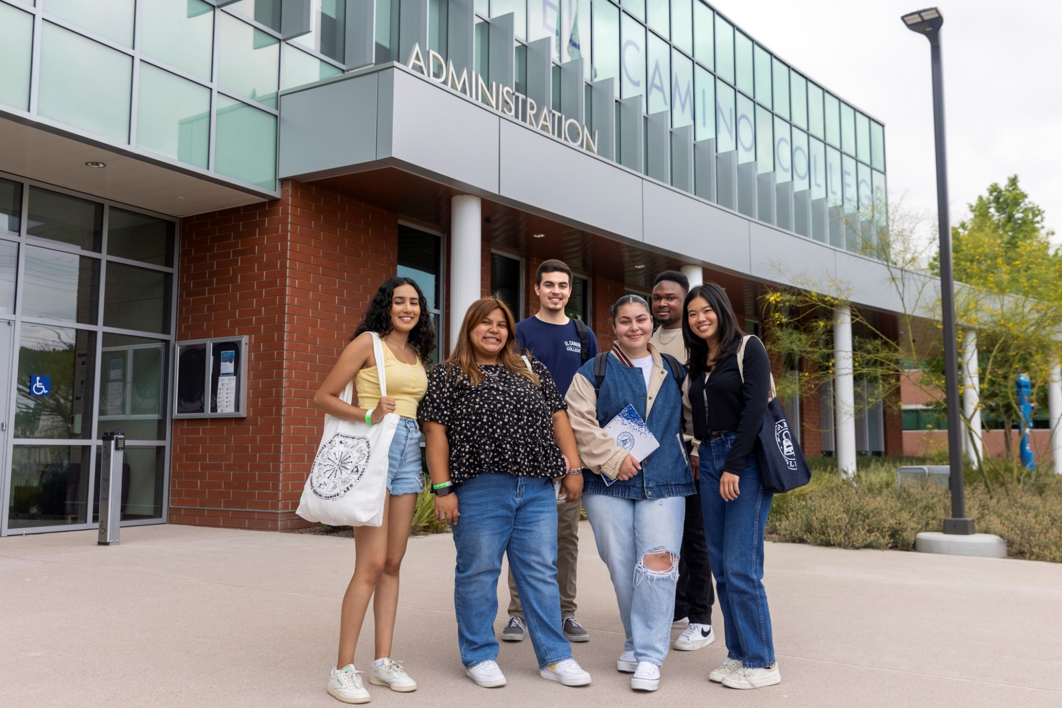

Slide 21


Slide 22
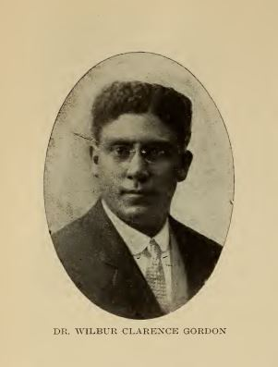


Slide 23
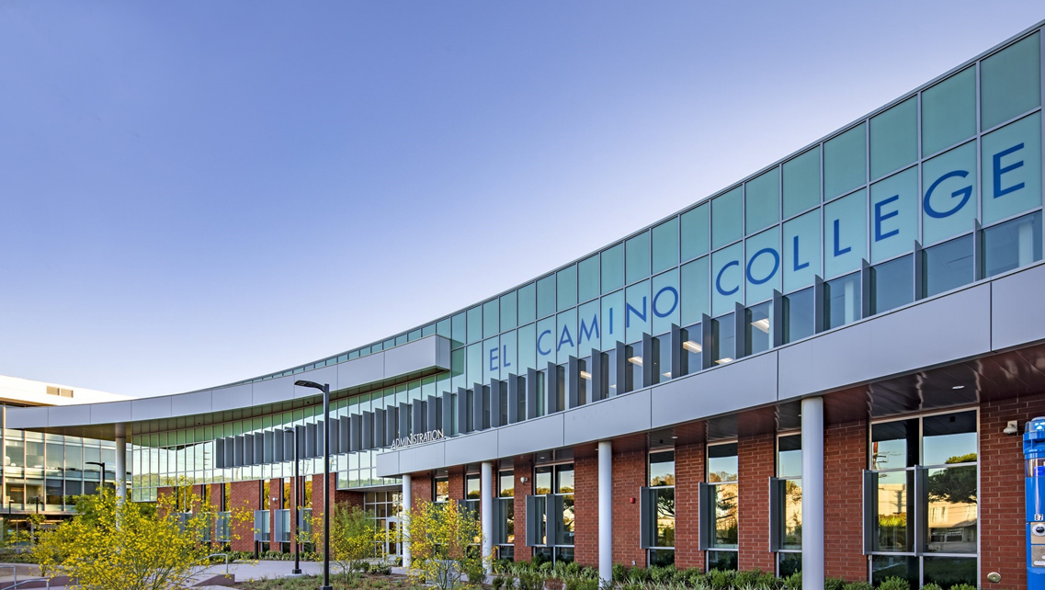
Comprehensive Integrated Planning 22-23
Student-Centered Excellence
Vision
Strategy
Continuity
Innovation

Slide 24
Comprehensive Integrated Plan
Professional Development Day: August 2022: “The What?”
Comprehensive Integrated Plan
Professional Development Day: February 2023: “The So What?”
What have we found out thus far?
Can we move forward with a few key initiatives now?
Professional Development Day: August 2023: “The Now What?”
- Approving and Implementing the Comprehensive Integrated Plan

Slide 25
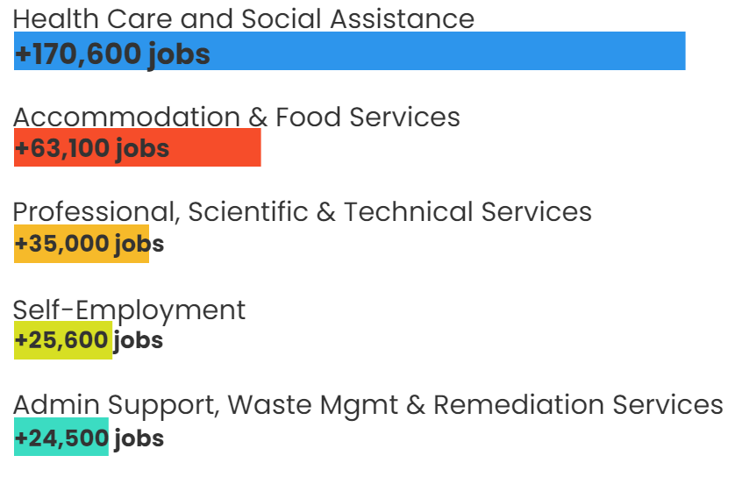
LA County Fastest Growing Industry Sectors by 2028
Health Care and Social Assistance is projected to add more than 170,000 jobs by 2028, by far the largest increase of any industry sector.
Other industry sectors provide students opportunities for high-growth occupations.
Source: U.S. Bureau of Labor Statistics retrieved from California Employment Development Department.

Slide 26
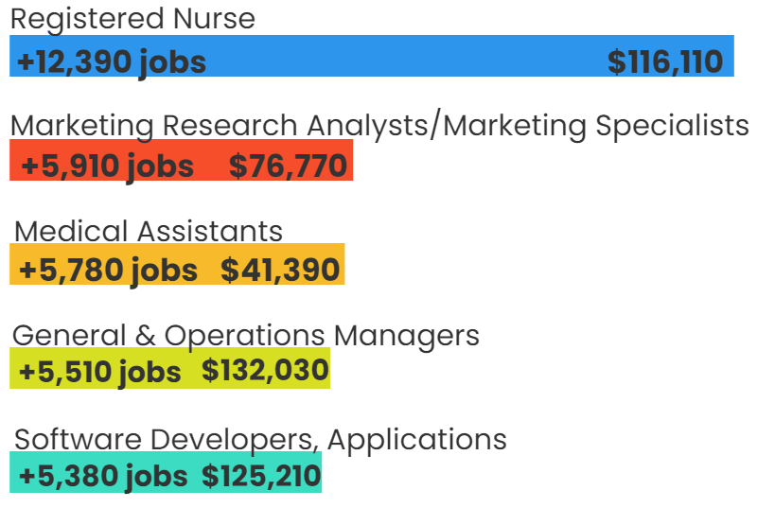
LA County Top-5 Living Wage Occupations by Employment Numeric Change 2018-2028
High Growth + Living Wage
Career Ladders
Continuing Education
Specific Skills Development
Industry Partnerships
Source: U.S. Bureau of Labor Statistics retrieved from California Employment Development Department. Note: The annual living wage in LA County was $38,217 in 2021 for a single adult.

Slide 27
Listening to Our Communities
Students
Faculty
Staff
Residents in the District
Foundation
Community-Based Organizations and Partners
Business and Industry Partners
Government Representatives

Slide 28
Challenges & Opportunities
Opportunity for Continuity and Transformation through many transitions
  Delivery of instruction
  Customer-focus
  Choice for both Traditional and Non-Traditional Students
  Industry-Partner relationships
  Student and Community success
  New and improved facilities

Slide 29
Safety, Security, Emergency Operations
Key focus of the Comprehensive Integrated Plan
Opportunity for your voices to be heard
Planning partners ALMA Strategies will be hosting a table this afternoon during Coffee & Conversations w/Colleagues (East Dining Room)

Slide 30
Comprehensive Integrated Planning 22-23
Student-Centered Excellence
Vision
Strategy
Continuity
Innovation

Slide 31


Slide 32
Commitment to Students and Community
  New and improved facilities for:
  Physical and Mental Health Resources
  Warrior Pantry
  Wardrobe
  Physical Fitness/Dance/Pilates
  Under construction right now

Slide 33
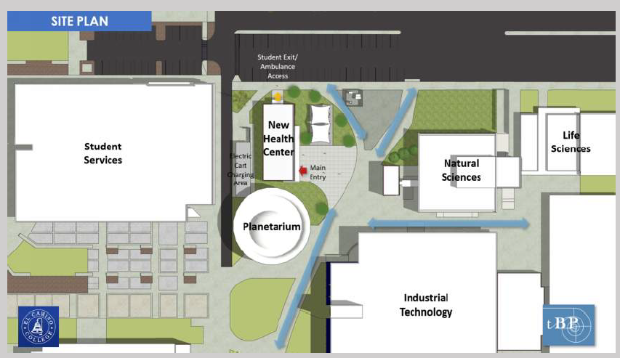
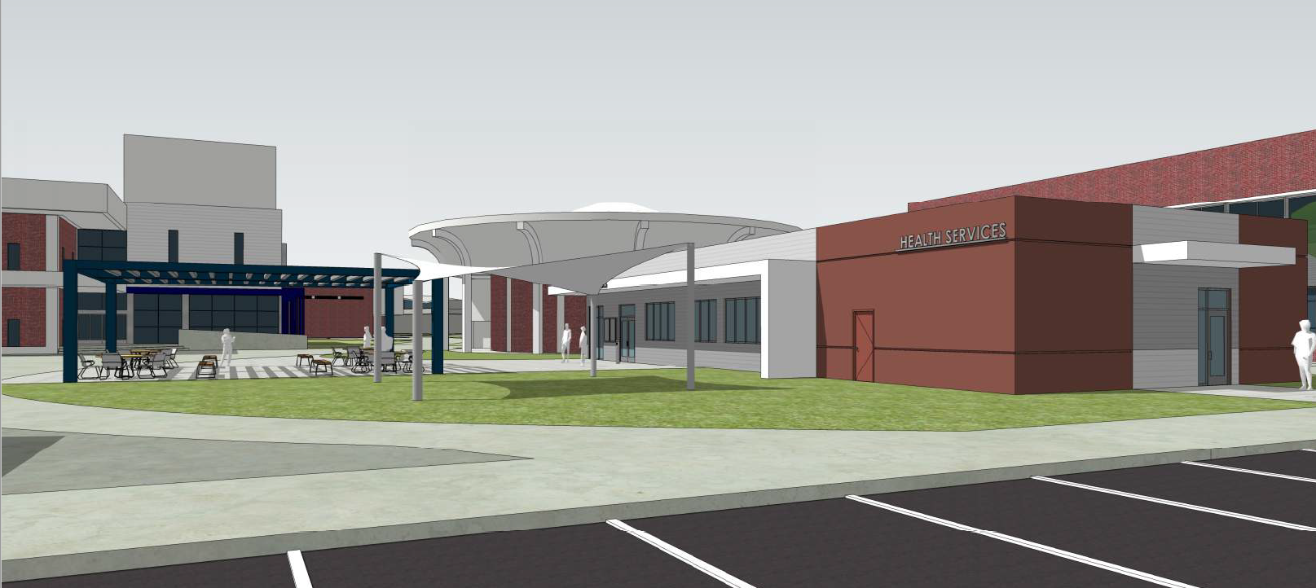
New Student Health Services Building
Physical Health
Mental Health
Occupancy: 2023

Slide 34
New Modular Village
Warrior Pantry
Wardrobe
Wellness Center
Dance, Pilates, Fitness
Occupancy: 2023

Slide 35
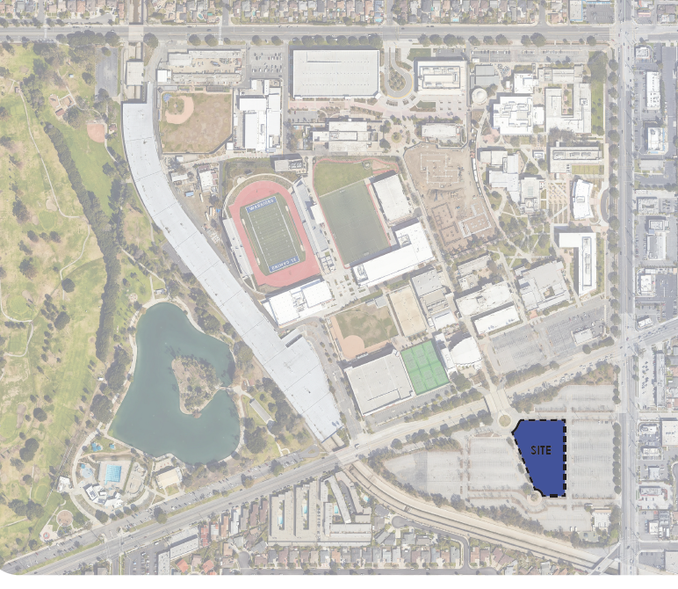
Affordable Student Housing Grant Application
State-funded Study
Need for: 1000+ beds
Feasible: 306 Beds
$68 Million Project
Self-sustaining

Slide 36
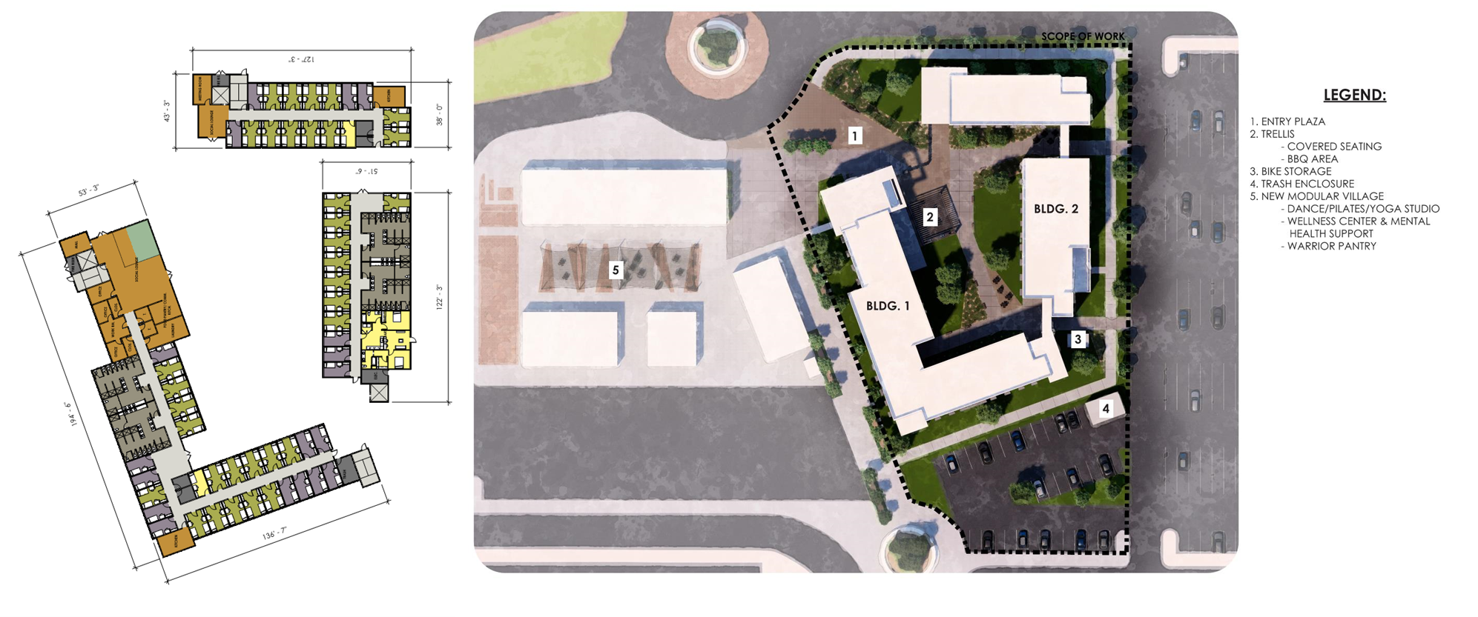
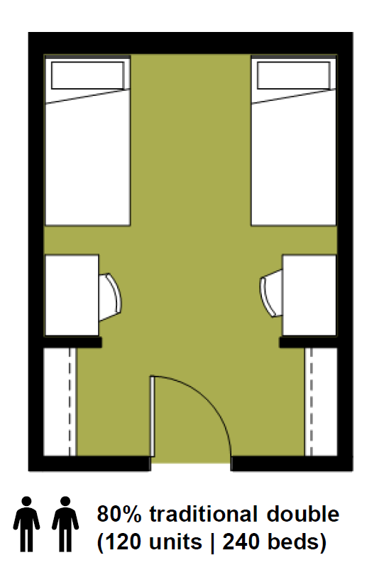
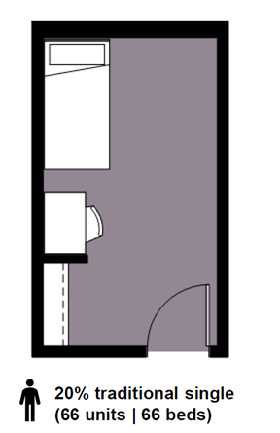
Affordable Student Housing: Grant Application

Slide 37
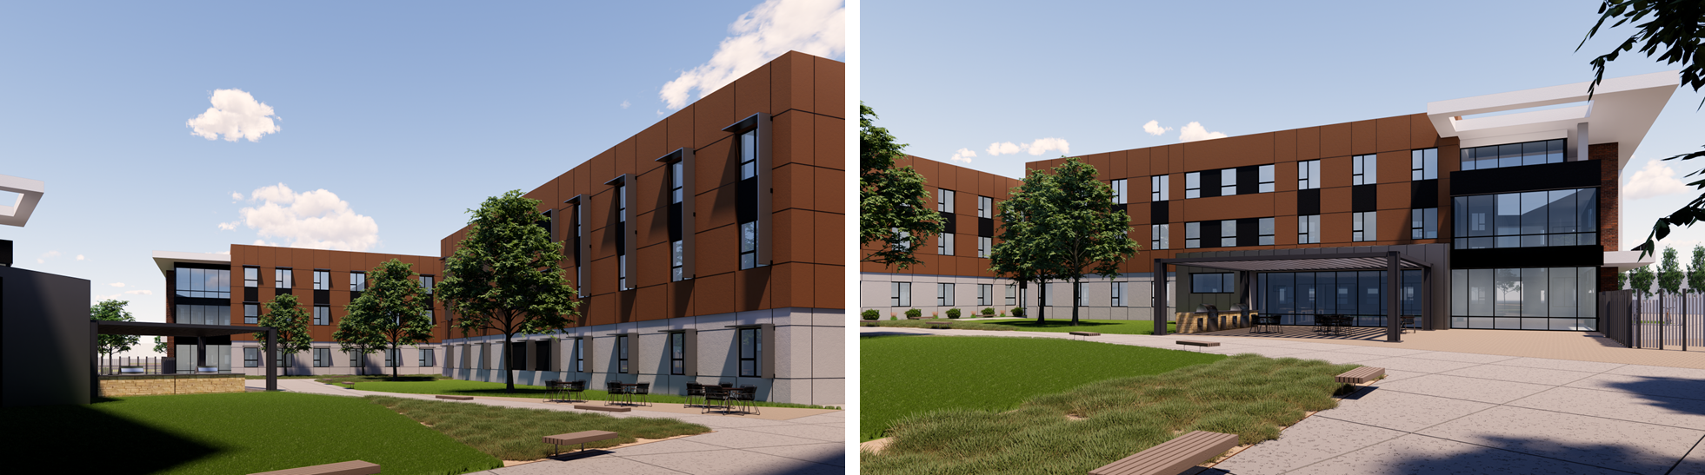
Affordable Student Housing Grant Application

Slide 38
IMPACT Video
Polly Parks

Slide 39
IMPACT
nnovative
easurable
urposeful
nti-racist
aring
ransformative

Slide 40
Announcements
Anna Brochet
Academic Senate Vice President for Faculty Development

Slide 41

Spring 2023 Schedule
10:45am – 12:00pm Division/Department Meetings (Various Locations)
11:30am – 1:30pm Campus Lunch (North Gym)
12:30pm – 1:30pm Tenure Reception (East Dining Room)
2:00pm – 3:00pm Coffee & Conversation with Colleagues
(East Dining Room)

Slide 42


Slide 43


Ask Me Buttons!
The Office of Professional Development & Learning, along with Outreach and School Relations, invite you to join us again and wear your ASK ME buttons during the first two weeks of the semester. This lets students know that we are here to help so they can succeed at El Camino!

