Slide 1
#aiTIXCoordinator
Foundations for New Title IX Coordinators
VIRTUAL TRAINING | Wednesday, August 18, 2021

Slide 2
you will be better equipped to navigate the demands of your complex new role on campus.
Notes:
This can be revised FYI.

Slide 3
AGENDA
Welcome and Introductions
12:00 – 12:30 p.m. ET
Title IX Key Concepts: Scope, Jurisdiction, and Institutional Obligations
12:30 – 1:15 p.m. ET
Break
Federal Regulations, Navigating Your Policy, Procedures, and Case Management
1:30 – 2:30 p.m. ET
Break
Strategies to Lead Training & Campus-Wide Programming Efforts
3:00 – 4:00 p.m. ET
Break
Making Your Action Plan
4:15 – 4:45 p.m. ET
Final Q&A and Wrap Up
4:45 – 5:00 p.m. ET

Slide 4
#aiTIXCoordinator
Foundations for New Title IX Coordinators
Jeanine Bias, MPA, CDP, CDT
Director of Institutional Diversity and Inclusion & Title IX Coordinator | Sam Houston State University

Slide 5
Introductions
Name
Institution
If you could only take away one thing from this training, what would it be?

Slide 6
Title IX Key Concepts
Notes:
12:15 – 1:00 pm (45 minutes)

Slide 7

TITLE IX STATES:
“No person in the United States shall, on the basis of sex, be excluded from participation in, be denied the benefits of, or be subjected to discrimination under any education program or activity receiving Federal financial assistance.”
Title IX of the Education Amendments of 1972
Implementing Regulations at:
20 U.S.C. § 1681 & 34 C.F.R. Part 106

Slide 8

SCOPE
The Title IX Coordinator is responsible for coordinating the recipient's responses to all complaints involving possible sex discrimination. This responsibility includes monitoring outcomes, identifying and addressing any patterns, and assessing effects on the campus climate.
April 24, 2015 Dear Colleague Letter issued by the Office for Civil Rights

Slide 9

THE MANY “HATS” OF A TITLE IX COORDINATOR
Oversight of Title IX compliance and grievance process
Campus & Community Liaison
Training and Education
Policy Development and Implementation
Assess Campus Climate

Slide 10

SPECIFIC APPLICATIONS WITHIN “NEW RULE”
Promptly respond to all reports of sexual harassment
Gatekeeping responsibility for formal complaints
Serve as facilitator through Grievance Process
Ensure all university personnel with specific duties related to Title IX are appropriately trained, document completion, and publish record of training on designed website (including training materials)

Slide 11

SPECIFIC APPLICATIONS WITHIN “NEW RULE”
Notification of Title IX Policy & Procedures to both current and potential members of the campus community
Responsible for maintaining a record of all complaints, files, evidence, and other documents for a period of seven years

Slide 12

JURISDICTION
“Title IX Applies” When…
  A formal complaint has been filed by an affected individual/student (or parent on behalf of a student under 18) indicating they have experienced one or more forms of Title IX Sexual Harassment and requesting that the institution investigate the incident. The Title IX Coordinator may also file a formal complaint if warranted. (Actual Knowledge)
  At the time of filing the formal complaint, the complainant must have been participating in or attempting to participate in an institution’s education program or activity.

Slide 13

JURISDICTION
“Title IX Applies” When…
  Institution must have had substantial control over the respondent and the context where the sexual harassment occurred.
  The sexual harassment must have occurred towards a person in the United States.

Slide 14
TITLE IX SEXUAL HARASSMENT DEFINED
Title IX Sexual Harassment refers to Sexual Misconduct that meets one or more of these three types of behavior:
  (i) A Component's Employee conditioning provision of an aid, benefit or service of the Component on an individual's participation in unwelcome sexual conduct ("quid pro quo" harassment which may be express or implied and need not be "severe" or "pervasive" as a single incident is inherently "offensive" and jeopardizes equal educational access;
  (ii) Unwelcome conduct determined by a reasonable person to be so severe, pervasive and objectively offensive that it effectively denies a person equal access to the Component's Education Program or Activity, or
  (iii) "Sexual Assault," "Dating Violence," "Domestic Violence" or "Stalking" as defined in referenced statutes.

Slide 15
JURISDICTION
What happens if a report does not meet the Jurisdiction Requirements?
Compliance vs. Campus Climate

Slide 16

IN LIFE AND IN TITLE IX…

Slide 17

FOCUS ON THE BIGGER PICTURE

Slide 18
FUNDAMENTALS OF TITLE IX
Equity
Impartiality
Fairness
Transparency

Slide 19
BASIC PRINCIPLES OF TITLE IX
Thorough | Reliable | Impartial
Prompt | Effective | Equitable
End Discrimination | Prevent Recurrence | Remedy effects upon victim & community
INVESTIGATION =
PROCESS =
REMEDIES =

Slide 20
INSTITUTIONAL OBLIGATIONS
Publish
Publish Notice of Non Discrimination
Designate
Designate Title IX Coordinator
Disseminate
Disseminate Policies on Sexual Discrimination/ Misconduct
Address/Investigate
Address/Investigate Complaints
Adopt and publish
Adopt and publish fair & equitable grievance procedures

Slide 21
INSTITUTIONAL OBLIGATIONS
Once a school knows or reasonably should know of possible sexual violence, it must take immediate and appropriate action to investigate.
If sexual violence has occurred, prompt and immediate steps to end the sexual violence, prevent its recurrence, and address its effects MUST be taken.

Slide 22
INSTITUTIONAL OBLIGATIONS
Must take steps to protect the Complainant AND RESPONDENT as necessary, including supportive measures steps taken prior to the final outcome of the investigation.
Provide a grievance procedure for filing reports/complaints of sex discrimination, including complaints of sexual violence.
Equal opportunity for both parties to present witnesses and other evidence.

Slide 23
INSTITUTIONAL OBLIGATIONS
Institution must determine standard of evidence to resolve complaints
Notify both parties of initial notice and outcome of the complaint as well as appeal rights.
Equal opportunity for both parties to present witnesses and other evidence.

Slide 24
INSTITUTIONAL OBLIGATIONS
Train individuals with heightened responsibilities
Train students and employees
Provide ongoing awareness campaign and programming

Slide 25

TAKE A DEEP BREATH
ADVICE FROM A SEASONED TIX COORDINATOR
You are not alone
Ask for help
Ask for resources
Know the regs
Know your policy
Know your campus
Establish a consistent process
Proactive vs. Reactive

Slide 26
Office for Civil Rights
https://www2.ed.gov/about/offices/list/ocr/newsroom.html
Title IX Regulations Addressing Sexual Harassment (unofficial copy)
Title IX Regulations Addressing Sexual Harassment (Federal Register)
Title IX: Fact Sheet: Final Title IX Regulations
Title IX: U.S. Department of Education Title IX Final Rule Overview
Title IX: Summary of Major Provisions of the Department of Education’s Title IX Final Rule
OCR Blog

Slide 28
Break

Slide 29
Navigating Your Policy/Procedures
Notes:
12:15 – 1:00 pm (45 minutes)

Slide 30
POLICY FOUNDATION LEGAL REQUIREMENTS
Title IX
Clery
Regulations
DCLs
Timely Warning
Policy Definitions
VAWA
Other
Rights
Procedural Requirements
Training/ Programming
State Law
FERPA

Slide 31

YOUR INSTITUTIONAL POLICY AND PROCEDURES
Comprehensive Institutional Policy
Other related university policies
Flowcharts
Checklists
Document templates

Slide 32
POLICY CONSIDERATIONS
Where can you access the policy?
Is the policy reader-friendly for multiple audiences?
How often do you review the policy? Opportunity for feedback?

Slide 33
POLICY CHECKLIST
Non-Discrimination Statement
Statement of Jurisdiction
Confidentiality
Definition Section
Mandatory Reporting Obligations
How to Report Instructions
Title IX Coordinator Information
Grievance Procedures
Timeframes for process
Resources
Training & Prevention

Slide 35
Case Management
Notes:
12:15 – 1:00 pm (45 minutes)

Slide 36

WHY IS CASE MANAGEMENT CRITICAL FOR TITLE IX COORDINATORS?
Compliance
Institutional Memory
Clery Reporting
State Law

Slide 37

AGENDA
Best practices for tracking cases
Model checklist & timeline for case consistency and efficiency
Sample Notice Letters for parties during cases
Developing your own case management log

Slide 38
Do you currently have a strategy for managing cases?
Notes:
Yes
No
Don’t know

Slide 40
From: Smith, Taylor
Subject: Fw: Makeup Request
Good morning Title IX Coordinator,
I just received this email from a student. I am not sure what to do. Please advise.
Dr. Smith
Forwarded Message --------------------------------------------------------------------------
From: Johnson, Jayden
Subject: Makeup Assignment
Hey Dr. Smith,
I apologize for emailing you and not being in class lately, but is it possible to make up the exam from last week? I was assaulted in my dorm room the other day, had to go to emergency room, and then I was at the police station multiple times. I haven’t been able to go back to my dorm, so my parents are picking me up today, and I don’t know when I will feel comfortable coming back on campus.
Thanks for understanding!
Jayden

Slide 41

ELEMENTS FOR TRACKING A CASE
Receipt of Report
Report Assessment
Communicating with Parties
Investigation/Resolution
Case Oversight
Case Completion/ Compliance

Slide 42
Case Management Log

Slide 43
REPORT ASSESSMENT
Safety Concerns
Reporting Obligations
Threat to campus
Individual safety
Clery
State Law
University Officials
Report Review
Additional Information
Reporter Information
Pattern
Follow Up
Other reporters?

Slide 44
Checklist Template

Slide 45

COMMUNICATING WITH THE PARTIES
Initial Contact with Complainant
  Methods of Outreach
What should the communication include
  Purpose of communication
  Rights
  Resources
  Policy
  Request to meet
Complainant response
  Positive response
  Negative response
  No response

Slide 46
COMMUNICATING WITH THE PARTIES
Initial Contact with Respondent
  Methods of Outreach
What should the communication include
  Purpose of communication
  Rights
  Resources
  Policy
  Request to meet
Respondent response

Slide 47
Initial Communication Template

Slide 48

COMMUNICATING WITH THE PARTIES
Pre-Meeting
  Location and set up
  Technology
Initial Meeting
  Introduction
  Rapport Building
  Address Immediate Needs
    Safety
    Support/ Referrals
    Academics
  Intake Checklist
  Gather additional information (if appropriate)
Post-Meeting

Slide 49
Intake Checklist Template

Slide 50

INVESTIGATION/RESOLUTION
  Support Services
  Informal Resolution
  Formal Investigation

Slide 51
Sample Notice Letters & Sample Communication Log

Slide 52

CASE OVERSIGHT
  Timeline
  Advisors
  Investigative Report Review
  Process Facilitator
  - Hearing
  - Appellate Process

Slide 53
CASE COMPLETION/COMPLIANCE
  Remedies
  Final Outcomes
  File Preservation

Slide 54

BEST PRACTICES IN CASE MANAGEMNT
Be organized
Develop a process
Seek assistance
Utilize a case management system

Slide 55
What obstacles have faced or do you anticipate in case management?
Notes:
Please revise and incorporate throughout your Pre-Cion.

Slide 57
Break

Slide 58
Strategies to Lead Training & Campus-Wide Programming Efforts
Notes:
1:30 – 2:30 pm (60 minutes)

Slide 59

AGENDA
Compliance requirements
Training plan
Program plan
Ongoing awareness campaign
Marketing efforts

Slide 60
WHAT DO WE HAVE TO DO?
Each institution must develop and implement a comprehensive prevention and outreach program on sexual misconduct including but not limited, to sexual harassment, sexual assault, dating violence, and stalking. The comprehensive prevention and outreach program must address a range of strategies to prevent sexual misconduct, including sexual harassment, sexual assault, dating violence, and stalking. The program should include a public awareness campaign, primary prevention, bystander intervention, and risk reduction strategies.
-Violence Against Women’s Act

Slide 61

WHAT DO WE HAVE TO DO?
Training for Title IX Coordinators, Deputy Coordinators, Investigators, Decision Makers, and Appellate Authority
Training for Responsible Employees
NCAA Compliance Training for Athletics
Primary Prevention Training
Ongoing prevention programming
State Law requirements?
Other considerations?

Slide 62

TRAINING YOUR TITLE IX TEAM
Auditing your team’s knowledge and skill level
Identifying training gaps
Internal training resources
External training resources
Cross training your team
Your role as facilitator
Self guided resources and training

Slide 63

TRAINING FOR TITLE IX TEAM
Critical Content
  Definition
  Bias
  Stereotypes
  Conflicts of Interest
  Relevance
  Credibility
  Technology

Slide 64
TRAINING FOR RESPONSIBLE EMPLOYEES/CAMPUS AUTHORITIES
Delivery
Content
Who?
When?
How?
Frequency?
Definitions
Reporting Responsibilities
Failure to Report
Policy

Slide 65

NCAA COMPLIANCE
Partnership with Athletics
Timeframe
Content

Slide 66
PRIMARY PREVENTION TRAINING
Delivery
Audience
Online
In-person
Alternatives
Incoming students
- Freshmen
- Transfer
- Graduate students
Content
Completion Requirement
- Length
- Definitions
- Policy
- Resources
- Deadline
- Penalty

Slide 68
Who are your campus collaborators when it comes to Title IX programming efforts?

Slide 69
ONGOING PREVENTION PROGRAMMING REQUIREMENTS
Notes:
Also consider state law requirements

Slide 70
ONGOING PREVENTION PROGRAM CONSIDERATIONS
Delivery
Collaborations
Who?
When?
How?
Frequency?
Victim Advocacy Centers
Health Center
Counseling Center
Academic Departments
Special Populations
Topics
Greek Life
Residence Life
Athletics
Others?
Consent
Bystander Intervention
Victim Empowerment
Risk Reduction Measures
Others?

Slide 71

PROGRAM PLANNING
ACTION PLAN
Create Comprehensive Program Goals
Content Development
Delivery
Campus-Wide Programming Vs Custom Programming
Budget

Slide 72

BEST PRACTICES IN ONGOING PREVENTION PROGRAMMING
Passive Marketing Campaign
Training Peer Educators
Calendar of Significant Events
  Domestic Violence Awareness Month
  Sexual Assault Awareness Month

Slide 73
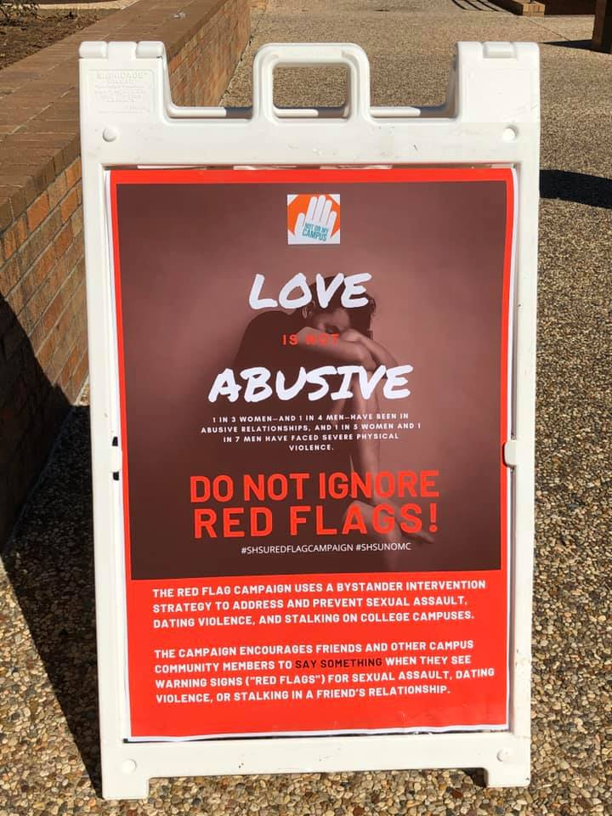
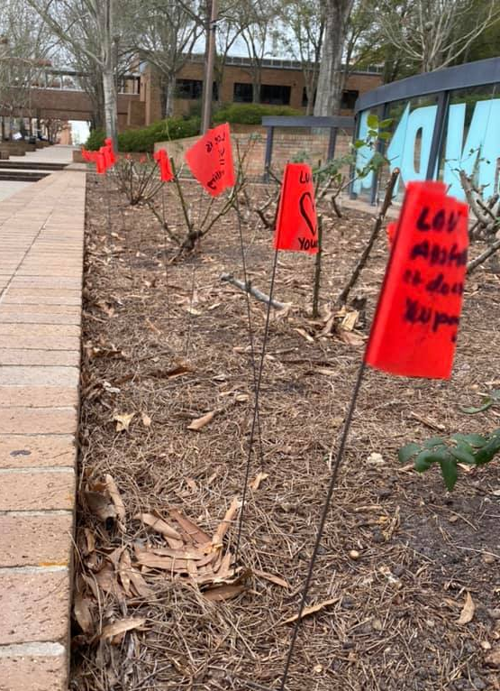
ONGOING PREVENTION PROGRAMMING

Slide 74

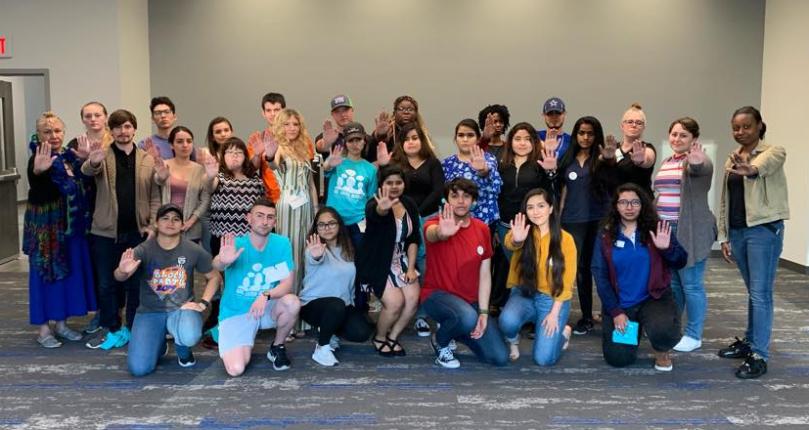
ONGOING PREVENTION PROGRAMMING
Annual Calendar of Events:
NOMC Take the Pledge Shirt Give-A-Way - August
Consent Week - September
NOMC Interest Meeting 1 - September
NOMC New Member Orientation - September
NOMC Interest Meeting 2 - October
Domestic Violence Awareness Month Essay Contest September 30th - October 20th
Domestic Violence Awareness Self Defense Training Class - October
Bystander Intervention Training - November
Healthy Relationships Workshop January
Love is Love Week - February
Alcohol & Spring Break Preparedness Training March
Sexual Assault Awareness Month Events - (All Month Long in April )

Slide 75


ONGOING PREVENTION PROGRAMMING

Slide 76
What are your most successful programs to date?
What are your programming challenges or limitations?

Slide 77
Break

Slide 78
Your Action Plan
Making Your

Slide 79
Creating Your Action Plan

