Slide 1
CALVET FEE WAIVER FOR
VETERAN DEPENDENTS
VA Education Benefits: https://www.va.gov/education/eligibility/
CAL VET Fee Waiver: https://www.calvet.ca.gov/VetServices/Pages/College-Fee-Waiver.aspx
Notes:
Hello Veteran Dependents – this presentation will walk you through how to apply for the education benefit you may be eligible for as a dependent of a veteran. This presentation is updated as we receive policy changes from the VA and the State of CA…however, we encourage you to visit the VA and State of CA Fee Waiver Website for more detailed information – the links are listed here.

Slide 2
CALVET COLLEGE FEE WAIVER
​The College Fee Waiver for Veteran Dependents benefit waives mandatory system-wide tuition and fees at any State of California Community College, California State University, or University of California campus.
This program does not cover the expense of books, parking or room and board. There are four plans under which dependents of Veterans may be eligible..
Notes:
The Cal Vet fee waiver program is the benefit program for dependents of veterans. It waives mandatory tuition and fees at any OF THE STATE OF CALIFORNIA collegeS or universitIES. It does not cover books, parking or room and board. There are 4 different plans that dictate criteria for eligibility.

Slide 3
PLAN A
The unmarried child of a Veteran who is totally service-connected disabled or whose death was officially rated as service-connected is eligible. The child must be over 14 years old and under 27 years old to be eligible. If the child is a Veteran, then the age limit is extended to age 30;
The spouse of a wartime Veteran who is totally service-connected disabled is eligible. There are no age limit restrictions;
The unmarried surviving spouse of a wartime Veteran whose death has been rated as service-connected is eligible. There are no age limit restrictions;
Any dependent of any Veteran who has been declared missing in action, captured in the line of duty by hostile forces, or forcibly detained or interned in the line of duty by a foreign government or power is eligible. You cannot apply for CH 35 benefits under Plan A.
Notes:
The unmarried child of a veteran who is totally service connected or a veteran who died on active duty… is eligible if the child is over 14 years old and under 27 years old. If the child is also a veteran then the age limit is extended to 30.
The benefit is also extended to the spouse of a wartime veteran who has a totally service connected disability or the unmarried surviving spouse of a wartime Veteran who died on active duty, – no age limit.
And lastly any dependent of any veteran who has been declared mission in action, captured in the line of duty by hostile forces, or foreign gov or power is eligible… You cannot apply for CH 35 benefits under Plan A

Slide 4
PLAN B
The child of a Veteran who has a service-connected disability, or had a service-connected disability at the time of death, or died of service-related causes is eligible. The child's annual income, which includes the child's adjusted gross income, plus the value of support provided by a parent, may not exceed the national annual income limit. The current academic year entitlement is based upon the previous calendar year's annual income. Under Plan B, wartime service is not required and there are no specific age requirements. Children are the only dependents eligible under this plan. There is no prohibition against receiving concurrent VA Chapter 35 benefits.
Notes:
The child of a veteran who has a service connected disability or had a service connected disability at the time of death or died in active service is eligible. The child’s annual income may not exceed the State income limit. Under Plan B wartime service is not required and there are no specific age requirements. You may receive Chapter 35 benefits as well. Please visit the VA website for Veteran Education benefits for details on CH 35.

Slide 5
PLAN C
Any dependent of any member of the California National Guard, who in the line of duty while on active service to the state, was killed, died of a disability resulting from an event that occurred while in active service to the state, or is permanently disabled as a result of an event that occurred while in the service to the state is eligible. Surviving spouses who have not remarried are also eligible.
"Active duty service to the state," for the purpose of this benefit, means a member of the California National Guard activated pursuant to Section 146 of the Military and Veterans Code. A copy of those orders pursuant to Section 146, not Section 143, must be furnished to establish eligibility.
Notes:
Any dependent of any member of the CA National Guard who was killed while on active duty or who died from a disability resulting from an event while on active duty, or is pernanentl y disabled as a result of an event that occurred while on active duty, is eligible. Unmarried surviving spouses are also eligible. Active duty service for the CA Naional Guard is defined here in Plan C

Slide 6
PLAN D
Medal of Honor recipients and children of Medal of Honor recipients under the age of 27 may qualify. Benefits under Plan D are limited to undergraduate studies only, and applicants are subject to both income and age restrictions. There is no prohibition against receiving concurrent VA Chapter 35 benefits.
Notes:
Medal of Honor recipeints and children of medal of honor recipients under the age of 27 may qualify. Plan D is limited to undergrad studies only and applicants are subject to both income and age restrictions. Applicants may receive CH 35 benefits also.

Slide 7
Accessing Benefits
All applicants must meet California residency requirements as per the schools requirements.
If eligibility criteria is met, use of the College Waiver for Veterans Dependents may be applied to state-support programs in the CCC, CSU, and UC systems.
If you are a child of a Veteran, you must attach Verification of Dependency. Acceptable verifications include, but are not limited to, a Birth Certificate, Adoption Records or Marriage Certificate. Those seeking status as an Adopted Child or as a Stepchild must have entered into such status prior to the child's 23th Birthday.
All applicants must also complete the California Promise Grant Application to be included with your CALVET Fee Waiver Application.
Notes:
All applicants must meet CA residency requirements as set by schools. Dependents must attach verification of dependency which could include a birth certificate, adoption… or marriage records…. Step children or adopted children must have become the legal dependent of the eligible veteran prior to the child’s 23rd birthday. All applicants must also complete the California Promise Grant Application to be included with your CALVET Fee Waiver Application…we will talk about the CA Promise Grant in the slides to follow.

Slide 8
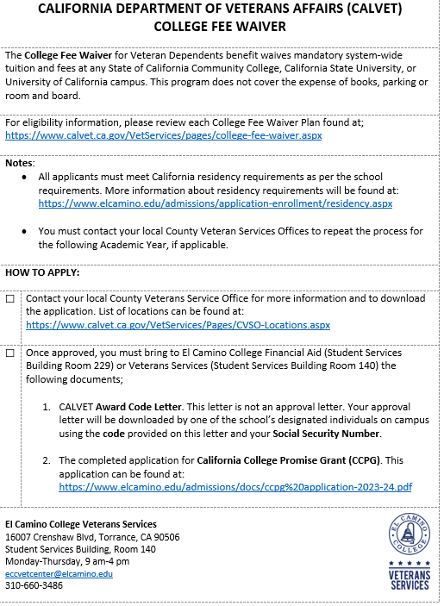
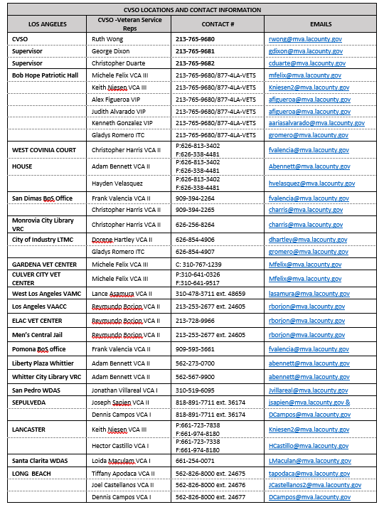
CALVET Fee Waiver Links/
VSO Locations
Notes:
This slide includes links to the CAL veT FEE WAIVER APPLICATION, ALL THE CAL VET VSO OFFICES AND A LINK TO THE CA PROMISE GRANT APPLICATION.

Slide 9
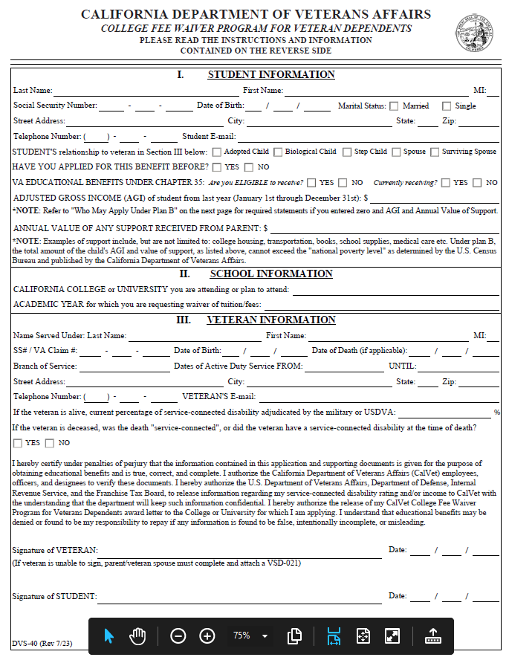
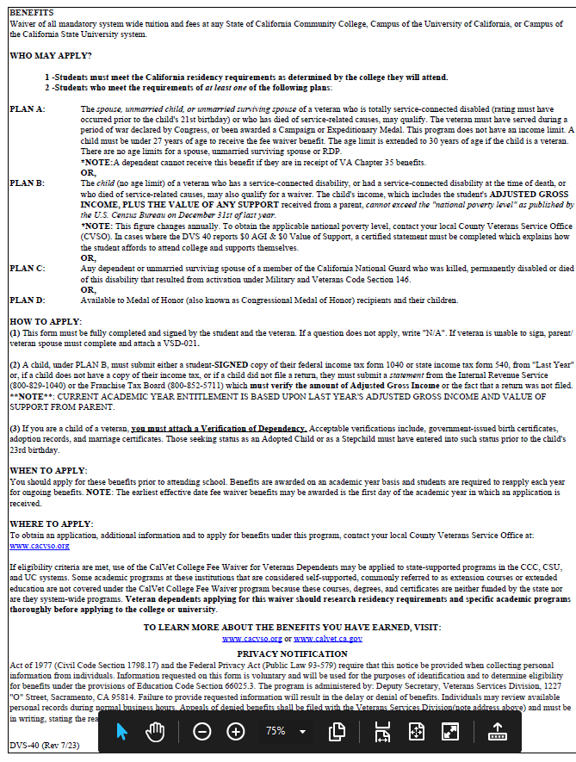
The CALVET Fee Waiver Application
Notes:
The CALVET Fee Waiver application looks like this. Please complete this application enitirely, It describes the different PLANS for your eligibility. After completing this form – you must then take it to your local Veteran Services Office.

Slide 10
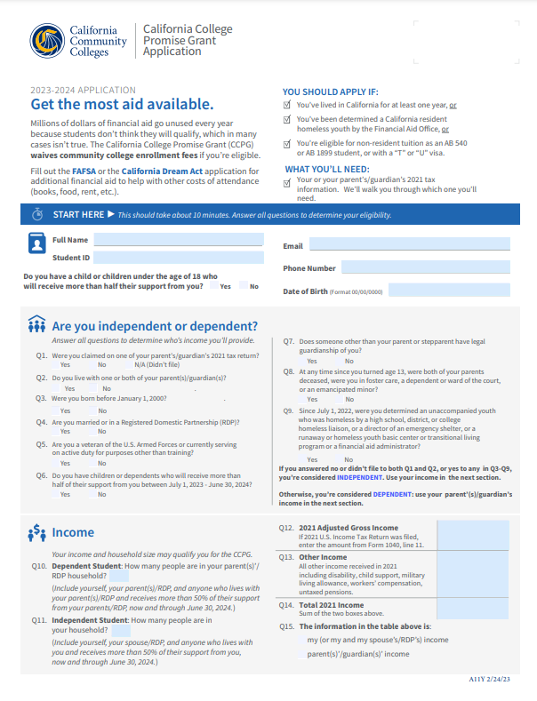
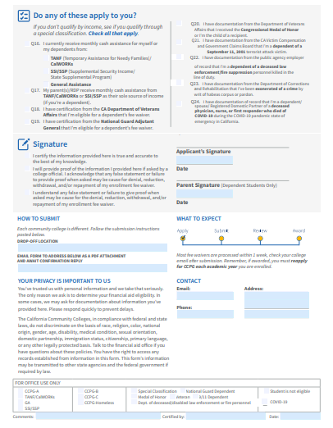
You will need to fill out the
California College Promise Grant
and turn it into the FINANCIAL AID OFFICE.
The California Promise Grant Application
https://www.cccco.edu/-/media/CCCCO-Website/docs/application/2023-24-promise-grant-application-english-draft-a11y.pdf?la=en&hash=66BBB2FE27829C985EFC05CC350DCDE865469073
Notes:
This is the image of the CA Promise Grant application. The link to access the application is included here. The application is available in English and in Spanish.
ALL APPLICANTS MUST APPLY FOR THE CALIFORNIA COLLEGE PROMISE GRANT INCLUDING THOSE APPLYING FOR THE CAL VET FEE WAIVER BENEFITS.
THE CA COLLEGE PROMISE GRANT IS FOR ELIGIBEL CA RESIDENTS, the grant permits enrollment fees to be waived…
If you do not meet citizenship qualifications but meet the AB540 residency standards, you must complete the California Dream Act application to determine eligibility.
CA Promise grants begin in the summer semester of each academic year and must be renewed every year.

Slide 11
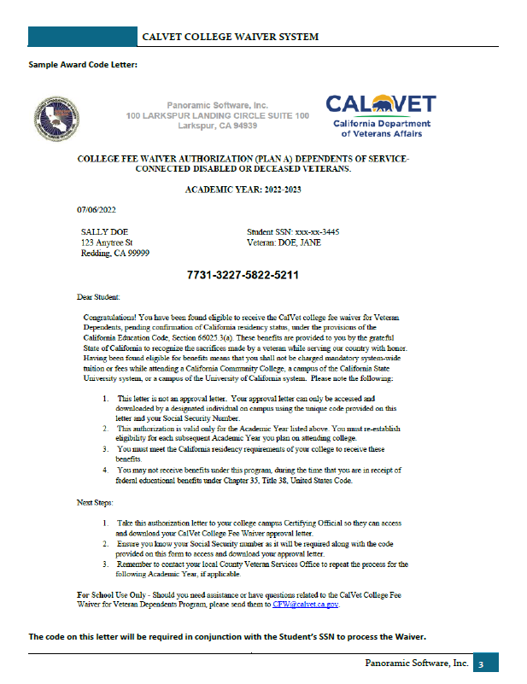
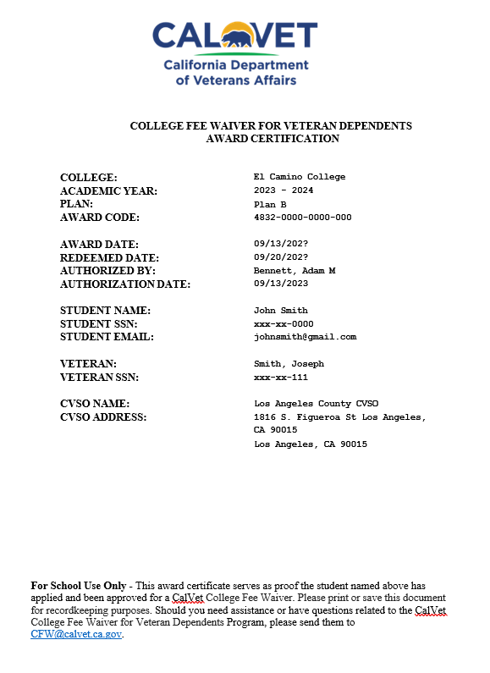
1.
2.
Authorization Letter
CA Promise Grant Application
Identification
SS Number
1. Award Letter with Authorization
2. Award Letter with Approval Number
Notes:
Once you have submitted your application to the VSO Office, and your elgibility is verified by CALVET, you receive an Award Letter… Image #1 is the award letter with authorization number only. This is not the approval letter. This is the letter you must bring to the certrifying official in the Veteran Resource Center at El Camino. The certifying official will need 4 things from you to obtain an approval letter. The need your Authorizaion letter, CA Promise Grant Application, your legal Identification and your Social Security number. The certifying official will upload your Authorizaiton number, and your CA Promise Grant Applicaiton into the CAL VET system. Once you are approved an Approval letter is generated….Item #2 is an example of the Approval letter confirming your eligibility for benefits. You have then completed the CAL VET fee waiver process.

Slide 12
Steps to Apply for CALVET Fee Waiver
Go to CALVET homepage…use the College Fee Waiver Calculator to determine eligibility.
Download CALVET fee waiver application. Complete application and take to local Veteran Services Office – they will verify your eligibility and then the application can be forwarded to the CALVET main office.
Once eligibility is determined you will receive a letter with a verification number…NOT AN APPROVAL NUMBER yet… from the CALVET system in Sacramento.
Download and complete the California Promise application.
YOU MUST BRING THE LETTER with the verification number, your legal form of identification, your Social Security number, and the California Promise Application, to the Veteran Resource Center where the certifying official will verify your identification and upload the verification number and California Promise Application into the CALVET system.
Once the number is verified by the system an APPROVAL LETTER is generated FOR THE BENEFIT PLAN YOU ARE ELIGIBLE FOR. You have successfully completed your CALVET Fee Waiver application.
Notes:
And Finally, Let’s recap the steps to apply for

Slide 13
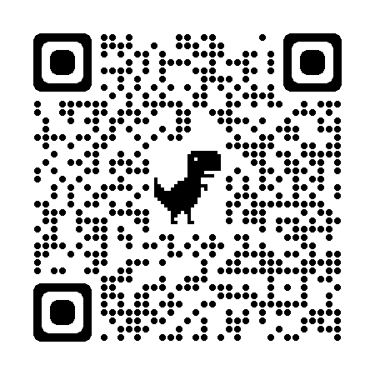
L
SURVEY!
Notes:
Lastly, please scan the QR Code to take a really brief survey, we wish you much success in your academic journey and thank you for choosing El Camino n

